Slide 1

Optimal Control of a Two-Wheeled Self-Balancing Robot Using LQR and Multi-Objective Genetic Algorithm
(In Submission for Endsemester Research Project Evaluation)
Presented by :
Pritam Ranjan Kalita
MTech Robotics Engineering (3rd Semester)
School of Advanced Engineering
Project Supervisor:
Dr. Rahul Singhal
Electrical Cluster
School of Advanced Engineering

Slide 2
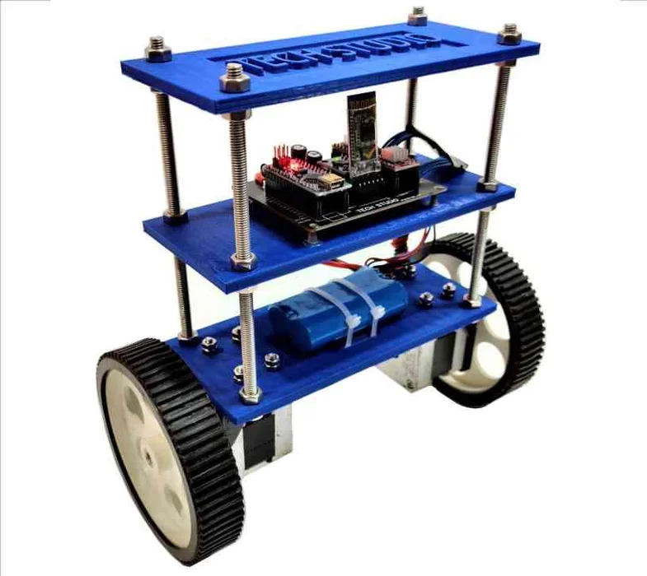
Motivation
The Self Balancing Segway Robot is inspired from the Cart & Inverted Pendulum (CIP) model which is a classical problem studied in Control Engineering. The operational principles of CIP model also used in designing of self-balancing hoverboards, Humanoid and Bipedal Robots, Rocket and Missile Guidance systems etc.
Segway-type robots serve as a platform for testing innovative control strategies that can be then extended to more complex robotic systems and autonomous vehicles.
Figure 1. A self-balancing Segway robot. Adapted from "Self-Balancing Robot Using Arduino" by My Tech Studio, Instructables. Retrieved from https://www.instructables.com/Self-Balancing-Robot-Using-Arduino/. Copyright by Instructables.

Slide 3
Literature Review
Sl. No | Authors | Year | Remarks
[1] | Mudeng et al. | 2020 | PID controller design and simulation for two-wheeled balancing robot Used Ziegler–Nichol’s method for tuning the PID gains.
[2] | Putra et al. | 2025 | LQR controller implementation for two-wheeled balancing robot
[3] | Mohammed and Abdulla | 2020 | LQR gains optimization using Genetic Algorithm and Bacteria Foraging Optimization Algorithm. Comparison revealed that the BFOA-LQR controller is faster and a more stable balancing system for the Segway vehicle.
[4] | Feriyonika & Hidayat | 2020 | Implemented LQG (Linear Quadratic Gaussian) control for two-wheeled balancing robot. Combined Kalman filter with Linear Quadratic Regulator (LQR) to reduce sensor noise and optimize balance performance.
[5] | Choudhry et al. | 2023 | EKF-based Sliding Mode Controller (ESMC) with payload estimation. Robust control handling unknown mass (up to 200 kg)
[6] | Burkan & Özgüney | 2017 | Applied adaptive-robust and fuzzy logic controllers for balancing a two-wheeled Segway robot. Addresses payload variations and parameter uncertainties.
[7] | Su et al. | 2020 | Suggested a nonlinear cascade controller for combined balance and motion control. Behavior of the robot is estimated using a Kalman filtering algorithm
[8] | Chen et al. | 2025 | Self-balancing robot with reaction wheel mechanism. Used a Adaptive Double-Fuzzy Anti-Integral Saturation PID (ADFAS-PID) for stability.

Slide 4
Research Objectives
Study the mathematical model of the Segway Self-Balancing Robot and derive the Transfer function and State-Space model equations for application in design of linear controllers – PID and LQR.
Implement a PID controller for controlling the system. Simulate the results using MATLAB & SIMULINK.
Implement a LQR controller for controlling the system. Simulate the results using MATLAB & SIMULINK.
Implement Genetic Algorithm for tunning of the LQR Controller. Simulate the results using MATLAB & SIMULINK.

Slide 5
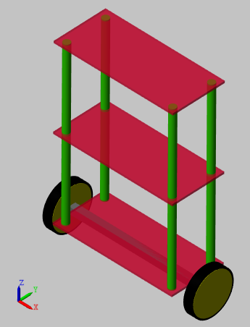
Methodology
Model Specifications :
Mass of each plate (kg) | 1
Dimensions of each plate (cm) | 18 x 8 x 0.3
Mass of each corner support rod (kg) | 0.0625
Radius of each corner support rod (mm) | 5
Height of each corner support rod (cm) | 25
Dimensions of connecting rod between the wheels (cm) | 20 x 1 x 1
Mass of connecting rod between the wheels (kg) | 0.1
Radius of each wheel (m) | 0.0325
Mass of each wheel (kg) | 0.05
Table 1. Some Model Specifications of the Segway Robot as simulated in MATLAB-Simulink
Figure 2. Model of the Self-Balancing Segway Robot as simulated in MATLAB-Simulink

Slide 6
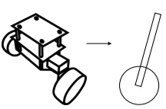

Methodology
Mathematical Model of Segway Robot: Defining Some Constants
From our model specifications (last slide), we set some constants which we will need later for finding the Transfer Function and State Space Model equations of the robot :
b = Viscous Friction Constant = 0.1 N/m/sec
M_{c} = Mass of Chassis = 1 kg
M_{w} = Mass of each Wheel = 0.1 kg
L_{c} = Distance of COM of the chassis from the axis of rotation of wheels
= 0.129 m
R_{w} = Radius of each wheel = 0.0325 m
I_{c} = Moment of Inertia of Chassis rotating abt. Wheel axis
= $\frac{1}{12} . M_{c} . {L^{2}}_{c}$
I_{w} = Moment of Inertia of Wheel rotating abt. Wheel axis
= $\frac{1}{2} . M_{w} . {R^{2}}_{w}$
COM
θc
L_{c}
Y
X
Figure 3. Simplified Model of the Self-Balancing Segway Robot used for Mathematical Analysis
Source: [4] Feriyonika, F. & Hidayat, A. (2020). Balancing Control of Two-Wheeled Robot by Using Linear Quadratic Gaussian (LQG).

Slide 7
Methodology
Before Proceeding Further…
There a two ways to approach the Control Problem of the Two-Wheeled Self Balancing Segway Robot:
The Torque Approach
The Force Approach

Slide 8

Methodology
Before Proceeding Further…
Torque Approach :
                Controller directly outputs the torque that the motor needs to apply to keep the robot balanced.
                Harder to simulate; uses more computation power.
                Used for PID Controller implementation here.
      Force Approach :
      Controller outputs the horizontal push force F with which if the robot base is supposedly pushed, will keep the system balanced.
      The push force F is then converted to required torque $τ_{motor}$ using the following relation:
      $$τ_{motor}= \frac{F.r_{wheel}}{2}$$
      More popular approach in books and papers.
      Harder to simulate; uses more computation power.
      Used for LQR and GA-Optimized LQR implementation here.
(Source: Adapted from H. Hellman and H. Sunnerman, “Two-Wheeled Self-Balancing Robot: Design and Control Based on the Concept of an Inverted Pendulum,” B.Sc. thesis, KTH Royal Institute of Technology, Stockholm, Sweden, 2015)

Slide 9
Methodology
Part 1 : PID Controller Implementation

Slide 10
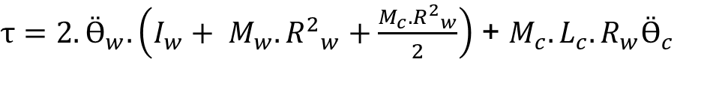
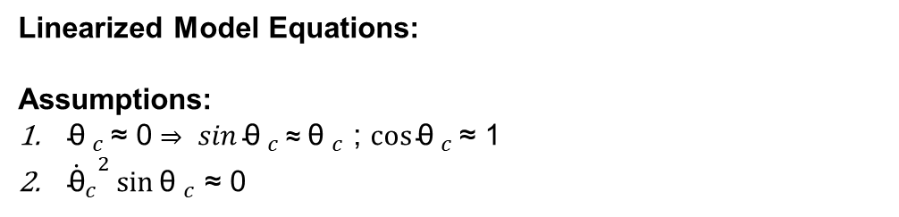
Methodology
Mathematical Model of Segway Robot: The Torque Approach
COM
Non-Linearized Model Equations:
θc
$τ=2.Ӫ_{w}.\left(I_{w}+ M_{w}. {R^{2}}_{w}+\frac{M_{c}. {R^{2}}_{w}}{2}\right)$ + $M_{c}.L_{c}.R_{w}(Ӫ_{c}\cos{{\text{θ} }_{c}}−{{\dot{\text{θ}}}_{c}}^{2}\sin{{\text{θ} }_{c}})$
$−$ $τ=Ӫ_{c}\left(I_{c} +M_{c}.{L^{2}}_{c}\right)+ M_{c}L_{c}R_{w}Ӫ_{w}$ $\cos{{\text{θ} }_{c}} −M_{c}L_{c}g\sin{{\text{θ} }_{c}}$
Y
L_{c}
Linearized Model Equations:
Assumptions:
${\text{θ} }_{c }\text{≈} \text{0 }\text{⇒} sin{{\text{θ} }_{c}}\text{≈} {\text{θ} }_{c}$ ; $\cos{{\text{θ} }_{c}}\text{≈}\text{ 1}$
${{\dot{\text{θ}}}_{c}}^{2}\sin{{\text{θ} }_{c}}$ $\text{≈}$ 0
(Source: Avinash Dubey and Avijit Pandey, “Technical Session on Basics of Self Balancing Robot,” e-Yantra, YouTube video, 2:16:10, Aug. 9, 2022. Available: https://www.youtube.com/watch?v=nOHky2f58ME)
X
Figure 4. Simplified Model of the Self-Balancing Segway Robot used for Mathematical Analysis
Source: [4] Feriyonika, F. & Hidayat, A. (2020). Balancing Control of Two-Wheeled Robot by Using Linear Quadratic Gaussian (LQG).
$τ=2.Ӫ_{w}.\left(I_{w}+ M_{w}. {R^{2}}_{w}+\frac{M_{c}. {R^{2}}_{w}}{2}\right)$ + $M_{c}.L_{c}.R_{w}Ӫ_{c}$
$−$ $τ=Ӫ_{c}\left(I_{c} +M_{c}.{L^{2}}_{c}\right)+ M_{c}L_{c}R_{w}Ӫ_{w}$ $−M_{c}{.L}_{c}.g.{\text{θ} }_{c}$

Slide 11

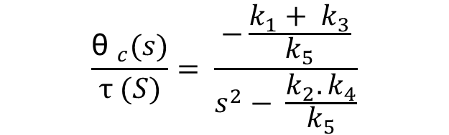
Methodology
Mathematical Model of Segway Robot: The Torque Approach
Transfer Function of the Segway Robot Plant:
COM
θ_{c}
$$\frac{{\text{θ} }_{c}(s)}{τ (S)}= \frac{−\frac{k_{1}+ k_{3}}{k_{5}}}{s^{2}− \frac{k_{2}. k_{4}}{k_{5}}}$$
L_{c}
Y
${\text{θ} }_{c}$ = Chassis Tilt Angle Plant Output (Feedback)
$τ$ = Torque applied to each individual wheel Plant Input (Control Signal)
$k_{1}=M_{c}.{L^{2}}_{c}+ I_{c}$
$k_{2} = M_{c}.{R^{2}}_{w}+{2.M}_{w}.{R^{2}}_{w}+2.I_{w}$
$k_{3}= M_{c}.R_{w}.L_{c}$
$k_{4}=M_{c}.L_{c}.g$
$k_{5}=k_{1}.k_{2} −k_{3}^{2}$
X
Figure 5. Simplified Model of the Self-Balancing Segway Robot used for Mathematical Analysis
Source: [4] Feriyonika, F. & Hidayat, A. (2020). Balancing Control of Two-Wheeled Robot by Using Linear Quadratic Gaussian (LQG).

Slide 12
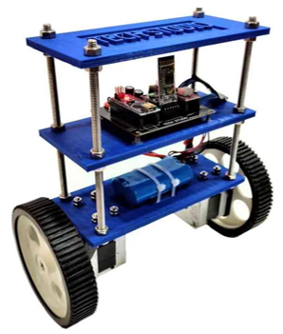


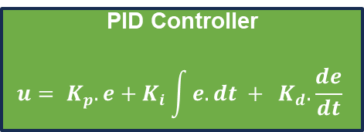
Methodology
PID Controller Implementation: Basic Block Diagram
PID Controller
$$u= K_{p}.e+K_{i}\int{e. dt + } K_{d}.\frac{de}{dt}$$
Control Signal
(Wheel Torque)
$$R_{ref}$$
$$e$$
+
-
Plant
(Physical Model / Transfer Function)
Feedback (Chassis Tilt Angle)

Slide 13
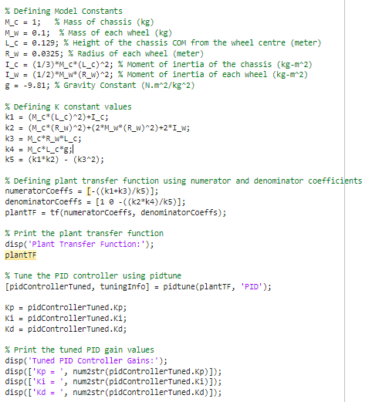
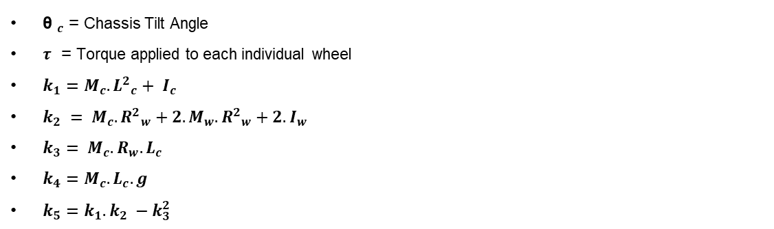


Methodology
PID Controller Implementation: Tuning of PID Gains
MATLAB Code For Getting Tuned PID Parameters:
M_{c} = Mass of Chassis = 1 kg
M_{w} = Mass of each Wheel = 0.1 kg
L_{c} = Distance of COM of the chassis from the axis of rotation of wheels
= 0.129 m
R_{w} = Radius of each wheel = 0.0325 m
I_{c} = Moment of Inertia of Chassis rotating abt. Wheel axis
= $\frac{1}{12} . M_{c} . {L^{2}}_{c}$
I_{w} = Moment of Inertia of Wheel rotating abt. Wheel axis
= $\frac{1}{2} . M_{w} . {R^{2}}_{w}$
Transfer Function of the Segway Robot Plant:
$$\frac{{\text{θ} }_{c}(s)}{τ (S)}= \frac{−\frac{k_{1}+ k_{3}}{k_{5}}}{s^{2}− \frac{k_{2}. k_{4}}{k_{5}}}$$
${\text{θ} }_{c}$ = Chassis Tilt Angle
$τ$ = Torque applied to each individual wheel
$k_{1}=M_{c}.{L^{2}}_{c}+ I_{c}$
$k_{2} = M_{c}.{R^{2}}_{w}+{2.M}_{w}.{R^{2}}_{w}+2.I_{w}$
$k_{3}= M_{c}.R_{w}.L_{c}$
$k_{4}=M_{c}.L_{c}.g$
$k_{5}=k_{1}.k_{2} −k_{3}^{2}$

Slide 14
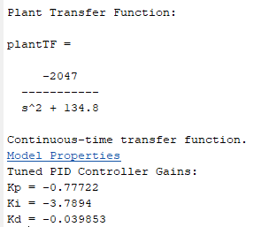
Methodology
PID Controller Implementation: Tuning of PID Gains
Code For Getting Tuned PID Parameters:

Slide 15
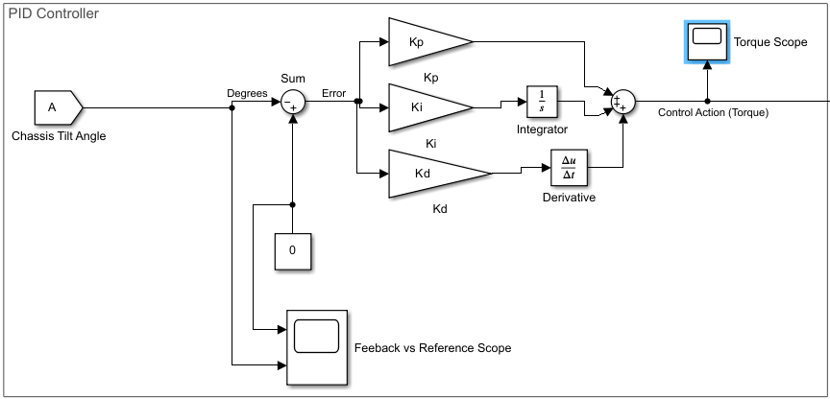
Methodology
PID Controller Implementation: Simulink Block Diagram of PID Controller
Figure 4. Block Diagram of PID Controller as implemented in Simulink

Slide 16
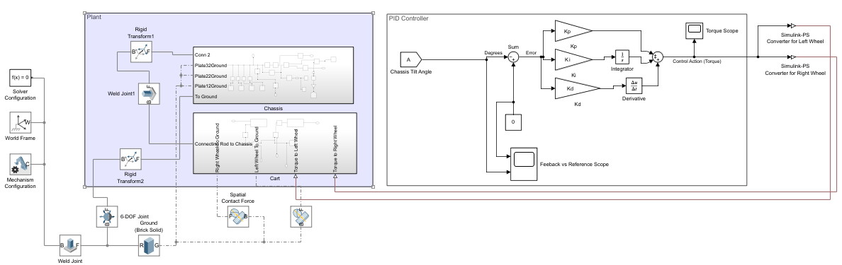
Methodology
PID Controller Implementation: Simulink Block Diagram of Complete Project

Slide 17
Methodology
Part 2 : LQR Controller Implementation

Slide 18

Methodology
Mathematical Model of Segway Robot: The Force Approach
COM
θc
Linearized Model Equations:
$F_{input}=(M_{cart}+ M_{chassis}$).ẍ + b.ẋ - $M_{chassis}.$ $L_{c}.Ӫ_{c}$
L_{c}
Y
X
$$F_{input}$$
$\left(I_{chassis}+M_{chassis}.{L_{c}}^{2}\right).$ $Ӫ_{c} −M_{chassis}.g.L_{c}.{\text{θ} }_{c}=M_{chassis}.L_{c}.\text{ẍ}$
(Source: Adapted from H. Hellman and H. Sunnerman, “Two-Wheeled Self-Balancing Robot: Design and Control Based on the Concept of an Inverted Pendulum,” B.Sc. thesis, KTH Royal Institute of Technology, Stockholm, Sweden, 2015)
Figure 6. Simplified Model of the Self-Balancing Segway Robot used for Mathematical Analysis
Source: [4] Feriyonika, F. & Hidayat, A. (2020). Balancing Control of Two-Wheeled Robot by Using Linear Quadratic Gaussian (LQG).

Slide 19


Methodology
Mathematical Model of Segway Robot: The Force Approach
COM
State-Space Model Equation:
θc
$ẋ\left(t\right)=$ $Ax\left(t\right)+Bu\left(t\right)$ -- State Equation
$y\left(t\right)=Cx\left(t\right)+Du(t)$ -- Output Equation
L_{c}
$$x\left(t\right)=\left[\begin{matrix}\text{x} \\ ẋ \\ {\text{θ} }_{c} \\ { θ ̇}_{c}\end{matrix}\right], A= \left[\begin{matrix}0 & 1 & 0 & 0 \\ 0 & \frac{−\left(I_{chassis}+M_{chassis}.{L_{c}}^{2}\right).b}{k} & \frac{{M_{chassis}}^{2}.g.{L^{2}}_{c}}{k} & 0 \\ 0 & 0 & 0 & 1 \\ 0 & \frac{−M_{chassis}.L_{c}.b}{k} & \frac{M_{chassis}.g.L_{c}(M_{cart}+ M_{chassis})}{k} & 0\end{matrix}\right], B= \left[\begin{matrix}0 \\ \frac{I_{chassis}+M_{chassis}.{L_{c}}^{2}}{k} \\ 0 \\ \frac{M_{chassis}.L_{c}}{k}\end{matrix}\right], C= \left[\begin{matrix}1 & 0 & 0 & 0 \\ 0 & 1 & 0 & 0 \\ 0 & 0 & 1 & 0 \\ 0 & 0 & 0 & 1\end{matrix}\right], D=\left[0\right], y\left(t\right)=\left[\begin{matrix}\text{x} \\ ẋ \\ {\text{θ} }_{c} \\ { θ ̇}_{c}\end{matrix}\right], u\left(t\right)=\left[F_{input}\right]$$
$$k= I_{chassis}\left(M_{cart}+ M_{chassis}\right)+ M_{cart}.M_{chassis}.{L_{c}}^{2}$$
Y
X
$$F_{input}$$
Figure 7. Simplified Model of the Self-Balancing Segway Robot used for Mathematical Analysis
Source: [4] Feriyonika, F. & Hidayat, A. (2020). Balancing Control of Two-Wheeled Robot by Using Linear Quadratic Gaussian (LQG).
(Source: Adapted from H. Hellman and H. Sunnerman, “Two-Wheeled Self-Balancing Robot: Design and Control Based on the Concept of an Inverted Pendulum,” B.Sc. thesis, KTH Royal Institute of Technology, Stockholm, Sweden, 2015)

Slide 20




Methodology
LQR Controller Implementation: Basic Block Diagram
LQR Controller:
$F_{input} =$-K. $\overline{x}$(t)
Control Signal
($F_{input}$)
$$R_{ref}$$
$\overline{x}$(t)
+
-
Error
$${[\text{−0.5, }0,0,0]}^{T}$$
Plant
(Physical Model / Transfer Function)
State Feedback : $x\left(t\right)={[\text{x}\text{, }ẋ,{\text{θ}}_{c},{ θ ̇}_{c}]}^{T}$

Slide 21
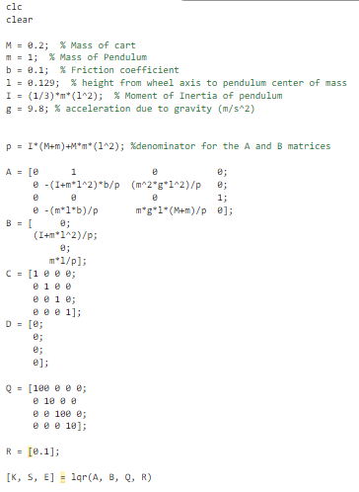

Methodology
LQR Controller Implementation: Calculation of K Gain Matrix
MATLAB Code for calculating K Gain Matrix
Given A and B (from Plant).
Choose Q and R.
Solve Algebraic-Riccati Equation for S (yields multiple solutions for S)
$A^{T}S+SA −SBR^{−1}B^{T}S+Q=0$
4. Compute $K= R^{−1}.B.S$ (yields multiple solutions for K)
5. Calculate the $eig(A−BK)$ for all the K’s.
6. Choose K that yields the most stable system (most negative eigen values).

Slide 22


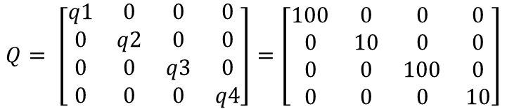
Methodology
LQR Controller Implementation: Calculation of K Gain Matrix
Selected Values of Q and R Matrices:
$$Q= \left[\begin{matrix}q1 & 0 & 0 & 0 \\ 0 & q2 & 0 & 0 \\ 0 & 0 & q3 & 0 \\ 0 & 0 & 0 & q4\end{matrix}\right]=\left[\begin{matrix}100 & 0 & 0 & 0 \\ 0 & 10 & 0 & 0 \\ 0 & 0 & 100 & 0 \\ 0 & 0 & 0 & 10\end{matrix}\right]$$
$$R=\left[r\right]= [0.1]$$

Slide 23
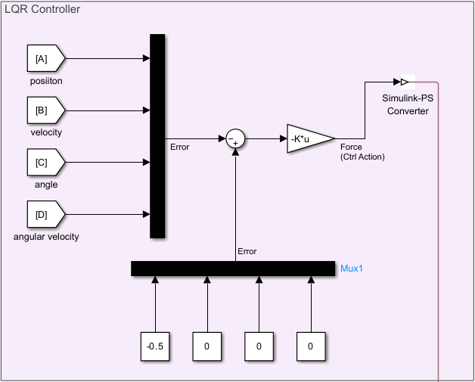
Methodology
LQR Controller Implementation: Simulink Block Diagram of Controller

Slide 24
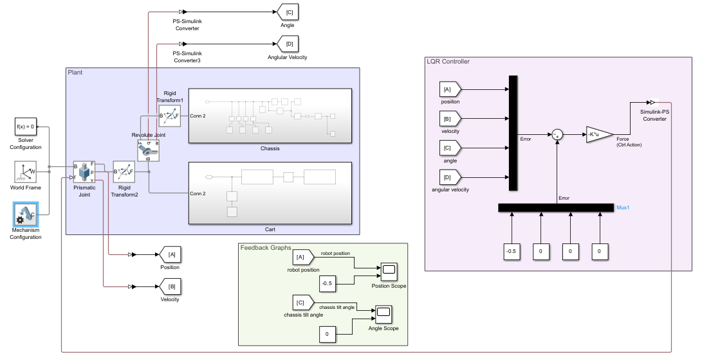
Methodology
LQR Controller Implementation: Simulink Block Diagram of Complete Project

Slide 25
Methodology
Part 3 : GA-Optimized LQR Controller

Slide 26



Methodology
GA-LQR Controller Implementation: Basic Block Diagram
Genetic Algorithm
Q
R
LQR Controller:
$F_{input} =$-K. $\overline{x}$(t)
Control Signal
($F_{input}$)
$$R_{ref}$$
$\overline{x}$(t)
+
$${[\text{−0.5, }0,0,0]}^{T}$$
-
Error
Plant
(Physical Model / Transfer Function)
State Feedback : $x\left(t\right)={[\text{x}\text{, }ẋ,{\text{θ}}_{c},{ θ ̇}_{c}]}^{T}$

Slide 27
Methodology
GA-LQR Controller Implementation: GA Algorithm Structure
Initial Population
Calculate Fitness Function / Cost Function / Objective Function
Selection
Crossover & Mutation
Stopping Criteria:
Maximum number of generations reached ?
Optimal Solution
No
Yes

Slide 28


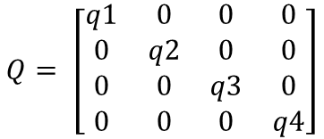
Methodology
GA-LQR Controller Implementation Details (Set by the Programmer)
Number of variables = 5
$$Q= \left[\begin{matrix}q1 & 0 & 0 & 0 \\ 0 & q2 & 0 & 0 \\ 0 & 0 & q3 & 0 \\ 0 & 0 & 0 & q4\end{matrix}\right]$$
[q1, q2, q3, q4, r]
$$R=\left[r\right]$$
One set of all 5 values constitutes a single Gene.
Lower Limit of Variables = [1 1 1 1 0.001]
Upper Limit of Variables = [1e6 1e5 1e5 1e4 10]
Position Error
Number of Objective Functions = 2
Integral Time Absolute Error
(ITAE)
Chassis Tilt Angle Error
$$J_{ITAE}= \int_{0}^{T}{t\left|e(t)\right|}dt$$
Population Size = 40
Each Single Generation contains in total 40 Genes
Number of Max. Generations = 40

Slide 29
Methodology
For every gene of the generation, the program calculates the corresponding K gain matrix.
Runs the simulation
Computes both the fitness functions
GA-LQR Controller Implementation: GA Program Details
Initial Population
Calculate Fitness Function / Cost Function / Objective Function
Selection
After completing the process for 1 entire generation
Crossover & Mutation
Stopping Criteria:
Maximum number of generations reached ?
Optimal Solution
No
Yes

Slide 30
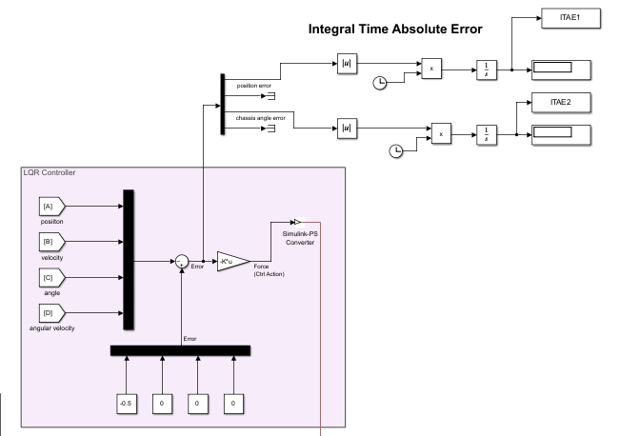
Methodology
GA-LQR Controller Implementation Details : Simulink Block Diagram
Figure 8: Simulink Block Diagram for Extracting the Integral Time Absolute Error Values

Slide 31
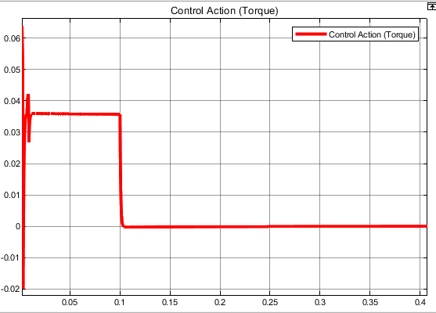
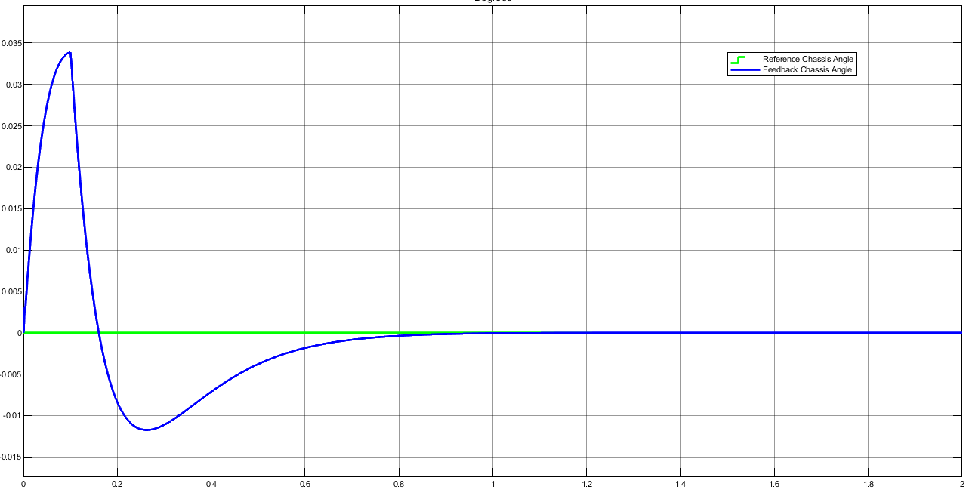
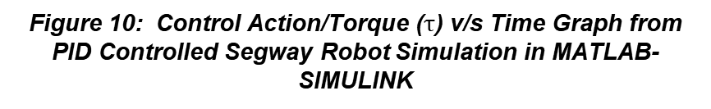

Results
Part 1: PID Controller
Figure 9 : Chassis Tilt Angle ($\text{θ}\text{c}$) v/s Time Graph from PID Controlled Segway Robot Simulation in MATLAB-SIMULINK
Figure 10: Control Action/Torque ($τ$) v/s Time Graph from PID Controlled Segway Robot Simulation in MATLAB-SIMULINK

Slide 32
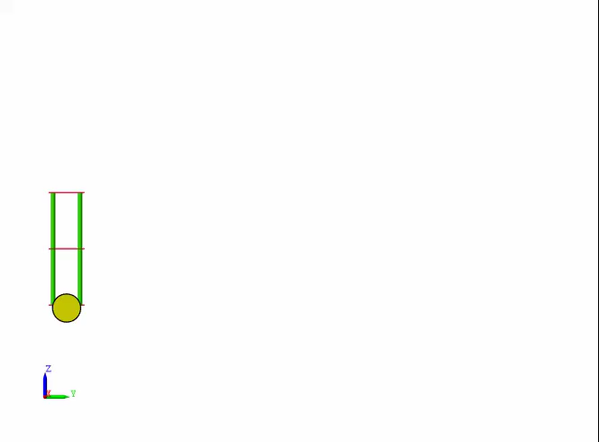
Results
Part 1: PID Controller
Video 1: PID Controlled Segway Robot Simulation in MATLAB-SIMULINK

Slide 33
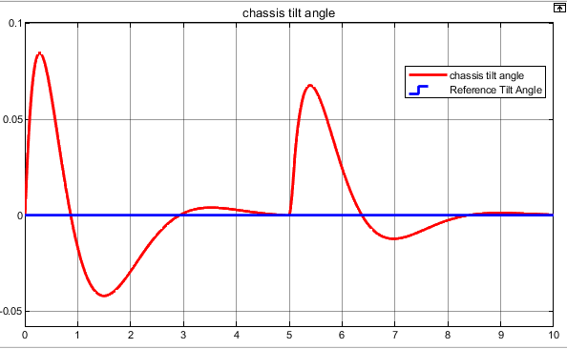
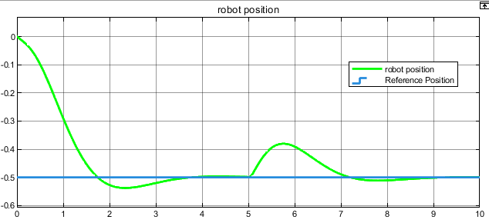


Results
Part 2: LQR Controller
Figure 11 : Position ($x$) v/s Time Graph from LQR Controlled Segway Robot Simulation in MATLAB-SIMULINK
Figure 12 : Chassis Tilt Angle (${\text{θ} }_{c}$) v/s Time Graph from LQR Controlled Segway Robot Simulation in MATLAB-SIMULINK

Slide 34
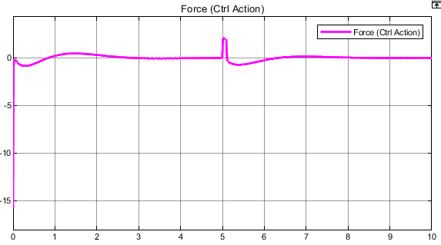
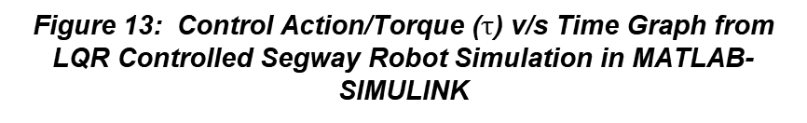
Results
Part 2: LQR Controller
Figure 13: Control Action/Torque ($τ$) v/s Time Graph from LQR Controlled Segway Robot Simulation in MATLAB-SIMULINK

Slide 35
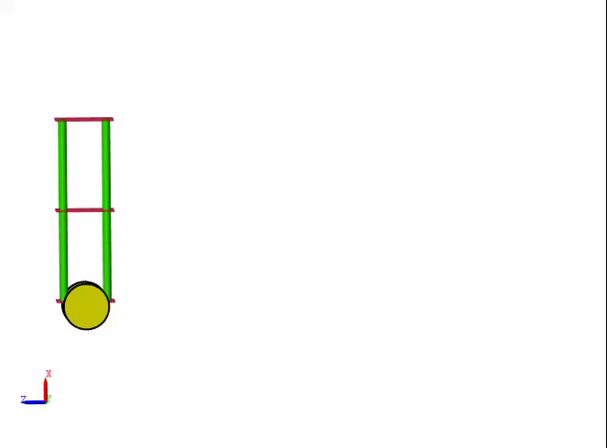
Results
Part 2: LQR Controller
Video 2: LQR Controlled Segway Robot Simulation in MATLAB-SIMULINK

Slide 36
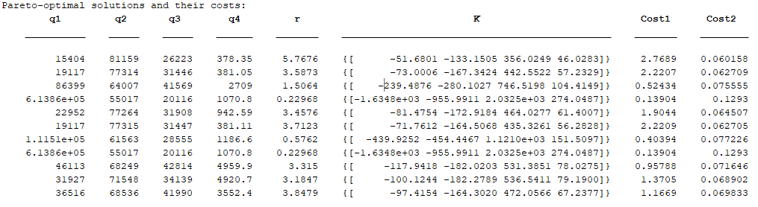
Results
Part 3: GA-Optimized LQR Controller
After Running For 40 Generations…
Figure 14: Final Output of Genetic Algorithm After 40 Generations

Slide 37
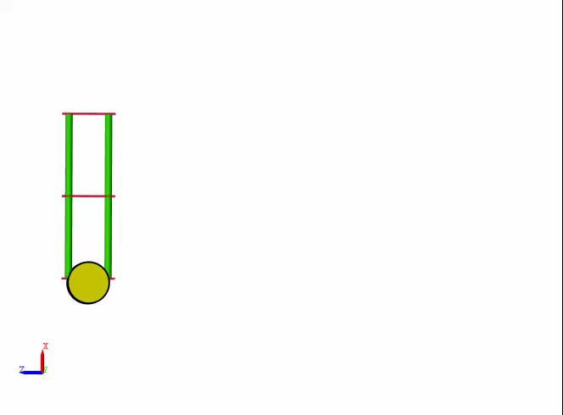
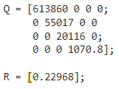
Results
Part 3: GA-Optimized LQR Controller
Video 3: GA- Optimized LQR Controlled Segway Robot Simulation in MATLAB-SIMULINK

Slide 38
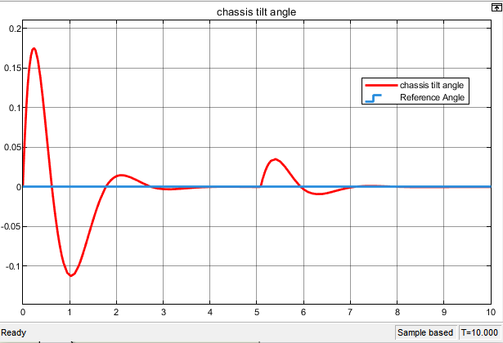
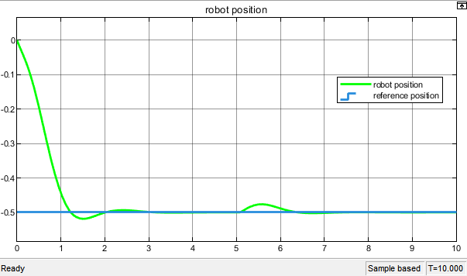
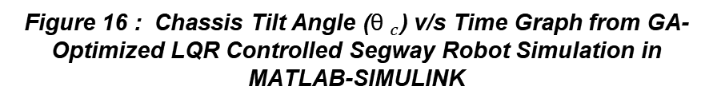
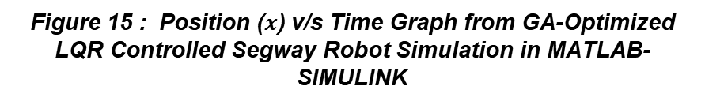
Results
Part 3: GA-Optimized LQR Controller
Figure 15 : Position ($x$) v/s Time Graph from GA-Optimized LQR Controlled Segway Robot Simulation in MATLAB-SIMULINK
Figure 16 : Chassis Tilt Angle (${\text{θ} }_{c}$) v/s Time Graph from GA-Optimized LQR Controlled Segway Robot Simulation in MATLAB-SIMULINK

Slide 39
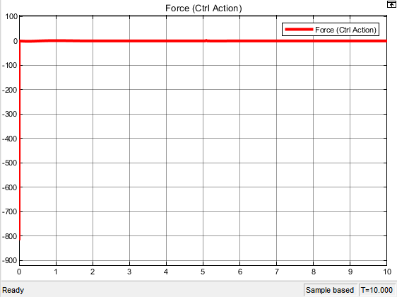
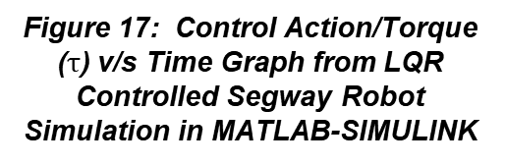
Results
Part 3: GA-Optimized LQR Controller
Figure 17: Control Action/Torque ($τ$) v/s Time Graph from LQR Controlled Segway Robot Simulation in MATLAB-SIMULINK

Slide 40
Results
Table 1. Performance parameters of the Segway using LQR and GA-LQR controller
Controller | System Output | Rise Time (seconds) | Settling Time (seconds)
LQR – Manually Tuned | Position | 1.16 | 8.17
 | Chassis Tilt Angle | 0.0014 | 9.99
LQR – GA Tuned | Position | 0.85 | 6.03
 | Chassis Tilt Angle | 0.0004 | 9.98
Conclusion
As can be inferred from the above table, the performance of the GA-tuned LQR controller is superior than that of the manually tuned LQR controller.

Slide 41
References
V. Mudeng, B. Hassanah, Y. T. K. Priyanto, and O. Saputra, “Design and Simulation of Two-Wheeled Balancing Mobile Robot with PID Controller,” Int. J. Sustain. Transp. Technol., vol. 3, no. 1, pp. 12–19, Apr. 2020.
L. G. B. Putra, F. Wahab, and T. A. Tamba, “Design and Implementation of Linear Quadratic Regulator Control for Two-Wheeled Self-Balancing Robot,” Bull. Electr. Eng. Inform., vol. 14, no. 2, pp. 931–939, Apr. 2025.
I. K. Mohammed and A. I. Abdulla, “Balancing a Segway Robot Using LQR Controller Based on Genetic and Bacteria Foraging Optimization Algorithms,” TELKOMNIKA Telecommun. Comput. Electron. Control, vol. 18, no. 5, pp. 2642–2653, Oct. 2020.
Feriyonika and A. Hidayat, “Balancing Control of Two-Wheeled Robot by Using Linear Quadratic Gaussian (LQG),” J. Telecommun. Electron. Comput. Eng., vol. 12, no. 3, pp. 55–59, Sep. 2020.
O. A. Choudhry, M. Wasim, A. Ali, M. A. Choudhry, and J. Iqbal, “Modelling and Robust Controller Design for an Underactuated Self-Balancing Robot with Uncertain Parameter Estimation,” PLoS One, vol. 18, no. 8, Aug. 2023, Art. no. e0285495.
B. R. Burkan and Ö. C. Özgüney, “Balance Control of Segway Robots Using Adaptive-Robust Controller,” Ind. 4.0, Int. Sci. J., vol. 2, no. 1, pp. 38–41, 2017.
Y. Su, T. Wang, K. Zhang, C. Yao, and Z. Wang, “Adaptive Nonlinear Control Algorithm for a Self-Balancing Robot,” IEEE Access, vol. 8, pp. 3751–3760, 2020.
J. Chen, N. He, Z. Xu, M. Dou, and L. He, “Design and Implementation of a Novel Two-Wheeled Composite Self-Balancing Robot for Stationary Operations in Unknown Terrain,” IEEE Access, vol. 13, pp. 86032–86045, May 2025.

Slide 42
Thank You

