Slide 1

WEB & MOBILE DEVELOPMENT INTERNSHIP
TASK#3: PAYMENT GATEWAY INTEGRATION
BY: PREET BHANSALI
BY: PREET BHANSALI

Slide 2
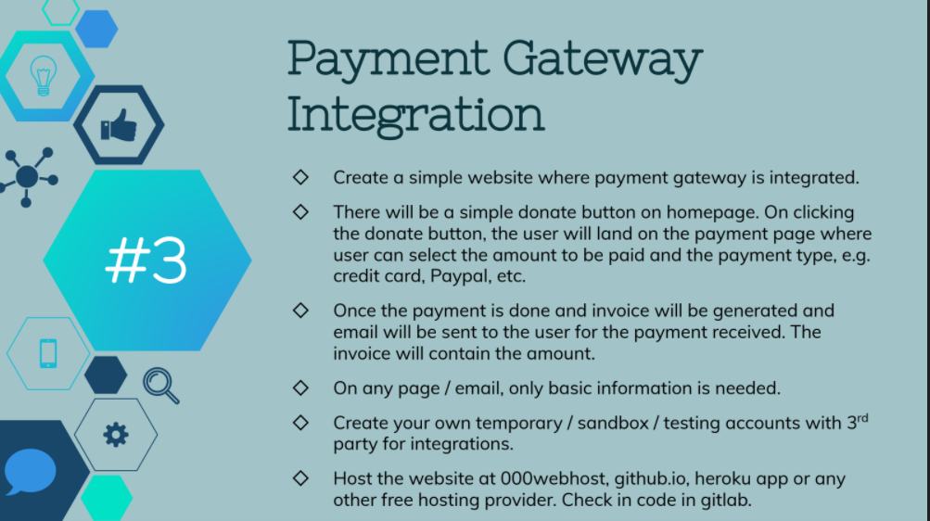

Slide 3
WEBSITE LINK:
https://sahara-tsf.000webhostapp.com/

