Slide 1

SkillBridge India
QUARTERLY BUSINESS REVIEW: Q4 2025
To: Board of Directors & Executive Leadership Team
From: Office of the Chief Executive Officer
Date: December 26, 2025

Slide 2

FY2025 PERFORMANCE
Executive Summary
Capitalized on 9% YoY Indian digital recruitment growth, achieving a milestone of 14.2 Million Monthly Active Users in Q4.

Slide 3
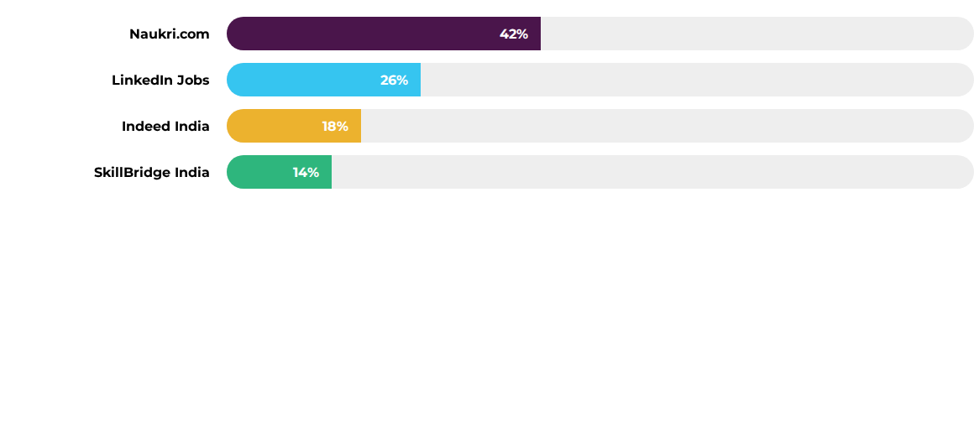
Competitor Landscape Market Share
Naukri: Deep enterprise network & B2B SaaS focus.
LinkedIn: Social recruiting and leadership focus.
Indeed: SME market & gig-economy aggregation.
SkillBridge: Skill-verified matching & Tier 2/3 focus.

Slide 4

User Growth Trends (MAUs)
14.2M
12.9M
11.4M
10.1M
Q1 2025
Q2 2025
Q3 2025
Q4 2025
96% of users access via mobile, favoring our app-centric Tier-2/3 expansion strategy.

Slide 5
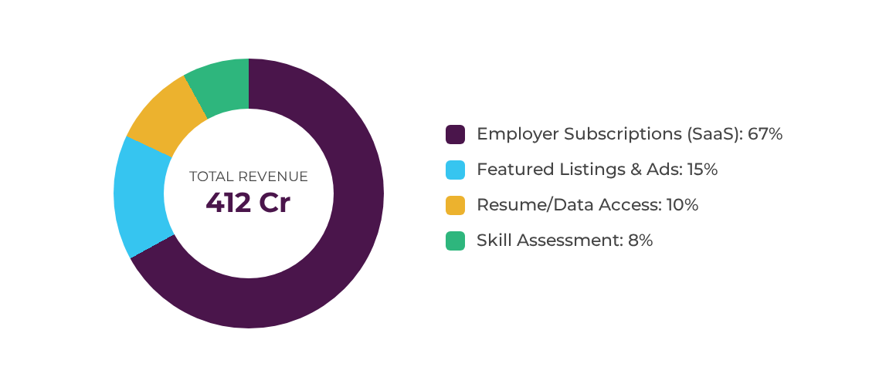
Revenue Breakdown (FY 2025)

Slide 6
Quarterly Financial Performance
Metric (INR Crore) | Q1 2025 | Q2 2025 | Q3 2025 | Q4 2025
Revenue | 88 | 97 | 108 | 119
Direct Costs | 26 | 29 | 32 | 35
Marketing | 18 | 21 | 24 | 22
Operations | 3 | 3 | 3 | 2
EBITDA Margin | 46.6% | 45.4% | 45.4% | 50.4%
FY2025 Total Revenue: 412 Crore | Total Operating Costs: 218 Crore

Slide 7
Two-Year Projections (Revenue)
680 Cr
520 Cr
412 Cr
2025 (Actual)
2026 (Target)
2027 (Projected)
Anticipated +26% YoY growth in 2026 and +31% YoY in 2027.

Slide 8


Project Pragati: Tier-2/3 Expansion
Expanding the Footprint
•
Targeting key growth hubs: Coimbatore, Jaipur, and Ahmedabad.
•
35% of new job creation in 2025 originated from non-metro regions.
•
Localizing UI experience in Hindi, Tamil, and Marathi to drive accessibility.
•
Partnering with local industry bodies to bridge regional talent gaps.

Slide 9

AI-Powered MatchScore
Revolutionizing Screening
Deployment of a proprietary Large Language Model (LLM) to score candidate resumes against specific job descriptions.
Impact: Reduced recruiter screening time by 40%, significantly increasing ROI for enterprise clients.
Positions SkillBridge as a premium alternative to legacy aggregators through AI-led screening.

Slide 10







Verified Credentials via India Stack
DigiLocker Integration
Pre-Vetted Talent
Digital Credentials
Direct integration allowing candidates to display Verified badges for academic and professional history.
Addressing high talent-shortage reporting (82%) by providing instantly verifiable credentials.
Strategic pivot to Skill-Verified credentials to reduce employer time-to-hire by 18%.
Opportunity: Hundreds of Global Capability Centres (GCCs) are expanding in India, creating a high-margin segment for pre-vetted matching.

Slide 11


Risks and Opportunities
Risks
Opportunities
Automation Displacement: 38% of employers report reductions due to AI. Pivoting to AI-human hybrid roles.
The Gig Economy: 24% of workforce participation. Launching "SkillBridge Flex" for project-based hiring.
Data Privacy: Scrutiny from the DPDP Act requires investment in compliance infrastructure.
GCC Expansion: Over 118 unicorns and GCCs create a premium matching market.

Slide 12
FY2026 OUTLOOK
Strategic Conclusion
SkillBridge India is positioned for significant growth. Our focus on quality talent matching, verified credentials, and tier-2/3 expansion will drive sustainable growth and profitability.
Questions?
Office of the Chief Executive Officer | December 2025

Slide 13


Image Sources
https://sp-ao.shortpixel.ai/client/to_webp,q_glossy,ret_img,w_750,h_394/https://authbridge.com/wp-content/uploads/2025/06/Gig-and-platform-workers-vision-2047-blog-image-1024x538.png
Source: authbridge.com
https://image-assets.aus-2.volcanic.cloud/api/v1/assets/images/3fe6043d37d875192a41daf9faabcdd7?t=1766465585%3Fsize%3D400x400%23&webp_fallback=png
Source: www.crescendo-global.com

