Slide 1


QUARTERLY BUSINESS REVIEW
Strategic Performance
& 2026 Outlook
Quarterly Performance Summary: Q4 2025
Office of the CEO December 26, 2025

Slide 2


EXECUTIVE SUMMARY
412 Cr
14.2 M
18%
TOTAL FY25 REVENUE
MONTHLY ACTIVE USERS
FASTER TIME-TO-HIRE
SkillBridge India concluded FY2025 with robust performance, capitalizing on a 9% YoY growth in digital recruitment. Strategic pivots toward AI-led screening and Skill-Verified credentials have successfully reduced employer friction.

Slide 3

COMPETITOR LANDSCAPE ANALYSIS
Strategic Positioning
SkillBridge currently holds a 14% market share in the white-collar segment.
•
Edge: Skill-verified matching & Geolocation.
•
Growth: Outperforming niche startups in velocity.
•
Focus: Expansion into Tier-2/3 & Digital Credentials.

Slide 4
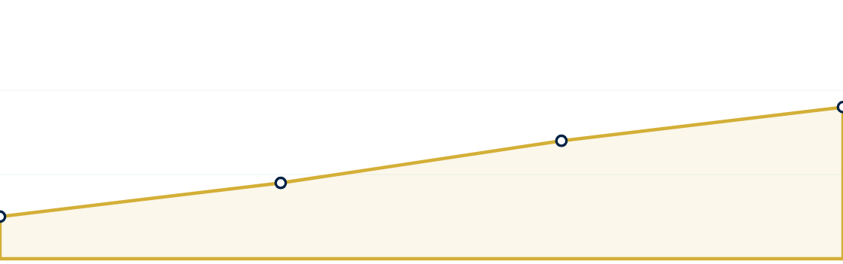
USER ENGAGEMENT TRENDS (MAUS)
* 96% of users access the web via mobile, favoring our app-centric strategy. Q4 deceleration reflects a shift from quantity to quality talent acquisition.

Slide 5
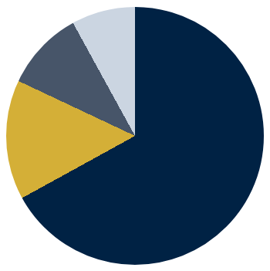
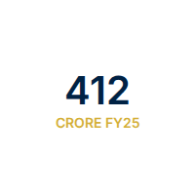
MONETIZATION DIVERSIFICATION
Revenue Sources
Employer Subscriptions (SaaS): 276 Cr (67%)
Featured Listings & Ads: 62 Cr (15%)
Resume/Data Access: 41 Cr (10%)
Skill Assessment & Credentials: 33 Cr (8%)

Slide 6
QUARTERLY FINANCIAL PERFORMANCE
Period (2025) | Revenue (Cr) | Marketing (Cr) | Operating Costs (Cr) | EBITDA Margin
Q1 | 88 | 18 | 26 | 46.6%
Q2 | 97 | 21 | 29 | 45.4%
Q3 | 108 | 24 | 32 | 45.4%
Q4 | 119 | 22 | 35 | 50.4%
* Q4 efficiency driven by optimized marketing spend and higher contribution from high-margin SaaS subscriptions.

Slide 7


Project Pragati:
Tier-2/3 Expansion
Expanding footprint into Coimbatore, Jaipur, and Ahmedabad. In 2025, 35% of new job creation came from non-metros.
Localization Strategy
Partnering with local industry bodies to localize UI in Hindi, Tamil, and Marathi.

Slide 8

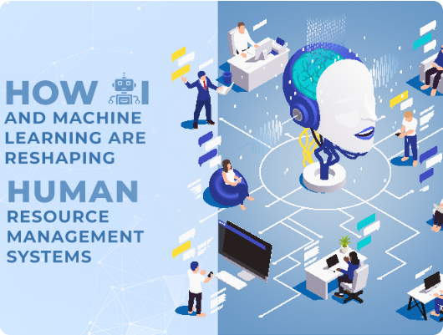

AI-POWERED MATCHSCORE
Large Language Model (LLM) Integration
40%
REDUCTION IN RECRUITER SCREENING TIME
Deploys proprietary LLM to score candidate resumes against job descriptions, significantly increasing ROI for enterprise clients.

Slide 9






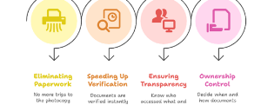
DIGITAL TRUST: INDIA STACK INTEGRATION
DigiLocker Synergy
Vetted Talent
Employer Trust
Integrating with DigiLocker to allow candidates to display Verified badges for their academic and professional history.
Directly addresses the high talent-shortage reporting (82%) by providing pre-vetted, credible talent pools.
Positions SkillBridge as a premium alternative to legacy aggregators through verifiable data transparency.

Slide 10


2026-2027 REVENUE TARGETS
2026 TARGET
2027 TARGET
520 Cr
680 Cr
+26% YoY Growth
+31% YoY Growth

Slide 11


FUTURE RISKS & STRATEGIC OPPORTUNITIES
Key Risks
Opportunities
Automation Displacement: 38% employers report job reductions due to AI. Response: Pivot to AI-human hybrid roles.
The Gig Economy: 24% of workforce now gig-based. Opportunity to launch "SkillBridge Flex" portal.
GCC Expansion: 118+ unicorns and hundreds of GCCs expanding in India; a high-margin premium segment.
Data Privacy: Scrutiny from the DPDP Act requires significant infrastructure investment.

Slide 12



SkillBridge India
Empowering India's digital future through verified skills, AI innovation, and market transparency.
www.skillbridgeindia.com | ceo@skillbridgeindia.com

Slide 13




IMAGE SOURCES
https://tradebrains-wp.s3.ap-south-1.amazonaws.com/wp-content/uploads/2025/09/Untitled-design-2025-09-09T164707.089-1080x675.jpg
Source: tradebrains.in
https://sftevolve.com/wp-content/uploads/2025/06/banner-3.jpg
Source: sftevolve.com
https://negd.gov.in/wp-content/uploads/2025/09/Screenshot_3.png
Source: negd.gov.in
https://media.istockphoto.com/id/1656369677/photo/towering-over-the-city.jpg?s=612x612&w=0&k=20&c=i150ZqfGeLSbb-8pe9irpnfcNNFuGGziXE-jnwGHgGI=
Source: www.istockphoto.com

