Slide 1
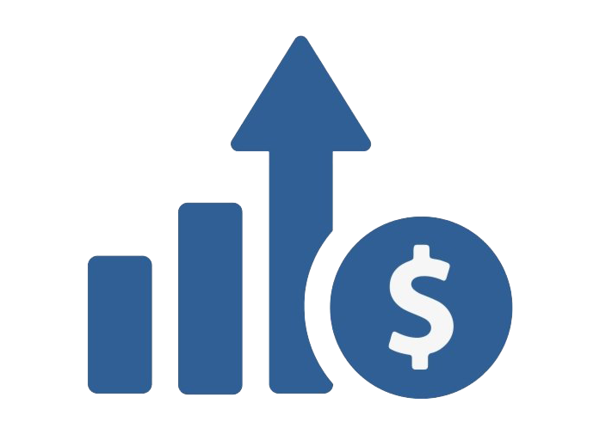
TrackWise
Preeth Nazareth
UX Design Bootcamp Capstone Project
This Photo by Unknown Author is licensed under CC BY-NC

Slide 2
CHALLENGES
The challenge is to track investments in the app that is user-friendly for novice users with limited investment knowledge.
Designing a dashboard that uses pie charts and graphs to simplify portfolio management.
The main difficulty is balancing simplicity with comprehensive financial insights with ease of use, and not to overwhelm the user.

Slide 3
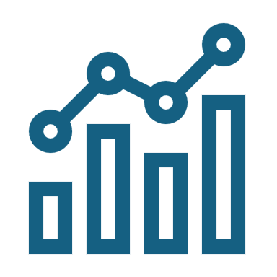
GOAL
To design an application that features a simple intuitive dashboard, incorporating pie charts and graphs to facilitate easy tracking and comprehensive management of investments.

Slide 4
USER RESEARCH
User Personas: Developed detailed user personas on novice investors.
Questionnaires: Gather insights from novice investors about what they expect from an investment portfolio dashboard. Questions were focused on their current frustrations, preferred features, and the type of data they'd like to track.
User Interviews: Conduct in-depth interviews with real POSB app novice investors to understand how they currently manage their portfolios, their pain points, and what they would expect from monthly updates.

Slide 5

What I Heard What I Saw What I Concluded
What I Heard
As a casual investor I struggle with tracking the portfolios due to complex interfaces and overwhelming financial jargon.
I want a more intuitive tool for managing investments, especially on mobile platforms.
I want to see a concise visuals of tracking investment performance to make informed decisions.
What I Saw
Many current apps offer overly complex dashboards that cater to advanced users but alienate casual investors.
Users often find it difficult to interpret financial data or locate relevant information, such as portfolio performance or asset allocation.
There’s a lack of simple, intuitive designs that balance ease of use with comprehensive insights, especially in mobile apps.
What I Concluded
Casual investors need a streamlined, intuitive tracking system that presents financial data in a clear and easily digestible manner.
Visual aids like Pie charts, graphs, and simple dashboards can make it easier for users to monitor and manage their portfolios without feeling overwhelmed.
Creating a dashboard that is user-friendly, ensuring effective decision-making for users with limited investment knowledge.

Slide 6

HOW MIGHT WE
How might we design a dashboard that simplifies investment tracking for casual users without overwhelming them with complex data?
How might we create an intuitive user experience that allows users with limited financial knowledge to easily understand and manage their investment portfolios?
How might we use visual aids like pie charts and graphs to help users quickly assess their investment performance and make informed decisions?
How might we balance detailed financial insights with user-friendliness to ensure both novice and experienced investors can effectively track their portfolios?
How might we create a seamless mobile experience that provides comprehensive investment updates while remaining simple and intuitive?
How often is the investment data updated in the app? Can I trust this data?

Slide 7
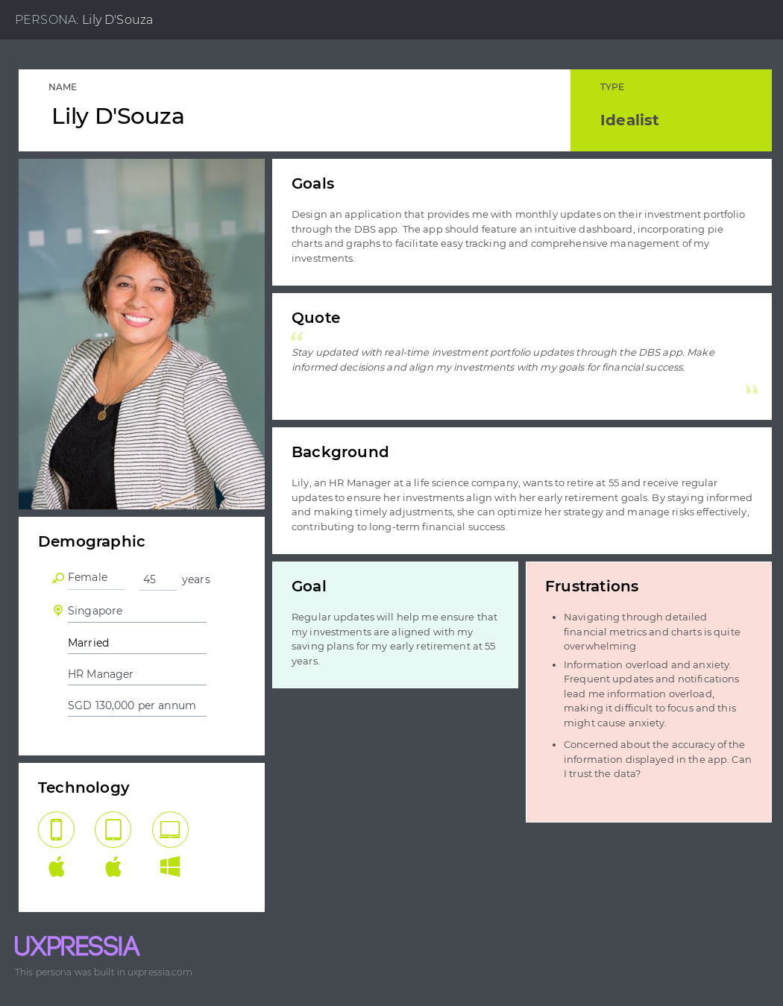
User Persona 1

Slide 8
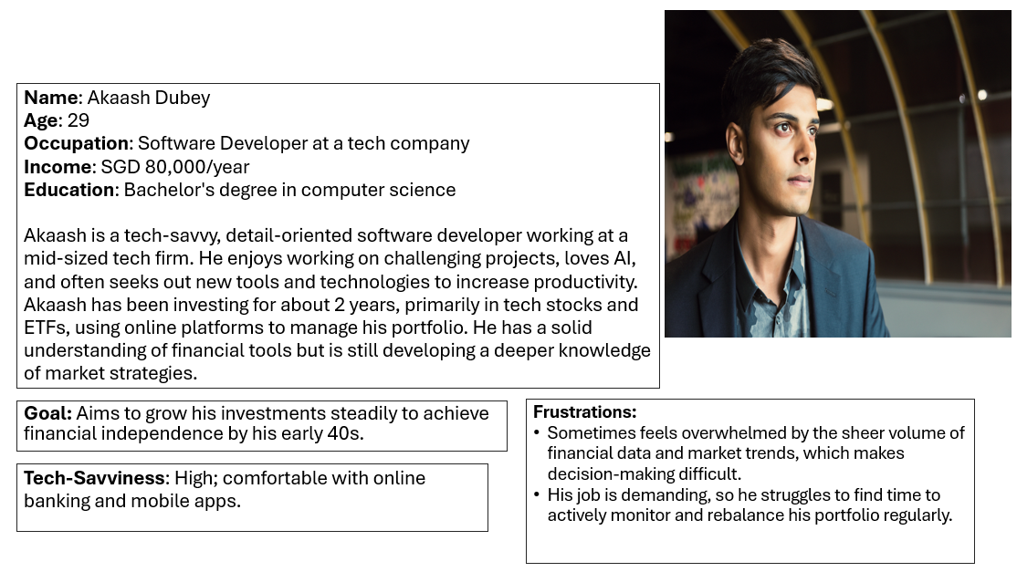
User Persona 2

Slide 9
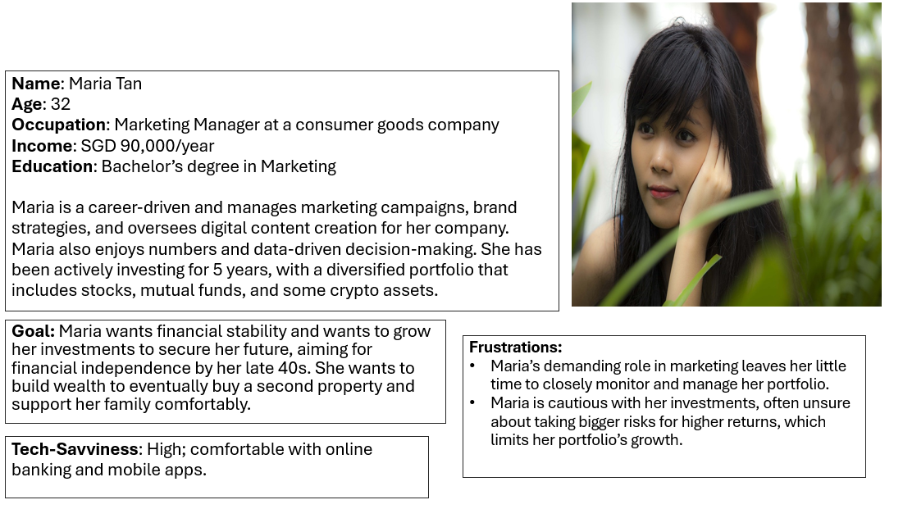
User Persona 3

Slide 10
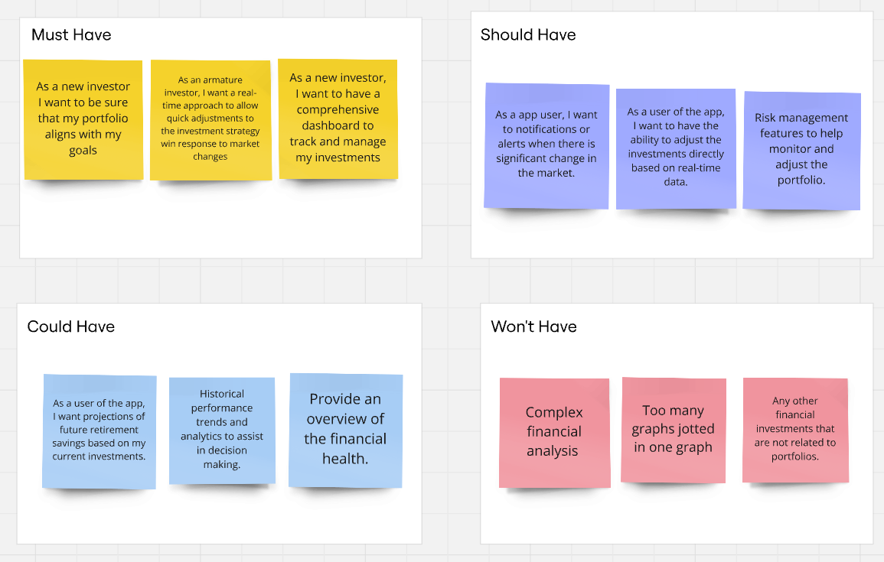
The MoSCoW Template For Prioritizing Requirements
The template has been completed using Miro

Slide 11
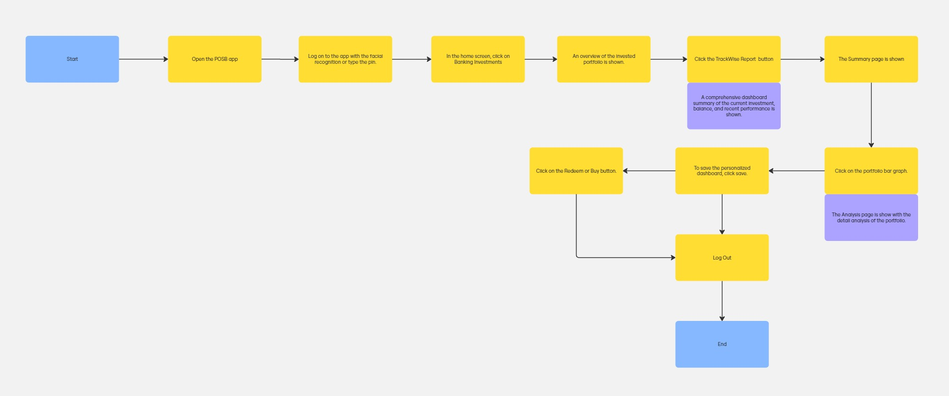
USER FLOW
The template has been completed using Miro

Slide 12
WHAT WE WANTED IDEAS
AI-Powered Investment Recommendations: The dashboard offers AI-driven insights based on market trends and portfolios performance, suggesting rebalancing strategies or new investment opportunities.
Voice Command Integration: Allow users to use voice commands for tasks like checking portfolio balance, setting up alerts, or getting detailed insights on specific investments.
Risk Profile Tracker: AI tool that continuously monitors the portfolios risk level, sending alerts if it deviates from your chosen risk profile and offering suggestions for mitigation.
Simulation Tool: Simulate different market scenarios like, recession and inflation and see how your portfolio would perform under each, providing a "what if" analysis feature.
Sustainability Impact Score: Show the environmental or social impact of my investments with a sustainability score, helping socially-conscious investors align portfolios with their values.

Slide 13
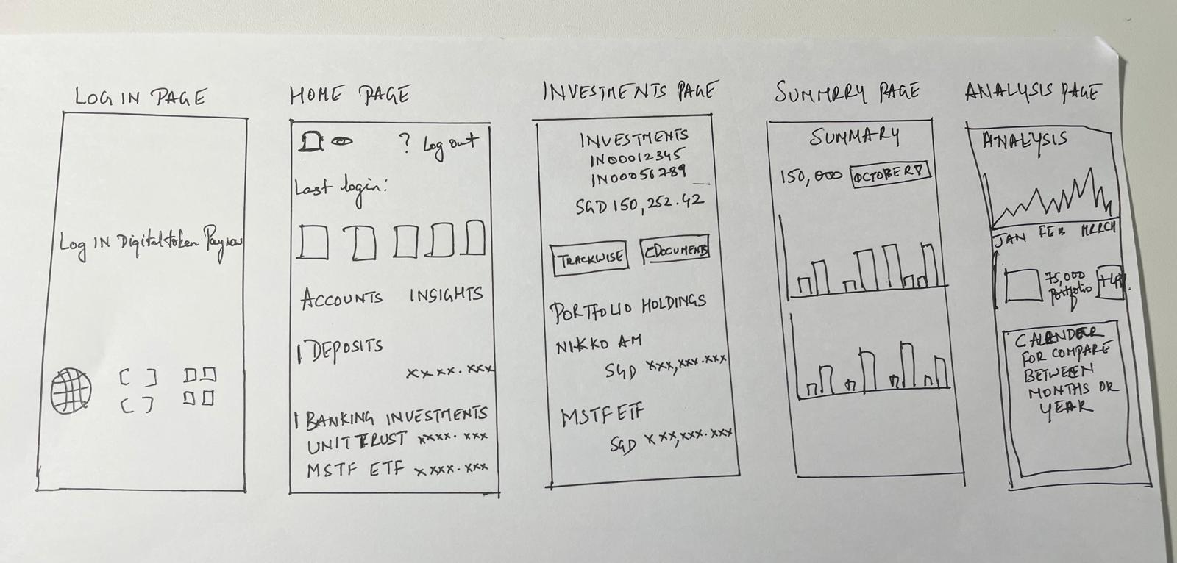
L0W FIDILITY
Used paper and pencil

Slide 14
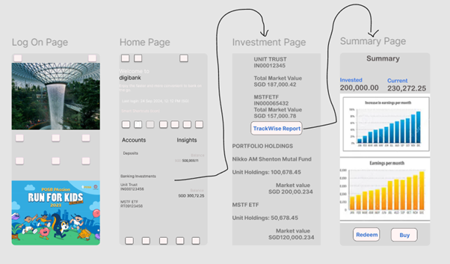
MID FIDILITY
Used Figma
(Click to view in Figma)

Slide 15
USABILITY TESTING
I did a real-life test case scenarios tasks that reflect how users would interact with the app. I tested the following metric tasks on five novice investors and five experienced investors.
Time on Task: Tracked how long it took the users to complete each scenario, identifying any tasks that take longer than expected.
Task Completion Rate: Measured how many users can successfully complete the assigned tasks without guidance.
Error Rate: Noted the frequency of mistakes or misunderstandings, such as users not finding features or misinterpreting data.
User Satisfaction: Post-test surveys with questions like:
Was the data easy to understand
Was the dashboard layout intuitive?
Would you use this app regularly to manage your portfolio?

Slide 16

FEEDBACK
After gathering feedback from usability testing, I focused on the following aspects:
Is the dashboard self-explanatory?
AI-based insights or personalized investment advice
Is user data securely stored and transmitted? Are there protections in place against unauthorized access?
Does it refresh in real-time, or is there a noticeable lag?
Did the novice and experienced investors engage with the app differently?

Slide 17
RETROSPECTIVE
This project taught me the importance of balancing simplicity with depth, especially when designing a financial dashboard that caters to both novice and experienced investors.
The user feedback after the usability testing played a crucial role in refining features and made sure that the app met diverse needs effectively.
Overall, I had a good learning experience and skills enhancement in user-centered design and data visualization that helped me understand the complexity of delivering actionable insights for the fintech platforms and app.

Slide 18

TOOLS USED
Miro
Figma
UXPressia
Microsoft PowerPoint

Slide 19

THANK YOU

