Slide 1
Support Vector Machines
Submission By: Preetha Selvaraj
Student ID: 23026653

Slide 2
What is SVM?
What is SVM?
A supervised machine learning algorithm for classification and regression tasks.
It finds the optimal hyperplane that best separates different classes of data.
Key Idea:
Maximize the margin (distance) between the classes for better generalization.

Slide 3
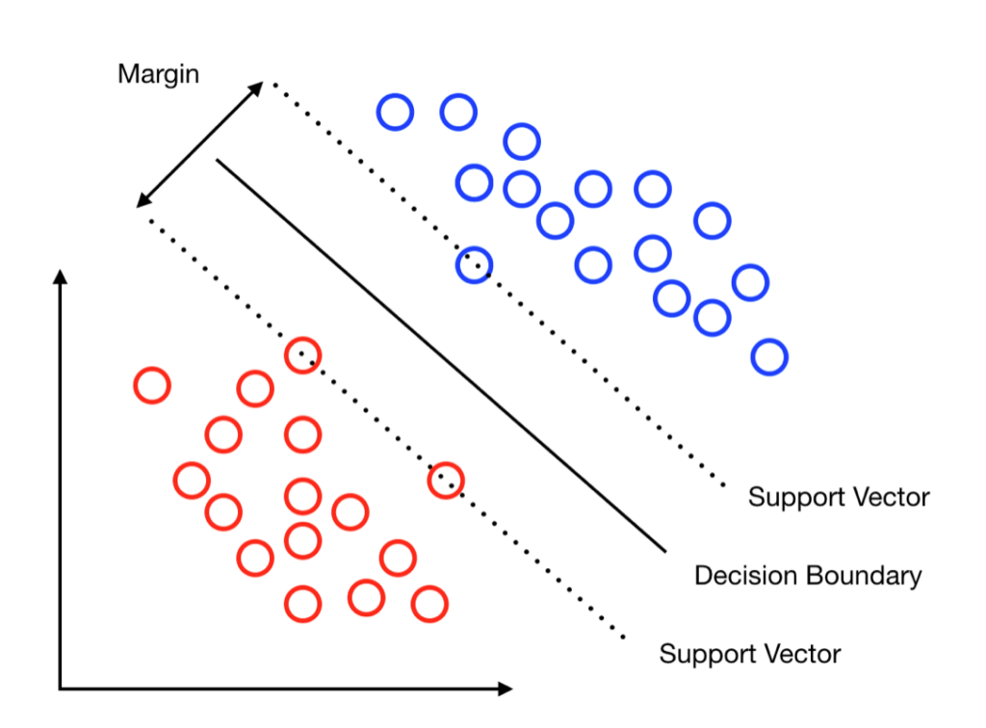

Key Concepts
• Hyperplane: The decision boundary that separates data points of different classes.
$$w ⋅x + b = 0$$
• Margin: The distance between the hyperplane and the nearest data points:
$$\text{Margin}\text{ = }\text{2 / ||}\text{w}\text{||}$$
• Support Vectors: Data points closest to the hyperplane that influence its position.

Slide 4
How SVM Works
Identify a hyperplane to separate data into classes.
Maximize the margin between the classes.
Solve a quadratic optimization problem to find the global minimum.
Use the Kernel Trick to handle non-linear data.

Slide 5
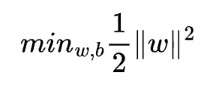
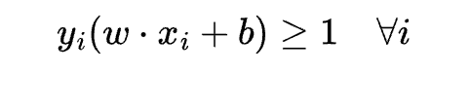
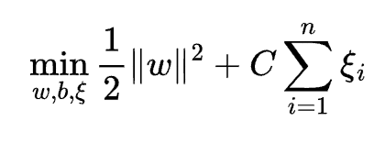
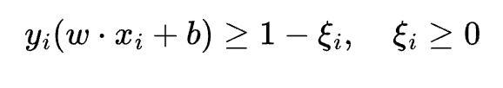
Optimization in SVM
• Primal Formulation:
Subject to:
Soft Margin (for misclassifications):
Subject to:

Slide 6
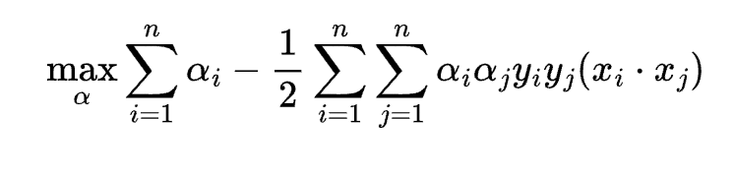
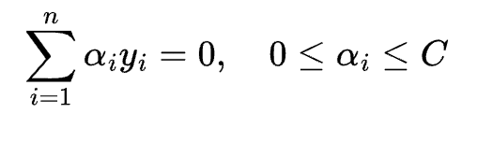

Dual Formulation
Convert the optimization into a dual problem:
Subject to:
Only support vectors (data points closest to the hyperplane)

Slide 7
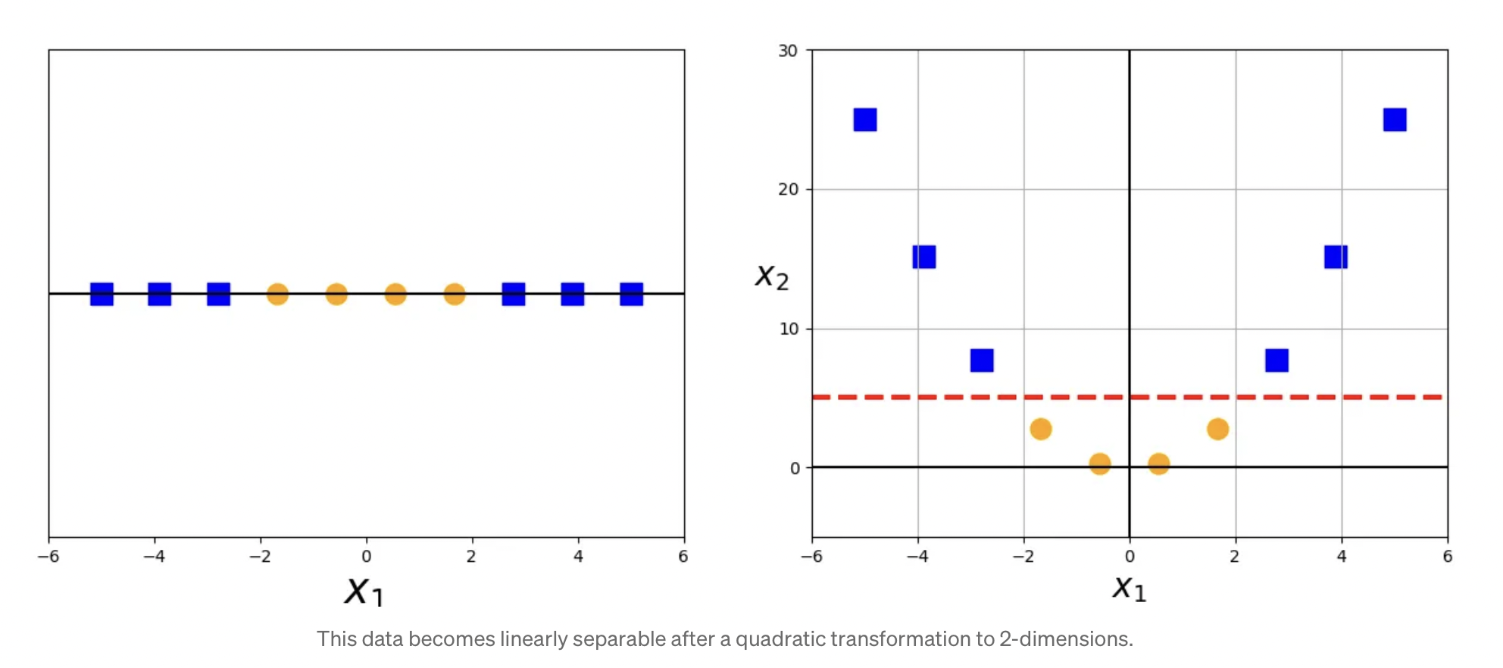


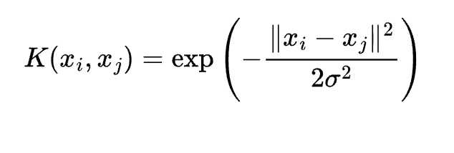
The Kernal Trick
• Problem: When data isn’t linearly separable.
• Solution: Use kernel functions to transform data into a higher-dimensional space where it becomes linearly separable.
• Common Kernels:
Linear Kernel →
Polynomial Kernal →
RBF →

Slide 8
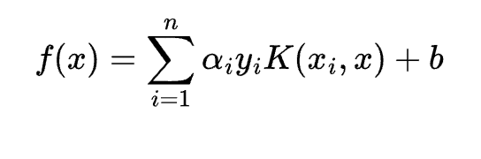

Prediction
• After training, the decision function is:
Classification rule:

Slide 9
Advantages of SVM
• Works well in high-dimensional spaces.
• Effective for both linear and non-linear problems.
• Robust to overfitting (with proper regularization).
• Can handle outliers using soft margin classification.

Slide 10
Limitations of SVM
• Computationally expensive for large datasets.
• Requires careful selection of kernels and hyperparameters.
• Sensitive to noise in data.
• Doesn’t perform well when the number of features exceeds the number of samples.

Slide 11
Applications of SVM
• Text Classification: Spam detection, sentiment analysis.
• Image Recognition: Handwriting recognition, face detection.
• Bioinformatics: Protein classification, gene analysis.
• Finance: Fraud detection, stock market prediction.

