Slide 1
Support Vector Machines
Submission By: Preetha Selvaraj
Student ID: 23026653

Slide 2
What is SVM?
What is SVM?
A supervised machine learning algorithm for classification and regression tasks.
It finds the optimal hyperplane that best separates different classes of data.
Key Idea:
Maximize the margin (distance) between the classes for better generalization.

Slide 3
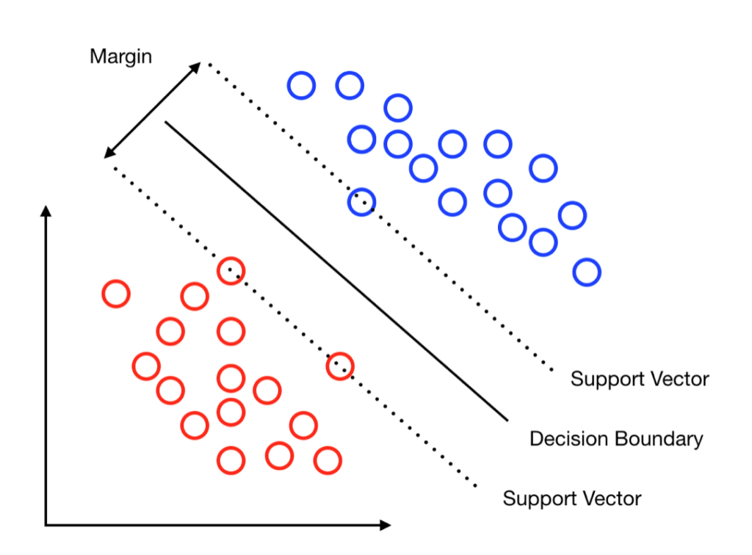

Key Concepts
• Hyperplane: The decision boundary that separates data points of different classes.
$$w ⋅x + b = 0$$
• Margin: The distance between the hyperplane and the nearest data points:
$$\text{Margin}\text{ = }\text{2 / ||}\text{w}\text{||}$$
• Support Vectors: Data points closest to the hyperplane that influence its position.

Slide 4
How SVM Works
Identify a hyperplane to separate data into classes.
Maximize the margin between the classes.
Solve a quadratic optimization problem to find the global minimum.
Use the Kernel Trick to handle non-linear data.

Slide 5
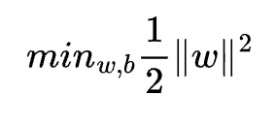
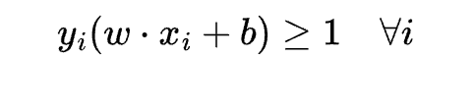
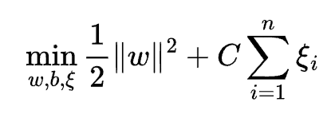
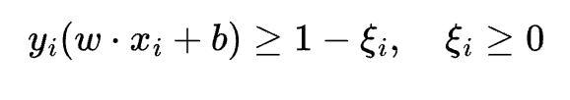
Optimization in SVM
• Primal Formulation:
Subject to:
Soft Margin (for misclassifications):
Subject to:

Slide 6
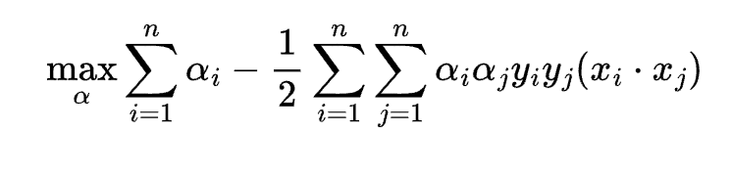
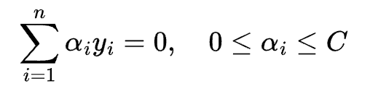

Dual Formulation
Convert the optimization into a dual problem:
Subject to:
Only support vectors (data points closest to the hyperplane)

Slide 7
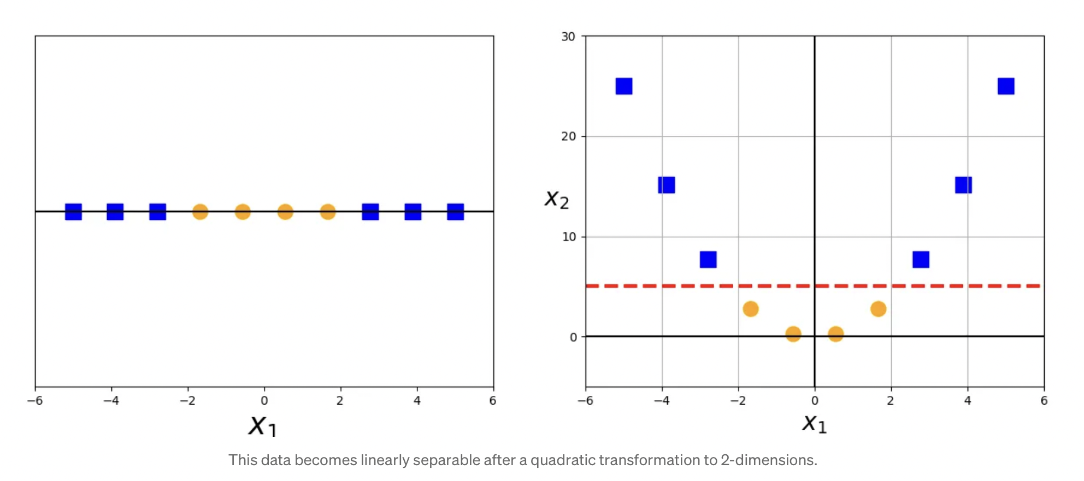


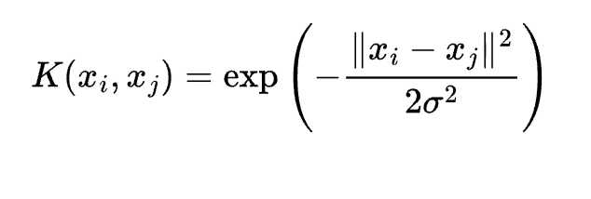
The Kernal Trick
• Problem: When data isn’t linearly separable.
• Solution: Use kernel functions to transform data into a higher-dimensional space where it becomes linearly separable.
• Common Kernels:
Linear Kernel →
Polynomial Kernal →
RBF →

Slide 8
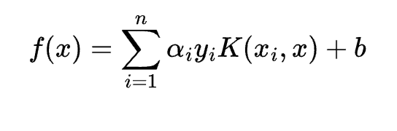

Prediction
• After training, the decision function is:
Classification rule:

Slide 9
Advantages of SVM
• Works well in high-dimensional spaces.
• Effective for both linear and non-linear problems.
• Robust to overfitting (with proper regularization).
• Can handle outliers using soft margin classification.

Slide 10
Limitations of SVM
• Computationally expensive for large datasets.
• Requires careful selection of kernels and hyperparameters.
• Sensitive to noise in data.
• Doesn’t perform well when the number of features exceeds the number of samples.

Slide 11
Applications of SVM
• Text Classification: Spam detection, sentiment analysis.
• Image Recognition: Handwriting recognition, face detection.
• Bioinformatics: Protein classification, gene analysis.
• Finance: Fraud detection, stock market prediction.

Slide 12
Watch the Tutorial on SVM
This tutorial explains the fundamentals of Support Vector Machines (SVMs), showcasing their functionality and unique characteristics through visualizations and code examples.
GitHub Link - https://github.com/Preetha-Selvaraj/SVM
YouTube Link – SVM Tutorial - https://www.youtube.com/watch?v=Nm9xXJSF3Vc
Google Drive Link – SVM Tutorial –
https://drive.google.com/file/d/1PA3FPH2SipHoZhe1LuiOA586Wssv1Ytz/view?usp=share_link

