Slide 1

ANIMO
Here for YOU...

Slide 2

→ Animo is an app designed to help people suffering from anxiety, depression , addiction and other causes of stress..
→ Our app with the help of voluntary moderators ( with certified level of knowledge in Psychology and related subjects ), sets up support group meet -ups for our users .
→ Motive - To help our users get through the worst times of their life. Mental health ,if not taken care of ,tends to be more dangerous than one might expect .

Slide 3
USER PRIVACY
→ Animo ensures complete anonymity of users ( except moderators ).
→ This is for two main purposes :
*Ensure safety of the user.
*Make it easier for the user to communicate

Slide 4
FEATURES
→ SUPPORT GROUP MEET-UPS
→ CONTACTS OF PSYCHOLOGISTS
→ REFERENCE TO HELPFUL BOOKS , MOVIES , DOCUMENTARIES.

Slide 5
UI

Slide 6
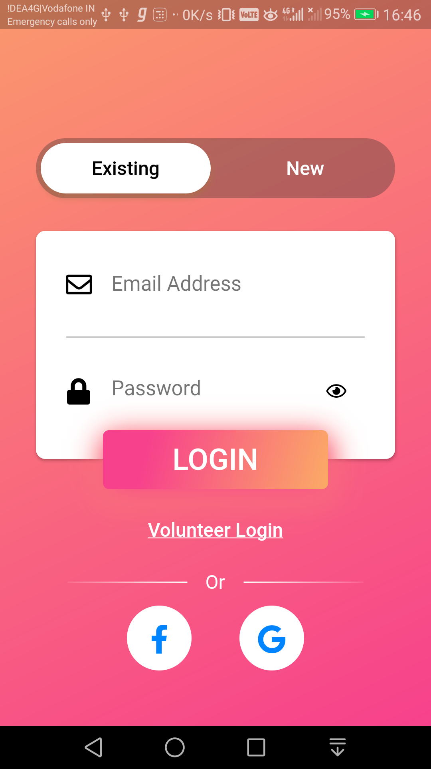
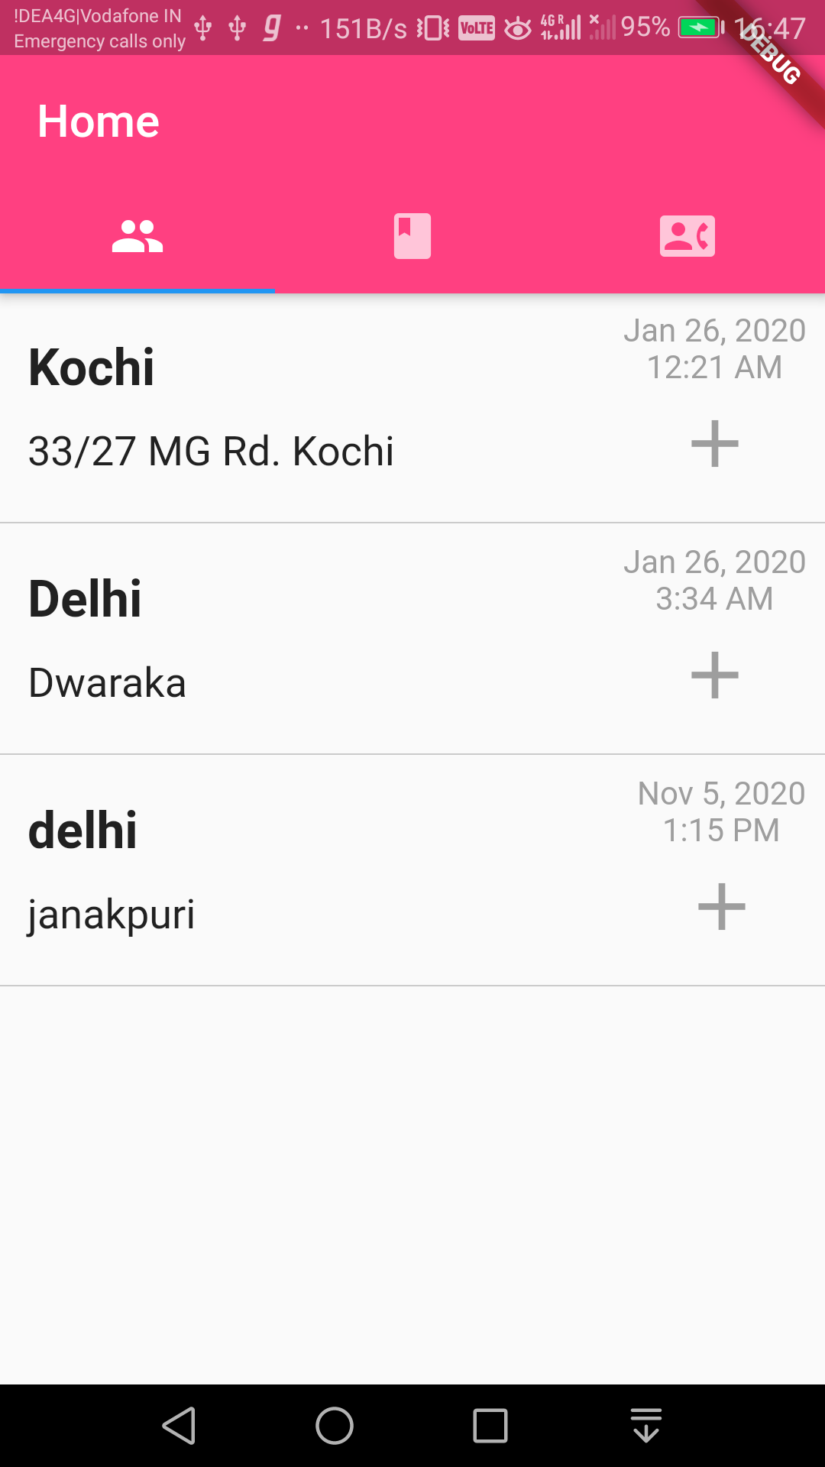
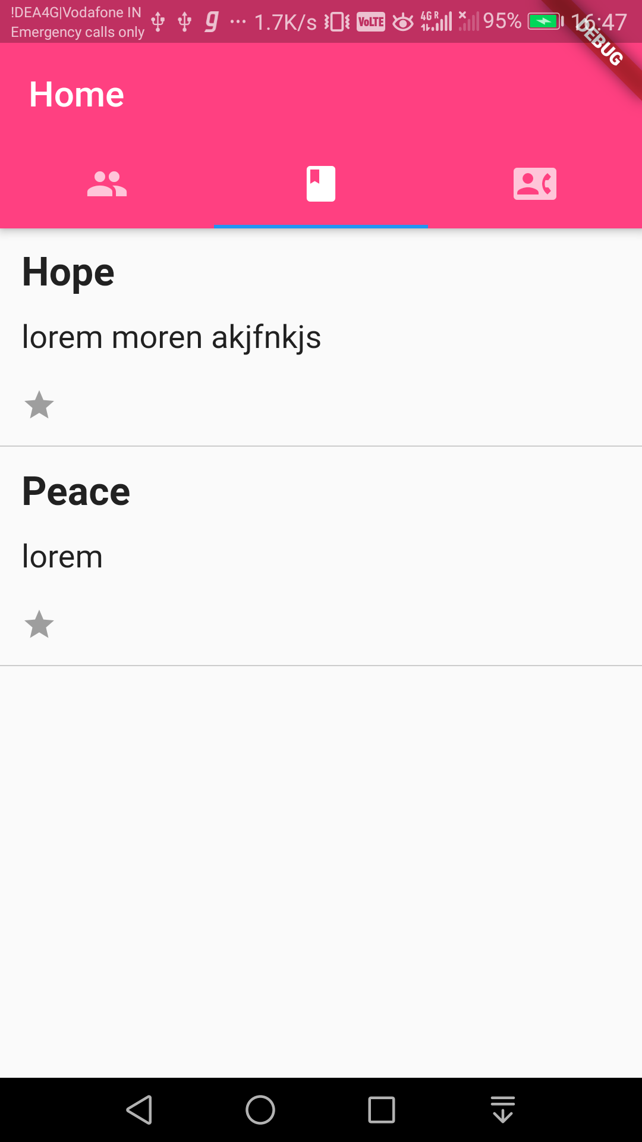

Slide 7
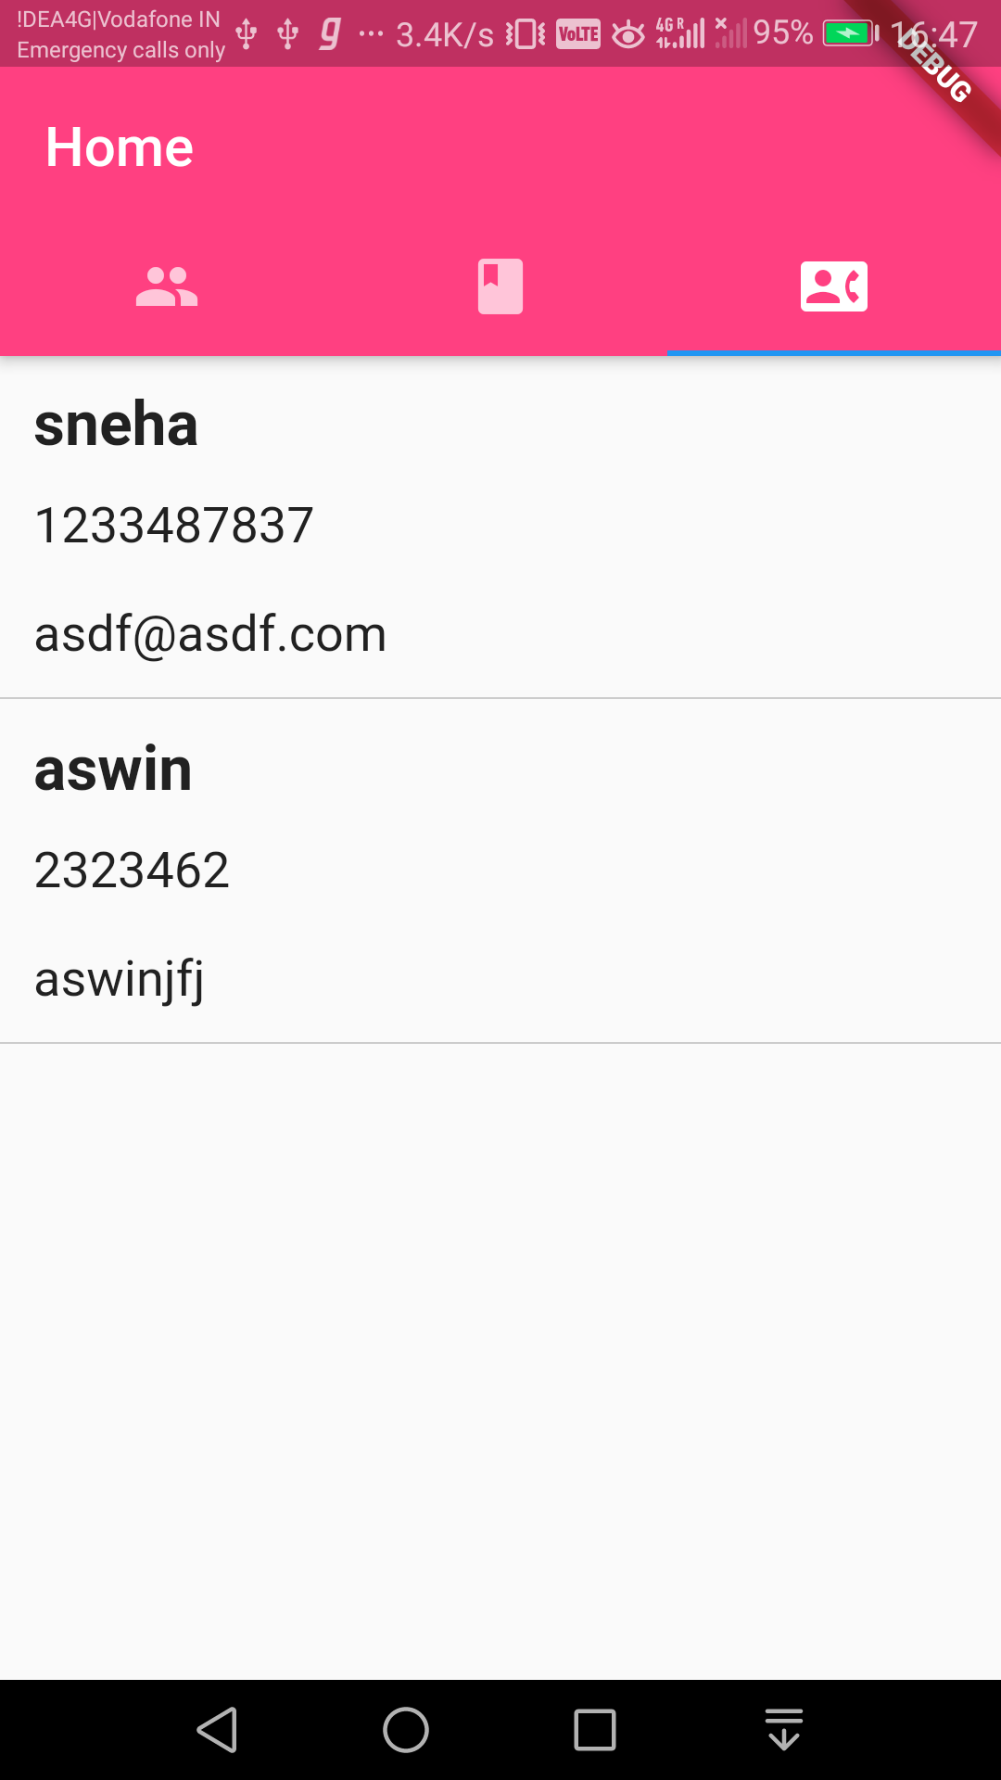
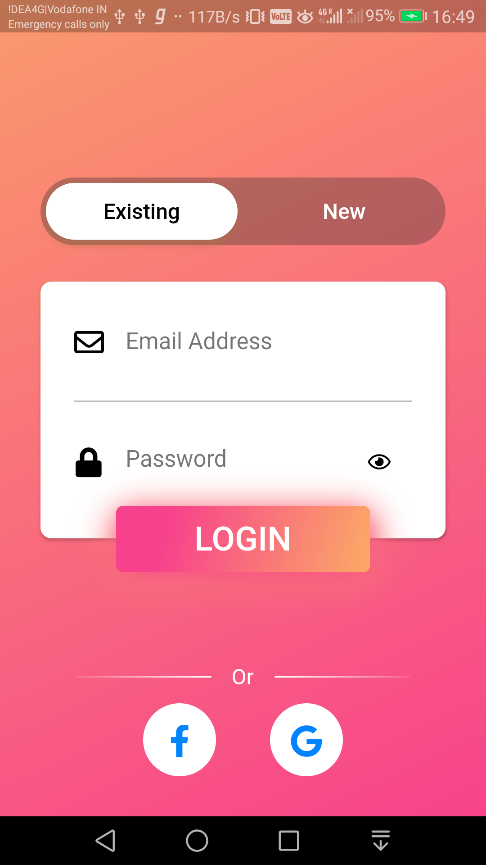
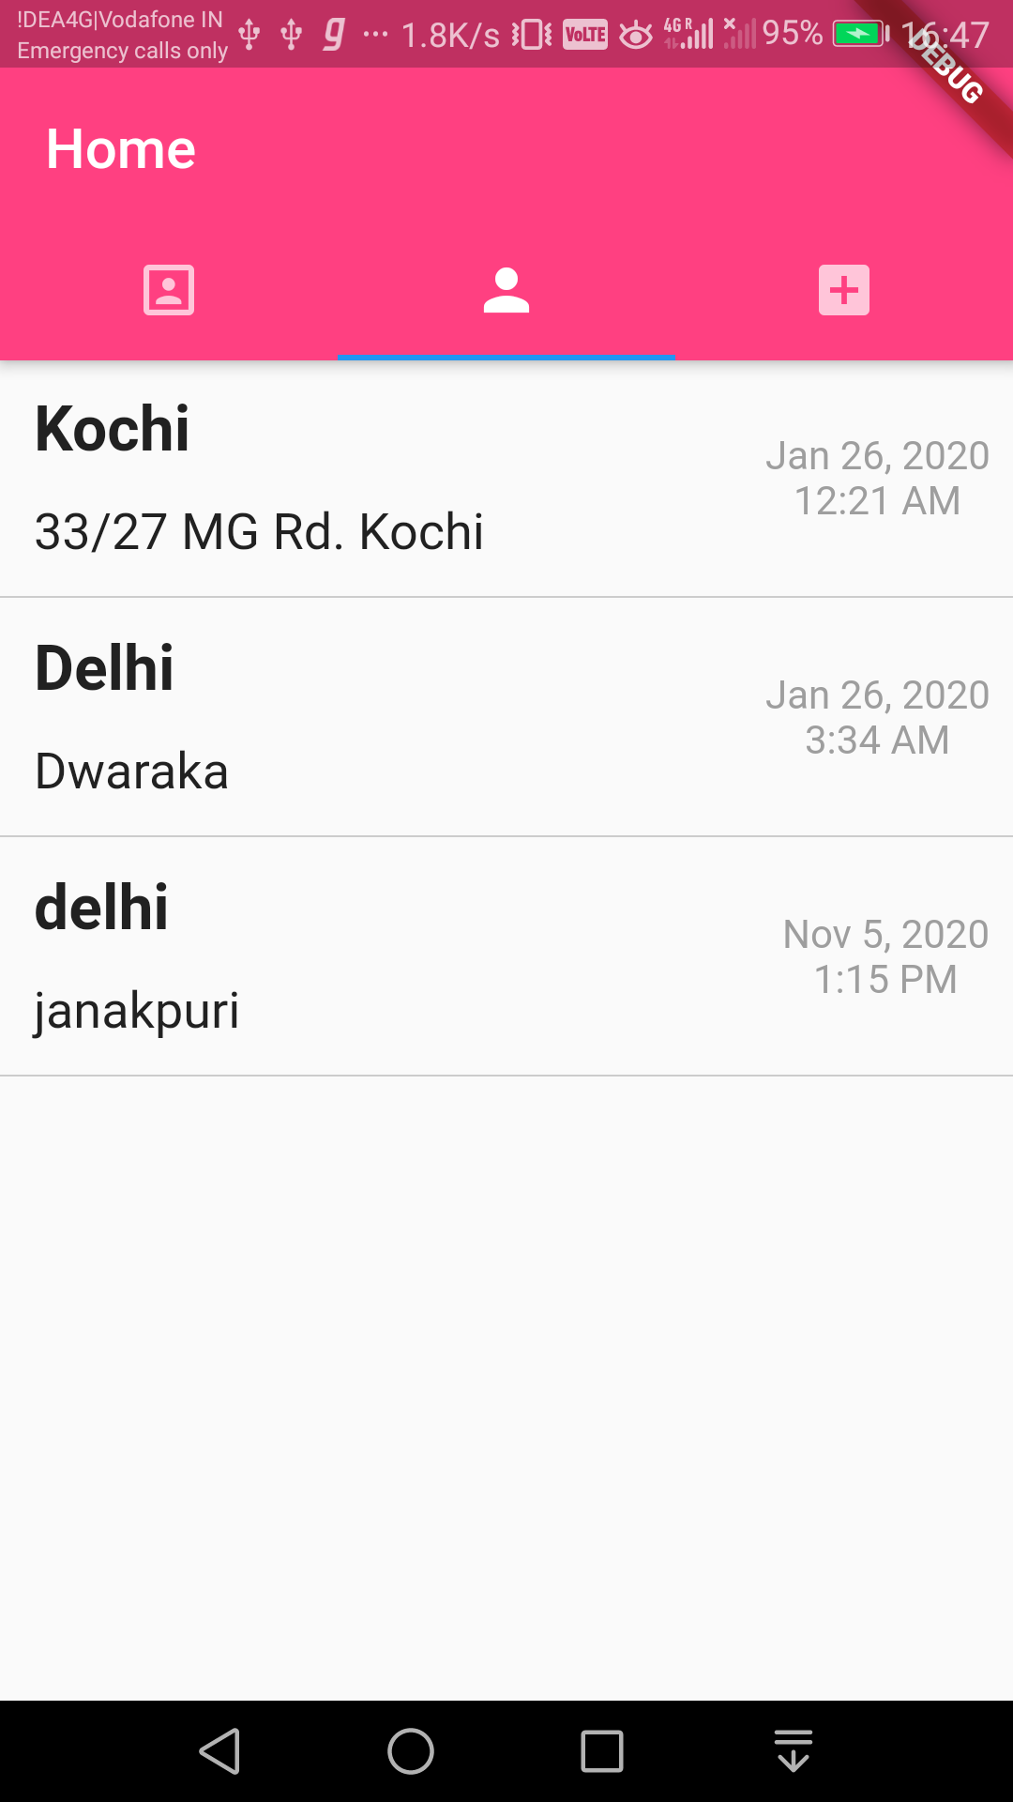

Slide 8
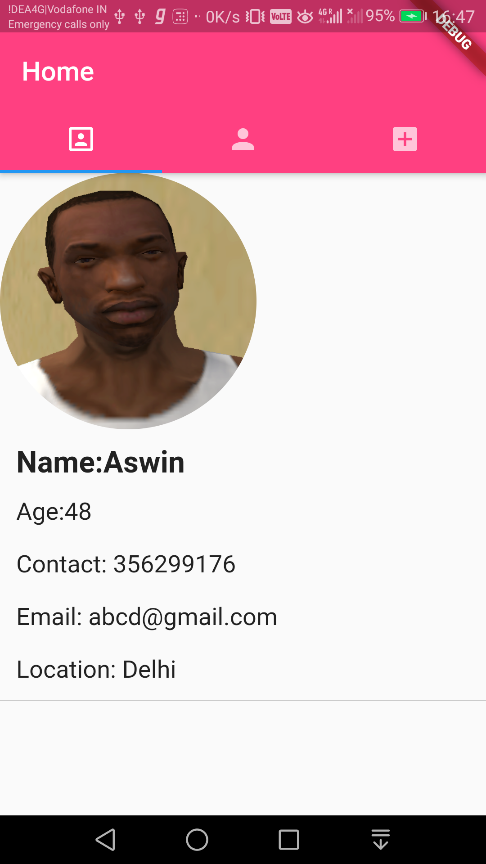
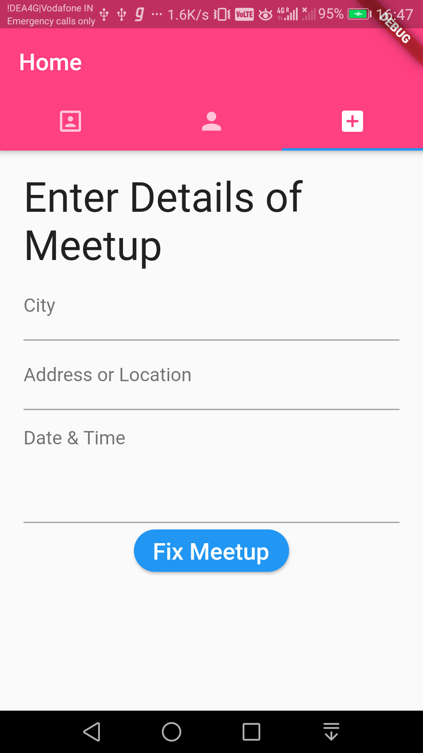

Slide 9
