Slide 1
SECURE VISION AI
CIFAR-10 Image Classification: Baseline CNN vs ResNet18
Machine Learning Lab – Final Examination
TEAM MEMBERS
Reyaan
Prithvi
Tarun
241BCADA54
241BCADA66
241BCADA03
Data Engineer
Data Analyst
Data Scientist
Preetham M
Jason
Tusharr
241BCADA72
241BCADA16
241BCADA29
ML Engineer
Analytics Engineer
BI Developer
Machine Learning Lab – Final Exam Project
Notes:
All six members introduce their role. Group number is not in the repo; add it here if your lab requires one.

Slide 2
2. Problem Statement & Objective
PROBLEM
Input
32 × 32 × 3 RGB image
Assign each 32×32 RGB image to one of 10 object classes, inside a reproducible pipeline that covers data checks, training, evaluation and inference.
↓
Model
Baseline CNN | ResNet18
WHY IT MATTERS
A classifier is only useful if its data is clean, its results are comparable, and its speed and error cost are known. CIFAR-10 is a controlled stand-in; the repo states it is not real surveillance imagery.
↓
Output (target: class label 0–9)
Predicted class, confidence, latency (ms)
MACHINE LEARNING OBJECTIVE
Compare a baseline CNN with a ResNet18 on accuracy, macro F1 and latency, select the better model, and serve it through a Streamlit app.
airplane
automobile
bird
cat
deer
dog
frog
horse
ship
truck
Machine Learning Lab – Final Exam Project
Notes:
Suggested presenter: Tarun. Note the honest framing: CIFAR-10 is a stand-in benchmark, not real surveillance data (stated in the repo README and report).

Slide 3
3. Dataset & Data Understanding
60,000
32×32×3
10
5,000 / 1,000
images in CIFAR-10
pixels per image (RGB)
classes, perfectly balanced
images per class (train / test)
HOW THE DATA IS SPLIT (STRATIFIED, RANDOM STATE 42)
Train 45,000
Val 5,000
Test 10,000
DATASET & FEATURES
LIMITATIONS
CIFAR-10 (Krizhevsky & Hinton); Python archive of ~162.6 MB, fetched by data/raw/download_data.py from the project Google Drive
Target: class label 0–9 (airplane … truck)
Features: 3,072 raw pixel values per image; derived brightness, contrast and R/G/B means for EDA (50,000 × 7 table)
Low-resolution, generic objects; not real surveillance frames
The 10 labels are not security-event categories
CIFAR-10 scores should not be read as real-world surveillance performance (repo README)
Machine Learning Lab – Final Exam Project
Notes:
Suggested presenter: Reyaan. Source: README, docs/data_pipeline.md, data/processed/preprocessing_config.json, class_distribution.csv.

Slide 4
4. Data Preparation & EDA
CLEANING & VALIDATION
EDA 1: mean brightness by class (0–255)
All checks PASS: 0 missing values, 0 invalid labels, 0 duplicate images (MD5 hash), 0 train/test overlaps, pixel range 0–255.
SCALING
Pixels ÷ 255 → [0, 1] float32, then CIFAR-10 per-channel mean/std standardization.
AUGMENTATION (TRAINING ONLY)
Random crop with padding 4 and random horizontal flip.
FEATURE ENGINEERING
EDA 2: BALANCE
EDA 3: OUTLIERS (IQR)
Per-image brightness, contrast and R/G/B channel means for EDA.
Every class has exactly 5,000 training and 1,000 test images (10% each): the classes are already balanced.
Brightness 820 (1.64%), contrast 200 (0.4%), red 771, green 839, blue 352 of 50,000 images flagged; all 50,000 are still used.
Machine Learning Lab – Final Exam Project
Notes:
Suggested presenter: Prithvi. Source: data_quality_report.csv, anomaly_summary.csv, image_statistics.csv, src/model.py. Brightness chart is computed from image_statistics.csv (50,000 training images).

Slide 5
5. Machine Learning Approach
BASELINE CNN
RESNET18 (CIFAR-10 VARIANT)
Conv 32 → Conv 64 → Conv 128 (3×3, ReLU, max-pool after each) → Flatten → Dense 256 → 10 logits.
3×3 stem (64 filters) → 4 stages of 2 residual BasicBlocks (64, 128, 256, 512) → global average pool → 10 logits.
Why: a simple reference point to judge whether depth is worth it. Weights file: 2.5 MB.
Why: a deeper residual network, intended to learn richer visual features than the baseline (project report). Weights file: 44.9 MB.
TRAINING SETUP (IDENTICAL FOR BOTH MODELS)
15
128
Adam
Cross-entropy
45k / 5k / 10k
42
epochs
batch size
lr 0.001, cosine decay
sparse, from logits
train / val / test
random seed
Hyperparameter tuning: not performed; one fixed configuration per model. Final selected model: ResNet18.
Machine Learning Lab – Final Exam Project
Notes:
Suggested presenter: Tarun (Data Scientist). Source: src/model.py. Hyperparameter tuning was not performed in the repo: both models were trained once with one fixed configuration.

Slide 6
6. Model Evaluation
Held-out test set (10,000 images)
Per-class F1 on the test set (axis starts at 0.5)
Metric | Baseline CNN | ResNet18
Accuracy | 0.7975 | 0.9041
Macro precision | 0.7969 | 0.9039
Macro recall | 0.7975 | 0.9041
Macro F1 | 0.7970 | 0.9039
Weighted F1 | 0.7970 | 0.9039
Validation (5,000): ResNet18 0.9092, baseline 0.7926 accuracy, close to the test scores.
PERFORMS WELL
PERFORMS POORLY
WHY MACRO F1
ResNet18 F1: automobile 0.957, truck 0.949, ship 0.948.
Cat 0.791, dog 0.852, bird 0.871. The confusion matrix shows 106 cats predicted as dog and 85 dogs as cat.
Classes are balanced (1,000 each), so accuracy and macro F1 agree; macro F1 also exposes weak classes like cat.
Machine Learning Lab – Final Exam Project
Notes:
Suggested presenter: Jason (Analytics Engineer). Source: data/processed/metrics/*.csv. ROC-AUC is not computed anywhere in the repo, so it is not claimed here.

Slide 7
7. Results & Dashboard / Visualization
90.41%
959 vs 2,025
33.78 ms
72.7%
ResNet18 test accuracy vs 79.75% baseline
wrong predictions out of 10,000 (ResNet18 vs baseline)
ResNet18 latency vs 6.24 ms baseline (5.4× slower)
auto-accepted at threshold 0.98, with 98.4% accuracy on those
Expected cost per 1,000 images (illustrative units)
WHAT THE RESULTS MEAN
ResNet18 is the better classifier: +10.66 accuracy points
Sending low-confidence images to review cuts ResNet18 cost 68.6% vs trusting every prediction, and 54.8% vs reviewing everything
The baseline serves 160.3 images/s vs 29.6 for ResNet18
POWER BI DASHBOARD (DASHBOARD/ FOLDER)
4 pages: model overview and latency, per-class F1, cost and threshold, data quality and anomalies.
Machine Learning Lab – Final Exam Project
Notes:
Suggested presenters: Tusharr (dashboard) and Jason (cost/threshold). Cost units are placeholder assumptions in src/validations/decision.py: review $1, missed detection $10, false alarm $5 (so $15 per wrong prediction). Add a screenshot of your Power BI report here if you want a visual backup; the repo zip has no exported images.

Slide 8
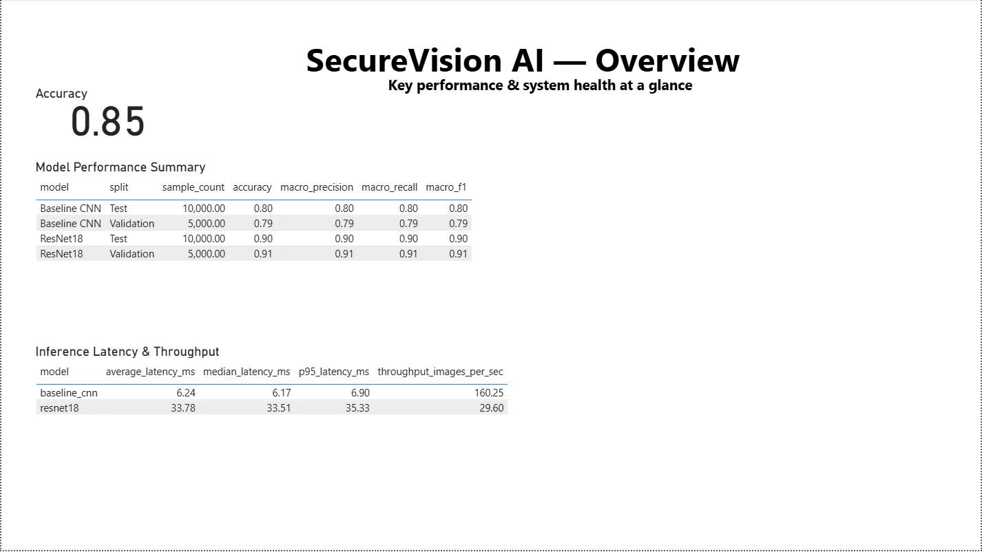
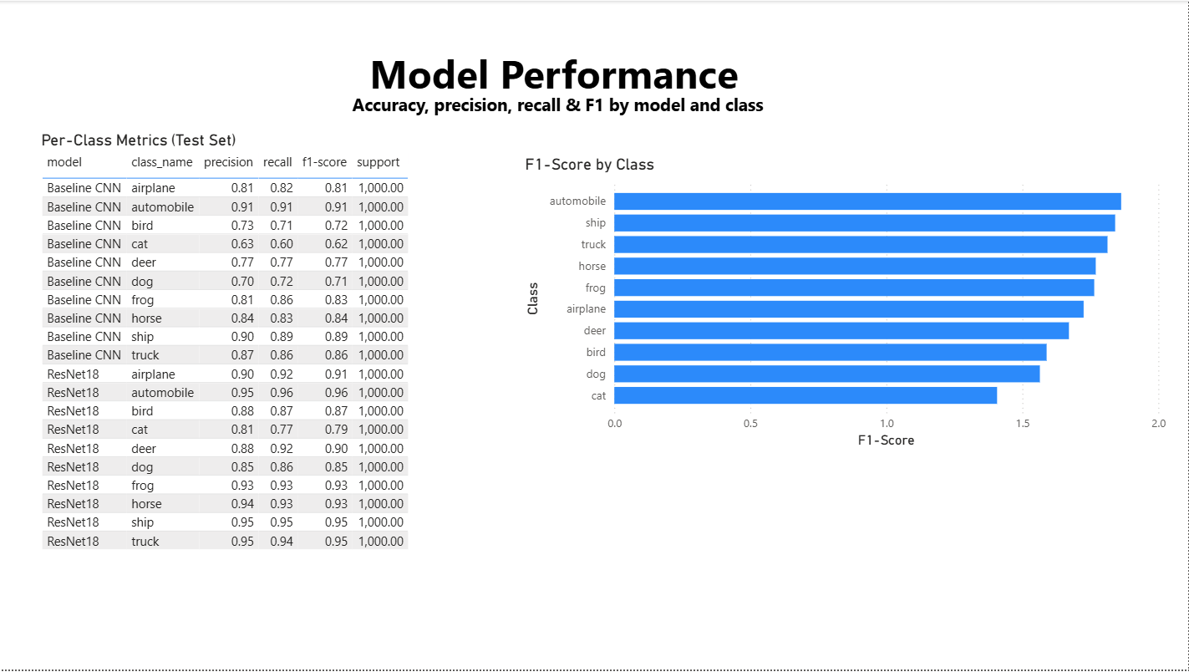
7. Power BI Dashboard: Overview & Model Performance
DASHBOARD PAGE 1 · OVERVIEW
DASHBOARD PAGE 2 · MODEL PERFORMANCE
ResNet18 reaches 0.90 test accuracy against 0.80 for the Baseline CNN, but averages 33.78 ms per image vs 6.24 ms (29.6 vs 160.3 images/s).
Per-class precision, recall and F1 on the test set. Cat is the weakest class for both models (F1 0.62 baseline, 0.79 ResNet18); automobile is the strongest.
Machine Learning Lab – Final Exam Project

Slide 9
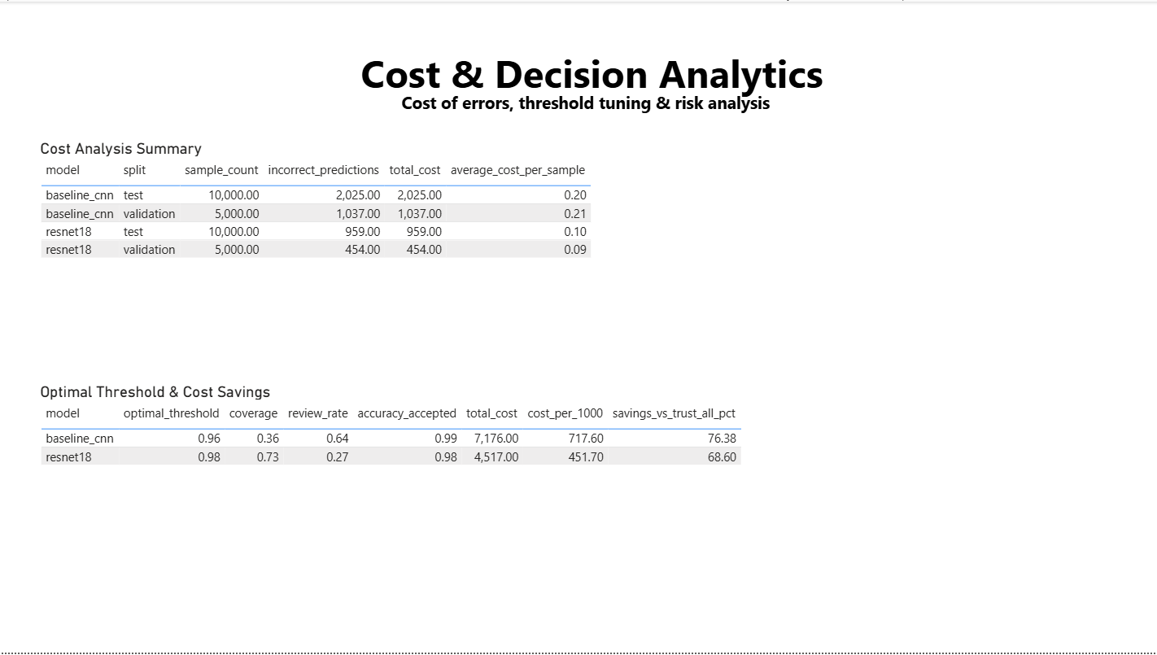
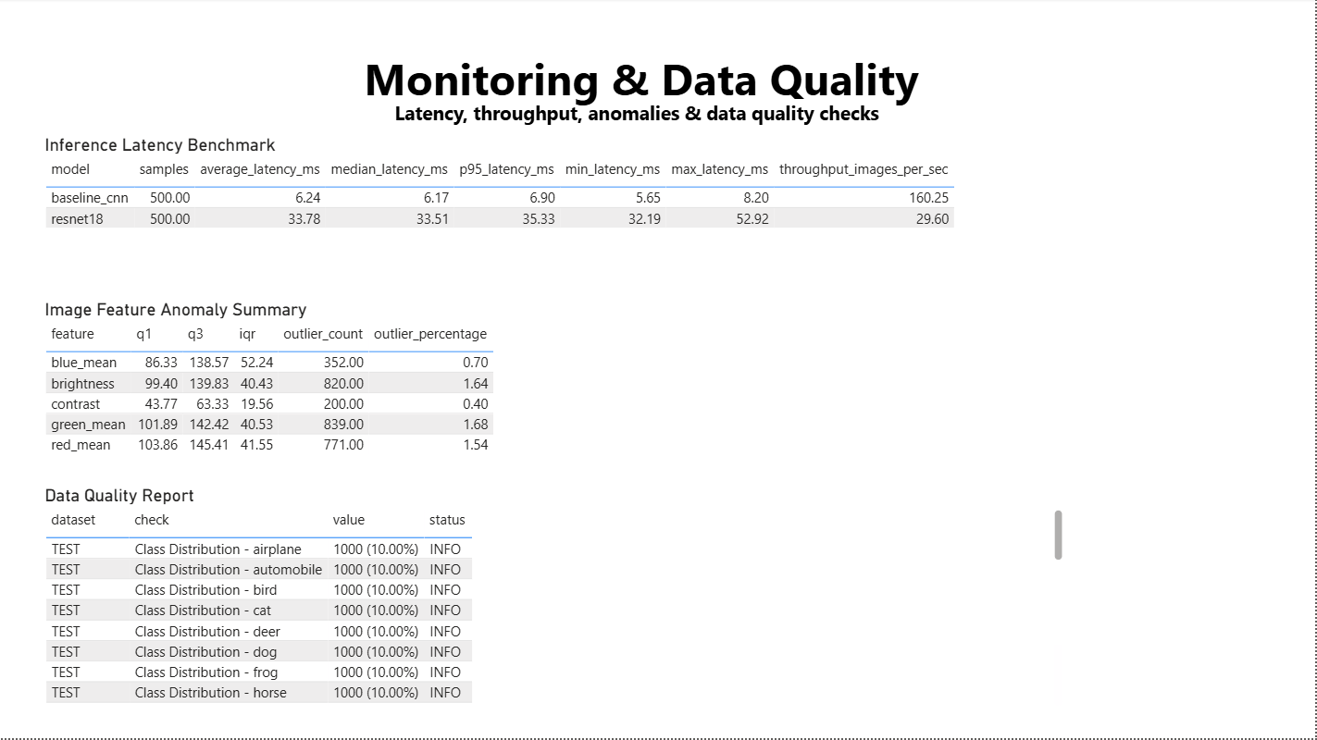
7. Power BI Dashboard: Cost & Data Quality
DASHBOARD PAGE 3 · COST & DECISION ANALYTICS
DASHBOARD PAGE 4 · MONITORING & DATA QUALITY
Average error cost is 0.10 per sample for ResNet18 vs 0.20 for the baseline. At threshold 0.98, ResNet18 auto-accepts 73% of images and saves 68.6% vs trusting every prediction.
Latency benchmark over 500 samples (ResNet18 p95 35.33 ms vs 6.90 ms). IQR checks flag 0.4–1.7% of images per feature; classes stay balanced at 1,000 per class.
Machine Learning Lab – Final Exam Project

Slide 10
8. Live Demo
1
Launch
SAMPLE PREDICTION RECORDS (RESNET18, TEST SET)
streamlit run app.py from the repo root. Tabs: Predict, Project Metrics, About Project.
Sample 5604: correct
True: automobile Predicted: automobile
Confidence: 1.000
2
Input
Pick Baseline CNN or ResNet18 and upload a 32×32-compatible image.
3
Preprocess
Sample 2405: wrong but confident
True: cat Predicted: frog
Confidence: 1.000
Check shape is 32×32×3, divide by 255, standardize with CIFAR-10 mean/std.
4
Predict
Forward pass, softmax over 10 classes, take the top class.
HOW TO READ THE OUTPUT
Confidence is the softmax maximum. ResNet18 averages 0.964 when correct and 0.750 when wrong, so a high score is helpful but not a guarantee.
5
Output
Predicted class, confidence and latency; latency is logged to prediction_log.csv.
Machine Learning Lab – Final Exam Project
Notes:
Suggested presenter: Preetham M (ML Engineer). Run `streamlit run app.py` from the repo root before presenting. Take screenshots of the Predict tab as backup: the repo does not contain any. Example values on the right come from data/processed/batch_predictions.csv (ResNet18, test split). Note: prediction_log.csv still holds two ResNet18 rows at confidence about 0.12; do not use those for the demo.

Slide 11
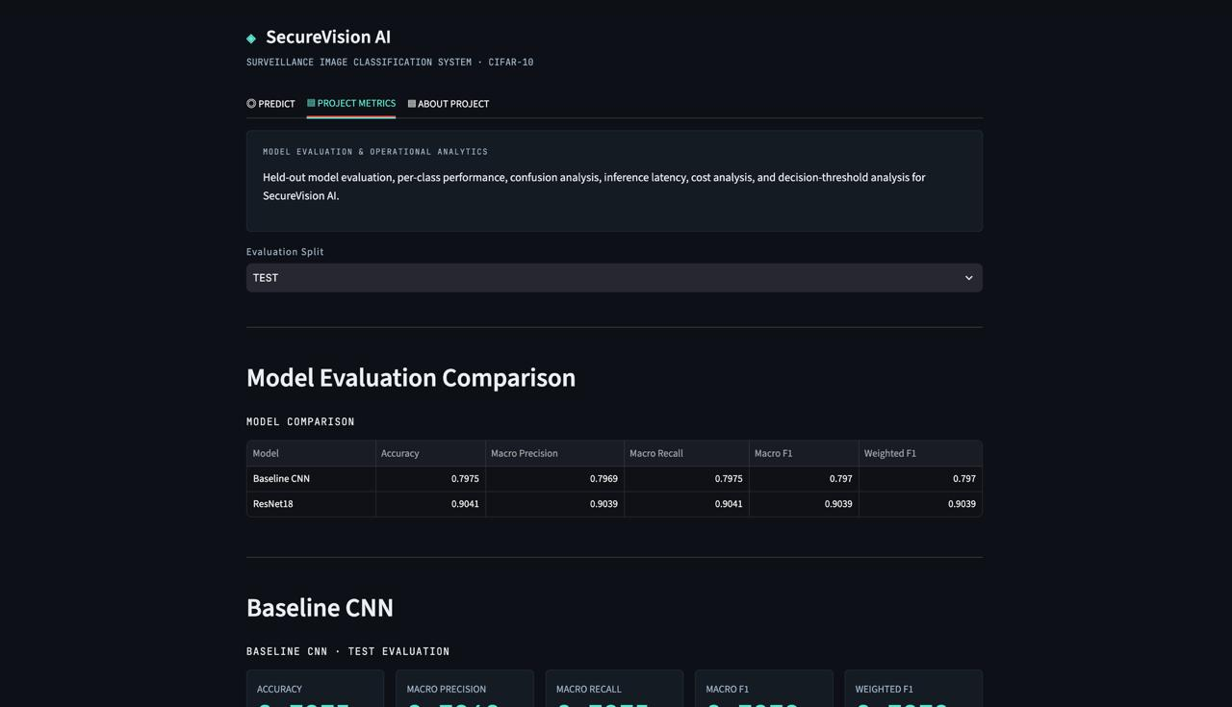
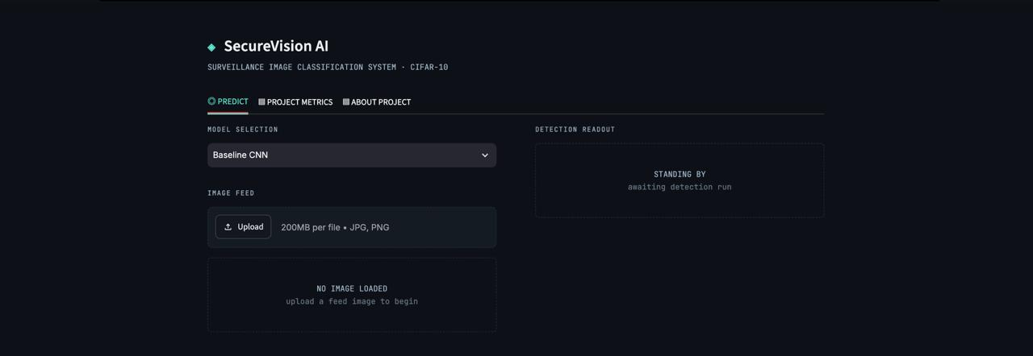
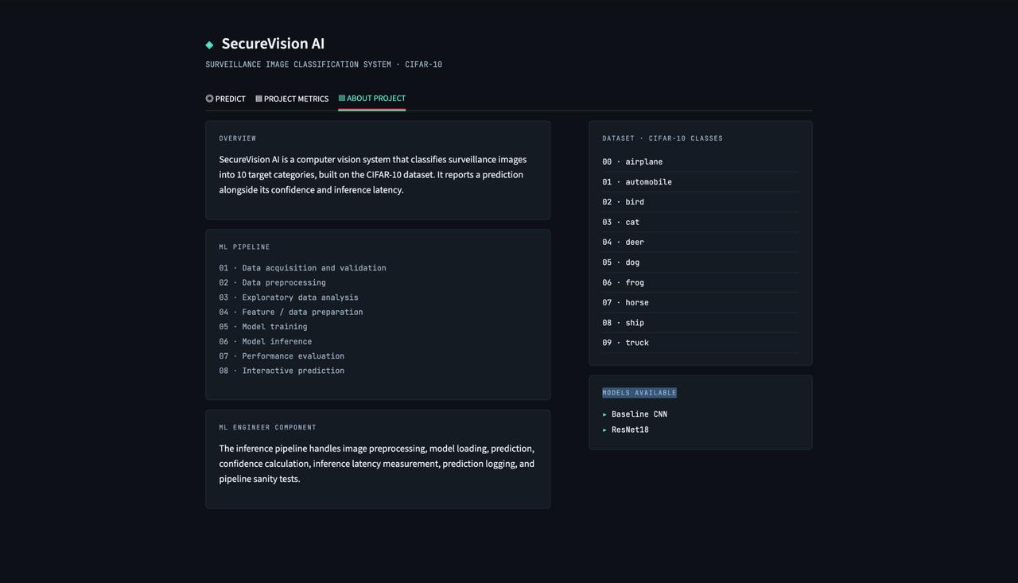
8. Live Demo: Streamlit App Tabs
PROJECT METRICS TAB · MODEL EVALUATION & ANALYTICS
PREDICT TAB · UPLOAD & DETECT
ABOUT PROJECT TAB
Held-out evaluation for both models: comparison table, per-class performance, confusion matrices, latency, cost and decision-threshold analysis.
Machine Learning Lab – Final Exam Project

Slide 12
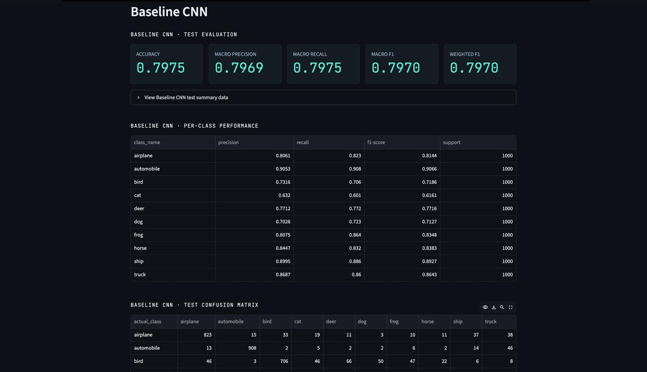
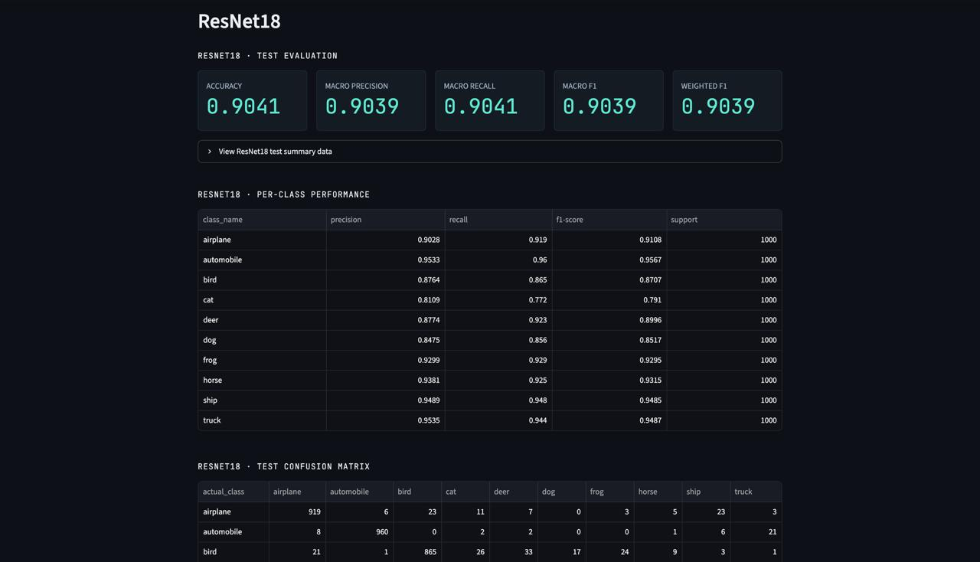
8. Live Demo: Model Evaluation in the App
BASELINE CNN · TEST EVALUATION
RESNET18 · TEST EVALUATION
Test accuracy 0.7975 and macro F1 0.7970, with per-class performance and a confusion matrix below. Cat is the weakest class (F1 0.6161).
Test accuracy 0.9041 and macro F1 0.9039. Every class improves over the baseline; cat rises to an F1 of 0.791.
Machine Learning Lab – Final Exam Project

Slide 13
9. Challenges & Improvements
WHAT WENT WRONG AND HOW WE FIXED IT
CURRENT LIMITATIONS
ResNet18 gave random-looking predictions in the app. It is a subclassed Keras model whose variables were not built before loading weights. Fix: run a dummy forward pass first. prediction_log.csv still has ResNet18 rows at confidence 0.12 (chance is 0.10).
CIFAR-10 is not surveillance data
Cat F1 is only 0.791; cats and dogs get confused
Some errors are made with very high confidence
No hyperparameter tuning; one run per model
Cost figures are placeholder assumptions
Raw dataset too large for GitHub. The ~162.6 MB archive lives outside the repo; download_data.py fetches it.
Import and path errors. Code must run from the repo root and expects the data in a sibling folder (README, Common Issues).
WITH MORE TIME OR DATA
Train on a domain-specific surveillance dataset
Calibrate confidence and test robustness (blur, lighting, compression, occlusion)
Tune hyperparameters; add experiment tracking and CI tests
Monitor data and confidence drift
Accuracy vs speed. ResNet18 gains 10.66 points but is 5.4× slower.
Machine Learning Lab – Final Exam Project
Notes:
Suggested presenters: Reyaan and Preetham M. The bug story comes from commits d13a572 and e06a59e. The repo does not document other failed experiments; add any your team remembers, since the template asks 'what approaches did not work'.

Slide 14
10. Team Contribution, Learning & Conclusion
Member | Role | Contribution
Reyaan 241BCADA54 | Data Engineer | Ingestion, validation, preprocessing, quality and leakage checks
Prithvi 241BCADA66 | Data Analyst | EDA, distributions, image statistics, insights
Tarun 241BCADA03 | Data Scientist | CNN and ResNet18 models, training strategy, ML analysis
Preetham M 241BCADA72 | ML Engineer | Training integration, model artifacts, inference pipeline
Jason 241BCADA16 | Analytics Engineer | Metrics, cost matrix, threshold and Type I/II analysis
Tusharr 241BCADA29 | BI Developer | Dashboard, visualizations, KPI reporting
LEARNED
Accuracy alone is not enough: ResNet18 adds 10.7 points but is 5.4× slower. Data checks come before modeling.
CONCLUSION
ResNet18 selected: 0.9041 accuracy and 0.9039 macro F1 vs 0.7975 and 0.7970 for the baseline.
VALUE & NEXT STEPS
An academic, end-to-end ML lifecycle demo, not a production system. Next: surveillance-domain data, calibration, robustness tests.
GitHub Repository: https://github.com/Preetham-1064/secure-vision-ai
Machine Learning Lab – Final Exam Project
Notes:
All members present. Roles and responsibilities are taken from the README 'Team Responsibilities' table. Learnings are derived from the measured results, not quoted from the repo.

