Slide 1
Order Management & Supply Solutions
(Walmart - Inspired Project)
Preetham KS — Supply Chain Analytics Project
Generated: 2025-09-16 08:48

Slide 2
Objective & Datasets
Objective:
- Monitor demand vs forecast, track PO lifecycle, and detect supply disruptions.
Datasets:
- forecast_vs_actual.csv
- purchase_orders.csv
- supply_interruptions.csv
- inventory_snapshot.csv

Slide 3
Key KPIs
- Forecast Accuracy
- PO On-Time %
- Delayed PO Count
- Fill Rate
- Inventory Coverage Days

Slide 4
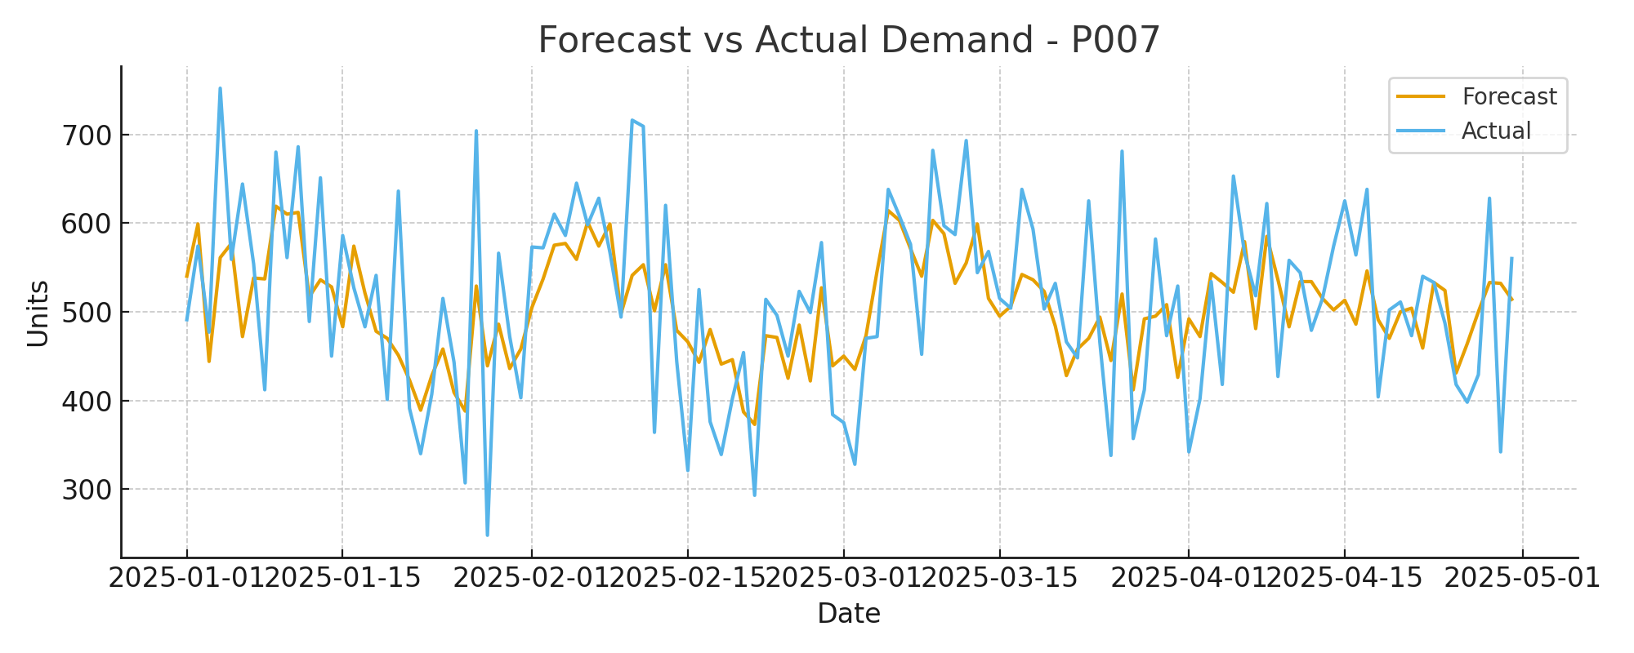
Forecast vs Actual — P007

Slide 5
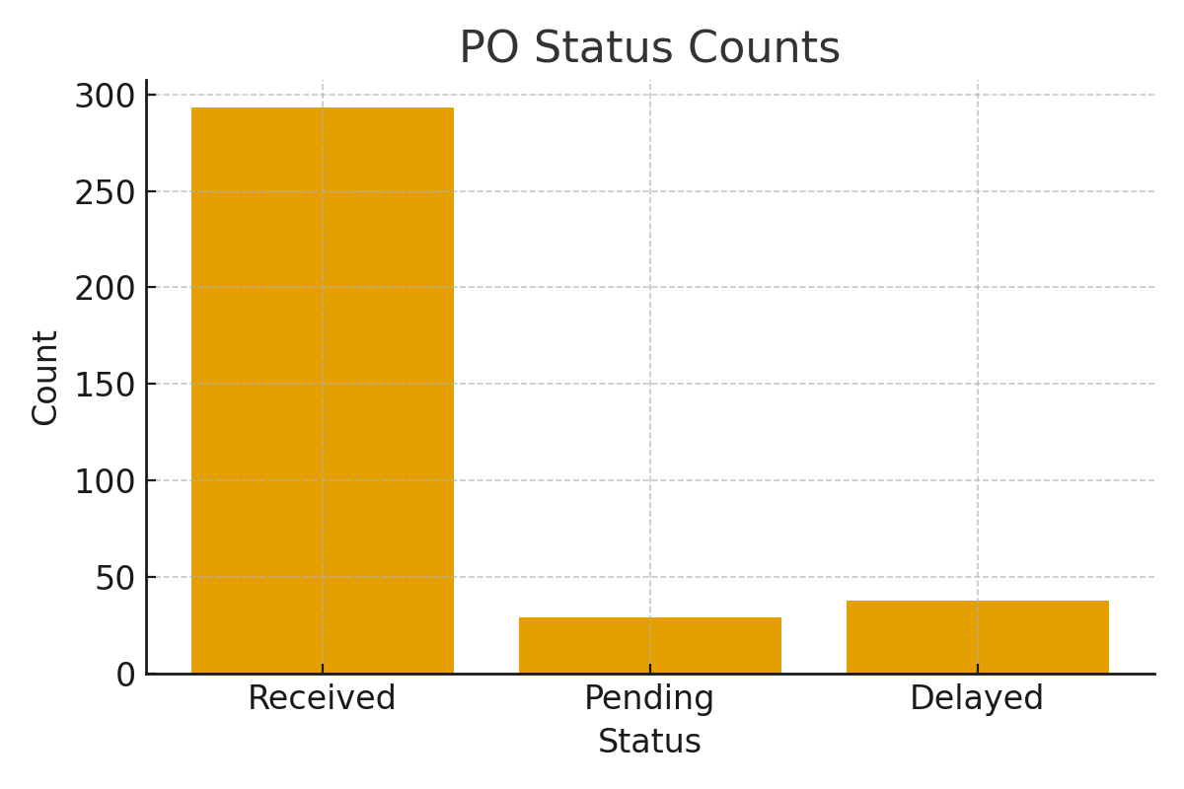
PO Status Overview

Slide 6
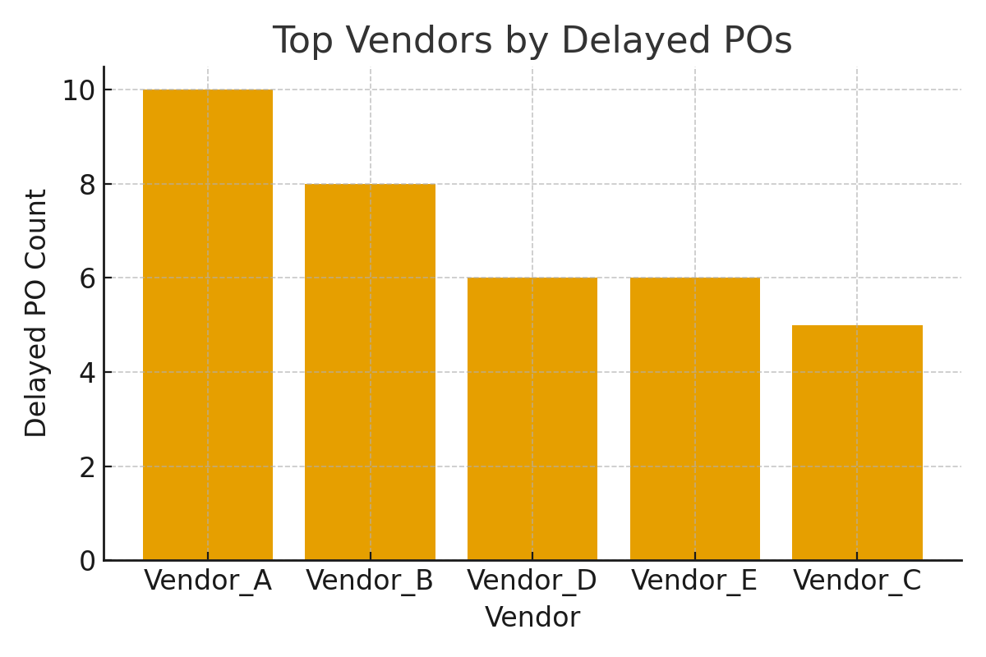
Top Vendors by Delayed POs

Slide 7
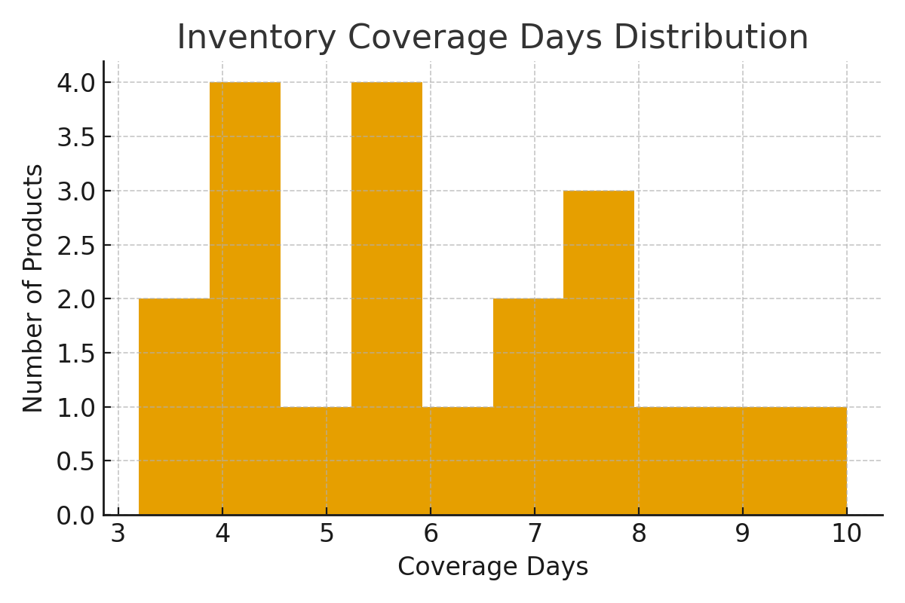
Inventory Coverage Distribution

Slide 8
SOP & Automation Ideas
- Daily data ingestion and validation
- Exception rules: flag delayed PO, low forecast accuracy
- Alerts via Power Automate for >7 day delays
- Weekly stakeholder report with top issues

Slide 9
2-minute Interview Script
Tell: I built an Order Management Analytics project inspired by Walmart to monitor demand vs forecast, track PO lifecycle, and detect supply disruptions.
Show: I created KPIs (Forecast Accuracy, PO On-Time %, Delayed POs), dashboards (Forecast vs Actual, PO Status, Vendor Delays).
Impact: This helps reduce stockouts, prioritize delayed POs, and escalate risks to supply managers.
Tools: SQL, Excel, Power BI.

Slide 10
Files & Next Steps
Files created in /mnt/data:
- CSVs: forecast_vs_actual.csv, purchase_orders.csv, supply_interruptions.csv, inventory_snapshot.csv
- SOP_Order_Management.txt
- sql_queries.txt
- power_bi_instructions.txt
- PPTX: project_outputs/Order_Management_Project_Presentation.pptx
Next steps: Build .pbix in Power BI using these CSVs; I can also create detailed measures/DAX on request.

