Slide 1



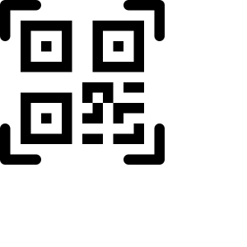






SMART MESS AUTOMATION SYSTEM
PROTOTYPE • PHASE 1
V1.1 Prototype: From Signup to QR Mess Credential
What happens, screen by screen, between a student opening the signup page and holding a working QR mess card.
1
2
3
4
5
Signup
Verify Email
Onboarding
Generate QR
Dashboard
University email only (@uohyd.ac.in), validated client + server side
Confirmation link sent — student opens their inbox from the same screen
Mandatory profile: ID, hostel, course, year, semester, photo
One click creates an opaque, zero-PII token — idempotent, no duplicates
Role-based redirect — QR ready to view, save or print
UNDER THE HOOD
Next.js 14 (App Router)
Supabase Auth
PostgreSQL + RLS
12 Messes
Client + server-rendered
PKCE + email confirmation link
Row-level security enforced
Mapped from 24 hostels
github.com/PreethamCodes/smart_mess_system
QR scanning, billing, leave & admin controls follow in later phases

