Slide 1
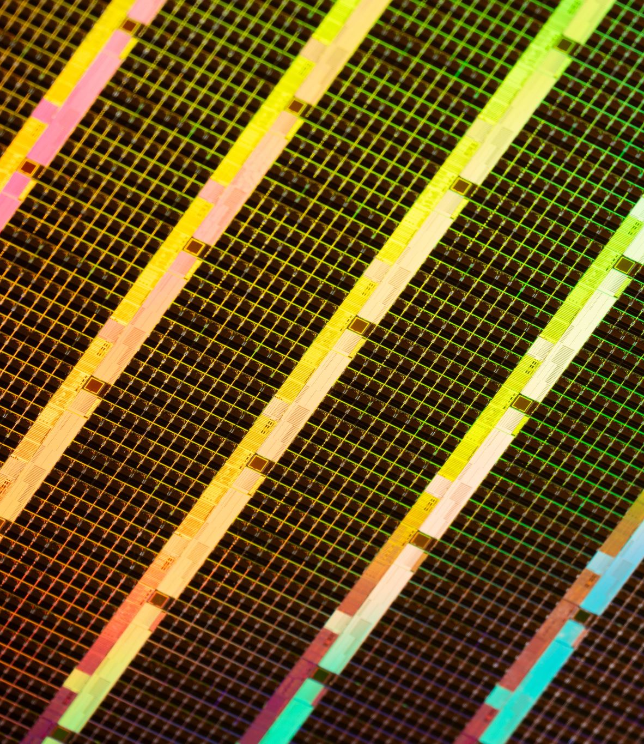
Energy‑Efficient Wireless Network Simulator
Visual overview: Topology, Architecture, RL concept, Energy States, and Dashboard

Slide 2
Agenda
Concept Overview
2. Architecture & Models
Topology
Channel modelling
Energy state & reinforcement learning
Dashboard & Results
Evaluation & Future work

Slide 3

Why this matters
Dense 5G/6G increases network energy use.
Static allocation wastes power during low demand.
Design a realistic simulator and evaluate RL-based resource allocation to improve energy efficiency under QoS constraints..

Slide 4

Radio
Model the real link: path loss (distance), shadowing (obstacles), fading (multipath), mobility, and inter-cell interference.
Compare
Baselines: Round Robin (RR) and Proportional Fair (PF), with static power and simple threshold-based sleep.
Power
Energy model: active power = idle overhead + load term; plus micro-sleep and deep sleep with wake-up costs and latencies.
RL policy sees load, queues, CQI, and power state, then decides sleep/power and gives allocation hints; all methods run on the same scenario for fair comparison.
Every TTI, compute SINR per PRB, map SINR → CQI → MCS to estimate each user’s achievable rate and errors.
Guardrails keep QoS (95th-percentile latency and loss) within limits; dashboard shows power vs load, energy breakdown, and efficiency trends.
SINR: Signal-to-Interference-plus-Noise Ratio
CQI: Channel Quality Indicator
MCS: Modulation and Coding Scheme
PHY: Physical layer
PRB: Physical Resource Block
TTI: Transmission Time Interval
PF/RR: Proportional Fair / Round Robin
RL/QoS: Reinforcement Learning / Quality of Service

Slide 5
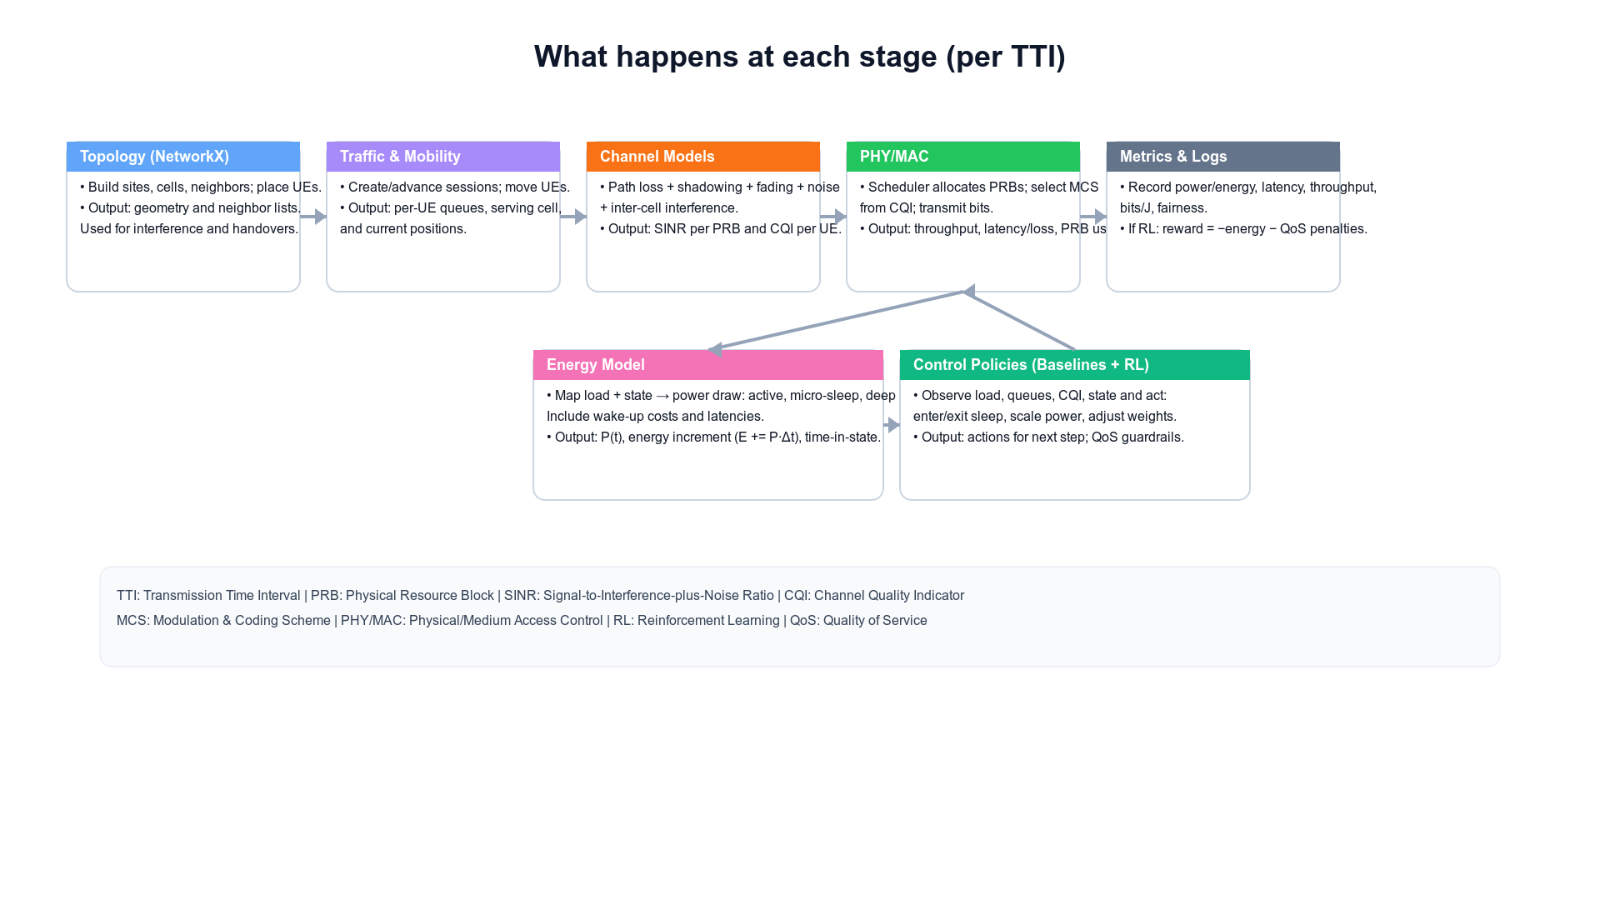
Architecture (modular & pluggable)
Topology → Traffic/Mobility → Channel → MAC/PHY → Energy Model → Control → Metrics

Slide 6
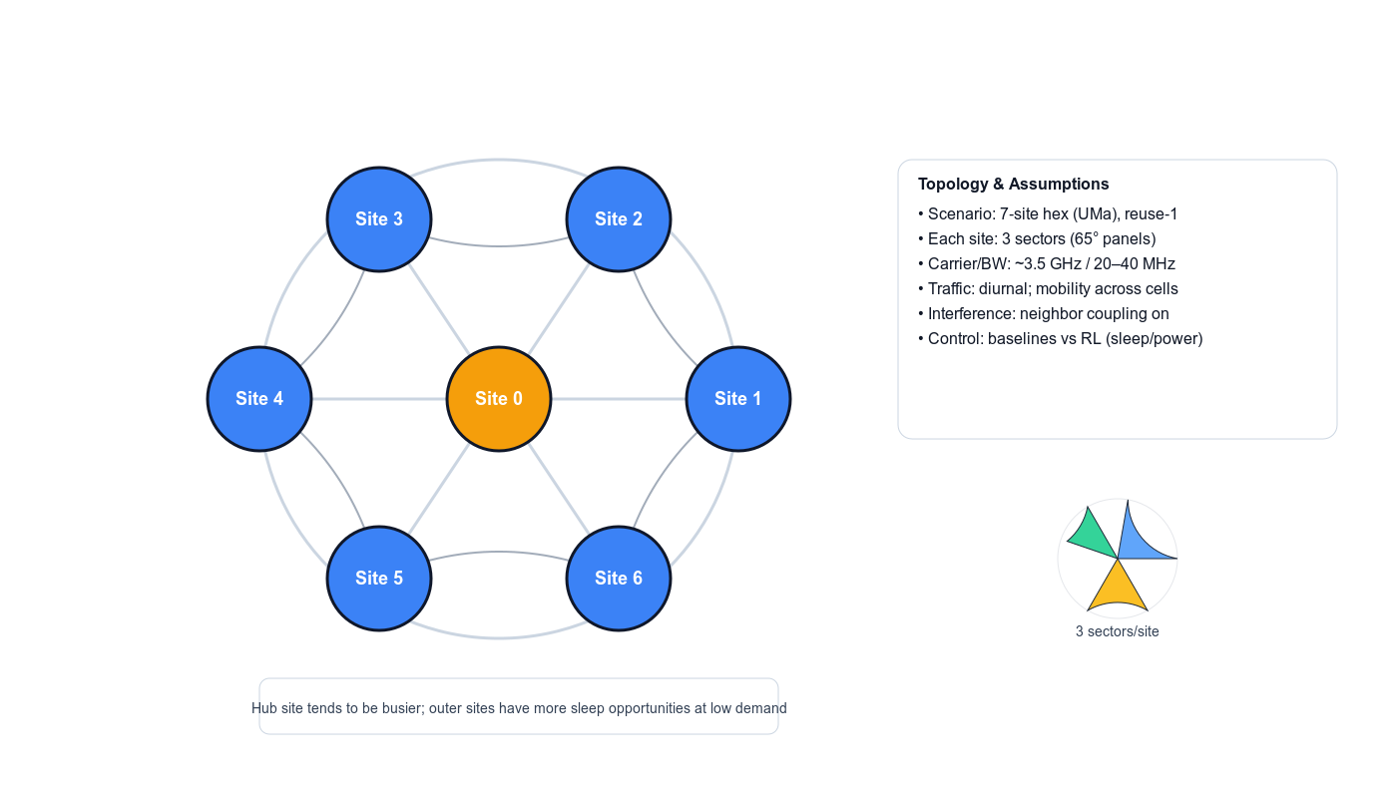
Topology & Assumptions
7‑site hex (reuse‑1), mobility and interference shown. Each site has 3 sectors. RL controls sleep/power with QoS guardrails.

Slide 7
Channel modeling (3GPP‑style)
Path loss : Distance/frequency attenuation. Shadowing: Slow obstacle‑induced variation. Small‑scale fading: Fast multipath changes.
Per‑slot pipeline: Compute Signal to Interface plus Noise Ratio → Quantize to Channel Quality Indicator → Pick Modulation and Coding Scheme → Derive achievable rate for scheduled RBs.
Sufficient realism for energy/QoS studies without full Physical Layer.

Slide 8
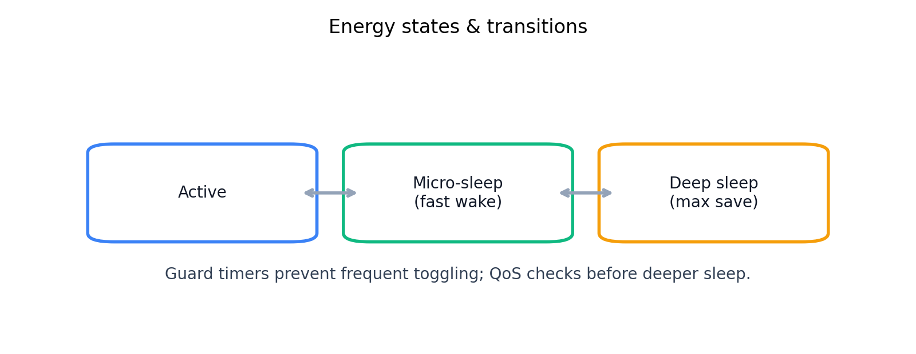
Energy states & transitions
Active ↔ Micro‑sleep ↔ Deep sleep; guard timers and QoS checks before deeper sleep.

Slide 9
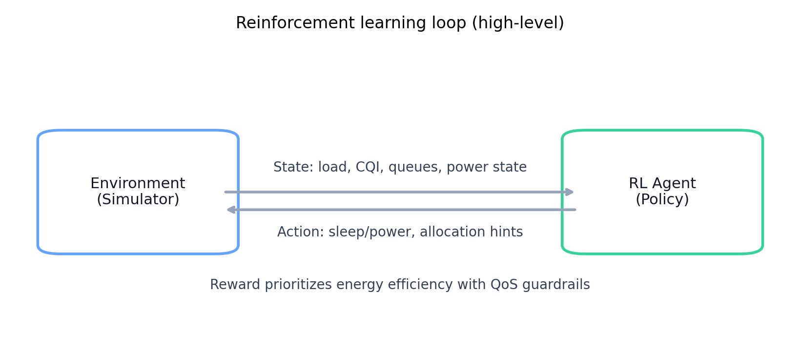
Reinforcement learning loop
Agent observes state and chooses actions (sleep/power/allocation) to reduce energy while respecting QoS.

Slide 10
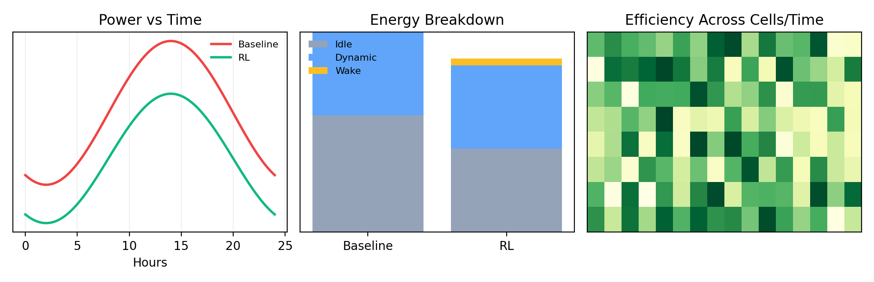
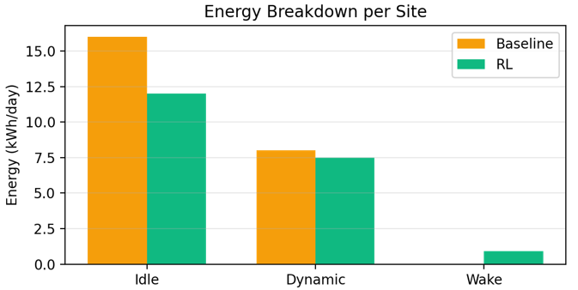
Dashboard views
Time series, energy breakdown, and efficiency heatmap for transparent analysis.

Slide 11
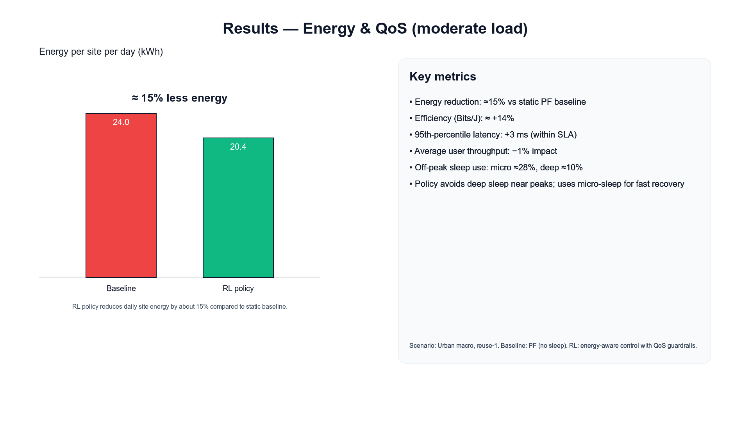

Slide 12
Evaluation & next steps
Baselines:Round Robin (RR) and Proportional Fair (PF), threshold sleep vs RL policy.
Scenarios: light/moderate/peak loads; mobility present.
Next: calibrate models, train policy, and compare visually.
Expectation: noticeable off‑peak energy savings without QoS regressions.

