Slide 1
A Hybrid Deterministic-Probabilistic
Security Framework for Edge IoT Networks
Using Optimized Isolation Forests and Signature Fusion
Pretham N N | M.Tech, Computer Network Engineering
Department of Information Science and Engineering
BMS College of Engineering, Bengaluru
Guide: Dr. H S Guruprasad, Professor, Dept. of ISE, BMSCE
Academic Year: 2025–2026

Slide 2
Agenda
01
Background & Problem Statement
02
Literature Review & Research Gaps
03
System Architecture
04
Feature Engineering & Preprocessing
05
Machine Learning Methodology
06
Hybrid Score Fusion Engine
07
Implementation & Container Hardening
08
Results, Analysis & Edge Performance
09
MLOps & Drift Detection
10
Limitations, Future Work & Conclusion

Slide 3
Background & Problem Statement
15B+
14–28
Mirai
3 Gaps
IoT Devices Globally
by 2030
Days avg. signature
publication delay
Botnet — canonical
IoT LAN threat
Detection · Edge ·
Operational Resilience
Detection Gap
Edge Deployment Gap
Operational Resilience Gap
Signature IDS: high precision on known threats but zero recall on zero-days.
ML-only models: broad generalization but unacceptable false-positive rates.
Most hybrid IDS research targets cloud infrastructure. IoT requires edge-local processing for latency, bandwidth, and data privacy constraints.
Deployed ML models degrade silently as traffic distributions evolve. No existing IoT IDS integrates MLOps drift detection with automated retraining.
Our Solution: Containerised Hybrid IDS on Raspberry Pi 4 — combining Zeek/Suricata + Isolation Forest Ensemble + XGBoost + Formal Score Fusion + MLOps Drift Monitoring

Slide 4
Review of Literature & Research Gaps
Signature-Based IDS
ML Anomaly Detection
Supervised Classifiers
Hybrid & Edge IDS
Kolias et al. (2017) — Mirai mechanics
Liu et al. (2008, 2012) — Isolation Forest
Sharafaldin et al. (2018) — CICIDS2017
Shi et al. (2016) — Edge computing
Paxson (1999) — Zeek/Bro architecture
Hariri et al. (2021) — Extended IF
Moustafa & Slay (2015) — UNSW-NB15
Yang et al. (2022) — IoT edge anomaly
Zarpelão et al. (2017) — IoT IDS survey
Şahin et al. (2021) — RobustScaler for IDS
Hassan et al. (2020) — Hyperparameter opt.
Gong et al. (2021) — Hybrid ML IDS
Gap: Zero-day blind spot (14–28 day lag)
Gap: High FPR without confidence fusion
Gap: Label dependency, distribution shift
Gap: No formal fusion + MLOps on ARM HW
✓ Our Work fills ALL four gaps: Hybrid detection + ARM edge hardware + formal confidence fusion + PSI-based MLOps monitoring

Slide 5
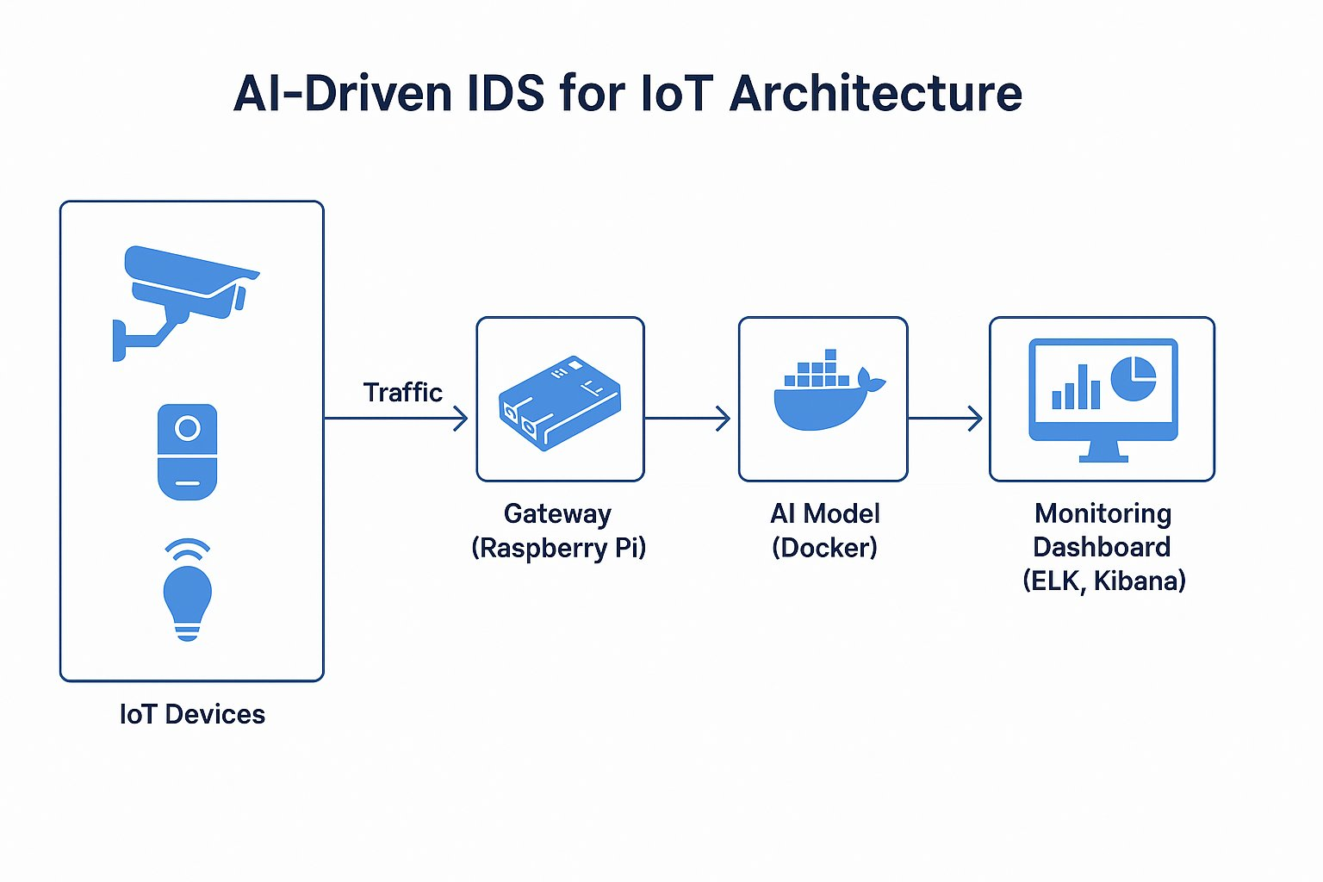
System Architecture — Four-Layer Design
Layer 1
IoT LAN
Cameras · Sensors · Plugs
Layer 2
Edge Gateway (Pi 4)
libpcap · eBPF · Zeek · Suricata
Layer 3
AI Inference (Docker)
FastAPI · gRPC · IF + XGBoost
Layer 4
ELK Stack
Logstash · ES · Kibana

Slide 6
Feature Engineering — 21-Feature Taxonomy
Base Network
Volume Metrics
Ratio Metrics
Intensity Metrics
Statistical & Binary
src_port P_src ∈ [0,65535]
total_bytes = B_sent + B_recv
bytes_ratio = B_sent/(B_recv+ε)
bytes_per_second = B_total/(T+ε)
log_duration = ln(T_flow+1)
dst_port P_dst ∈ [0,65535]
total_packets = N_sent + N_recv
packets_ratio = N_sent/(N_recv+ε)
packets_per_second
log_total_bytes = ln(B_total+1)
duration T_flow = t_end−t_start
bytes_per_packet_src / dst
avg_packet_size
sqrt_total_packets = √N_total
src_bytes / dst_bytes
port_ratio = P_src/(P_dst+ε)
is_well_known_src/dst_port
src_pkts / dst_pkts
tcp_flags_count / has_dns / has_http
ε = 1×10⁻⁸ floor prevents division-by-zero | Log & sqrt transforms stabilise skewed IoT traffic distributions | Binary indicators capture port privilege context

Slide 7
Preprocessing — Scaler Comparative Analysis
StandardScaler
MinMaxScaler
RobustScaler
z = (x − μ) / σ
x' = (x − x_min) / (x_max − x_min)
x' = (x − median) / IQR
IQR = Q3 − Q1
DDoS streams inflate σ, compressing normal traffic variance. Benign flows misclassified as anomalies.
Single large DDoS flow collapses all normal traffic metrics toward zero. Extreme range sensitivity.
Immune to outlier values. Preserves normal traffic variance. Directly contributed +26.97% accuracy gain.
FAILED
FAILED
OPTIMAL +26.97%

Slide 8
Machine Learning — Isolation Forest Formulation
Mathematical Foundation
Anomalies are Rare
Short Path = Anomaly
Few instances, statistically different from normal behaviour — isolated by fewer random binary partitions.
Anomalous flows reach leaf nodes in 2–4 splits. Normal flows require 8–15 splits. Score normalised to [0,1].
Anomaly Score
s(x, n) = 2^[ -E[h(x)] / c(n) ]
Score → 1.0 means anomalous
Path Length Normaliser
c(n) = 2H(n−1) − 2(n−1)/n
O(n log ψ) Complexity
No Labels Required
Average BST search length
Subsampled trees of size ψ give O(t·n·log ψ) time complexity. Suitable for ARM edge hardware at 1.8 GHz.
Fully unsupervised — detects zero-day threats without any labelled attack examples. Essential for IoT deployment.
Harmonic Approx.
H(i) ≈ ln(i) + 0.5772
Euler–Mascheroni constant

Slide 9
Hyperparameter Optimisation — Grid Search Results
Grid Search Space
Accuracy Improvement from Optimisation
Parameter
Values Searched
Optimal
Contamination α
{0.05, 0.10, 0.15, 0.20, 0.25, 0.30}
0.25
Max Samples
{0.5, 0.6, 0.7, 0.8, 0.9, 'auto'}
0.9
n_estimators
{50, 100, 200}
100
Why α = 0.25?
Active IoT LANs under botnet exposure exhibit 20–30% ambient anomaly density — far higher than the enterprise default of 10%. Setting α=0.25 correctly sizes the decision boundary to this threat density.
Why max_samples = 0.9?
IoT traffic is highly repetitive (same device types repeat similar flows). Broad per-tree subsampling allows individual estimators to capture high-density behavioural clusters.

Slide 10
Ensemble Isolation Forest & Supervised Classifiers
Ensemble — 5 Diverse IF Models
Supervised Classifiers
Model
α
max_samples
max_feat
Seed
XGBoost
Model 1
0.10
0.7
0.8
42
• max_depth = 6
• learning_rate = 0.1
• n_estimators = 100
Model 2
0.15
0.8
0.9
43
• subsample = 0.8
• colsample_bytree = 0.8
Model 3
0.08
0.6
0.7
44
• Early stopping on logloss (20% val. split)
99.59% Accuracy
Model 4
0.12
0.9
1.0
45
CatBoost
Model 5
0.20
0.5
0.6
46
• iterations = 100
• learning_rate = 0.1
Majority Vote Decision Rule:
• depth = 6
ŷ_ensemble = 𝕀( (1/5) × Σ ŷ_m ≥ 0.5 )
• loss_function = Logloss
• eval_metric = AUC
Alternative for categorical fields

Slide 11
Hybrid Score Fusion Engine — Mathematical Design
Score Fusion Engine
Severity Verdict
Signature Engine
(Zeek / Suricata)
S_threat
= w_sig × S_sig + w_ml × S_ml
CRITICAL
S_sig score + |R| rules
w_sig=0.6, w_ml=0.4
S_threat ≥ T_high
S_sig
= min(1.0, max(c_i) + δ × (|R|−1))
HIGH
δ = 0.05 multi-match boost
S_threat ≥ T_med
ML Ensemble
(IF + XGBoost)
S_ml
= (1/|P|) × Σ A_p
MEDIUM
S_ml = avg(A_p)
Mean of active model scores
S_threat ≥ T_low
C
= C_base + Δ_sig + Δ_ml + Δ_extreme
LOW
Confidence score [0,1]
otherwise
T_low=0.3 · T_med=0.6 · T_high=0.8 → thresholds dynamically adjusted by confidence C

Slide 12
Container Hardening & MLOps Drift Detection
Docker Container Hardening (CIS Benchmark)
MLOps Drift Detection Pipeline
Capability Whitelist
Read-Only Filesystem
PSI = Σᵢ [ (P_actual,i − P_expected,i) × ln(P_actual,i / P_expected,i) ]
cap_add: [NET_ADMIN, NET_RAW]
All other capabilities DROPPED
read_only: true
tmpfs: [/run, /tmp]
PSI < 0.1
Stable
No action needed.
Model performing normally.
Privilege Escalation Block
mTLS Inter-Service
security_opt: [no-new-privileges: true]
Prevents setuid binary escalation
All gRPC traffic encrypted
Mutual TLS certificate validation
PSI 0.1–0.2
Warning
Minor drift detected.
Monitor closely.
PSI > 0.2
Model Decay
Trigger auto-retrain.
Distribution significantly shifted.
Also: Kolmogorov–Smirnov (KS) test + Jensen–Shannon (JS) divergence • Monitoring cadence: every 24 hours

Slide 13
Experimental Setup & Dataset
Hardware Platform
Software Stack
Dataset
Device
⬡ Python 3.10
211,043
Raspberry Pi 4
⬡ Scikit-learn 1.3
Network Flow Records
CPU
⬡ XGBoost 1.7
ARM Cortex-A72
4-core @ 1.8 GHz
80/20
⬡ FastAPI 0.103
Stratified Train/Test Split
RAM
4 GB LPDDR4
⬡ Docker 24.0
Attack Categories:
OS
⬡ Zeek + Suricata
▸ Mirai Botnet
▸ Port Scan Recon
64-bit Raspberry Pi OS
⬡ Elasticsearch 8.x + Kibana
▸ Volumetric DDoS
▸ Brute-Force SSH/Telnet
▸ Benign Baseline

Slide 14
Results & Analysis — Model Performance Comparison
+26.97%
+39.92%
+28.12%
99.59%
Accuracy Gain
(Baseline→Optimised IF)
Recall Improvement
F1-Score Gain
XGBoost Accuracy
(Supervised)
Model | Accuracy % | Recall % | Precision % | F1 % | Paradigm
Baseline Isolation Forest | 54.13 | 43.05 | 93.15 | 58.89 | Unsupervised (α=0.10, No Scale)
Optimised Isolation Forest | 81.10 | 82.97 | 91.48 | 87.01 | Unsupervised (α=0.25, RobustScaler)
Ensemble Isolation Forest | 81.10 | 82.97 | 91.48 | 87.01 | Majority Vote (M=5, RobustScaler)
Supervised XGBoost | 99.59 | 99.50 | 99.65 | 99.57 | Supervised Classifier
Statistical Validation — McNemar's Test: χ² = 214.7 (p < 0.0001) | 95% CI for Optimised IF F1: [86.3%, 87.7%] | Bootstrap resampling n=1,000

Slide 15
Edge Gateway Performance & Resource Footprint
1,200
<0.15s
38%
420 MB
flows/sec
latency
CPU usage
RAM used
Sustained Throughput
End-to-End Inference
Per Flow (Max Load)
Average Under
Full Load
Out of 4 GB Available
(10.3% utilisation)

Slide 16
Limitations & Future Directions
Current Limitations
Future Directions
Encrypted traffic (TLS/QUIC) reduces feature diversity — payload-blind detection only
eBPF/XDP Acceleration
01
Kernel-bypass processing targeting 10,000+ flows/sec on gigabit interfaces
Adversarial evasion: attacker aware of α=0.25 could craft flows to evade IF boundary
Federated Learning
02
Privacy-preserving distributed training across multiple edge gateways
Small-scale LAN (10 IoT devices) — larger multi-vendor deployments may differ
Adversarial Robustness
03
Evaluate and harden against crafted evasion flows using adversarial ML
Labelled retraining required as novel attack families emerge for XGBoost model
6G & NB-IoT Support
04
Extend Zeek decoders to cover emerging IoT communication protocols
Static 5-tuple flow key — application-layer context not captured
XAI / SHAP Analysis
05
Generate human-readable alert explanations using Shapley values on XGBoost

Slide 17
Conclusion
Containerised Hybrid IDS
21-Feature Taxonomy
Hyperparameter Optimisation
01
Raspberry Pi 4 edge gateway integrating Zeek, Suricata, Isolation Forest ensemble, and XGBoost — first formally specified hybrid on ARM hardware
02
Mathematically derived feature set with ε-floor stabilisation, log/sqrt transforms, and binary IoT-specific indicators
03
Grid search raising IF accuracy 54.13% → 81.10% (+26.97 pp), statistically validated (χ²=214.7, p<0.0001)
Formal Score Fusion Engine
Production MLOps Pipeline
04
Confidence-adjusted hybrid threat scoring with dynamic severity classification — reduces alert fatigue
05
PSI + KS + JS drift monitoring with automated retraining triggers — first IoT IDS with operational lifecycle governance
This work demonstrates that production-grade hybrid IoT security with formal mathematical foundations is viable on constrained ARM edge hardware.

Slide 18
Key References
[1] F. T. Liu, K. M. Ting, Z.-H. Zhou, "Isolation Forest," ICDM, 2008.
[7] T. Chen, C. Guestrin, "XGBoost," ACM SIGKDD, 2016.
[2] C. Kolias et al., "DDoS in the IoT: Mirai and other botnets," IEEE Computer, vol.50, 2017.
[8] W. Shi et al., "Edge Computing: Vision and Challenges," IEEE IoT J., 2016.
[3] M. Antonakakis et al., "Understanding the Mirai Botnet," USENIX Security, 2017.
[9] T. Combe, A. Martin, R. Di Pietro, "To Docker or Not to Docker," IEEE Cloud Comput., 2016.
[4] S. Hariri, M. C. Kind, R. J. Brunner, "Extended Isolation Forest," IEEE TKDE, 2021.
[10] J. Gama et al., "A Survey on Concept Drift Adaptation," ACM Comput. Surv., 2014.
[5] I. Sharafaldin et al., "CICIDS2017 dataset," ICISSP, 2018.
[11] M. A. M. Vieira et al., "Fast Packet Processing with eBPF and XDP," ACM Comput. Surv., 2020.
[6] N. Moustafa, J. Slay, "UNSW-NB15 dataset," MilCIS, 2015.
[12] A. Khraisat et al., "Survey of IDS: Techniques, Datasets and Challenges," Cybersecurity, 2019.
Thank You · Questions Welcome
Pretham N N | preetham.scn24@bmsce.ac.in | Guide: Dr. H S Guruprasad

