Slide 1
Technical seminar on “Personality-Aware Product Recommendation System” By: G R Preetham(1BI19CS054) Under the Guidance of Prof. Pooja P. Professor Department of CSE,BIT

Slide 2
Agenda
Introduction
Literature Review
Proposed System
Applications
References

Slide 3
Introduction
*A personality-aware product recommendation system is an integral part of any modern online shopping or social network platform.
* The legacy recommendation systems rely only on the user’s previous buying behaviour to recommend new items.
* The proposed system is personality-aware from two aspects, it incorporates the user’s personality traits to predict his/her topics of interest and to match the user’s personality features with the associated items.
*Uses Meta-Interest, a personality-aware product recommendation system based on user interest mining and meta-path discovery.

Slide 4
Literature Review

Slide 5
1. “Customized Bundle Recommendation by Association
Rules of Product Categories for Online Supermarkets”[2]
Author : Yan Fang
Pub-year : 2018 IEEE Third International Conference on Data Science in Cyberspace
Proposed Idea
A customized bundle is a list of products recommended to consumers, among them they can choose his/her favourite products according to his/her preference.
It is realized by combinational using association rule mining, customer segmentation and recommendation techniques.
The association rules of product category are used to avoid mass unnecessary association rules of product.

Slide 6
Algorithms
In order to determine the categories of product preferred by each customer group, the Apriori algorithm is used.
The association rules are used to generate a serious correlated product categories for customers.
The algorithms of K-means and association rules are proposed by Liao as a bundling solution for marketing.
Limitations
Apriori algorithm is very slow and inefficient for large datasets.

Slide 7
2. “Similar Cluster recommendation of Product Purchases by Pages liked Analysis.”[3]
Author : Chantima Buaklee, Sukree Sinthupinyo,
Pub-Year : 2018 10th International Conference on Electronics, Computers and Artificial Intelligence (ECAI).
Proposed Idea
In this paper the main focus is on the correlation of purchasing histories and the customer’s interests on social network (i. e, on the Facebook Pages Liked ).
Based on customer’s interests on social network to predict the future interests of customers that would show through social network.

Slide 8
Algorithms
Naive Bayes Classification is a well- known and effective method in machine learning problem .
Bayes rules is the probabilistic models used to predict the value of a categorical attribute.
The figure describes that each customer can be classified into more than one category by the interests. For the example, customer who is interested in beauty product might be also interested in the category of sport and others.
Limitations
Naive Bayes outputs are not accurate always.
Facebook API provides limited data set.

Slide 9
3. “A Recommendation System for Online Purchase Using Feature and Product Ranking”.[4]
Author : R.V. Karthik, Sannasi Ganapathy, Arputharaj Kannan
Pub-Year : 2018 Eleventh International Conference on Contemporary Computing (IC3).
Proposed Idea
In this paper, they have proposed a algorithm called Feature Based Product Ranking and Recommendation Algorithm (FBPRRA) for providing suggestions to the customers who are interested in purchasing good quality products.
The proposed algorithm analyses online products and ranks them according to product reviews or comments.

Slide 10
Algorithms
FBPRR algorithm is developed for recommending the suitable products based on the analysis report of the customer feedbacks.
Based on online reviews, Wang et al have given an idea to recommend products for purchase by considering details about consumers who have purchased and to whom it was purchased (e.g – mouse gifted for his/her son).
Limitations
If there are no previous comments or reviews for particular item searched, then algorithm is of no use.

Slide 11
4. “Product Recommendation for e-Commerce System based on Ontology”[5]
Author : Ni Made Sat Vika Iswari, Wella
Pub-Year : 2019 1st International Conference on Cybernetics and Intelligent System. (ICORIS).
Proposed Idea
This study aims to build a product recommendation system on e-commerce platform according to user needs.
In this study, the Slope One algorithm is used where the input rating is given based on the domain ontology of the product.
Domain ontology is used to represent relationships between products.

Slide 12
Algorithms
The Slope One Algorithm is used to perform calculations based on a linear relationship of preference or weight values for each item compared.
Helps us to find the difference from an item with other items compared.
An ontology represents concepts and relationships between concepts in a particular domain of interest.
Limitations
Slope One Algorithm is not efficient for small data sets.

Slide 13
5. “A Product Recommendation System Based on User Complaint Analysis Using Product Reviews,” [6]
Author : Terutaka Yoshikawa, Yuanyuan Wang, Yukiko Kawai
Pub-Year : 2019 IEEE 8th Global Conference on Consumer Electronics (GCCE).
Proposed Idea
In this paper, they have proposed a novel product recommendation system that analyses two kinds of information: complaint information and satisfaction information from review comments on e-commerce.

Slide 14
Methodologies
In this paper, we determine the positive and negative meanings for each word by using the Japanese Sentiment Polarity Dictionary3, which is an open resource published by Tohoku NLP laboratory4. We calculate the weight of each feature word wn expressing complaints of a product using the following TF-IDF formula.
TF = #wn in complaint information of a product
total #words in reviews of a product
IDF = log total #reviews of a product
#reviews of a product contain wn
Limitations
The formula used is not much effective in complaint information extraction.

Slide 15
6. “An Online Recommendation System Using Deep Learning for Textile Products”[7]
Author : Umit Turkut, Adem Tuncer, Huseyin Savran, Sait Yılmaz
Pub-Year : 2020 International Congress on Human-Computer Interaction, Optimization and Robotic Applications (HORA).
Proposed Idea
In this paper, a deep learning-based online recommendation system has been proposed .
The deep learning model recommends patterns considering colour compatibility for textile products.
The proposed model has been trained and tested using our own pattern dataset including 12000 images.

Slide 16
Algorithms
This online recommendation system has been proposed with a Convolutional Neural Network (CNN).
The convolution layer extracts certain features from an input image by applying different types of filters. After each convolution layers, a nonlinear activation function is applied.
Later CNNs been used in large-scale image classification and recommend an appropriate product.
Limitations
A Convolutional neural network is significantly slower and requires a large Dataset to process

Slide 17
7. “Enhanced Product Recommendations based on Seasonality and Demography in Ecommerce,” [8]
Author : Keerthika K, Saravanan T,
Pub-Year : 2020 2nd International Conference on Advances in Computing, Communication Control and Networking (ICACCCN).
Proposed Idea
In this paper, they have discussed about the seasonality of product which is emerging trend in recommendation system to actively seek out the right product at right time.
In addition, the data of user’s demographics is considered which includes their gender, age, location, likes and ratings. The demography is the information useful for business application to understand the customer favourites.

Slide 18
Algorithms
Algorithm to distinguish seasonal product
SeasonalDependency (topN, months)
for all pi ← topN
do
if si > = MPV
then
if MR (pi, month) < TR
then
RemovefromList (topN, pi)
Minimum purchase value (MPV):
Limitations
More focus on seasonal products.

Slide 19
8. “Online Shop Recommendations: Decision Support System Based on Multi-Objective Optimization on the Basis of Ratio Analysis”[9]
Author : Okfalisa, Zulfahri, Dwi Utari Iswavigra, Megawati, Saktioto,
Pub-Year : 2020 8th International Conference on Cyber and IT Service Management (CITSM).
Proposed Idea
This research tries to provide an optimal online shop recommendation as an solution.
For the analytical calculation they have considered several criteria, including price, rating, discount, a product sold, and response chat

Slide 20
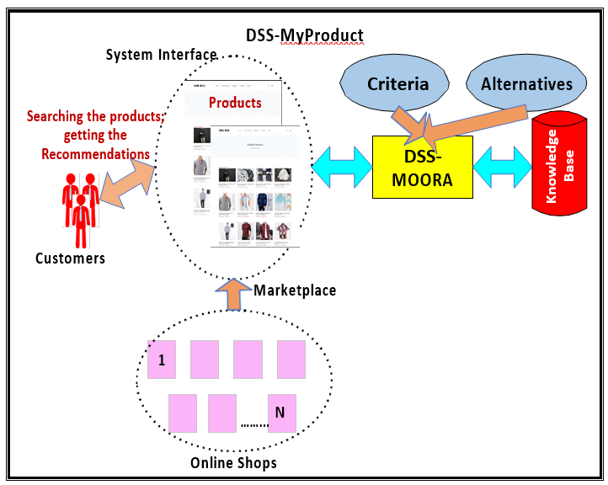
Methodologies
The Decision Support System (DSS) approach on management model applied Multi-Objective Optimization on the Base of Ratio Analysis (MOORA) is used for customers to be smartly guided to choose the high-quality product at the greatness services of an online shop.
DSS-My Product Architecture
Limitations
This concept of DSS-MOORA is restricted to men's shirt products.

Slide 21
9. “The Effect of Product Recommendation in Youtube To Consumer Impulsive Buying Of Smartphone Product”[10]
Author : Dimas Indiarto Sumiko, Anna Amalyah Agus
Pub-Year:2020 3rd International Conference on Computer and Informatics Engineering (IC2IE).
Proposed Idea
This paper aims to understand the effect of product recommendation content on Youtube to increase the intention to buy impulsively the smartphone products.
This study uses a quantitative approach. The questionnaire is used as an instrument for data collection.

Slide 22
Methodologies
Signalling theory has been used in identifying and understanding a signal that can be used by consumers in assessing product quality.
Conceptual Framework
Limitations
All Content creators suggestions won’t be accurate.

Slide 23
Author - Sahraoui Dhelim, Runhe Huang. Published year - 1, FEBRUARY 2021. IEEE TRANSACTIONS ON COMPUTATIONAL SOCIAL SYSTEMS, VOL. 8.
“Personality-Aware Product Recommendation System Based on User Interests Mining and Meta path Discovery”
Proposed system
The proposed system uses Meta-Interest which predicts the user’s interest and the items associated with these interests, even if the user’s history does not contain these items or similar ones.

Slide 24
This is done by analyzing the user’s topical interests and eventually, recommending the items associated with the user’s interest.
The proposed system is personality-aware from two aspects, it incorporates the user’s personality traits to predict his/her topics of interest and to match the user’s personality features with the associated items.
The purpose of Meta-Interest is to recommend the most relevant items by detecting the user’s topical interests from its social networking data based on
user interest mining and meta path discovery.

Slide 25
Algorithm/Methodologies:
Propose a product recommendation system that infers the user’s needs based on his/her topical interests.
The proposed system incorporates the user’s big-five personality traits to enhance the interest mining process and perform personality-aware product filtering.
The relationship between the users and products is predicted using a graph-based metapath discovery, therefore, the system can predict implicit and explicit interests.

Slide 26
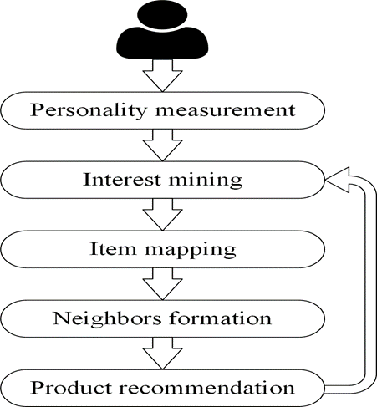
Architecture
Figure 1: Meta-Interest recommendations process

Slide 27
Applications
The products recommended will be more relevant to user and increases average order value in e-commerce platforms.
Providing feasibility and accuracy in the retail market, because inaccurate recommendations can produce a negative impact on a customer.
Increases the precision and accelerate the recommendation in online shopping websites, especially in cold-start settings(unpredictability concerning new items).
Even YouTube has a powerful recommendation system that filters content, based on user browsing history, search terms, age of videos.

Slide 28
References
[1] Yan Fang, Xinyue Xiao, Xiaoyu Wang, Huiqing Lan, “Customized Bundle Recommendation by Association Rules of Product Categories for Online Supermarkets,” 2018 IEEE Third International Conference on Data Science in Cyberspace (DSC).
[2] Chantima Buaklee, Sukree Sinthupinyo, “Similar Cluster recommendation of Product
Purchases by Pages liked Analysis,” 2018 10th International Conference on Electronics, Computers and Artificial Intelligence (ECAI).
[3] R.V. Karthik, Sannasi Ganapathy, Arputharaj Kannan “A Recommendation System for Online Purchase Using Feature and Product Ranking,” 2018 Eleventh International Conference on Contemporary Computing (IC3).

Slide 29
[4] Ni Made Satvika Iswari, Wella Wella, Andre Rusli, “Product Recommendation for e-Commerce System based on Ontology,” 2019 1st International Conference on Cybernetics and Intelligent System (ICORIS).
[5] Terutaka Yoshikawa, Yuanyuan Wang, Yukiko Kawai, “A Product Recommendation System Based on User Complaint Analysis Using Product Reviews,” 2019 IEEE 8th Global Conference on Consumer Electronics (GCCE).
[6] Umit Turkut, Adem Tuncer, Hüseyin Savran, Sait Yılmaz, “An Online Recommendation System Using Deep Learning for Textile Products,” 2020 International Congress on Human-Computer Interaction, Optimization and Robotic Applications (HORA).

Slide 30
[7] Keerthika K, Saravanan T, “Enhanced Product Recommendations based on Seasonality and Demography in Ecommerce,” 2020 2nd International Conference on Advances in Computing, Communication Control and Networking (ICACCCN).
[8] Okfalisa, Zulfahri, Dwi Utari Iswavigra, Megawati, Saktioto, “Online Shop Recommendations: Decision Support System Based on Multi-Objective Optimization on the Basis of Ratio Analysis,” 2020 8th International Conference on Cyber and IT Service Management (CITSM).
[9] Dimas Indiarto Sumiko, Anna Amalyah Agus, “The Effect of Product Recommendation in Youtube To Consumer Impulsive Buying Of Smartphone Product,” 2020 3rd International Conference on Computer and Informatics Engineering (IC2IE).

Slide 31
Thank You!

