Slide 1

Library management system
RNS INSTITUTE OF TECHNOLOGY
BENGALURU - 98
DEPARTMENT OF INFORMATION SCIENCE & ENGINEERING
Presentation on Internship
Preethan Anup Jain
USN: 1RN18IS079
TechieAid
Internal Guide
Mr. Ravi Kumar S G
Asst. Prof, Dept of ISE, RNSIT
External Guide
Mr. Ramesh Nediyadath
TechieAid

Slide 2
AGENDA
Abstract
About the Company
Introduction
Requirements
System Design
Detailed Design
Implementation
Conclusion and Future Enhancements
References

Slide 3
ABSTRACT
A library management system is software that is designed to manage all the functions of a library.
It helps librarian to maintain the database of new books and the books that are borrowed by members along with their due dates.
The system would provide basic set of features to add/update members, add/update books, and manage check in specifications for the systems based on the client's statement of need.

Slide 4
About the Company
TechieAid is IT services company registered under Govt. of India, Ministry of Micro, Small & Medium Enterprises (MSME).
TechieAid offers Software Development Services, Staffing Solutions, Technology Training, Leadership & Soft Skills Training and Coaching & Mentoring with 20+ years of industry experience.
TechieAid develop custom web based applications to kick-start the business on the Internet like Full Stack front and back end development.
TechieAid also provides services for end-to-end software test automation solutions using various industry standard tools, frameworks and technologies.

Slide 5
INTRODUCTION
Library management systems are designed to manage the movement of books and maintain records of the members in a library .
LMS is an automatic system that reduces the work burden of the staff/librarians through a single click. It will manage, organize and oriented the library task.
The LMS supports the librarian to add/view/delete/update details from the library stock.
Here we integrate all the library data into the SQL server.
Preliminarily the librarian has to add student and book details into the database. After that he/she can view/delete/update those details through the Integrated Library system.

Slide 6
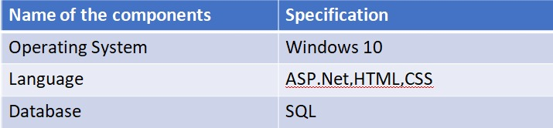
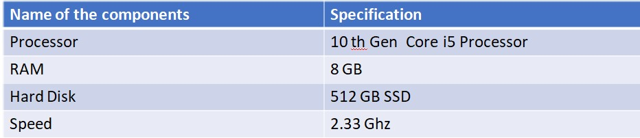
Requirements
Software Requirement

Slide 7
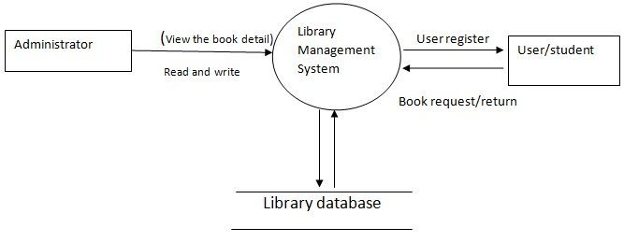
System Design

Slide 8
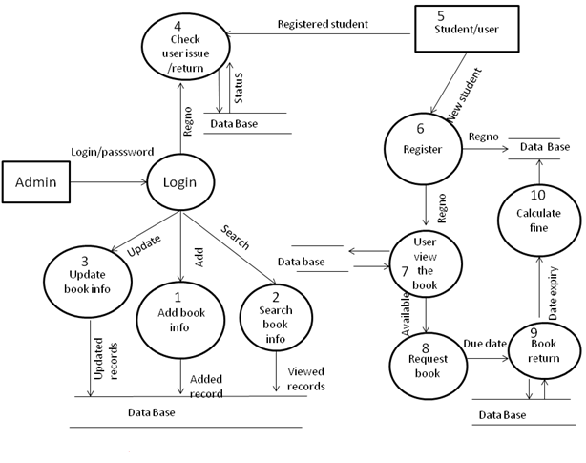
Detailed Design

Slide 9
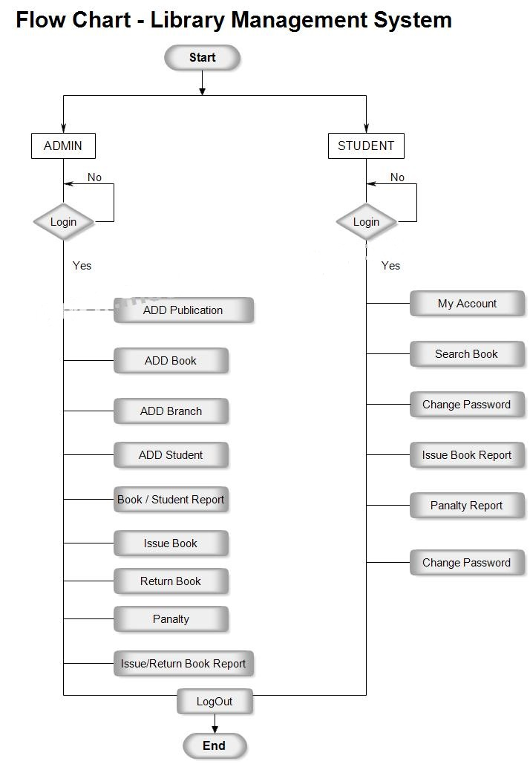

Slide 10
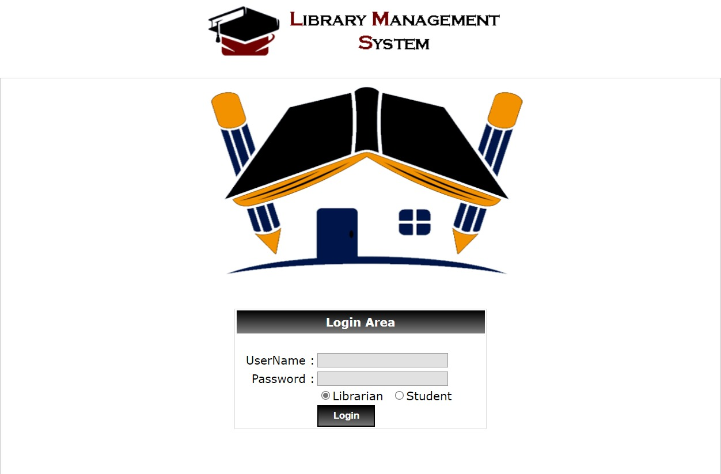
Result
Login Page

Slide 11
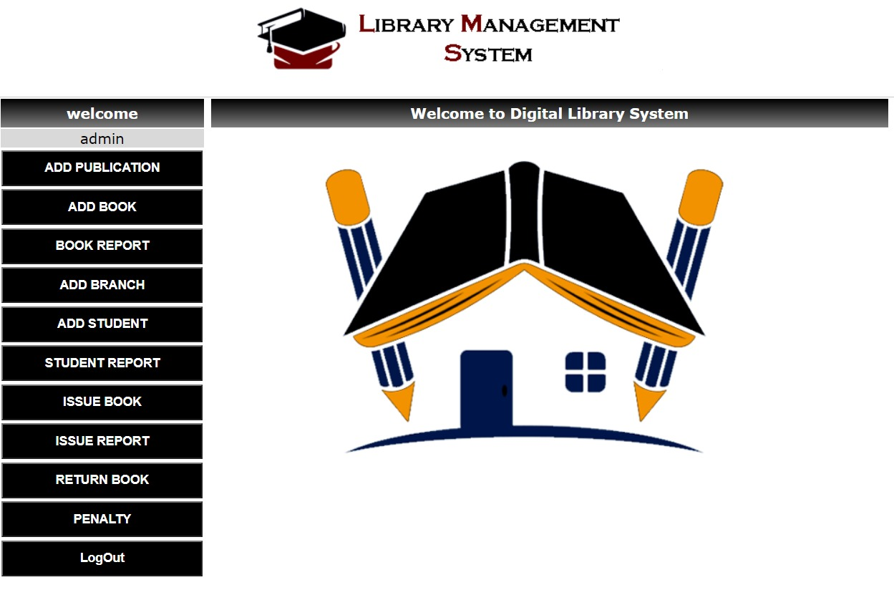
Result
Home Page

Slide 12
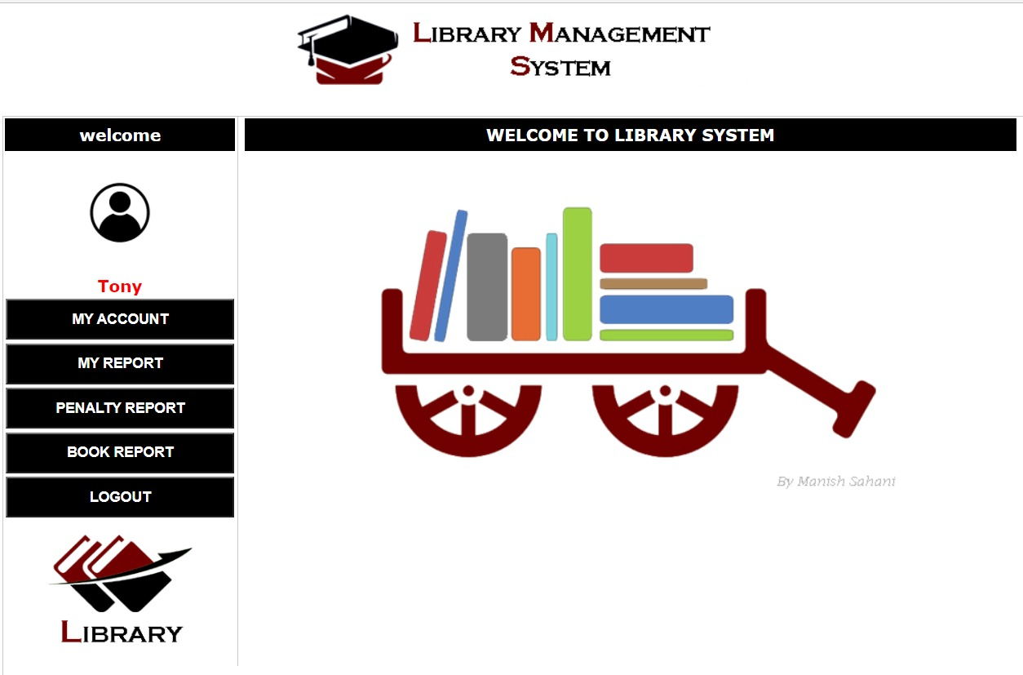
Result
Student Login

Slide 13
CONCLUSIONS
The Library Management System allows the user to store the book details and the person's details.
This software allows storing the details of all the data related to library.
The implementation of the system will reduce data entry time and provide readily calculated reports.
The computerization of the Library Management will not only improves the efficiency but will also reduce human stress thereby indirectly improving human recourses.

Slide 14
Future Enhancements
As technology emerges, it is possible to upgrade the system and can be adaptable to the desired system.
Based on future security issues, security can be enhanced using emerging technologies.
Changes made by any user can be monitored.
More control by the administrator.
Use of more extra classes and modules to short down the code.

Slide 15
REFERENCES
Microsoft Visual C# Step by Step (Developer Reference Edition).
RamezElmasri and Shamkant B. Navathe, Fundamentals of Database Systems.
Learn SQL Tutorial – javatpoint
MS SQL Server Tutorial (tutorialspoint.com)
C# Tutorial - GeeksforGeeks
What is .NET Framework? Explain Architecture & Components (guru99.com)

Slide 16
THANK YOU

