Slide 1
Lumen — Humanitarian Attention-Gap Intelligence
Full Name: Preethesh Carvalho, Deepthi C J
Registered Mail ID: 23i61.preethesh@sjec.ac.in, 23i62.deepthi@sjec.ac.in
College Name: St Joseph Engineering College, Mangalore
Mobile: 8904145205, 9019932005
IBM SkillsBuild Mail ID: 23i61.preethesh@sjec.ac.in, 23i62.deepthi@sjec.ac.in

Slide 2
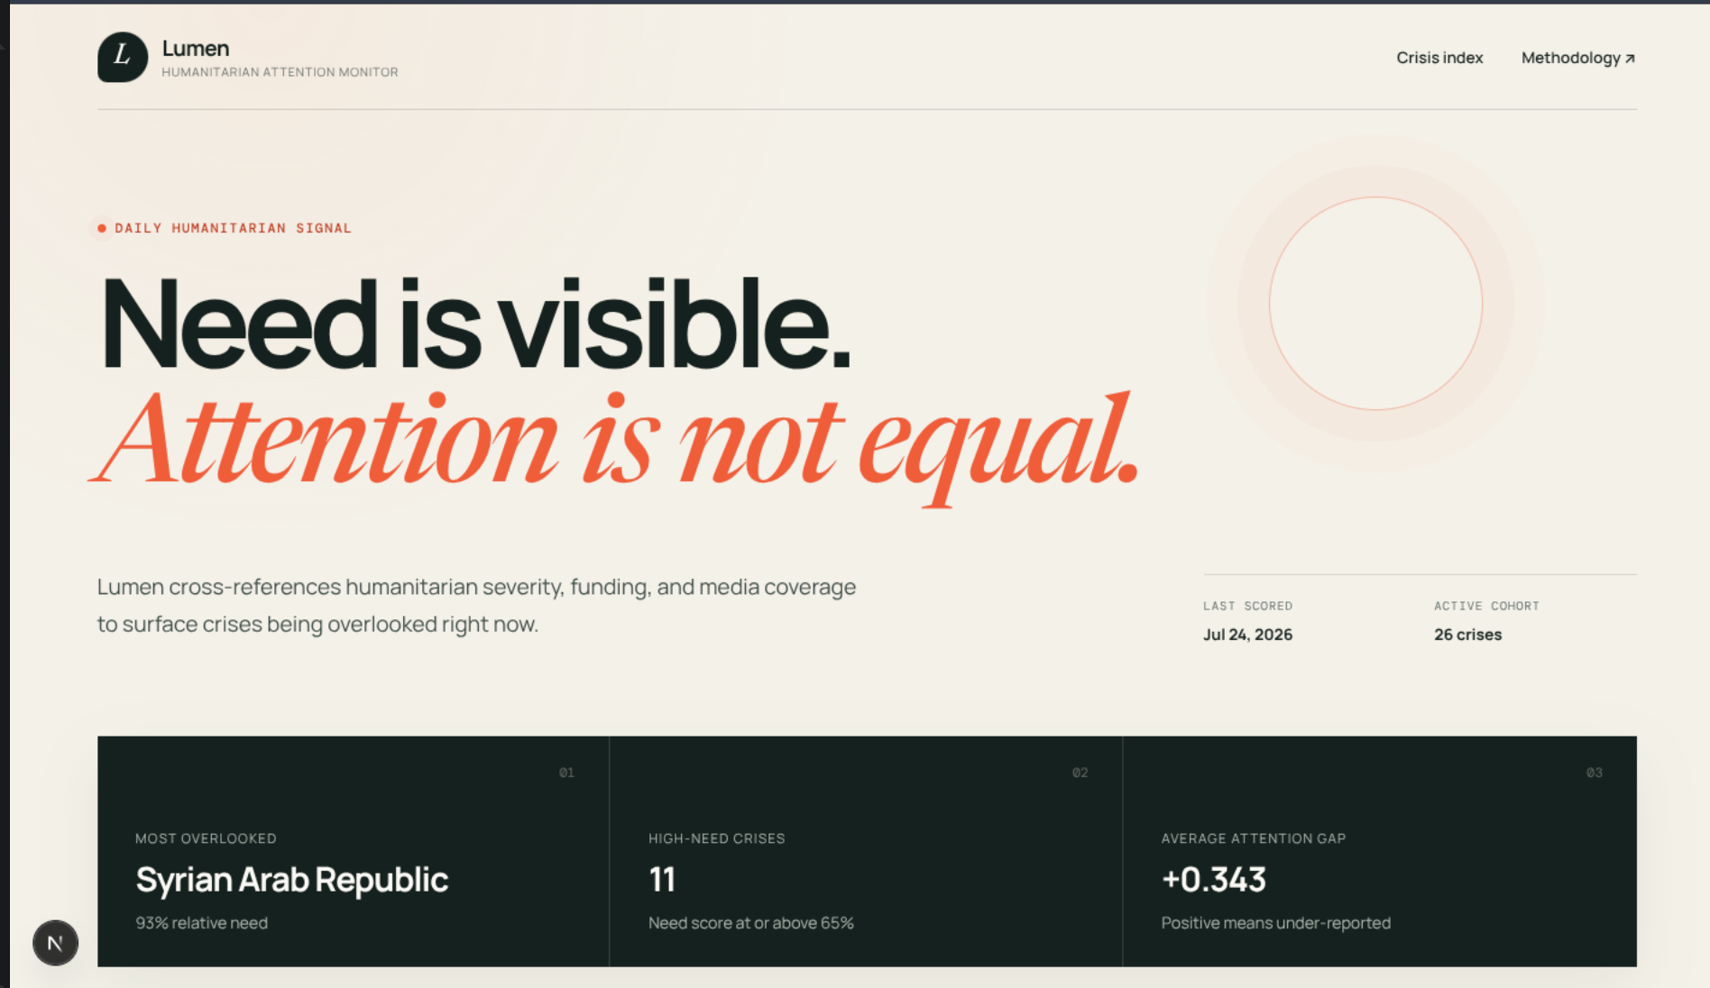

Introduction:
The Attention Gap:
High-need crises can remain under-reported.
Humanitarian and media data lives in separate systems.
Lumen's Response:
Compare need, coverage and underfunding transparently.
From Evidence to Action:
Rank 26 crises and deliver grounded briefs daily.

Slide 3
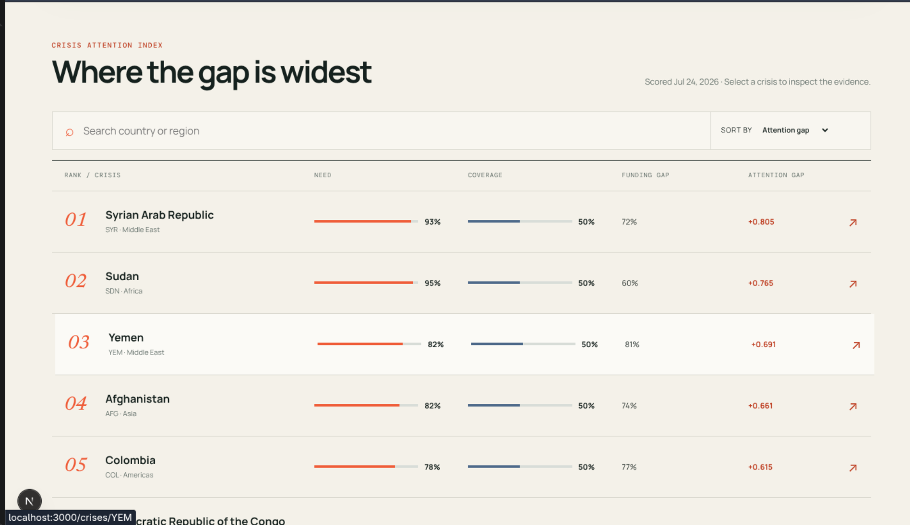

Problem Statement:
Objective:
Surface high-need, low-attention crises through transparent daily scoring.
Specific Goals:
Collect displacement, appeal, funding, disaster and coverage signals.
Store raw observations before computing scores.
Rank crises with a tested Attention-Gap formula.
Explain trends and evidence in a public dashboard.
Deliver briefs through Telegram and email.
Remain useful when a source or AI provider fails.

Slide 4

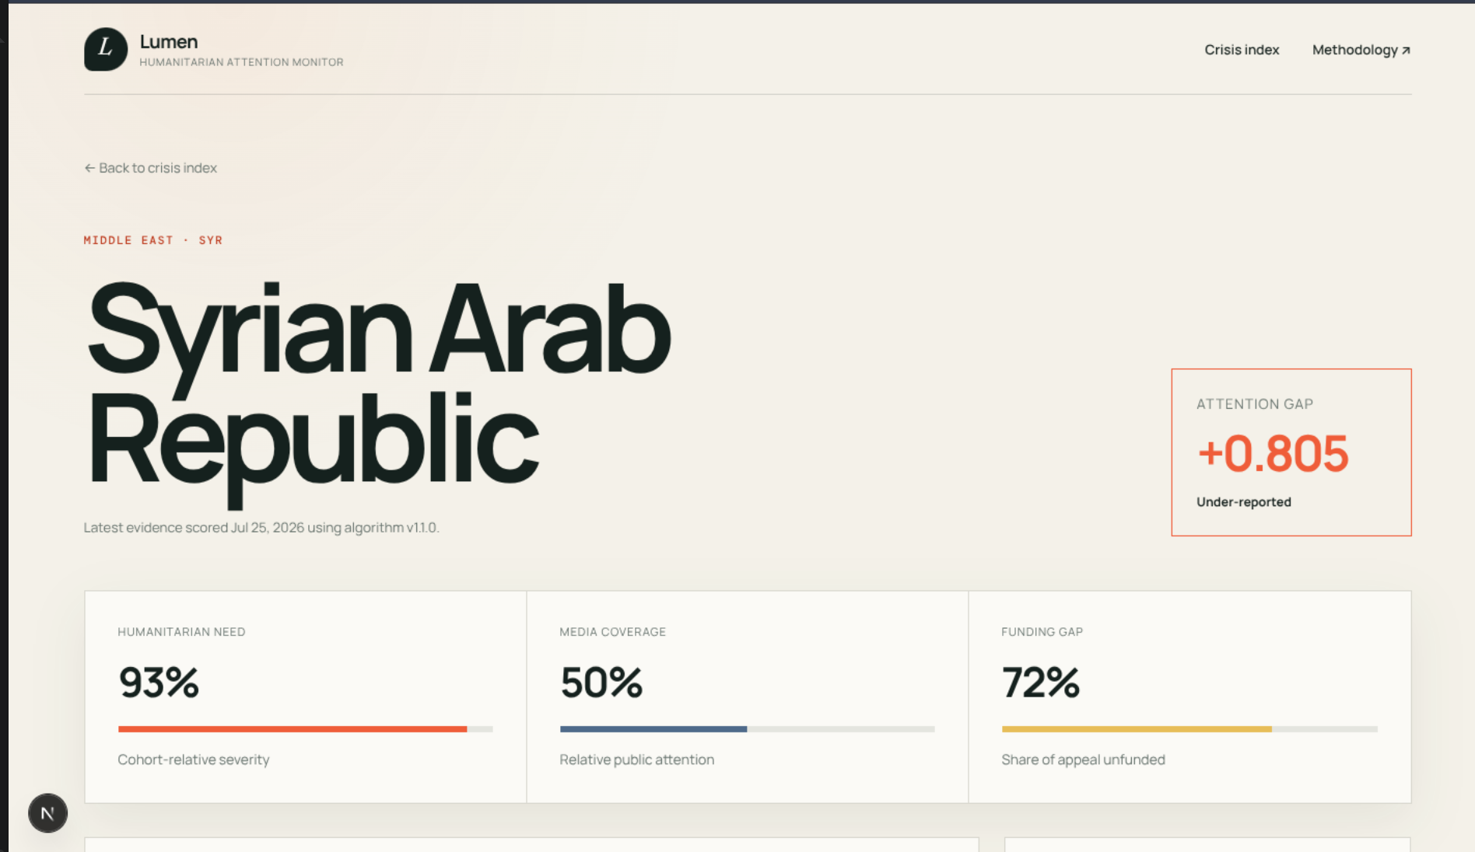

Sustainable Development Goals:
Goals Chosen: SDG 10, SDG 16 and SDG 17
Problem Statement:
Unequal crisis visibility weakens informed reporting, accountability and resource mobilisation.
Rationale:
Lumen supports fairer attention, explainable public-interest information, and partnerships across humanitarian data, journalism and funding actors.

Slide 5

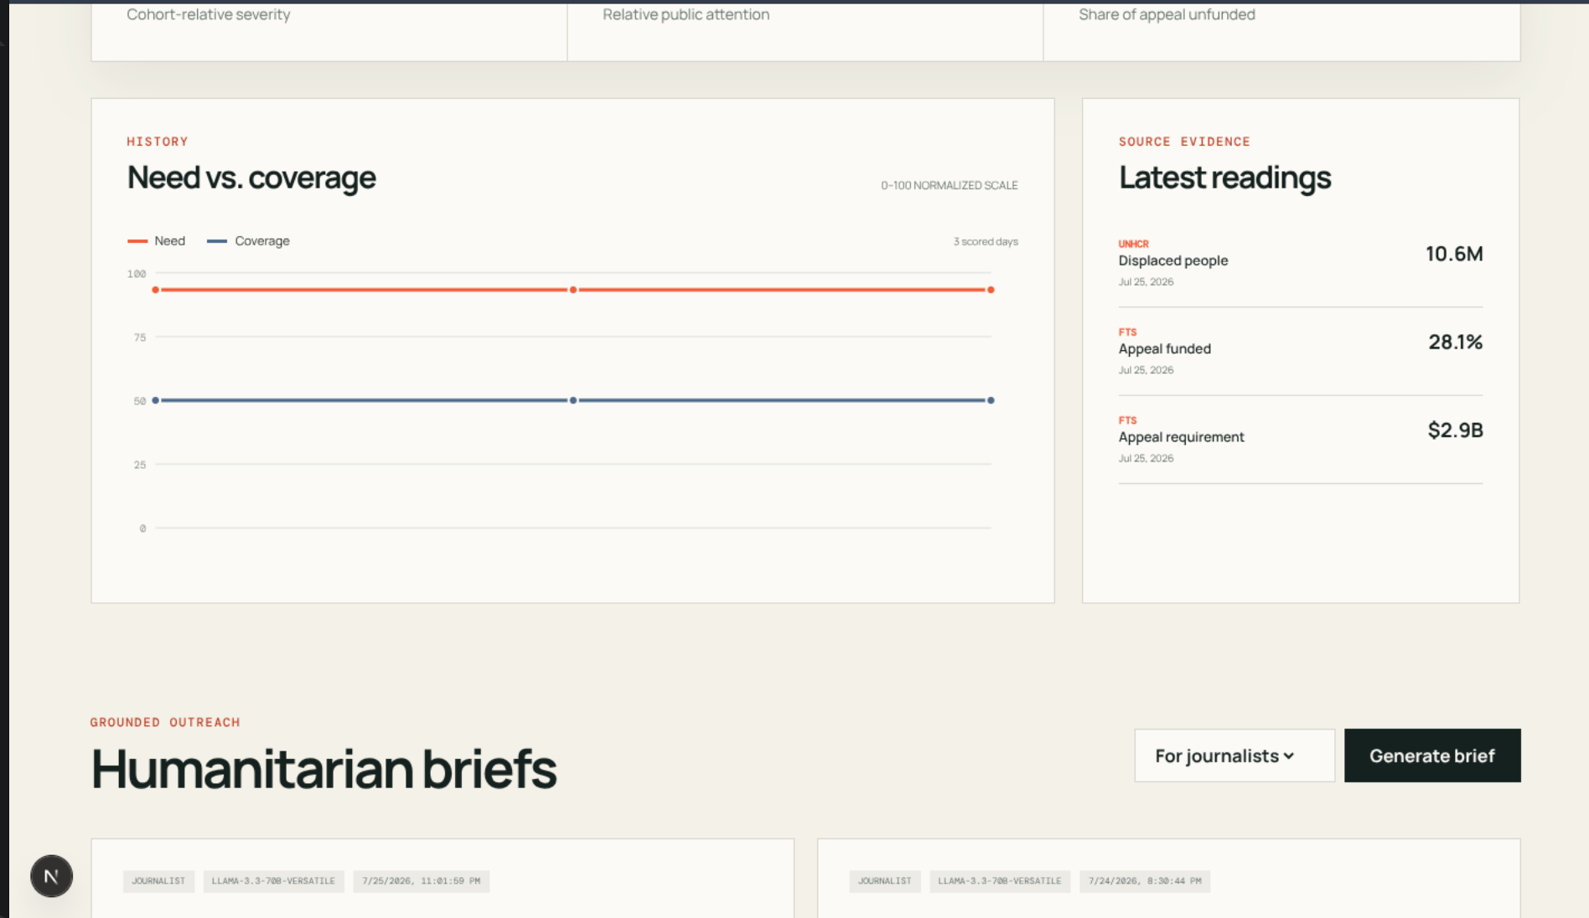

Data Collection and Preprocessing:
Evidence Storage and Preparation:
Data Sources:
UNHCR displacement; OCHA FTS appeals and funding.
Coverage and Disaster Signals:
GDELT media volume; ReliefWeb active disasters.
Daily adapters apply timeout, pacing, retry and validation.
Observation Store:
Raw readings are saved in PostgreSQL before scoring.
Preparation:
ISO3 mapping, parsing, log transform and missing-data handling.

Slide 6
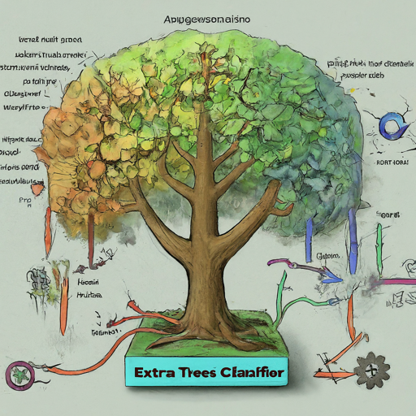
Attention-Gap Scoring Engine:
Algorithm:
Need Score
Displacement 50%, appeal size 30%, active disasters 20%.
Missing components are dropped and remaining weights re-normalized.
Coverage and Funding:
GDELT estimates coverage; OCHA FTS supplies the funding gap.
Formula v1.1.0:
(need − coverage) × (1 + 0.5 × funding gap) + 0.3 × funding gap
Versioned inputs make every result explainable and replayable.

Slide 7
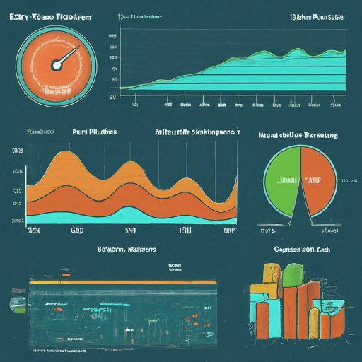
Validation and Reliability:
Verification:
39 scoring unit tests cover normalization, missing data and edge cases.
API integration tests run against PostgreSQL.
CI checks tests, types, web build, migrations and committed secrets.
Live-Data Result:
UNHCR and OCHA FTS successfully ranked the 26-crisis cohort.
Idempotent upserts prevent duplicate evidence during retries.
Grounding Controls:
Numeric facts are rendered directly from stored score inputs.
Any AI error or invented number triggers a deterministic fallback.

Slide 8

Tools and Resources:
Production Stack:
Application:
Next.js dashboard; Express and TypeScript API.
Data and Orchestration:
PostgreSQL 16; n8n daily scheduler; Docker Compose.
Delivery and Operations:
Optional Groq, Telegram, Resend, GitHub Actions, DigitalOcean and Caddy HTTPS.

Slide 9
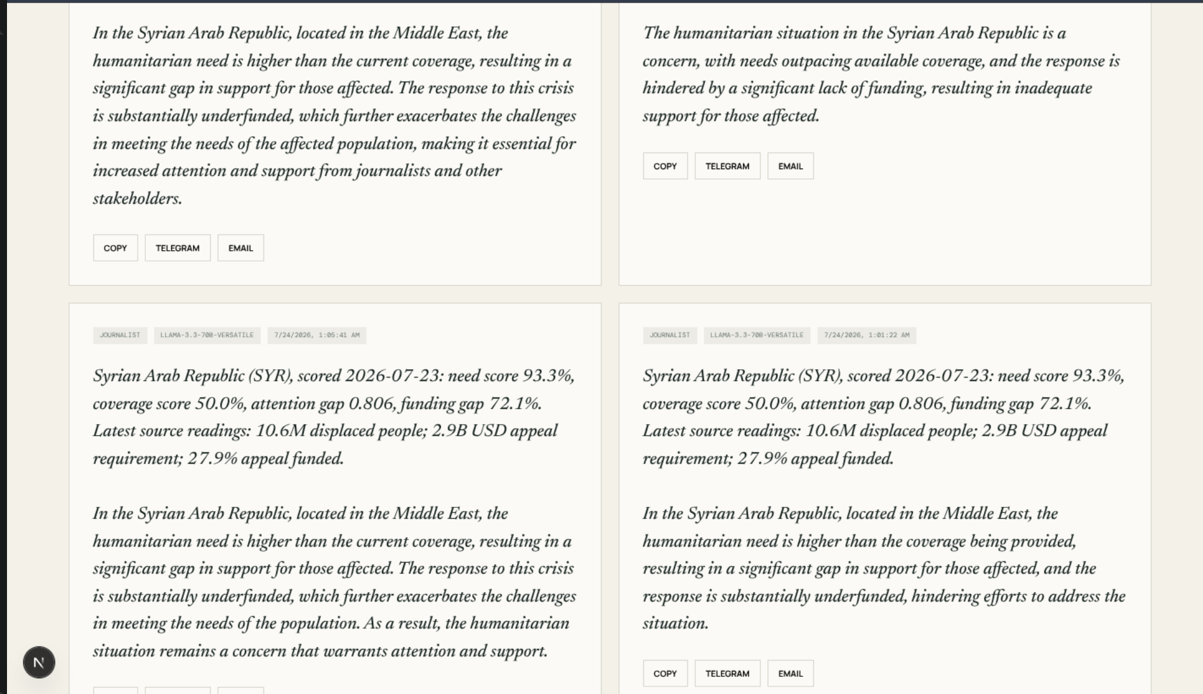

Project Impact and Effectiveness:
Problem Solving:
For Journalists and Editors:
Highlights overlooked stories and creates ready-to-share briefs.
For NGOs and UN Teams:
Reduces manual comparison and supports advocacy monitoring.
For Donors and Policy Teams:
Adds an explainable signal for attention and funding priorities.
Expected Outcomes:
Faster discovery, traceable communication and broader visibility.
Measure freshness, delivery success, users, shares and actions.

Slide 10
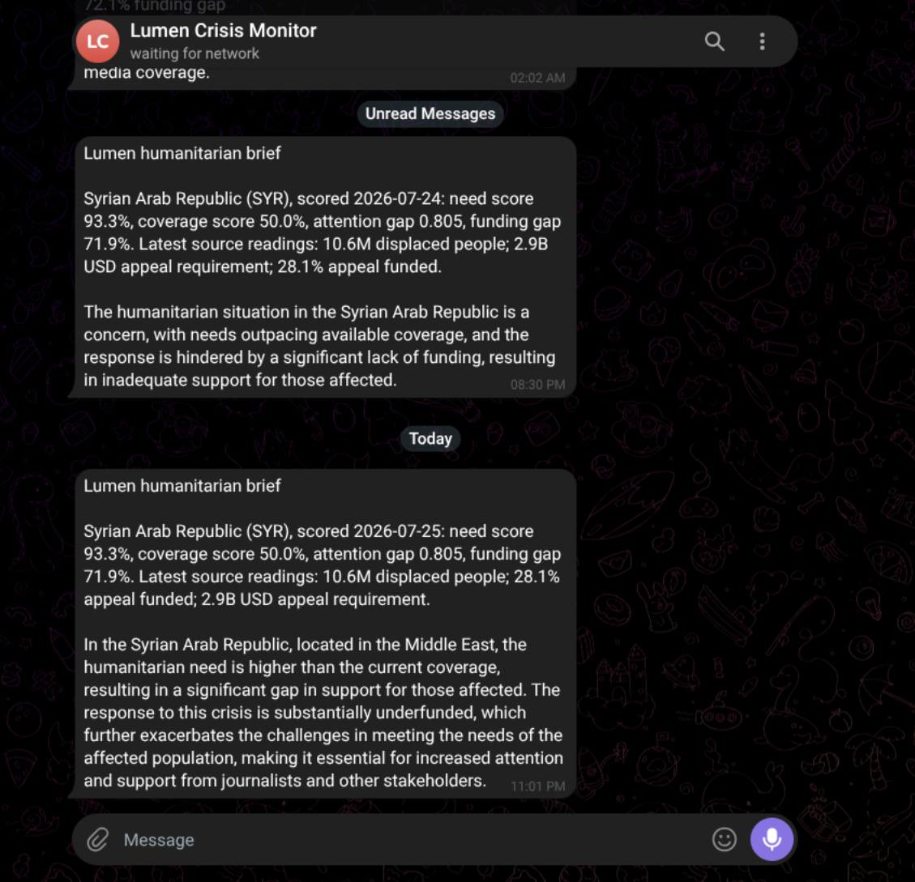

Why It Will Work:
Evidence-Driven:
Combines trusted public sources and preserves every raw observation.
Transparent by Design:
Versioned scoring and score-linked briefs make outputs auditable.
Resilient Operations:
A failed source or AI provider cannot stop ranking and outreach.
Proven End-to-End:
Dashboard, API, database, n8n, Telegram and email are working live.

Slide 11
Results and Output:
The live ranking surfaces Syrian Arab Republic, Sudan, Yemen and Afghanistan as current high attention-gap crises.

Slide 12
Deployed Lumen Dashboard:
Public HTTPS dashboard — explore rankings, crisis evidence, trends and grounded briefs.

Slide 13
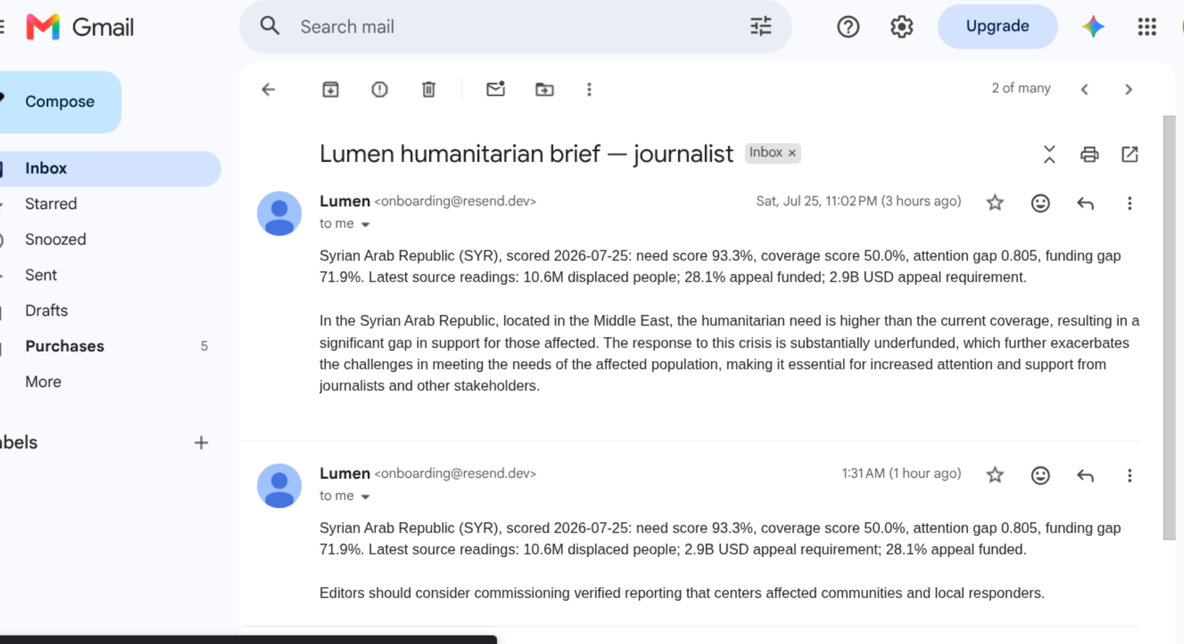
Live Notification Delivery:
Evidence-grounded humanitarian briefs were delivered successfully through Telegram and Resend email.

Slide 14


Project Links:
GitHub Repository: https://github.com/Preethesh16/Lumen
Dashboard (Frontend): https://lumen.64-227-166-157.sslip.io
API Health (Backend): https://api.64-227-166-157.sslip.io/health

Slide 15

Conclusion:
Summary:
Lumen measures where humanitarian need outpaces attention.
It connects daily public data, explainable scoring and live outreach.
Future Work:
Activate ReliefWeb after approval and calibrate with user feedback.
Pilot with newsrooms and NGOs; add fixed-scale and sub-national signals.

