Slide 1
HARDCODERS PRESENTS
Sense the collision
before it lands.
Spidey Sense combines live team presence with truthful repository intelligence—so agents coordinate before changes collide.
BROWSER-FIRST
NO-EGRESS GRAPH
VERIFICATION BUILT IN
GRAPH IS EVIDENCE, NOT AN ORACLE
HardCoders • Spidey Sense • Production pitch

Slide 2
THE COORDINATION BLIND SPOT
Agents move fast. Context does not.
Modern teams have three fragmented truths—and collisions happen in the gaps.
01
02
03
Human intent
Agent activity
Code structure
Who owns the mission? What outcome is expected?
Who is online? Which task is active or blocked?
Which files and symbols are actually connected?
A static dependency graph alone cannot see runtime dispatch, generated code, reflection—or team intent.
HardCoders • Entire Graph Buildathon

Slide 3
THE PRODUCT
One coordination loop. Four decisive moments.
Every surface shares the same live plan and the same evidence contract.
01
02
03
04
CONNECT
ASSIGN
MAP
VERIFY
Invite teammates in-browser
Declare mission + target
Project Graph evidence
Inspect source + run tests
The output is not “trust the graph.” It is: here is the evidence class, the caveat, and the safest next verification.
HardCoders • Entire Graph Buildathon

Slide 4
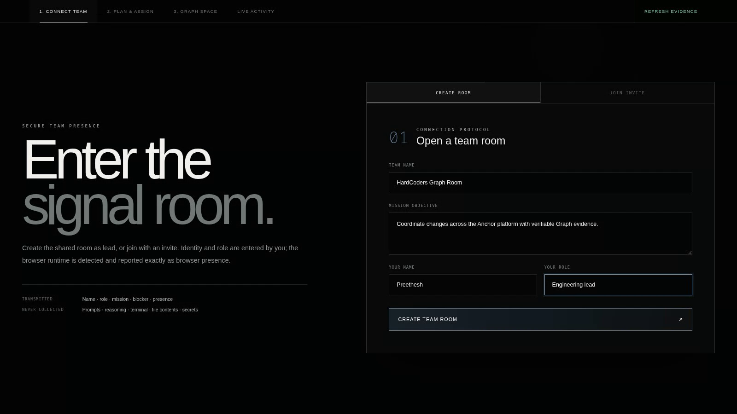
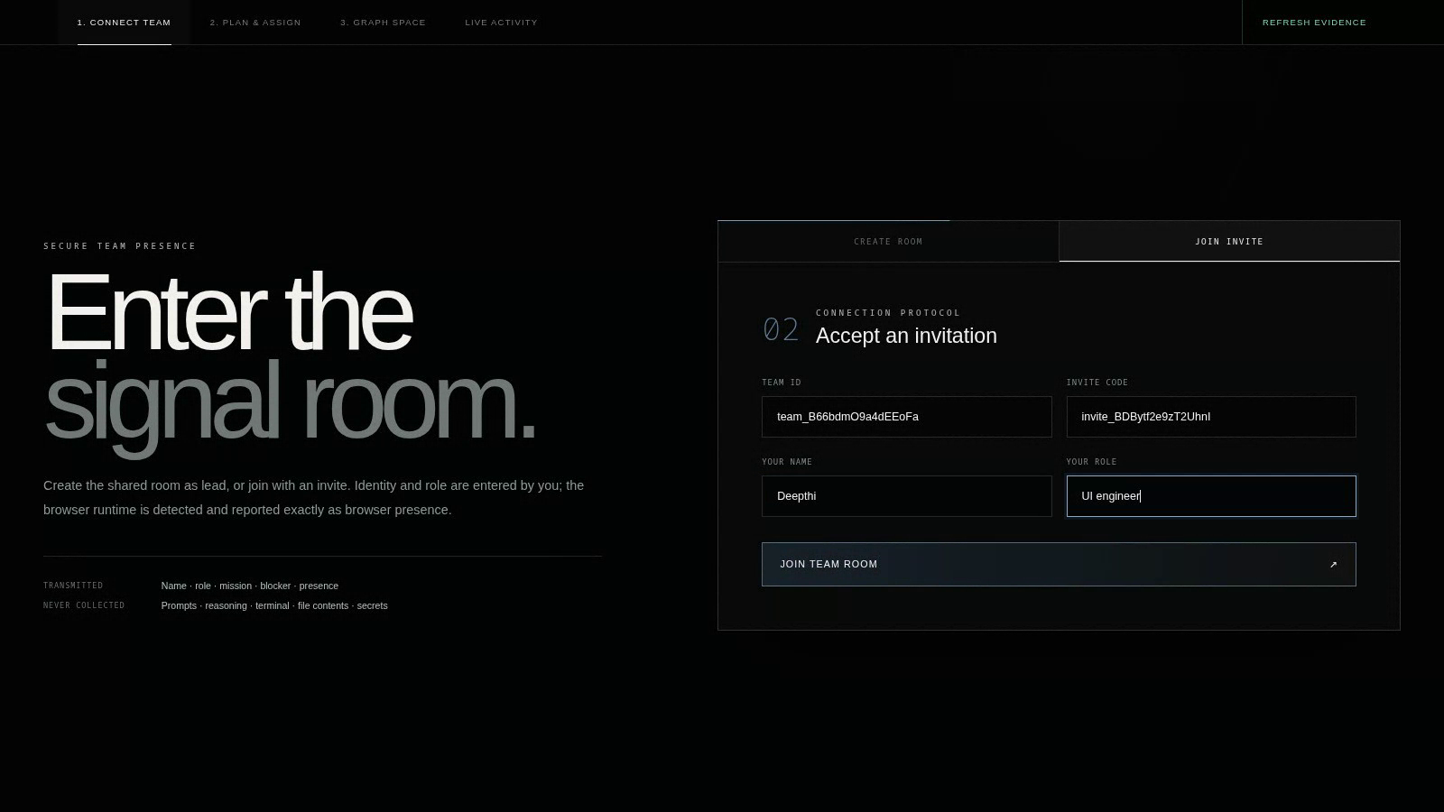
CONNECTION-FIRST EXPERIENCE
Real teammates. Zero invented identity.
Create and join entirely through the website; browser capability boundaries stay explicit.
PRIVATE INVITE FRAGMENT
SCOPED CREDENTIALS
NO TERMINAL ONBOARDING
Names and roles are entered by people. Provider details are detected—never fabricated.
HardCoders • Entire Graph Buildathon

Slide 5
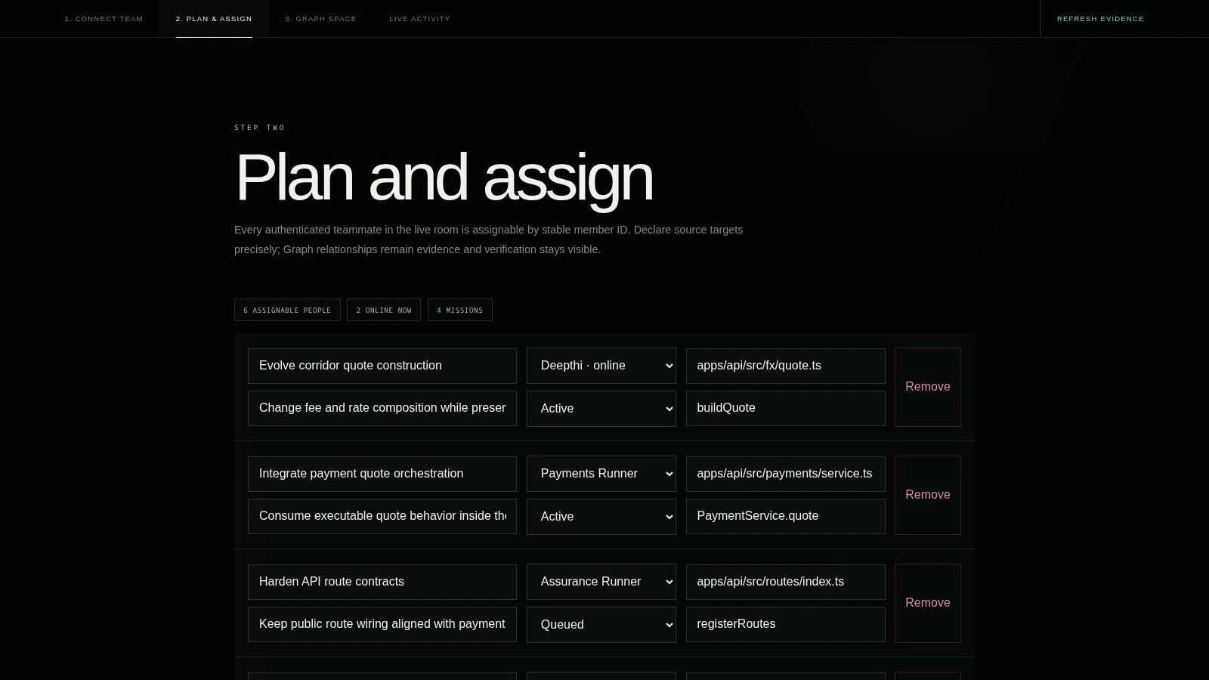
DYNAMIC ORCHESTRATION
Presence becomes actionable.
Authenticated members enter the plan by stable server-issued identity—not fragile display-name matching.
LIVE
Connected teammates become assignable immediately.
PRECISE
Mission, owner, state, file, and symbol stay editable.
DYNAMIC
No fixed people, paths, providers, or mission count.
HardCoders • Entire Graph Buildathon

Slide 6
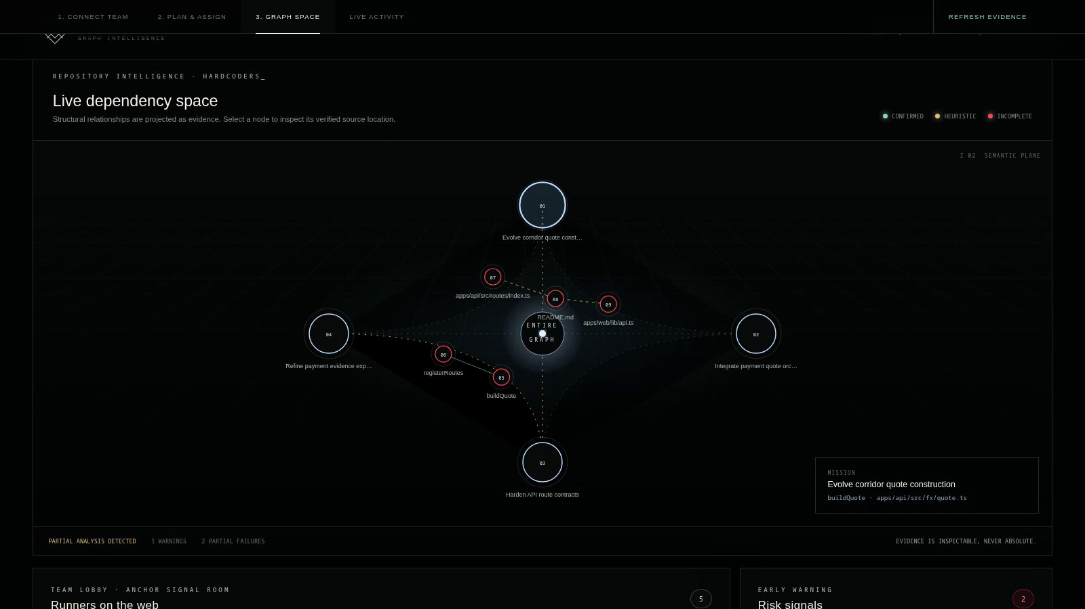
GRAPH-POWERED EXPERIENCE
A spatial map with an honesty layer.
CONFIRMED
HEURISTIC
INCOMPLETE
Mission nodes, source evidence, relation strands, and risk signals share one accessible SVG scene.
Real HardCoders_ repository evidence • Selectable nodes • Keyboard accessible

Slide 7
TRACK 2 REQUIREMENT
Confidence changes the decision.
The product never turns an incomplete static relationship into a certain runtime claim.
Exact / package / import-bound structural evidence
May support BLOCK when direct
Inspect source before merge
CONFIRMED
Inferred, pattern, co-change, framework or test evidence
REVIEW
Validate call sites + focused tests
HEURISTIC
Partial snapshot, parser failure, dropped support
REVIEW — never certainty
Runtime registration + source/test verification
INCOMPLETE
ABSENCE OF EVIDENCE ≠ EVIDENCE OF INDEPENDENCE
HardCoders • Entire Graph Buildathon

Slide 8
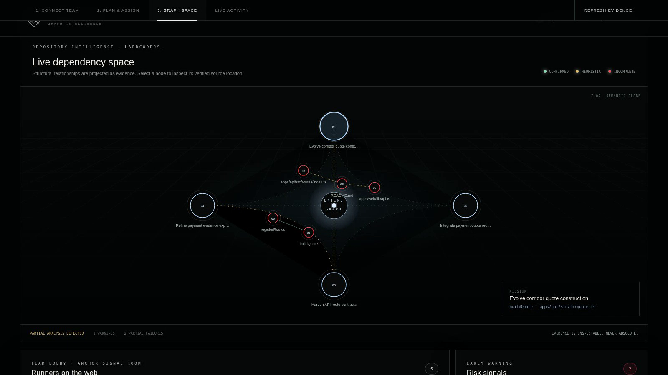
RUNNING PROOF, NOT SYNTHETIC CLAIMS
Mapped against HardCoders_.
The live production build analyzes the Anchor repository and preserves every detected limitation.
4,631
14,850
01
02
INDEXED NODES
GRAPH RELATIONS
ANALYSIS WARNING
PARTIAL FAILURES
Why the red matters
SQL parser failures and dynamic behavior lower confidence globally. Spidey Sense surfaces that state, downgrades claims, and points to source/test verification.
TRUTH OVER THEATER
HardCoders • Entire Graph Buildathon

Slide 9
PRODUCTION ARCHITECTURE
Shared presence. Local code intelligence.
The boundary is deliberate: team metadata can travel; repository analysis remains no-egress.
BROWSER
SHARED COORDINATOR
LOCAL ENTIRE GRAPH
VERIFICATION
Invite • identity • mission • blocker
Scoped tokens • heartbeat • SSE
Repository snapshot • risk engine
Source inspection • focused tests
TRANSMITTED
Name • role • mission • blocker • bounded activity
127.0.0.1 stays local. Cross-machine deployments require a reachable HTTPS origin or an explicitly controlled LAN binding.
NEVER COLLECTED
Prompts • reasoning • terminal • file contents • secrets
HardCoders • Entire Graph Buildathon

Slide 10
THE ASK
Don’t trust the map.
Use it to verify faster.
Judge the complete loop live:
01
Create a room
02
Join from another browser
03
Assign a live teammate
04
Inspect Graph evidence
05
Refresh and verify
github.com/Preethesh16/entire-graph
SPIDEY SENSE / SEE THE COLLISION BEFORE IT LANDS
HardCoders • Preethesh + team • Built with Entire Graph

