Slide 1

DOCTOR VISIT ANALYSIS

Slide 2

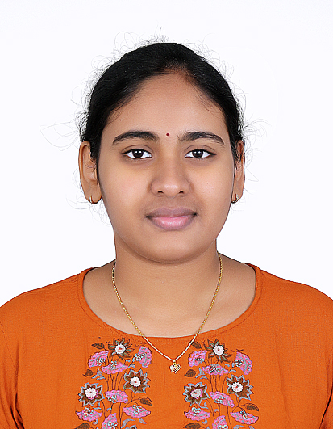
PAGE 2
NAME: VELICHETI LILA NAGA SAI SRI PREETHI
EMAIL ID:velichetipreethi@gmail.com
COLLEGE NAME: MAHATMA GANDHI INSTITUTE OF TECHNOLOGY
COLLEGE STATE: TELANGANA
INTERNSHIP DOMAIN : DATA ANALYTICS
DURATIONO: 5-06-2023 to 13-07-2023
ABOUT ME

Slide 3

PROBLEM STATEMENT
PAGE 2
Analyzing Doctor Visit Data to Gain Insights into Healthcare Patterns and Patient Behavior

Slide 4

PAGE 3
Introduction
Data overview
Details about the end user
My solution
My customizations
Project modelling
Results
AGENDA

Slide 5

PAGE 4
OVERVIEW
This project aims to gain valuable insights into healthcare patterns and patient behaviors by analyzing a dataset containing information about doctor visits. The dataset includes attributes such as gender, age, income, illness, payment options, and chronic conditions.
Various data visualization techniques, such as bar charts, histograms, scatter plots, and pie charts, are employed to present the data effectively.

Slide 6
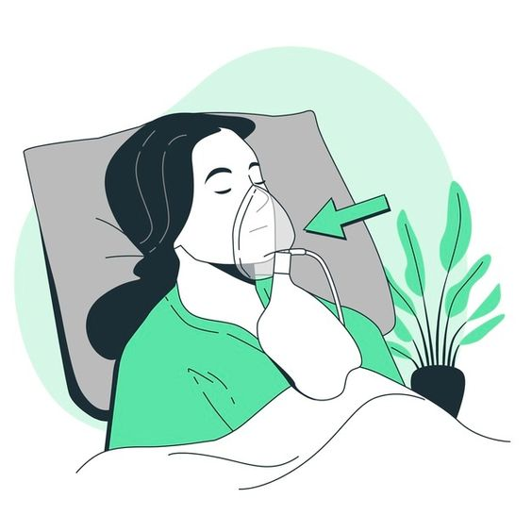
PAGE 5
END USER
Healthcare Providers and Facilities
Healthcare Administrators and Policy Makers
Public Health Organizations
Health Insurance Companies
Medical Researchers
Pharmaceutical Companies
Academic Institutions

Slide 7

SOLUTION
PAGE 6
The analysis of doctor visit data provides a comprehensive understanding of healthcare utilization, patient demographics, prevalent illnesses, and the impact of chronic conditions. It offers actionable insights that can inform decision making and improve healthcare services across various sectors.
Improved Patient Care
Resource Optimization
Research and Innovation

Slide 8

CUSTOMIZATION
PAGE 7
Understanding the context of the dataset was crucial.
To ensure data quality and accuracy, data cleaning and preprocessing were performed. This involved handling missing values, addressing outliers, and transforming the data into a suitable format for analysis. visualization techniques was tailored to the attributes and objectives of the analysis.
Different types of charts, such as bar charts, histograms, scatter plots, and pie charts, were selected to effectively represent the data and reveal patterns and relationships

Slide 9

MODELLING AND TECHNOLOGICAL APPROACH
PAGE 8
Utilized descriptive statistics and data visualization techniques to summarize and understand the dataset's main characteristics and patterns.
Cleaning and transforming the data to handle missing values, outliers, and prepare it for analysis.
Utilized Python and its popular libraries (e.g., Pandas, NumPy, Matplotlib, Seaborn) to conduct data manipulation, visualization, and modeling tasks.

Slide 10

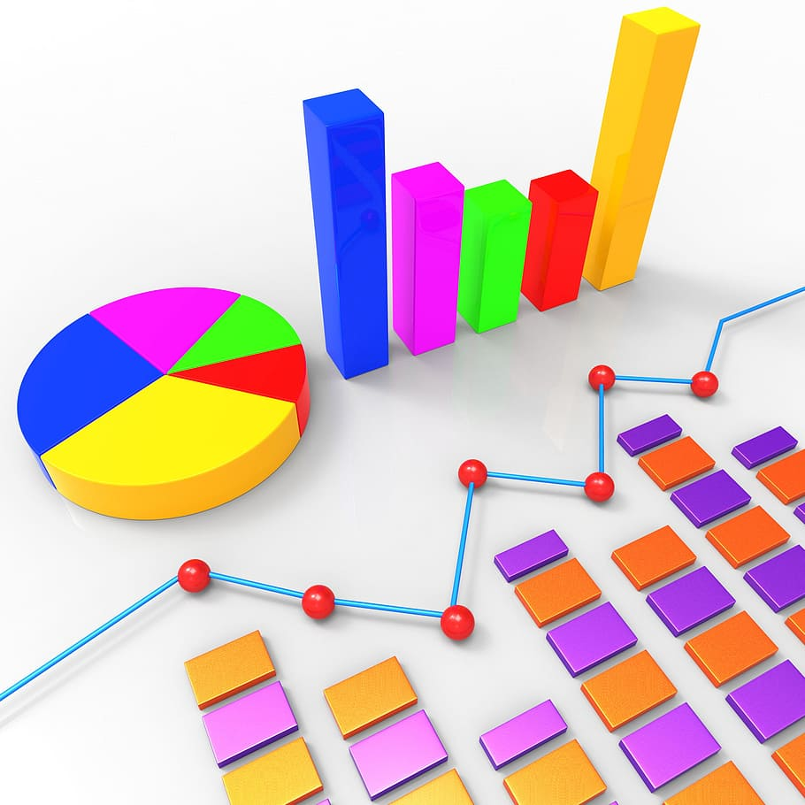
RESULT
PAGE 9
Illness Breakdown:
The majority of patients who have visited the doctor are affected by type 1 disease with 31.6% , followed by the type 0 with 29.9% of patients
Chronic conditions:
Patients with long-term chronic conditions tend to have more doctor visits compared to patients with non-chronic conditions.
Insurance Analysis:
The majority of patients have private insurance whereas only few hold the benefit of insurance provided by the government
Age Distribution:
The analysis reveals that the majority of doctor visits are made by patients in the age less than 30 and greater than 60 years, indicating a higher healthcare demand in this age range.

Slide 11

LINKS:
PAGE 10
Project Repository:
https://github.com/Preethi-1152/Doctors_visit_analysis

Slide 12

THANK YOU

