Slide 1


PENDRIVE

Slide 2

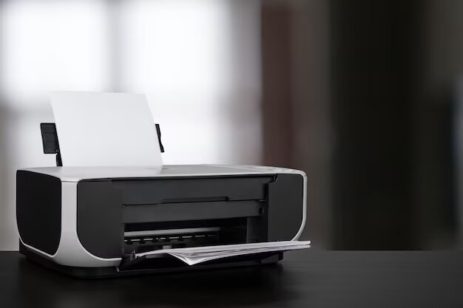
PRINTER

Slide 3

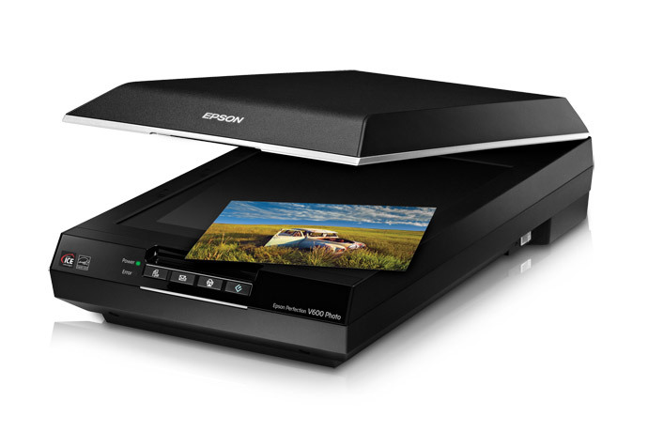
SCANNER

