Slide 1
SEO Project Comprehensive SEO Audit & Optimization for Organic Traffic Growth
PREETHI | MBT12

Slide 2
The company I have selected for the SEO Audit :
Just billing (https://justbilling.in/)
GOFRUGAL (https://www.gofrugal.com/)
Salesforce(https://www.salesforce.com/in/)”

Slide 3
Company selection
I selected the company “Just billing (https://justbilling.in/)” for this SEO project.
About Just billing:
Just Billing is an easy to use and comprehensive GST Invoicing & Billing App for Retail & Restaurant. It runs both on mobile and computer.
POS Software - makes it easier for you to keep track of your business & pay more importance to your business growth.
POS Software - Point of sale

Slide 4
Initial Audit :
Title: Just Billing- Best Android, Windows, iOS POS Billing Software.
Description : Simplify your business transactions with our user-friendly - Just Billing is an easy to use and comprehensive GST Invoicing & Billing App for Retail & Restaurant.
It provides the information of how to install the app , but it doesn’t provide the information for the device, it limited to some specific common devices.
POS software
Mobile POS (Android )
Windows POS
To enhance customer service ,they provide customized options.
Retail Billing Software (Super market, Grocery, Electronics, Gift Shops & Stationery)
Restaurant Billing Software (Take away, Self service, Ice cream parlor, Coffee shop, Bakery)
POS for Service Business (Accountant, Lawyer, Consultant, Photographer)

Slide 5
Keyword Research:
This page doesn’t have any specific key word, & long tailed keywords
It is not optimized, they have used the name repeatedly like (Billing ,POS, Software,Windows)
We can use Long-tailed keyword like “Best POS software for small businesses,Affordable billing software for retail” , etc..
ALTERNATE
ZOHO BILLING Keywords:
Zoho Billing Software
Zoho Invoice
Billing Solutions by Zoho
Long tailed keyword
How to use Zoho for billing
Best billing software for small businesses

Slide 6
On – Page SEO :
TITLE : Just Billing- Best Android, Windows, iOS POS Billing Software
Description : Simplify your business transactions with our user-friendly - Just Billing is an easy to use and comprehensive GST Invoicing & Billing App for Retail & Restaurant.
This page does not have optimized keyword , here I have mentioned the repeated words :
85 billing
67 POS
38 software
22 gst
19 retail
16 windows
15 business
14 android

Slide 7
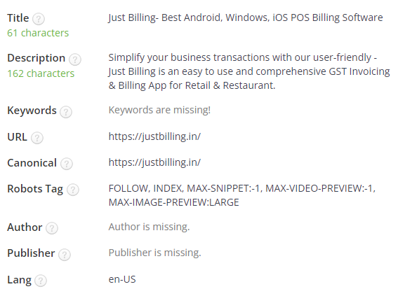
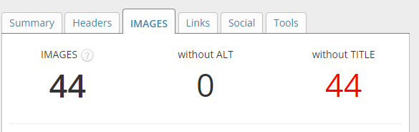
They have used the internal linking for CTA like explore more.
External link is only to use give the over view of Just billing.
They didn’t provide any video to how to download I and use in both internal & external link.
They have Optimize images with alt texts and descriptive file names

Slide 8
Technical SEO :
About Tags:
The page is using the canonical link tag.
The page does not contain any noindex header or meta tag.
Both the www and non-www versions of the URL are redirected to the same site.
Late response:
Some Javascript files don't seem to be minified.
Some CSS files don't seem to be minified.
The page makes 109 requests. More than 20 requests can result in slow page loading.
Security:
Google has not flagged this site for malware. It’s safe to browse
The site is using a secure transfer protocol (https).

Slide 9
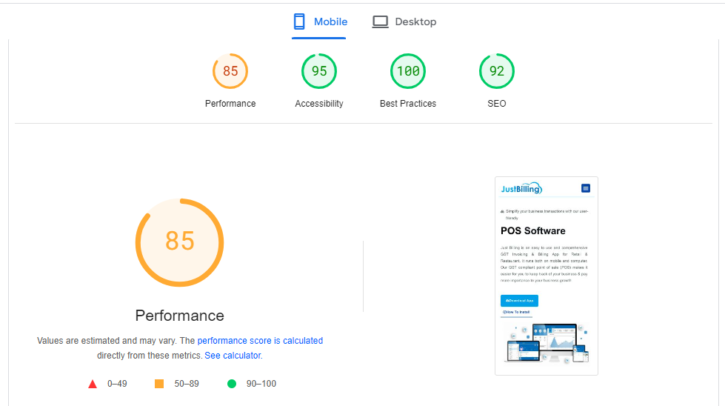
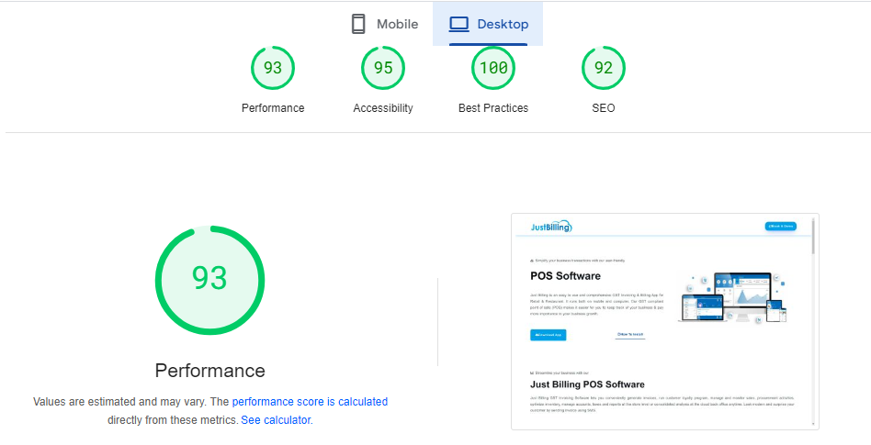
→Mobile
Desktop ←

Slide 10
To improve site and web page speed :
Choose a Reliable Hosting Provider,
Combine Files,
Compress Images,
Set Cache Headers,
Regular monitoring

Slide 11
Content Strategy :
Step-by-Step Guide to download and setup the “Just Billing” in both mobile and software.
Develop the detailed guidance.
Using the catchy CTA for download like “Click here or download”.
Using a proper keyword for primary and long tailed keywords (billing solutions, how to use Just Billing for invoicing.
Use H1, H2, and H3 tags effectively to structure content.
Optimize title tags and meta descriptions using target keywords.

Slide 12
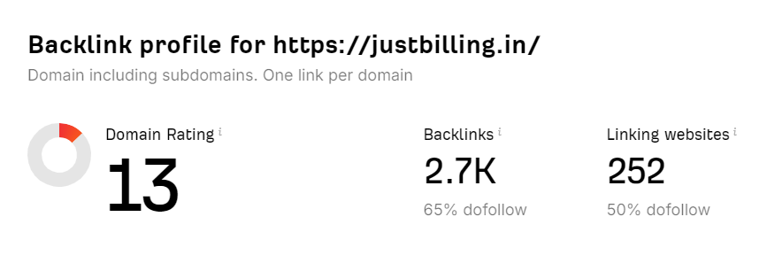
Off-Page SEO :
Content Sharing: Share blog posts, guides, and success stories to engage your audience and drive traffic back to the website
Encourage Customer Reviews: Ask satisfied users to leave positive reviews on platforms
Guest Blogging: Write guest posts on reputable blogs within the finance, accounting, or tech niches. Include backlinks to relevant pages on the JustBilling site.
Engagement Metrics: Track social media engagement, referral traffic, and reviews to evaluate the effectiveness of off-page strategies.

Slide 13
Company selection
I selected the company “GOFRUGAL (https://www.gofrugal.com/)” for this SEO project.
About Gofrugal:
Digital-first company that offers ERP solutions for retail, restaurant, and distribution businesses.
Easy and simple omnichannel ERP
Enterprise resource planning - It's a software system that includes all the tools and processes required to run a successful company, including HR, manufacturing, supply chain, finance, accounting, and more.

Slide 14
Initial Audit :
Title: Gofrugal | ERP Software for Retail, Restaurant, & Distribution Industries
Description : Gofrugal ERP system is a comprehensive billing to balance sheet solution scalable to meet the needs of any business. Our growing customers across 70+ countries and more than 1000+ partners across the world enjoy the lowest total cost of ownership with our ERP software.
It help you transform and manage the transition easily
Reimagine the customer experience.
Empower employees with the right technology.
Freedom to connect with your favorite apps.
Continuous innovation.

Slide 15
Keyword Research:
They have used the optimized key words.
The keyword used here are pos software, point of sale software, pos system, pos solutions, gofrugal.
Other key words can be used as “Business Management Software, Retail Management Software”
We can use Long-tailed keyword like “How to implement GoFrugal GoFrugal software pricing and features” , etc..
ALTERNATE
NetSuite Keywords:
NetSuite ERP
Cloud ERP Solutions
NetSuite CRM
Long tailed keyword
Features of NetSuite ERP
How to implement NetSuite ERP

Slide 16
On – Page SEO :
TITLE : Gofrugal | ERP Software for Retail, Restaurant, & Distribution Industries
Description : Gofrugal ERP system is a comprehensive billing to balance sheet solution scalable to meet the needs of any business. Our growing customers across 70+ countries and more than 1000+ partners across the world enjoy the lowest total cost of ownership with our ERP software.
The most common keywords we found on the page
42 ERP
29 Business
29 Retail
25 Software
22 Gofrugal
9 Experience
8 Manage
8 Inventory
7 Grow

Slide 17
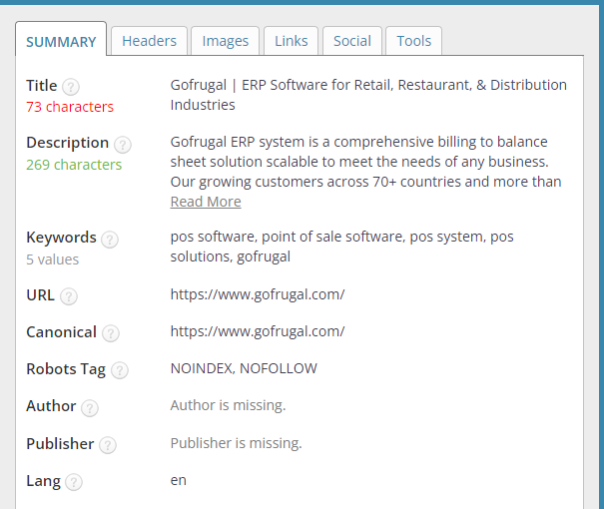
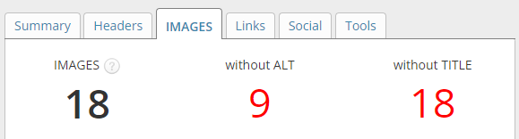
They have used the internal linking for CTA like explore more.
There is no External link.
They didn’t provide any video to how to download I and use in both internal & external link.
They have Optimize images but from images alt texts are missing and they provided descriptive file names.

Slide 18
Technical SEO :
About Tags:
The page is using the canonical link tag.
The page does not contain any noindex header or meta tag.
Both the www and non-www versions of the URL are redirected to the same site.
One H1 tag was found on the page.
Response:
Some Javascript files don't seem to be minified.
All CSS files appear to be minified..
The page makes 19 requests.
Security:
Google has not flagged this site for malware. It’s safe to browse
The site is using a secure transfer protocol (https).
Directory Listing seems to be disabled on the server.

Slide 19
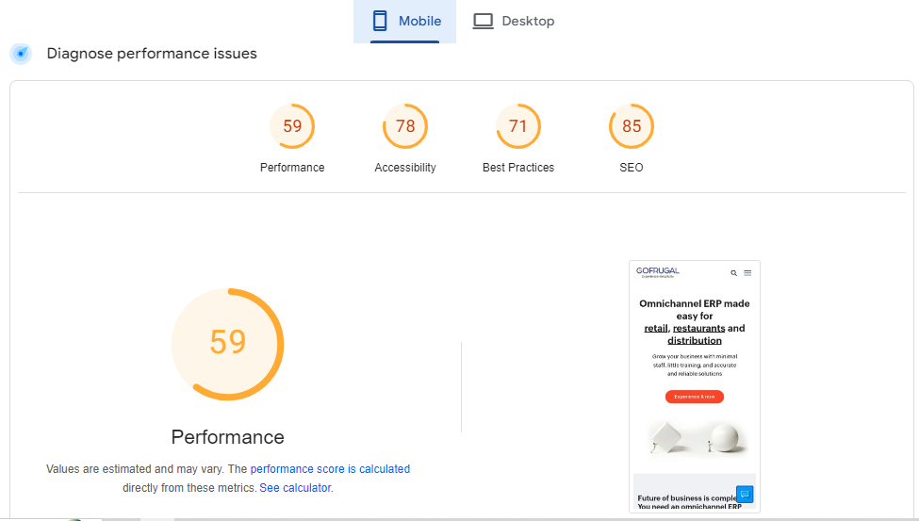
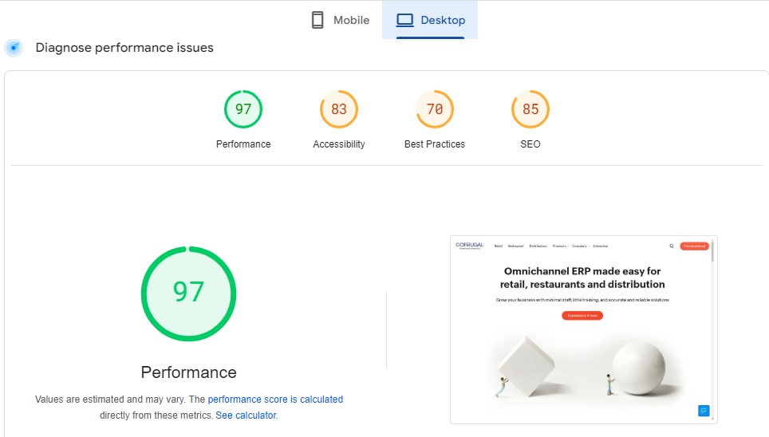
→Mobile
Desktop ←

Slide 20
To improve site and web page speed :
Choose a Reliable Hosting Provider,
Combine Files,
Compress Images,
Set Cache Headers,
Regular monitoring

Slide 21
Content Strategy :
Understand the challenges these personas face, such as managing inventory, streamlining operations, or reducing costs.
Create articles addressing industry trends, product features, and how-to guides
Using a proper keyword for primary and long tailed keywords (GoFrugal ERP, benefits of GoFrugal for retail.
Use H1, H2, and H3 tags effectively to structure content.
Optimize title tags and meta descriptions using target keywords.
Using catchy CTA’s

Slide 22
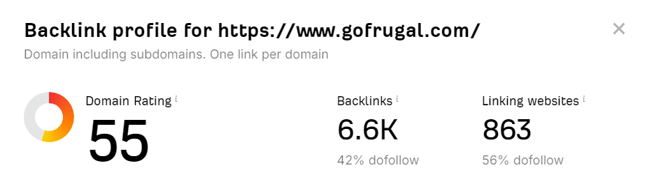
Off-Page SEO :
Guest Blogging: Contribute articles to reputable industry-related blogs and websites. Ensure to include backlinks to relevant pages on GoFrugal.
Active Profiles: Maintain active social media profiles on platforms like LinkedIn, Facebook, and Twitter. Share content that highlights GoFrugal's features, case studies, and industry insights.
Engage with Influencers: Collaborate with industry influencers to extend reach and credibility.
Local Directories: List GoFrugal in local business directories to improve local search visibility.

Slide 23
Company selection
I selected the company “Salesforce(https://www.salesforce.com/in/)” for this SEO project.
About Salesforce:
It is a cloud-based customer relationship management (CRM) platform that helps businesses connect with their customers
It centralize customer information, streamline sales processes, manage marketing campaigns, and provide actionable analytics, thereby improving customer relations and driving sales efficiency in businesses

Slide 24
Initial Audit :
Title:Salesforce: The Customer Company | Salesforce India
Description : Personalise every experience along the customer journey with the Customer 360. Unify marketing, sales, service, commerce, and IT on the world's #1 CRM.
It is a customer relationship management (CRM) platform. This helps in marketing, sales, commerce, service and IT teams work as one from anywhere
To enhance customer service ,they provide module
Salesforce values : quick ,look
Sales force CRM
Sales cloud basics

Slide 25
Keyword Research:
This page doesn’t have any specific key word, & long tailed keywords
It is not optimized, they have used the name repeatedly like (Salesforce,Cloud,trail)
We can use Long-tailed keyword like “How to implement Salesforce CRM , Benefits of using Salesforce for sales teams” , etc..
ALTERNATE
Adobe Campaign Keywords:
Adobe Campaign
Adobe Campaign Pricing
Marketing Automation Software
Long tailed keyword
How to use Adobe Campaign for email marketing
Benefits of Adobe Campaign for digital marketing

Slide 26
On – Page SEO :
TITLE : Salesforce: The Customer Company | Salesforce India
Description : Personalise every experience along the customer journey with the Customer 360. Unify marketing, sales, service, commerce, and IT on the world's #1 CRM.
This page does not have optimized keyword , here I have mentioned the repeated words :
8 Learn
8 Logo
6 Salesforce
6 Service
6 Cloud
5 Free
4 Customers
3 Sales
3 Start
3 Trial

Slide 27
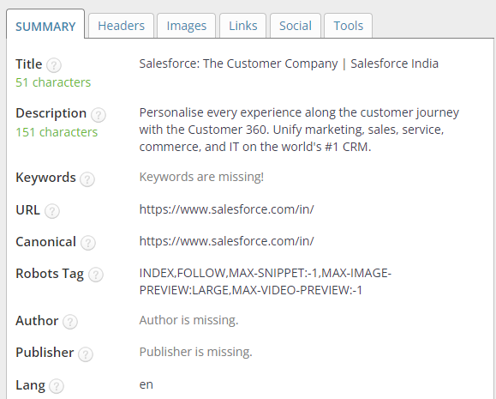
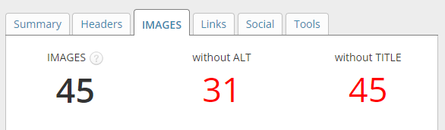
They have used the internal linking for CTA like explore more.
There is no External link.
They didn’t provide any video to how to download I and use in both internal & external link.
They have Optimize images but from images alt texts are missing and they provided descriptive file names.

Slide 28
Technical SEO :
About Tags:
The SEO title is set and is 51 characters long.
The page does not contain any noindex header or meta tag.
Both the www and non-www versions of the URL are redirected to the same site.
Late response:
Some Javascript files don't seem to be minified.
Some CSS files seem to be minified.
The page makes 45 requests. More than 20 requests can result in slow page loading.
Security:
Google has not flagged this site for malware. It’s safe to browse
The site is using a secure transfer protocol (https).

Slide 29
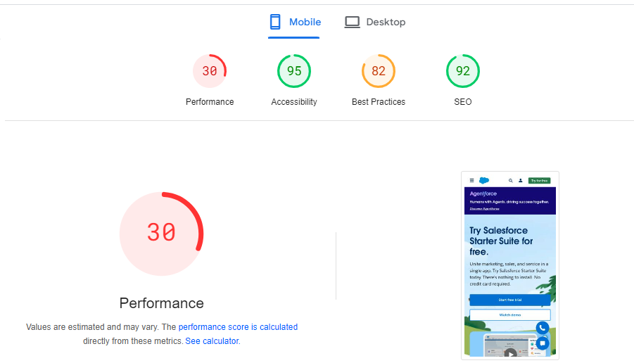
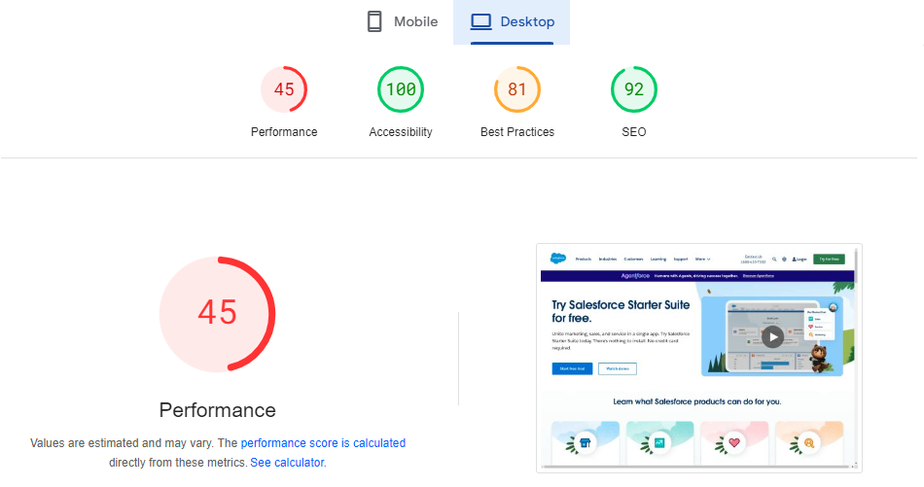
→Mobile
Desktop ←

Slide 30
To improve site and web page speed :
Choose a Reliable Hosting Provider,
Combine Files,
Compress Images,
Set Cache Headers,
Regular monitoring

Slide 31
Content Strategy :
Highlight successful implementations of Salesforce solutions by Indian companies to showcase ROI and real-world applications.
Keyword Integration: Use target keywords naturally in titles, headings, and throughout the content.
Meta Tags:Use H1, H2, and H3 tags effectively to structure content.
Using catchy CTA’s
Educational Content: Topics like "How to Choose the Right CRM for Your Business" or "Top 5 Features of Salesforce CRM.“
Content Refresh: Regularly update older content to keep it relevant and optimized.

Slide 32
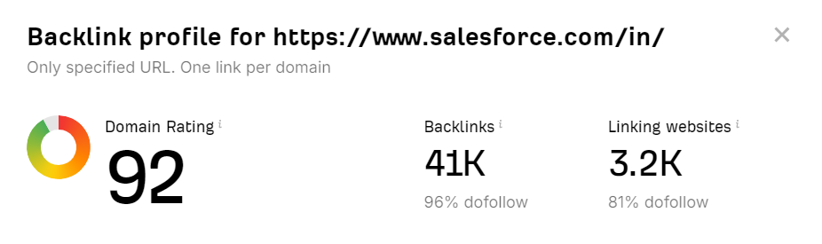
Off-Page SEO :
Industry Publications: Collaborate with industry publications to feature articles about Salesforce, linking back to the website.
Engage with Influencers: Partner with industry influencers to extend reach and credibility.
Showcase Success Stories: Highlight customer testimonials on the website and in promotional materials to build trust.
Optimize Google My Business: Ensure the Google My Business profile is fully optimized with accurate information, images, and regular updates.

Slide 33
Conclusion
This SEO audit report provides a starting point for improving online visibility and search engine ranking. By implementing the recommended actions.

Slide 34
Thank you !

