Slide 1

ANALYSIS

Slide 2
Introduction to Myntra.com
Myntra started as a B2B venture for personalized gifts, but transitioned to a full-fledged e-commerce company within a few years. In 2014, Flipkart acquired Myntra, and in 2018, Myntra became part of the Walmart Group
Myntra offers a wide range of products and brands, and has a loyalty program for customers. In 2022, Myntra launched an express delivery service, which allows shoppers to receive their orders within 24–48 hours.
Myntra sells a variety of products, including apparel, accessories, cosmetics, and footwear from over 500 brands
Myntra has added more than 50 international brands in the past year, including Mango, H&M, Nautica, Trendyol, NEXT, Kiabi, FCUK, Macy's, Barry M, and Parfois.

Slide 3

Social media platforms
#MyntraFashionSuprstar contest.
#mymyntralook,
#MyntraBFFWishlistNow
#myntrafashion
#myntraendofreasonsale
#fashionblogger
Myntra works with a variety of influencers, including celebrities, content creators, and fashion bloggers, to create content and advertise its products. They also have a reality show called Myntra Fashion Superstar to discover new influencers on the platform.

Slide 4


Reviews on Social media platforms
Promises delivery within 24–48 hours.
Not in good quality
Available 24/7 to answer queries
Late response
Offers a 30-day return policy
Instead of returning of r cash , offering vouchers
Cash on delivery
Damaged product

Slide 5
Competitors
Top 7 Competitors
1.Ajio.com
In August ajio.com received 21.45M visits with the average session duration 07:27. Compared to July traffic to ajio.com has decreased by -29.13%.
2.Meesho.com
In August meesho.com received 30.45M visits with the average session duration 10:27. Compared to July traffic to meesho.com has decreased by -8.06%.
3.Tatacliq.com
In August tatacliq.com received 7.78M visits with the average session duration 06:25. Compared to July traffic to tatacliq.com has increased by 28.42%.

Slide 6
4.Esty.com
In August etsy.com received 406.25M visits with the average session duration 09:56. Compared to July traffic to etsy.com has increased by 9.31%.
5.Nykaa.com
In August nykaa.com received 12.06M visits with the average session duration 05:05. Compared to July traffic to nykaa.com has decreased by -0.4%.
6.Flipkart.com
In August flipkart.com received 217.72M visits with the average session duration 08:26. Compared to July traffic to flipkart.com has decreased by -10.43%.
7.Jiomart.com
In August jiomart.com received 12.81M visits with the average session duration 06:54. Compared to July traffic to jiomart.com has increased by 4.91%.

Slide 7
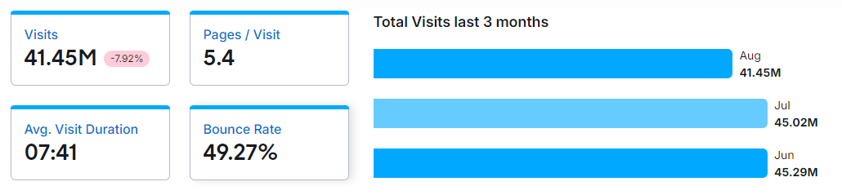
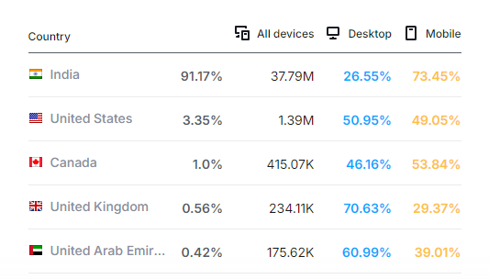
Myntra
In August myntra.com received 41.45M visits with the average session duration 07:41. Compared to July traffic to myntra.com has decreased by -7.92%.
Traffic by Country

Slide 8
Trend Fashion
Sustainability
Consumers are increasingly demanding sustainable and eco-friendly products, leading many companies to change their practices.
Artificial intelligence (AI)
AI-powered tools are becoming more common in the fashion industry, helping with trend prediction, design, and consumer preference prediction
3D printing
3D printing is a popular technology trend in the fashion industry, with benefits for both clothing and footwear.
Gender fluidity
Gender-fluid fashion is a big trend that's expected to continue.
Influencer marketing
Influencer marketing is a popular strategy for brands to improve their visibility, engagement, and reach.
Inventory management
Effective inventory management is critical in the fashion industry, where products have a short lifecycle and trends change quickly.

Slide 9
Improving Marketing position
The Rise of Vertical Integration
Consolidation: The Survival of the Fittest
Sustainability: A Regulatory and Ethical Imperative
Mass Customization: The Personal Touch
Geographic Dispersion and New Manufacturing Hubs
Transparency and Traceability: The Conscious Consumer
Automation: The New Workforce
Digital Transformation: Beyond the Buzzword
Fiscal Agility: Balancing the Books
Generative AI: The New Frontier in Fashion Innovation

