Slide 1
KEYLOGGER
CAPSTONE PROJECT
Presented By:
PREETHI P - Jeppiaar Institute of Technology – B.TECH IT

Slide 2
OUTLINE
Problem Statement
Proposed System/Solution
System Development Approach
Algorithm & Deployment
Result
Conclusion
Future Scope
References

Slide 3
PROBLEM STATEMENT
Develop a simple keylogger application using Python's Tkinter library and Pynput module. The keylogger should record key presses, holds, and releases, and save the data both in a text file and a JSON file.

Slide 4
PROPOSED SOLUTION
1. *Keylogger Functionality:* - Utilize the Pynput module to capture key events such as press, hold, and release. - Define functions on_press() and on_release() to handle key events and update the key log accordingly. - Use a global variable flag to differentiate between key presses and holds.
2. *Data Logging:* - Implement functions to generate both text and JSON log files. - Use generate_text_log() to save keys in a text file (key_log.txt). - Use generate_json_file() to save keys in a JSON file (key_log.json).
3. *User Interface:* - Build a simple GUI using Tkinter with Start and Stop buttons. - Define functions start_keylogger() and stop_keylogger() to start and stop the keylogger respectively. - Display status messages using a Label widget.

Slide 5
SYSTEM APPROACH
1. *Start Button:* - When the user clicks the "Start" button, start_keylogger() function is triggered. - This function initializes a keyboard listener using Pynput and updates the UI to indicate that the keylogger is running.
2. *Stop Button:* - When the user clicks the "Stop" button, stop_keylogger() function is called. - This function stops the keyboard listener and updates the UI to indicate that the keylogger has stopped.
3. *Key Logging:* - The on_press() and on_release() functions capture key events and update the key log accordingly. - Key events are differentiated between presses, holds, and releases based on the flag variable.

Slide 6
ALGORITHM & DEPLOYMENT
1 1. Algorithm:* - Initialize Tkinter window with a Label and two Buttons. - Define functions to start and stop the keylogger. - Implement functions to capture key events and update the log files.
2. *Deployment:* - Run the Python script on any system with Python and the required dependencies installed.
/

Slide 7
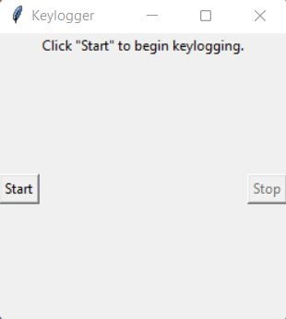
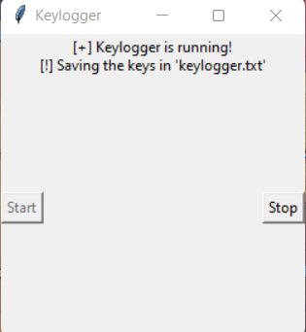
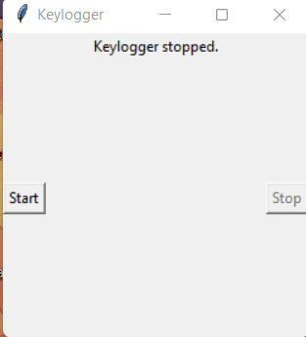
RESULT
The application provides a simple GUI interface to start and stop the keylogger. It records key events and saves them in both text and JSON formats.

Slide 8
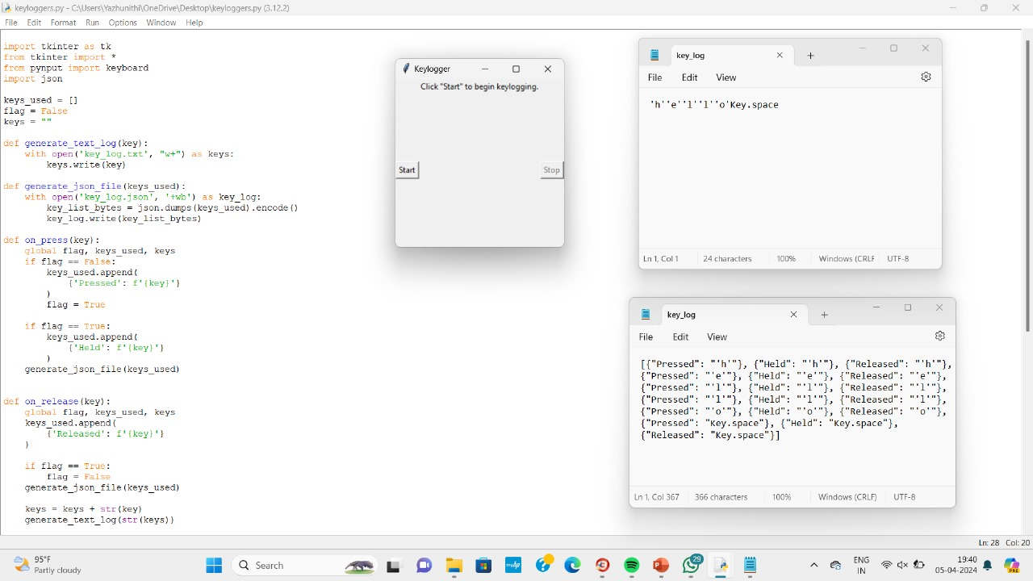
OUTPUT

Slide 9
CONCLUSION
The keylogger application successfully captures key events and saves them in log files. It provides a user-friendly interface for easy operation.

Slide 10
FUTURE SCOPE
1. mplement encryption for enhanced security of the logged data.
2. Add features for remote monitoring and control.
3. Improve logging efficiency and minimize resource consumption.

Slide 11
REFERENCES
- Tkinter Documentation: https://docs.python.org/3/library/tkinter.html
- Pynput Documentation: https://pynput.readthedocs.io/en/latest/

Slide 12
THANK YOU

