Slide 1
EMPLOYEE DATA ANALYSIS USING EXCEL
STUDENT NAME: PREETHI. P
REGISTER NO : 312204604
DEPARTMENT : COMMERCE
COLLEGE : K.C.S KASI NADAR COLLEGE OF ARTS & SCIENCE

Slide 2
PROJECT TITLE
Employee Rating card analysis

Slide 3


AGENDA
Problem Statement
Project Overview
End Users
Our Solution and Proposition
Dataset Description
Modelling Approach
Results and Discussion
Conclusion
3/21/2024 Annual Review

Slide 4

PROBLEM STATEMENT
The goal is typically to identify patterns, assess individual or team performance, and make data-driven decisions to improve overall productivity and employee satisfaction.

Slide 5

PROJECT OVERVIEW
Analysing this data can help organizations identify trends, strengths, and areas for improvement, which can inform decisions on promotions, training, and other HR-related actions.
Tables
Slicers
Pivot chart (line chart, pie chart )
Pivot chart formulas

Slide 6

WHO ARE THE END USERS?
Civil Engineering Department
Computer Engineering Department
Electrical Engineering Department
Electronics Engineering Department

Slide 7

OUR SOLUTION AND ITS VALUE PROPOSITION
Accessibility
Ease of use
Data organization
Data integration
Formulas and functions
Pivot tables
Charts and graphs
Used to analyse different situation

Slide 8
Dataset Description
Data Overview :
The data involved in Employee Rating Card Analysis typically consists of both quantitative and qualitative components.
Data fields :
Employee Name
Gender
Department
Problem solving
Punctuality
Communication
Team work

Slide 9
MODELLING
Data cleaning.
Creating table.
Creating pivot chart.
Creating dashboard.
Inserting pivot chart in dashboard.
Inserting formulas in dash board to make interaction.
Creating interactive dashboard by putting all together elements.
9

Slide 10
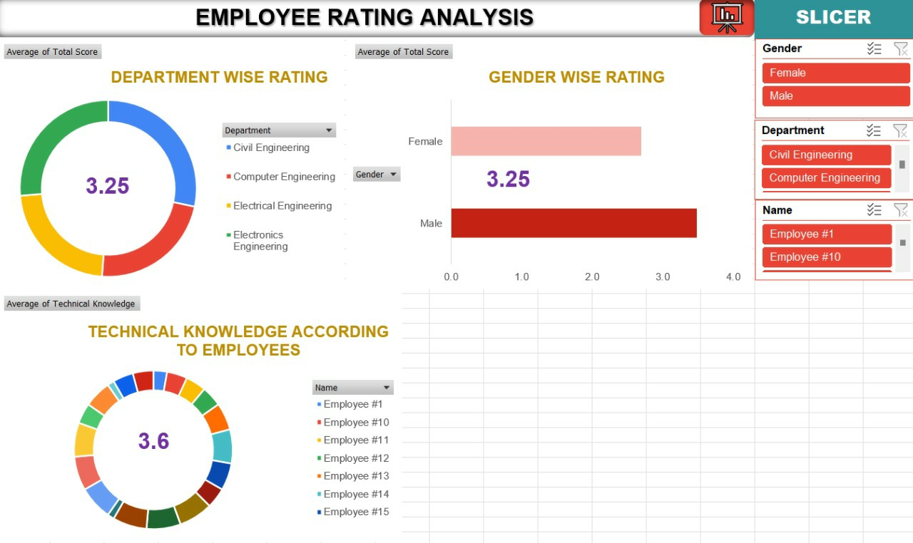
RESULTS
(Click to open file)
10

Slide 11
conclusion
The analysing an employee rating card in Excel, the conclusion typically summarizes the key findings and offers actionable insights based on the data. The analysis of the employee rating card reveals several important insights into the performance, strengths, and areas for improvement of the team.

