Slide 1
Employee Data Analysis using Excel
STUDENT NAME: PREETHI.S
REGISTER NO: 312205940,NAA MUDHALVAN,asunm293312205940
DEPARTMENT: COMMERCE (B.COM.GENERAL)
COLLEGE: VIDHYA SAGAR WOMEN’S COLLEGE.

Slide 2
PROJECT TITLE
Employee Performance Analysis using Excel

Slide 3


AGENDA
Problem Statement
Project Overview
End Users
Our Solution and Proposition
Dataset Description
Modelling Approach
Results and Discussion
Conclusion
3/21/2024 Annual Review

Slide 4

PROBLEM STATEMENT
Employment performance analysis evaluates employee productivity and efficiency, helping organizations improve workforce effectiveness and achieve business goals
Employment performance analysis also identifies training needs, informs promotion and compensation decisions, and enhances overall employee engagement and retention

Slide 5

PROJECT OVERVIEW
Employee data analysis involves collecting and analyzing data on aspects like employee performance, turnover rates, engagement levels, and skill gaps. It uses statistical methods, data visualization, and predictive analytics to identify trends and patterns. This helps organizations make informed decisions on hiring, training, and retention strategies. It also aids in identifying areas for improving employee satisfaction and productivity. Ultimately, it supports data-driven HR management and better organizational outcomes.
.

Slide 6
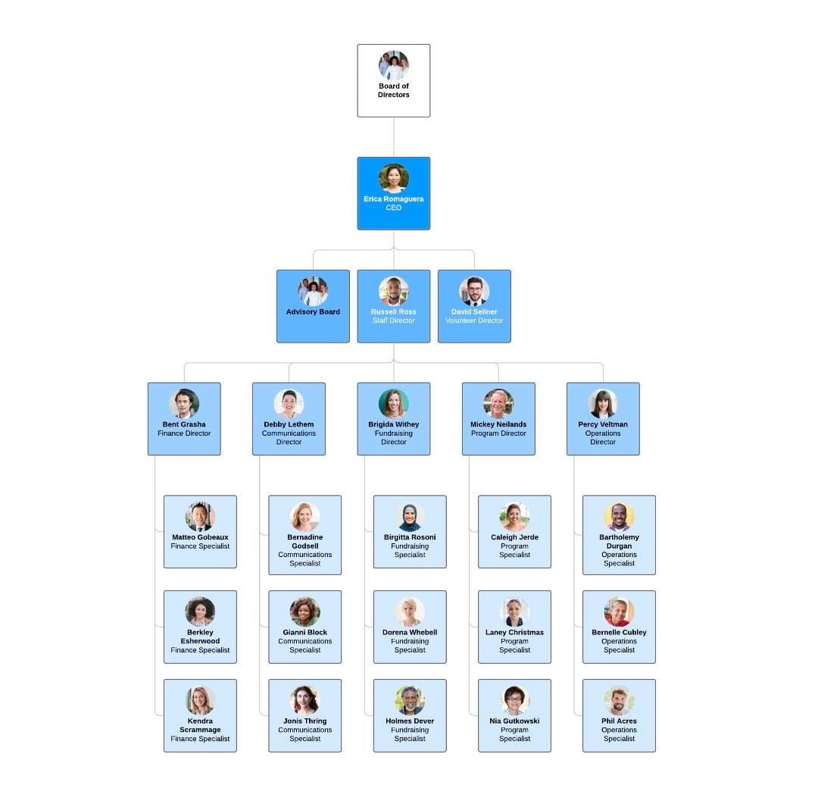

WHO ARE THE END USERS?
Board of Directors
Chief Executive Officer (CEO)
Chief Officers (CFO, COO, CMO, etc.)
Vice Presidents/Directors
Department Managers
Supervisors/Team Leaders
Operational Staff
Frontline Workers

Slide 7

OUR SOLUTION AND ITS VALUE PROPOSITION
Conditional format:
Formula :
IFS=Z8>=5”VERY HIGH”,Z8>=4,”HIGH”,Z8>=3,”MED,”TRUE,LOW)
FILTER
click conditional formatting
clickhighlight cell rules
click more rules
click option"blanks"
click Format only cell that contain
click "blank"
choose font fill colour "RED"
click filter option :colour
Missing value remove
click the filter option(by choosing colour"red")(no fill)
PIVOT SUMMARY
insert a pivot table by selecting your data range
common structure:rows(employee name\department,coloumns(KPIs),values(performance score)

Slide 8
Dataset Description
Employee data set-downloading in "NAN MUDHALVAN" dashboard
Employee Id-numerical values
Employee first name and last name
Employee type
Employee performance level
Employee gender-male,female
Employee rating-numerical values(value changing based on employee performance level like( "HIGH,MED,LOW")
EXAMPLE:MED=4,HIGH=5,LOW=2,3

Slide 9

THE "WOW" IN OUR SOLUTION
performance level=IFS(Z8>=5,"VERY HIGH",Z8>=4,"HIGH",Z8>=3,"MED",TRUE,"LOW')
3/21/2024 Annual Review
9

Slide 10
MODELLING
Data connection
1)download from edunet dashboard
2)using Excel features
3) highlights employee data set,creating new data set.
Future collection
1)(Pivot table):taking business unit into rows
2) identifying employee from various departments.
3) performance level into coloum level.
4)Remove empty cells.
5)take a gender collection click filter.
6) To find the grant total of employees gender like male,female.
10

Slide 11
DATA CLEANING
1) taking exit data column , there are some missing values.Steps for cleaning data
Step1: click conditional formatting
Step2: highlights cell rules.
Step3:more rules.
Step4:changing cell value blank
Step5: filling red colour*Exit data turned clear
PERFORMANCE LEVEL
Employee performance level based on numerical value like(1,2,3,4).4,5=" high" level 3,4="med" level 1,2 ="low" level To check multiple condition using IFS formula Z8>=5"VERY HIGH," Z8>=4"HIGH,"Z8>=3,"

Slide 12
1) taking exit data column , there are some missing values.Steps for cleaning data
Step1: click conditional formatting
Step2: highlights cell rules.
Step3:more rules.
Step4:changing cell value blank
Step5: filling red colour*Exit data turned clear
PERFORMANCE LEVEL
Employee performance level based on numerical value like(1,2,3,4).4,5=" high" level 3,4="med" level 1,2 ="low" level To check multiple condition using IFS formula Z8>=5"VERY HIGH," Z8>=4"HIGH,"Z8>=3,"MED","TRUE""LOW".Categories employee based on rating.

Slide 13
To summarize an employee data set, you typically need to include key elements such as:
*Employee Information*: Name, ID, Department, Position, and Contact Details.
*Demographics*: Age, Gender, Ethnicity, and Education.
*Employment Details*: Hire Date, Employment Status (full-time, part-time, temporary), and Work Location
*Compensation*: Salary, Bonuses, Benefits.
*Performance Metrics*: Performance Reviews, Achievements, and Goals.
*Attendance*: Attendance Records, Leave Taken, Absenteeism Rates.
*Tenure*: Length of Service and Promotion History.The specific details will depend on the scope of the data set and what aspects are being analyzed. If you provide more details or a sample of the data, I can help with a more tailored summary.

Slide 14
Employee Information: Name, ID, Department, Position, and Contact Details . Demographics: Age, Gender, Ethnicity, and Education . Employment Details: Hire Date, Employment Status (full-time, part-time, temporary), and Work Location. Compensation: Salary, Bonuses, Benefits . Performance Metrics: Performance Reviews, Achievements, and Goals . Attendance: Attendance Records, Leave Taken, Absenteeism Rates . Tenure: Length of Service and Promotion History.
.

Slide 15
Visualizing employee data can help you identify trends and insights. Here are some common types of visualizations for employee data : Bar Charts: Useful for comparing the number of employees in different departments or job roles . Pie Charts: Show the distribution of employees across various categories, like gender or employment status . Histograms: Display the distribution of numerical data, such as salaries or ages . Line Graphs: Track changes over time, such as employee turnover or attendance trends . Heat Maps: Show patterns and intensity, like absenteeism rates across different departments . Scatter Plots: Analyze relationships between two variables, such as performance ratings versus salary . Box Plots: Visualize the distribution and variability of salaries or other continuous data . Dashboards: Combine multiple visualizations to give a comprehensive view of various metrics and KPIs.

Slide 16
RESULTS
16

Slide 17
In this project, we successfully analyzed employee performance data using Microsoft Excel. By employing techniques such as data cleaning, applying the IFS formula, and creating pivot tables, we were able to efficiently evaluate and visualize key performance metrics.

Slide 18
conclusion
In this project, we successfully analyzed employee performance data using Microsoft Excel. By employing techniques such as data cleaning, applying the IFS formula, and creating pivot tables, we were able to efficiently evaluate and visualize key performance metrics.
Our analysis provided insights into employee performance trends, identified top and underperforming employees, and highlighted areas where improvements can be made. The use of Excel for this analysis proved to be highly effective due to its versatile functions and powerful data analysis tools.

Slide 19
This project demonstrates the importance of structured data handling and the potential of Excel in streamlining performance assessments for better decision-making. Moving forward, the insights gained can assist in optimizing employee performance and enhancing organizational efficiency.

Slide 20
Thank you

