Slide 1
Full Stack Development with MERN
THE STYLE – MERN Full Stack E-Commerce

Slide 2
1. Introduction
Project Title:
The Style – MERN Full Stack E-Commerce.
Team Members:
Preethi S

Slide 3
2.Project Overview:
Purpose:
The primary goal of The Style is to build a secure, scalable, and user-friendly online marketplace. It simplifies product discovery, enhances the shopping experience, and provides a centralized platform for both customers and administrators.
Features:
The platform ensures:
Smooth navigation and fast loading.
Secure authentication and authorization.
Efficient product and order management.
Responsive design across all devices.

Slide 4
3.ARCHItecture:
Frontend :
Built using React.js with a component-based architecture.
Navigation handled by React Router.
API communication handled with Axios.
Backend :
Follows RESTful API architecture.
Built using Node.js and Express.js.
Separate modules for routes, controllers, and models.
Middleware used for JWT authentication, Role-based authorization, Error handling and request validation.
Database:
MongoDB used for storing users, products, orders, and cart data.
Mongoose used for schema modelling and validation.

Slide 5
4. Setup Instructions:
Prerequisites:
Node.js
MongoDB
Visual Studio Code
Postman (for API testing)
Git
Installation:
Open the client folder and install required packages.
Open the server folder and install backend dependencies.
Configure environment variables.
Start the MongoDB service.

Slide 6
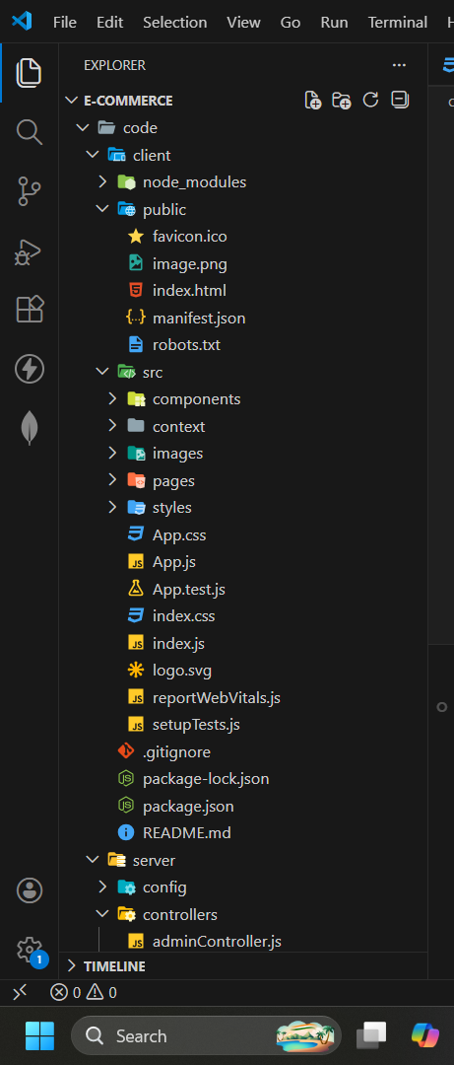
5. Folder Structure:

Slide 7
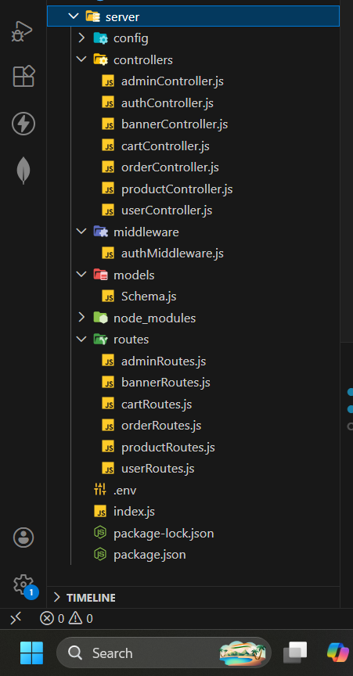
Server: Node.js backend.

Slide 8
6. Running the Application:
Frontend: npm start in the client directory.
cd client
npm start
Backend: npm start in the server directory.
cd server
node index.js

Slide 9
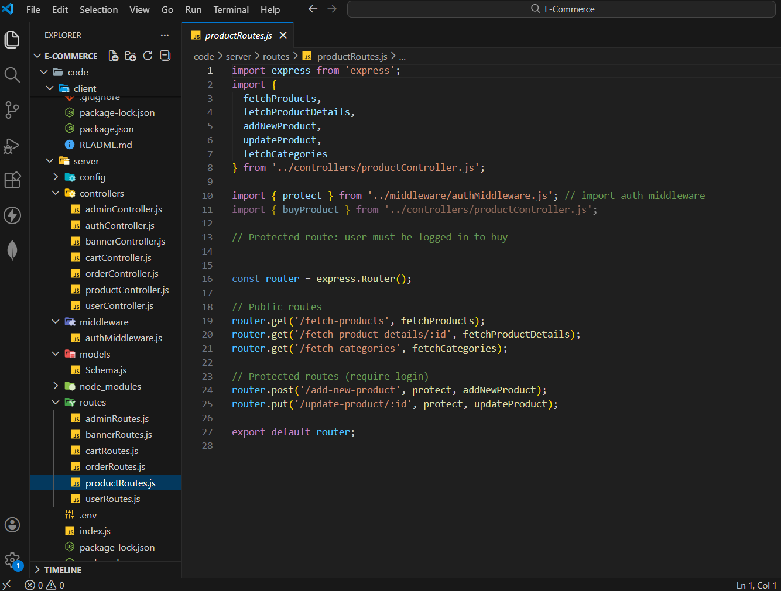
7. API Documentation:

Slide 10
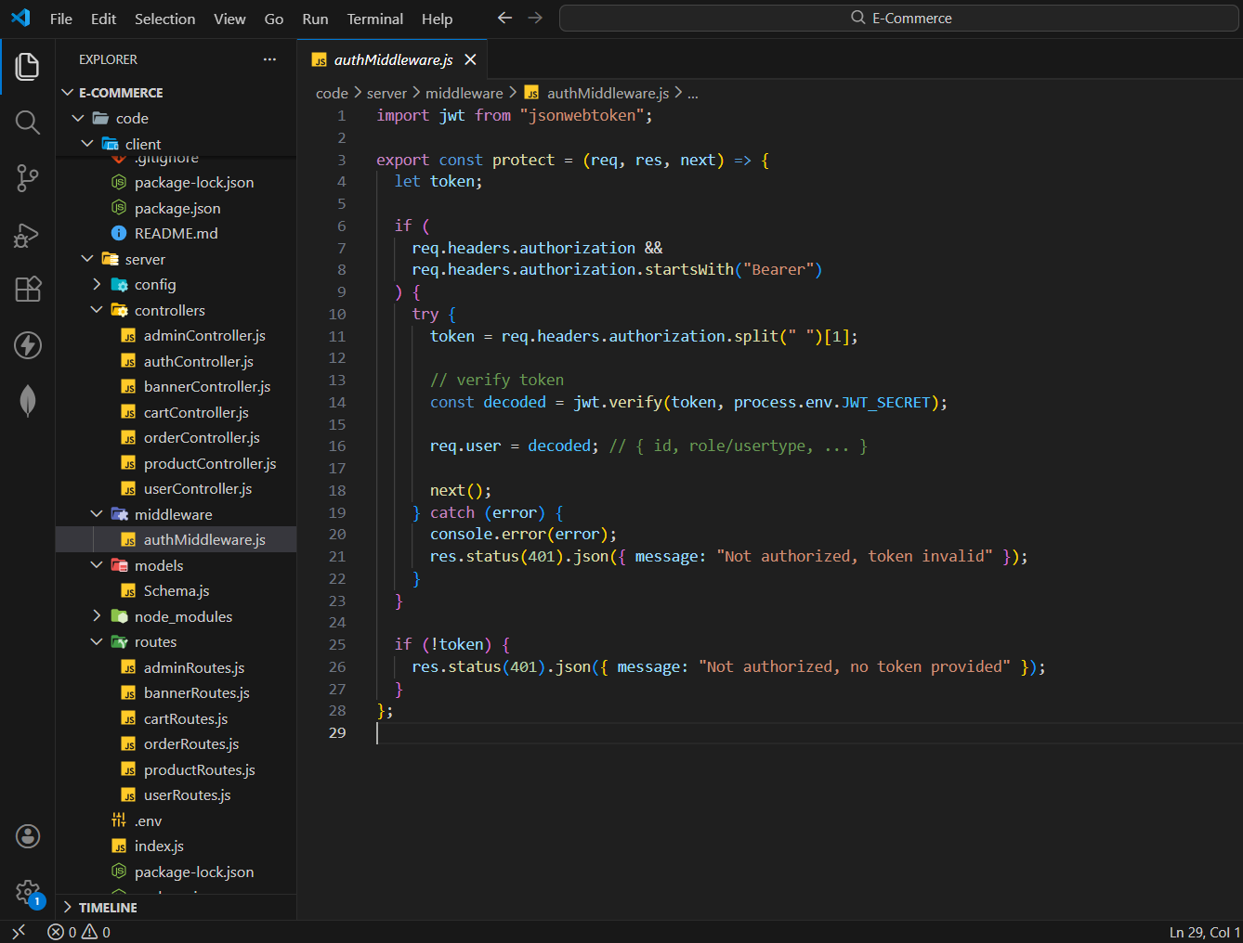
8. Authentication:

Slide 11
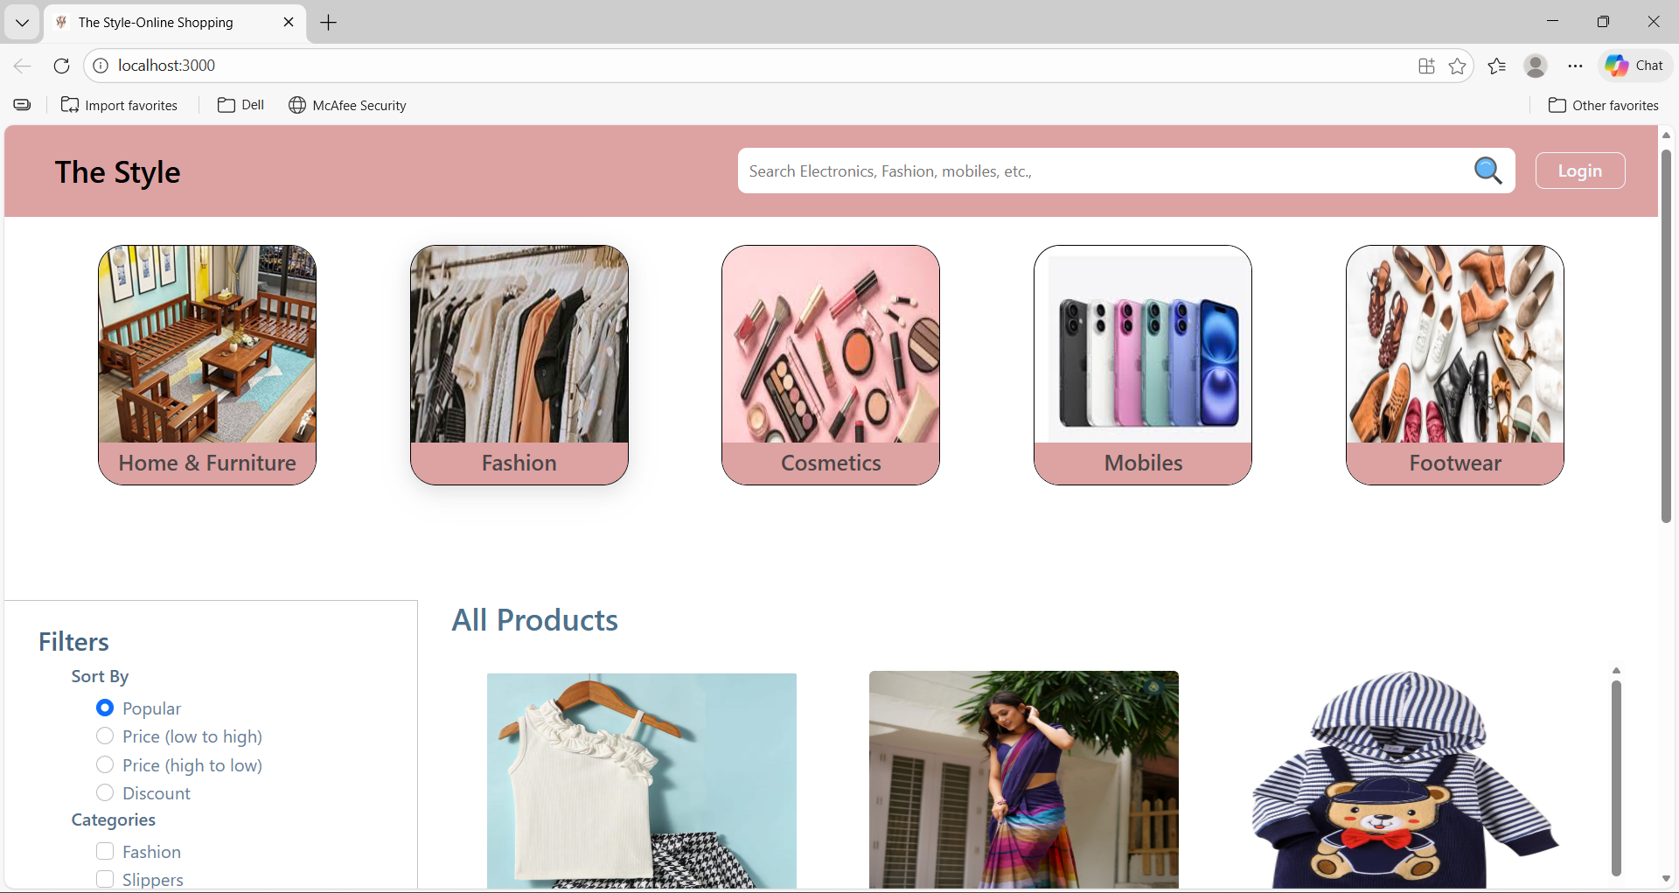
9. User Interface:

Slide 12
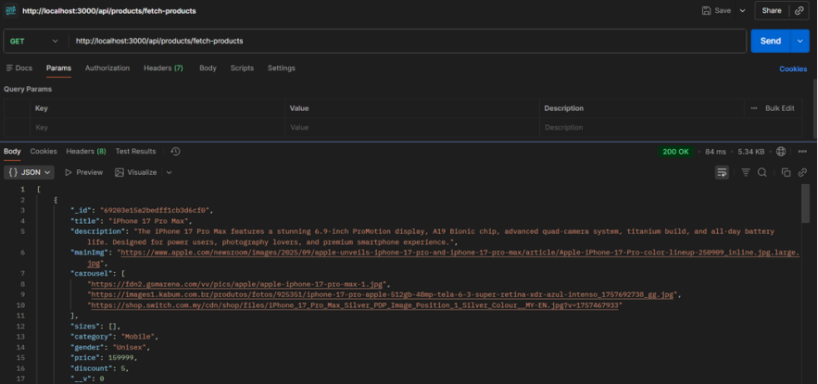
10. Testing:

Slide 13
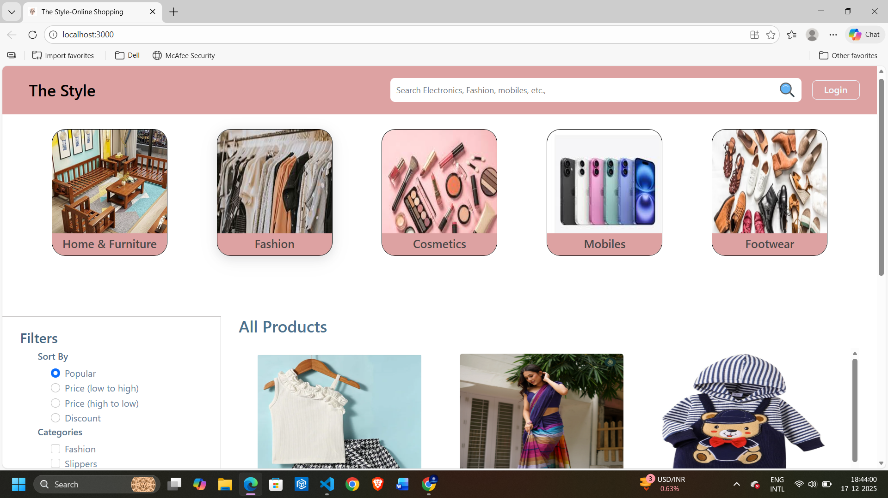
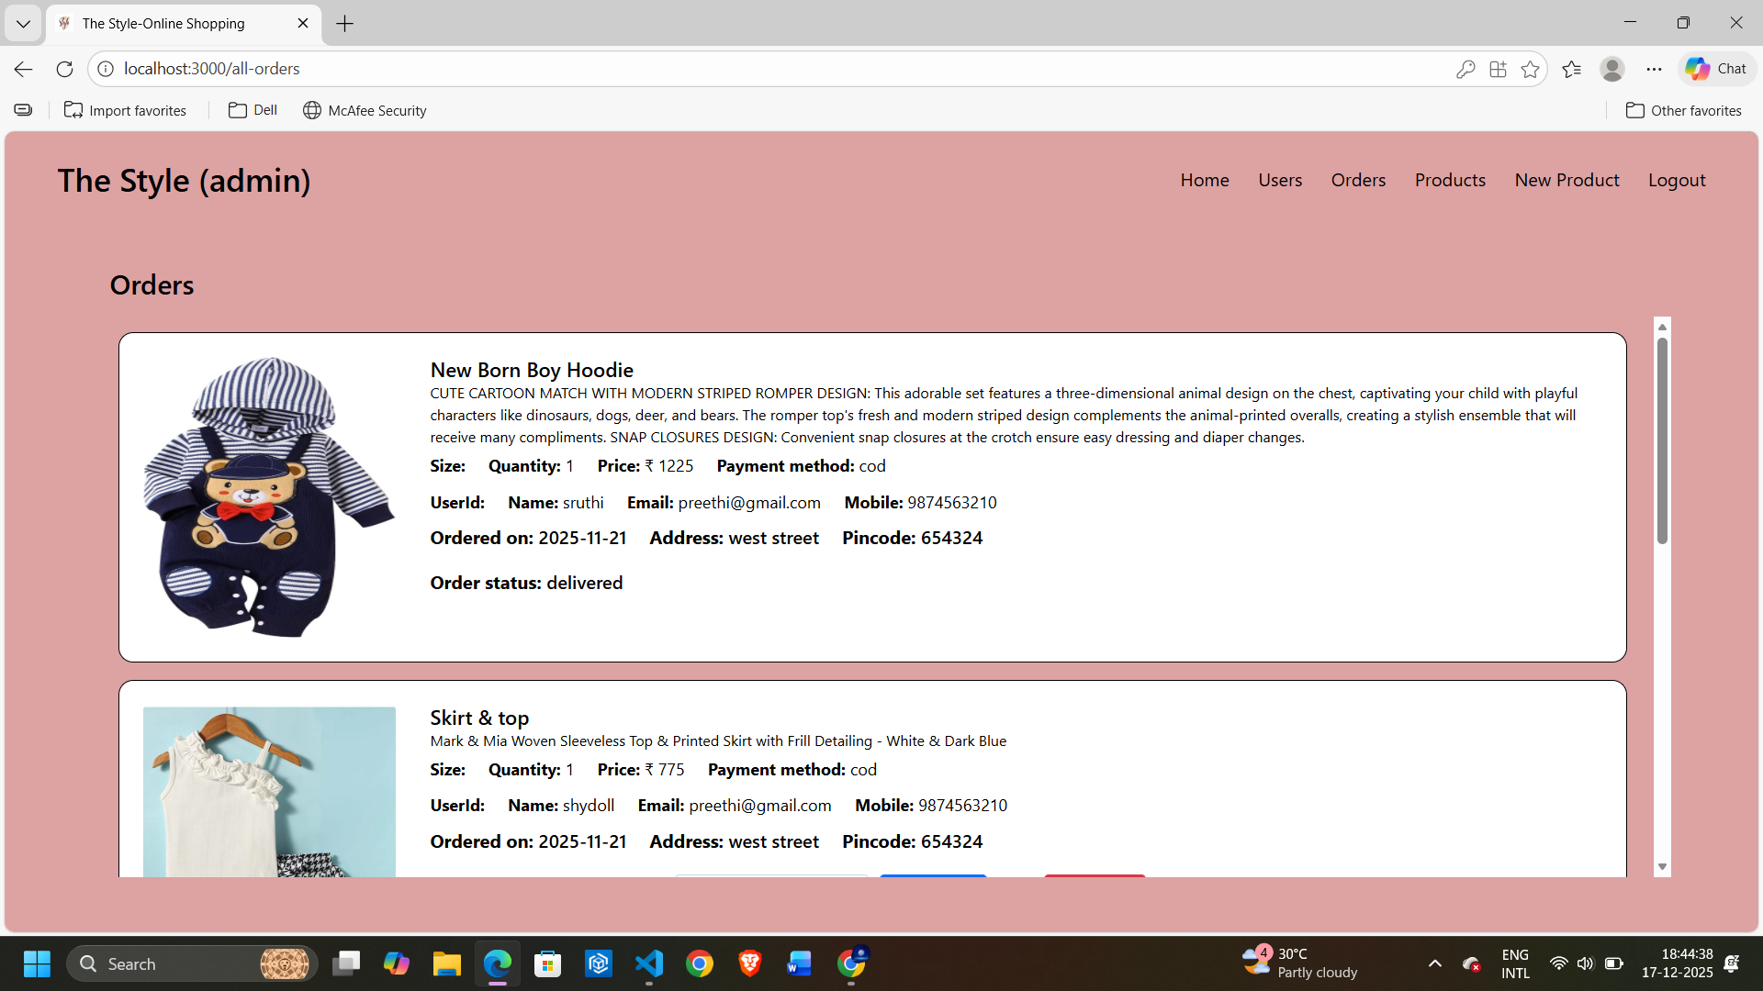
11. Screenshots & demo:

Slide 14
12. Known issues:
Online payment gateway integration pending
Email notification system not implemented
Pagination improvements needed for admin panels
UI optimization required for very small screen devices

Slide 15
13. Future enhancements:
Online payment integration
Order tracking feature
Wishlist functionality
Product reviews and ratings
Admin sales analytics dashboard
Email and notification services

