Slide 1
Full Stack Development with MERN
BOOKSTORE
-MERN FULL STACK ONLINE BOOKSTORE

Slide 2
1. INTRODUCTION:
Project Title : Bookstore-MERN Full Stack Online Bookstore
Team Members : Preethi S

Slide 3
2. Project Overview:
Purpose:
The primary objective of Book Store is to build a secure, scalable, and user-friendly online bookstore. It simplifies book discovery, enhances the reading purchase experience, and provides a centralized platform for both readers and administrators.
The platform ensures:
Easy book browsing and searching
Secure user authentication and authorization
Efficient book and order management
Responsive design across all devices

Slide 4
3. System Architecture:
Frontend:
The frontend is created using React.js with a component-based structure. It ensures reusability, fast rendering, and smooth navigation using React Router. State management is handled efficiently to manage cart and user data.
Backend:
The backend is built using Node.js and Express.js. It follows a RESTful architecture to manage requests related to users, books, cart, and orders. Middleware is used for authentication, error handling, and request validation.
Database:
MongoDB is used as the database to store user details, book information, cart items, and order records. Collections are designed to support scalability and efficient querying.

Slide 5
4. Setup Instructions:
Prerequisites:
Node.js
MongoDB
Visual Studio Code
Postman (for API testing)
Git
Installation:
Open the client folder and install required packages.
Open the server folder and install backend dependencies.
Configure environment variables.
Start the MongoDB service.

Slide 6
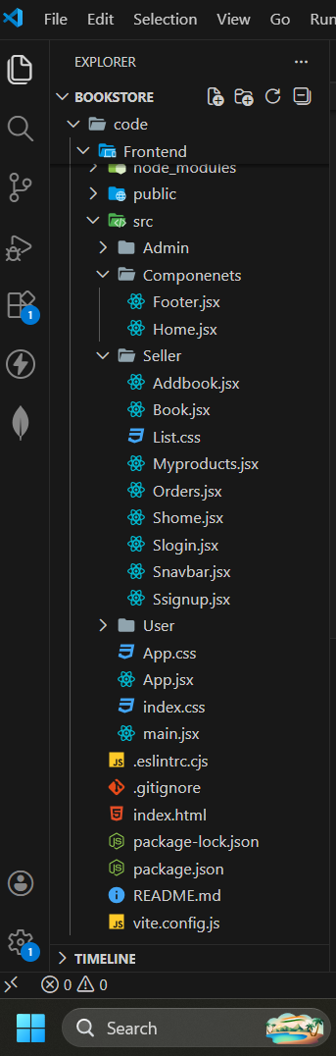
5. Folder Structure:
Client: React frontend

Slide 7
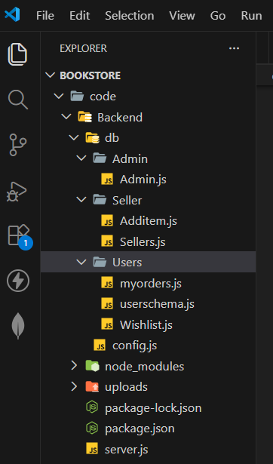
Server: Node.js backend

Slide 8
6. Running the Application:
Frontend: npm start in the client directory.
cd Frontend
npm start
Backend: npm start in the server directory.
cd Backend
node server.js

Slide 9
7. API Documentation:
Method | Endpoint | Description
POST | /api/users/register | Register new user
POST | /api/users/login | User login
GET | /api/products | Get all products
POST | /api/cart | Add item to cart
POST | /api/orders | Place order

Slide 10
8.Authentication:
Authentication is implemented using JWT (JSON Web Tokens). After login, a token is generated and used to access protected routes. Role-based authorization ensures that only administrators can access admin-level features. Passwords are securely encrypted before storing in the database.

Slide 11
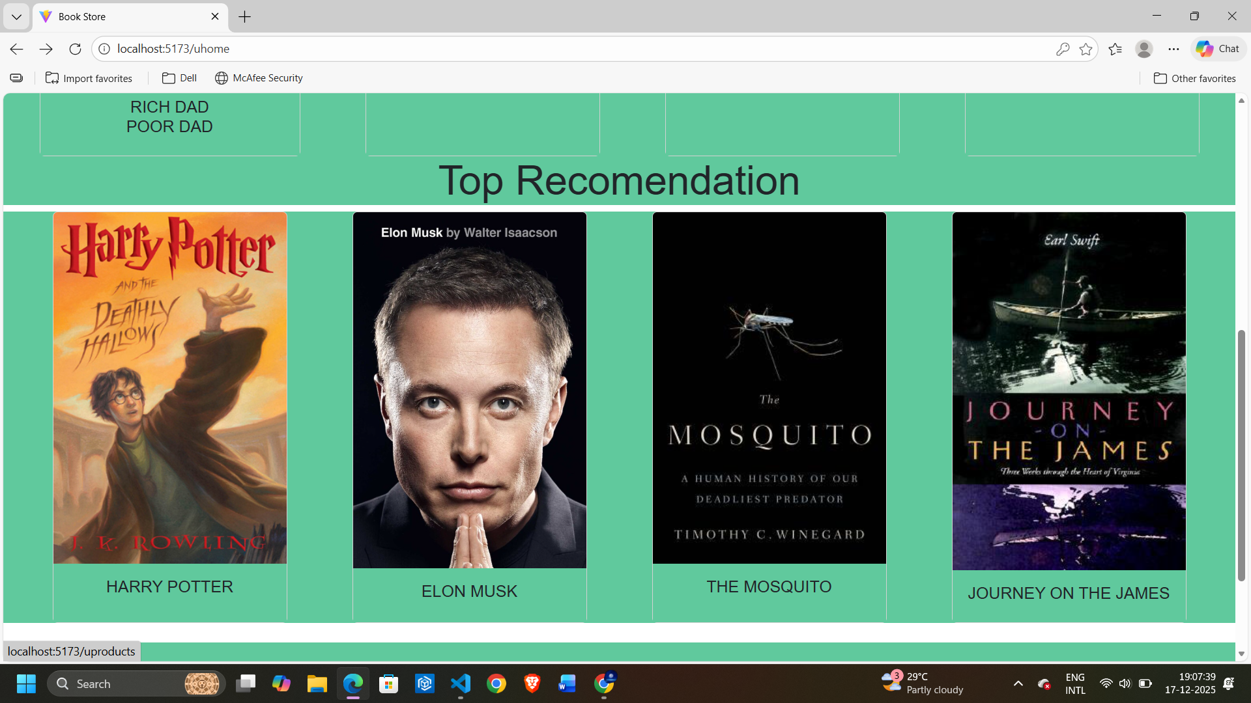
9. User Interface:

Slide 12
10. Testing:
Backend API testing performed using Postman
Frontend testing conducted using browser developer tools
Custom middleware used for error handling
Manual testing ensures functionality and user experience reliability

Slide 13
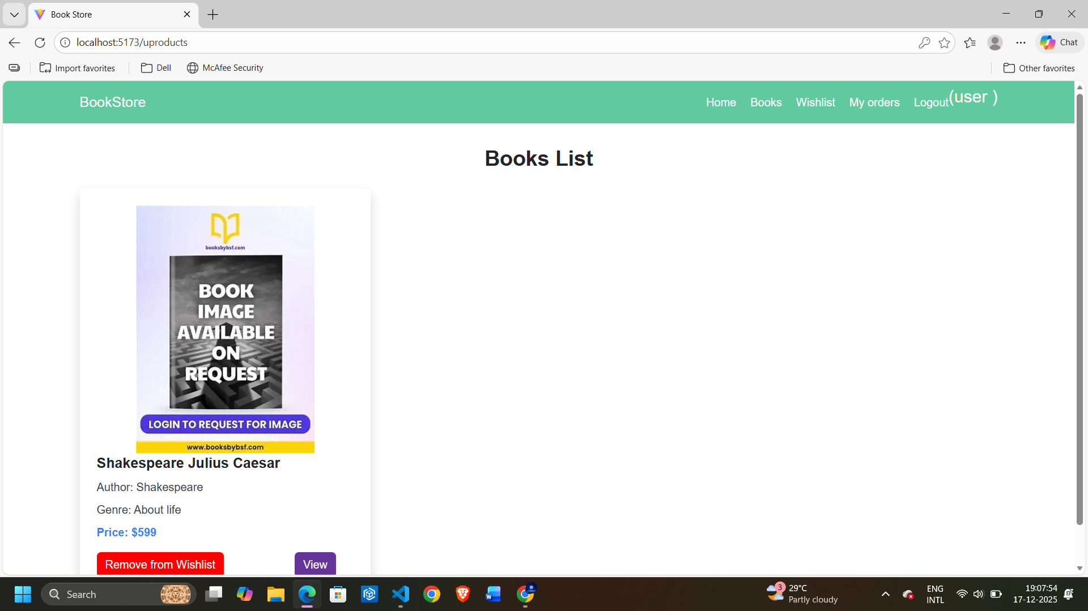
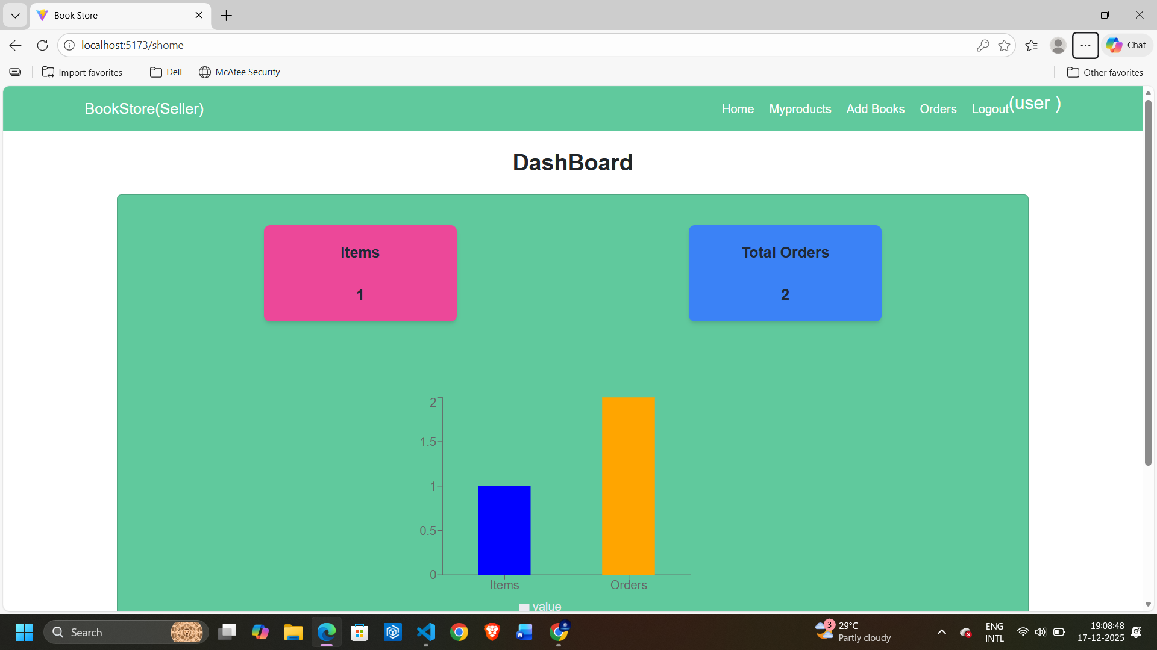
11. Screenshots & Demo:

Slide 14
12. Known Issues:
Online payment gateway integration pending
Email notification system not implemented
Pagination improvements needed for admin panels
UI optimization required for very small screen devices

Slide 15
13. Future Enhancements:
Online payment integration
Order tracking feature
Wishlist functionality
Product reviews and ratings
Admin sales analytics dashboard
Email and notification services

