Slide 1

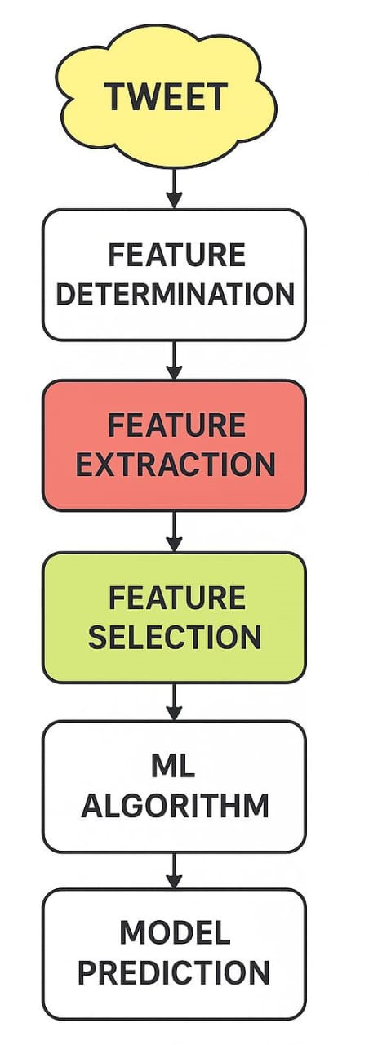
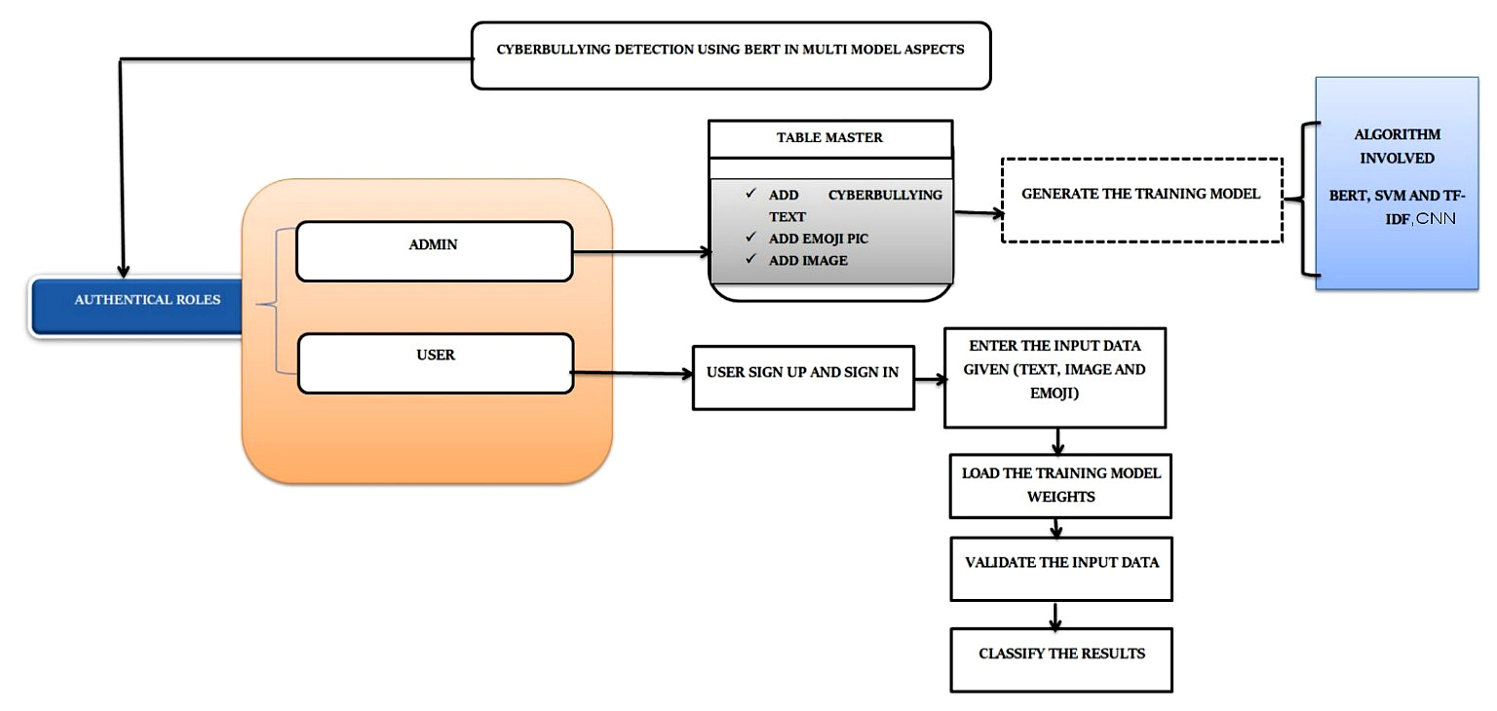
CYBERBULLYING DETECTION USING BIDIRECTIONAL ENCODER REPRESENTATIONS FROM TRANSFORMERS MULTIMODEL ASPECTS
ACADEMIC YEAR : 2024-2025
NAME OF THE STUDENTS : HEMASREE.G (21TH0140), PREETHI.R (21TH0171),
AFRETHA.B (21TH0105)
DEPARTMENT / YEAR / SEC : INFORMATION TECHNOLOGY/ IV / A NAME OF THE GUIDE : Mr.A.SANKARAN,M.E.,(Ph.D)
BATCH : 2021-2025 BATCH NO: A-12
ABSTRACT
This project presents a real-time multimodal cyberbullying detection system for a web chat application, leveraging BERT, TF-IDF SVM, and CNN to analyze text, emojis, and images. Users can send messages with emojis and images, the system detects offensive content through preprocessing and feature extraction using a hybrid of NLP and deep learning models. A late fusion method combines the outputs for final classification. On the sender side, abusive words are highlighted in red to warn the sender, while non-bullying content appears in blue. The receiver, however, only receives safe (blue) messages bullying content is blocked entirely. The admin panel logs all red-flagged content and sends alerts to both sender and receiver. Receivers are notified of blocked abusive attempts and can file complaints using stored data. This project offers an intelligent, privacy-conscious solution to cyberbullying, aiming to protect users, prevent harm before it happens, and support accountability in online communication.
EXISTING SYSTEM
PROPOSED SYSTEM
WORKING PROCEDURE
Input & Preprocessing: Users send text, emojis, and images via the chat interface. Text is cleaned, emojis are converted using demoji, and tokenized for TF-IDF and BERT. Images are resized, normalized, and augmented.
Model Inference & Fusion: TF-IDF + SVM, BERT, and CNN run in parallel to classify content. Their outputs are fused using weighted averaging and softmax to predict cyberbullying or safe.
Display & Feedback: Bullying content appears in red for the sender and is blocked from the receiver. All flagged data is stored, alerts are triggered, and periodic retraining adapts to new trends.
SDG GOALS
1. SDG 3 – Good Health and Well-being Protects users' mental health by detecting and preventing harmful online behavior like bullying.
….........................................................................
2. SDG 4 – Quality Education
Supports a healthy digital learning environment, helping students focus better without fear of online abuse
UNIQUENESS OF THE PROJECT
Detects cyberbullying using text, emojis, and images for high accuracy.
Blocks bullying content for receiver while warning sender with red highlights.
Admin alerts and logs enable complaint support without exposing harmful content.
CONCLUSION
This project presents a real-time, multimodal cyberbullying detection system that analyzes text, emojis, and images to block harmful content. By integrating smart content filtering, the system alerts both the sender and the receiver. Its scalability and adaptability through retraining contribute to a safer online communication environment.

