Slide 1
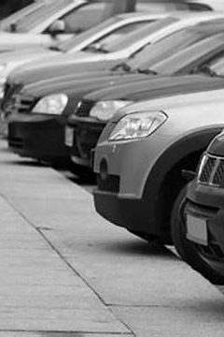
DriveEasy - CarRentalSystem
Submitted by Team 4
Katta, Rahul
Kamjula, Praneeth Kumar Reddy
Kavali, Bharath Chandra
Kilaru, Preethi Chandana
Konyala, Pravalika

Slide 2


Introduction
The Car Rental System is designed to streamline the vehicle rental process, simplifying reservation management, vehicle inventory tracking, and billing operations. Our aim is to enhance efficiency and convenience for both customers and the rental agency, ensuring a seamless experience throughout.
In this presentation, we will outline the scope, objectives, and goals of the Car Rental System. Additionally, we will go through functional and non-functional requirements essential for system performance, and will represent use cases, interaction diagrams, and class models.

Slide 3
Components Involved
Programming Language: Python
Python Module: Tkinter (Used for creating GUI APP)
Database: MySQL
Environment: Visual Studio Code

Slide 4
Functional Requirements
User Authentication and Security: Safe login for users and agents, protects data.
Car Reservation and Booking: Easy and quick process to book cars with live updates.
Vehicle Information and Selection: Detailed car info for easy browsing and selection.
Employee Access and Authorization: Secure employee login with role-based access.
User Reviews and Ratings: System for customers to review and rate their experiences.

Slide 5
Non-Functional Requirements
Performance: Quick and smooth operation, even under heavy use.
Usability: Easy for employees to use for all tasks.
Availability: Always on, accessible from anywhere, anytime.
Compliance: Stays up-to-date with laws and privacy standards.
Scalability: Can grow to handle more users and cars without issues.

Slide 6
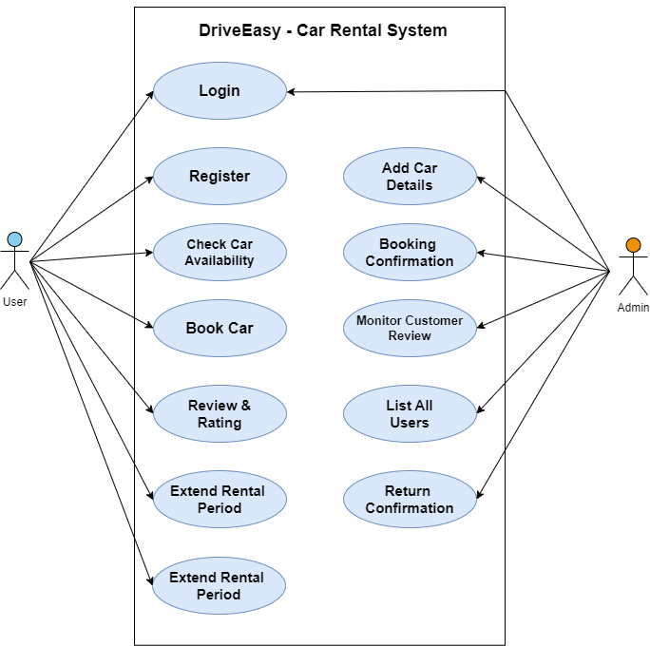
Use Case Diagram

Slide 7
Acceptance Criteria
Login User:
Users should be able to login successfully based on valid credentials i.e username and password.
Register User:
Users should be able to navigate to the registration page.
Selecting a car:
Users should be able to view a list of available cars including their type, model, view and price per rental period.
Extension of Rental Period:
Users should have the option to request an extension of the rental period for a specific car
Car Return and Checkout:
Users should have a straightforward process for returning rented vehicles.
Review and Rating System for Users:
Users should be able to rate and review their rental experience and the rented vehicles.

Slide 8
Constraints
Time Constraints: Adherence to specified deadlines is crucial to meet customer demand and ensure efficient operations.
Budget Constraints: Expenditures must remain within designated budgets to prevent financial strain on the rental company
Technology Constraints: Compatibility with existing infrastructure, including reservation systems and payment gateways, is necessary to ensure seamless integration.
Resource Constraints: Adequate availability of vehicles is indispensable to meet customer demand and prevent shortages

Slide 9

Risks & Assumptions
Risks:
Vehicle Availability Risk
Technological Risk
Market Competition Risk
Damage & Theft Risk
Customer Service Risk
Assumptions:
User Data Accuracy
Vehicle Maintenance Standard
Security Measures
System Integration

Slide 10
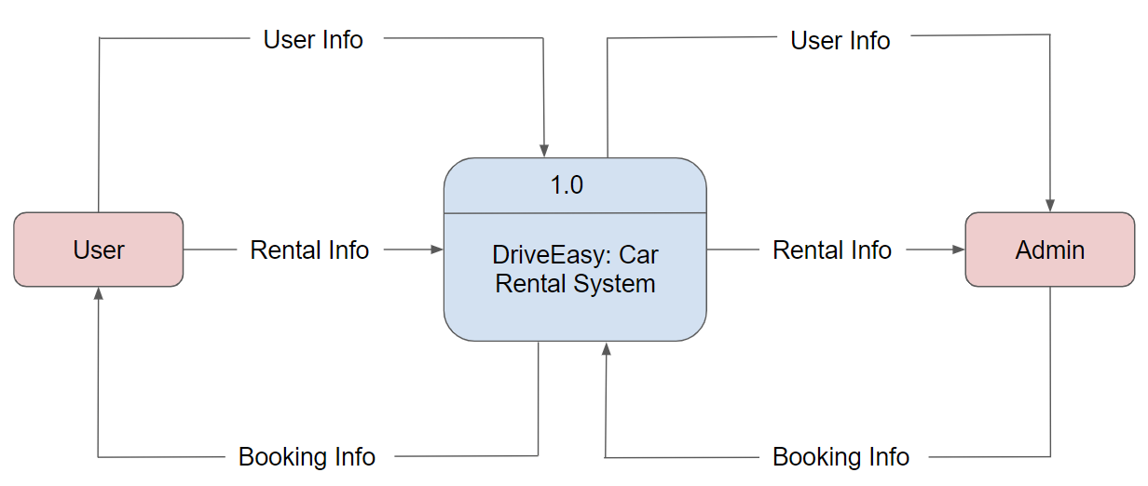
Context Level Diagram

Slide 11
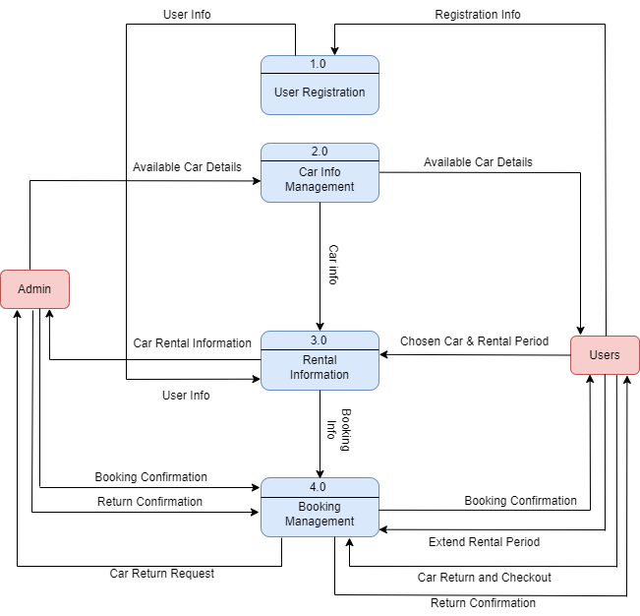
Data Flow Diagram (Level – 0)

Slide 12
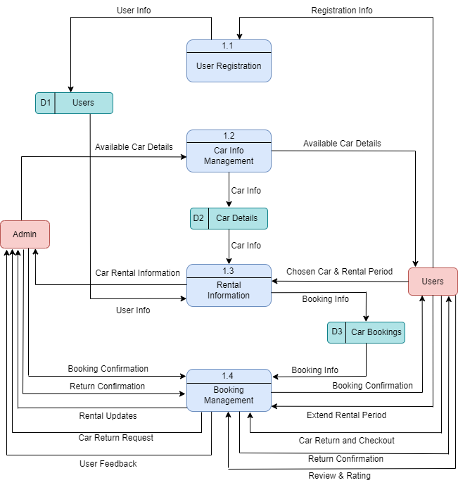
Data Flow Diagram (Level – 1)

Slide 13
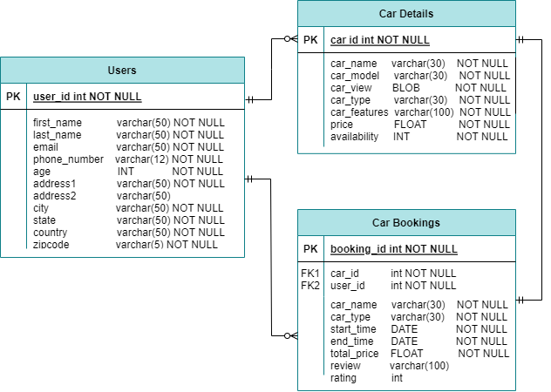
Entity Relationship Diagram

Slide 14
Conclusion
The Car Rental System project is dedicated to providing a user-friendly platform for accessing rental services. Our comprehensive system enables easy selection and booking of rental vehicles, ensuring a smooth experience for customers. Detailed documentation, including a thorough Software Requirement Specification (SRS) and clear system diagrams, enhances understanding and clarity. By adhering to best practices, our SRS is enriched with visual aids, remains concise, and allows for flexible development iterations. Our goal is to elevate the car rental experience, fostering seamless interactions between users and the rental service.

