Slide 1


BELAGAVI,KARNATAKA-590018
VISVESVARAYA TECHNOLOGICAL UNIVERSITY
KALPATARU INSTITUTE OF TECHNOLOGY
TIPTUR
“ENHANCING ACCIDENT PREDICTION THROUGH INTEGRATED KNN AND DBSCAN ALGORITHMS FOR SUPERIOR ACCURACY”
INFORMATION SCIENCE AND ENGINEERING
MAJOR PROJECT PHASE-2 (BIS786)
PRESENTING BY: ANKITHA K V PREETHI KUMARI LIKITHA M N
GUIDED BY:
PROF. CHETHAN KUMAR T
Assistant Professor, Dept. Of ISE, KIT,Tiptur
1KI22IS004
1KI22IS037
1KI23IS401

Slide 2
PROJECT TITLE
“ENHANCING ACCIDENT PREDICTION THROUGH INTEGRATED KNN AND DBSCAN ALGORITHMS FOR SUPERIOR ACCURACY”

Slide 3
TABLE OF CONTENTS
ABSTRACT
INTRODUCTION
OBJECTIVES
PROBLEM STATEMENT
LITERATURE REVIEW
PROPOSED METHODOLOGY
OUTCOME
FUTURE WORK
REFERENCES
CONCLUSION

Slide 4
ABSTRACT
Road traffic accidents are a growing global concern, endangering lives and infrastructure. Accurate prediction of accident severity is essential for effective emergency response and safety planning. This study introduces a hybrid model integrating KNN and DBSCAN algorithms improve prediction accuracy. The combined approach enhances reliability, reduces noise sensitivity, and supports safer urban mobility.

Slide 5

INTRODUCTION
Road traffic accidents are a major global concern, causing significant loss of life and economic damage each year. Accurate prediction of accident severity can help improve emergency response and safety planning. Traditional models often fail to handle noisy and complex traffic data effectively. Machine learning provides a promising solution, but no single algorithm performs well across all data types. Therefore, this study integrates KNN and DBSCAN algorithms to enhance prediction accuracy and model reliability.

Slide 6
OBJECTIVES OF THE STUDY
To develop an intelligent accident severity prediction system using Machine Learning.
To apply and analyse the performance of K-Nearest Neighbors (KNN) for severity classification.
To utilize DBSCAN for clustering accident data and detecting anomalies/noise.
To design a hybrid model (KNN + DBSCAN) that improves accuracy .
To contribute to safer urban mobility through data-driven accident prevention and management strategies.

Slide 7
PROBLEM STATEMENT
Road traffic accidents cause significant loss of life and property, and predicting their severity remains a major challenge. Traditional models often fail to perform well due to noisy, imbalanced, and complex real-world datasets. Single algorithms like KNN or DBSCAN have limitations such as overfitting, poor handling of noise, or reduced accuracy. There is a need for a more reliable and accurate model that can effectively analyze accident data. Hence, this project proposes an integrated KNN–DBSCAN model to enhance accident prediction accuracy and robustness.

Slide 8
LITERATURE SURVEY
Author / Year | Methodology / Technology Used | Key Findings & Results | Limitations / Gaps
AlHashmi, 2024 | Hybrid KNN + DBSCAN | Improved prediction accuracy; detects accident hotspots; handles spatial outliers | Tested on limited datasets; real-time deployment not explored
Briki et al., 2024 | Cluster-based severity resampling + Classification | Addressed class imbalance; improved model performance | Focused mainly on dataset preprocessing; not real-time
Chakravarthi, 2025 | Hybrid KNN-DBSCAN | Enhanced detection of clusters and outliers; better severity prediction | Requires careful parameter tuning; computationally intensive
Khosravi et al., 2024 | KNN | High accuracy in accident severity prediction; simple to implement | Sensitive to noisy data; limited in handling spatial clustering

Slide 9
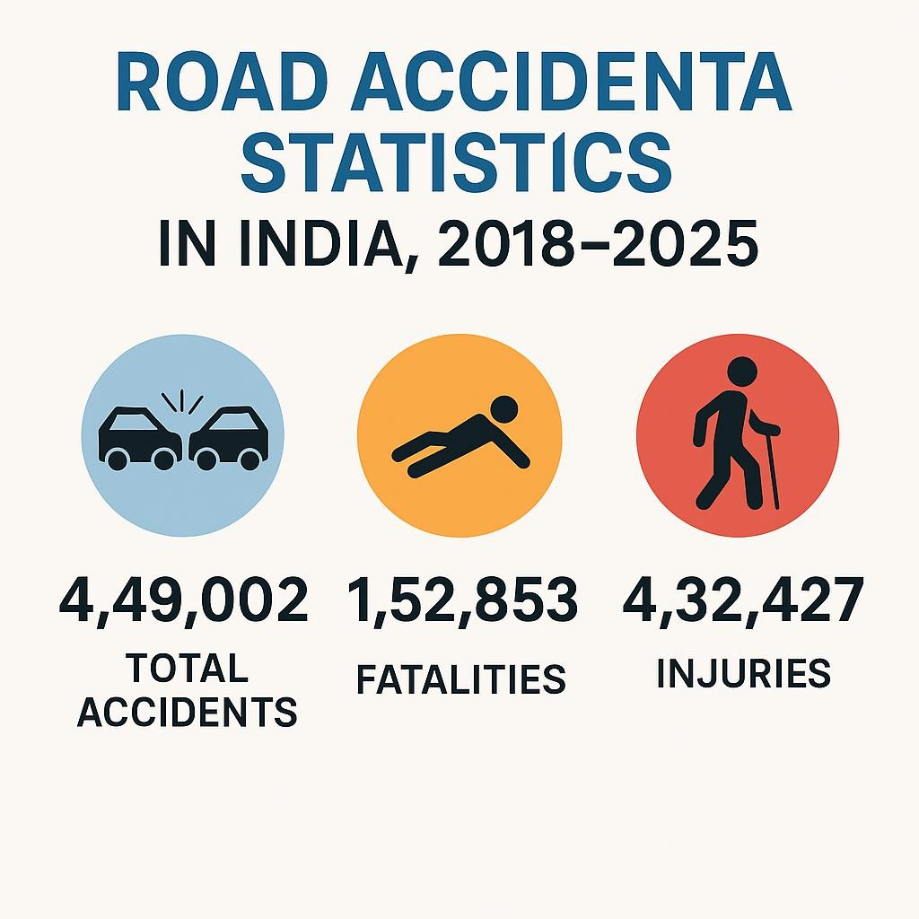
L

Slide 10
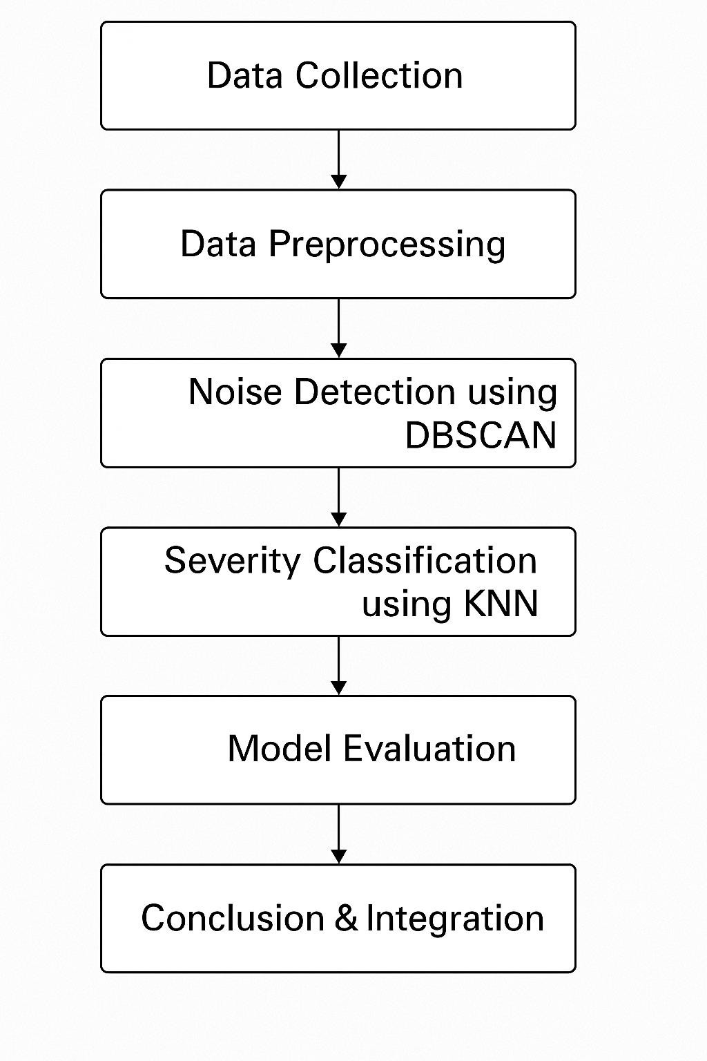
"Proposed Methodology for Accident Severity Prediction”

Slide 11
Proposed Methodology
Step 1: Data Collection
Real-world accident dataset with features like location, weather, time, and severity.
Step 2: Data Preprocessing
Handle missing values, normalize numerical data.
Encode categorical variables.
Remove irrelevant or redundant attributes.
Step 3: Noise Detection using DBSCAN
DBSCAN identifies dense clusters and filters outliers/noise.
Improves data quality before classification.

Slide 12
Step 4: Severity Classification using KNN
KNN classifies severity based on nearest neighbors.
Works on DBSCAN-cleaned data for better accuracy.
Step 5: Model Evaluation
Use metrics like accuracy, precision, recall, and F1-score.
Compare hybrid model with standalone KNN and DBSCAN.
Step 6: Conclusion & Integration
Final model supports predictive insights for accident management systems.

Slide 13
Existing System vs Proposed System
Criteria | Existing System | Proposed System
Approach | Uses individual machine learning algorithms such as KNN, Random Forest. | Integrates KNN and DBSCAN algorithms to form a hybrid model for better prediction accuracy and noise handling.
Data Handling | Sensitive to noise, outliers, and imbalanced datasets, leading to reduced model reliability. | DBSCAN removes noise and detects dense clusters, improving data quality before classification.
Accuracy | Moderate accuracy due to limitations of single models and lack of data preprocessing. | Achieves higher accuracy
Model Type | Single algorithm-based (supervised or unsupervised). | Hybrid model combining supervised (KNN) and unsupervised (DBSCAN) learning.
Scalability | Limited scalability and poor performance on large, heterogeneous datasets. | Improved scalability with
Real-Time Application | Struggles to handle real-time or dynamic data updates. | Can be adapted for real-time prediction and alert systems using pre-clustered data.
Result | Inconsistent and less reliable predictions | More consistent, accurate, and interpretable results that support safer urban mobility.

Slide 14
Advantages:
Predicts accidents more accurately than using KNN or DBSCAN alone.
Can handle noisy or unusual data well.
Works on different types of traffic data.
Helps with faster emergency response and resource planning.
Can use sensor data for smarter traffic safety.
Disadvantages:
More complex to set up and run.
Needs more computer power for large data.
DBSCAN parameters need careful tuning.
Harder to use in real-time traffic systems.
May need changes for different cities or road conditions.

Slide 15
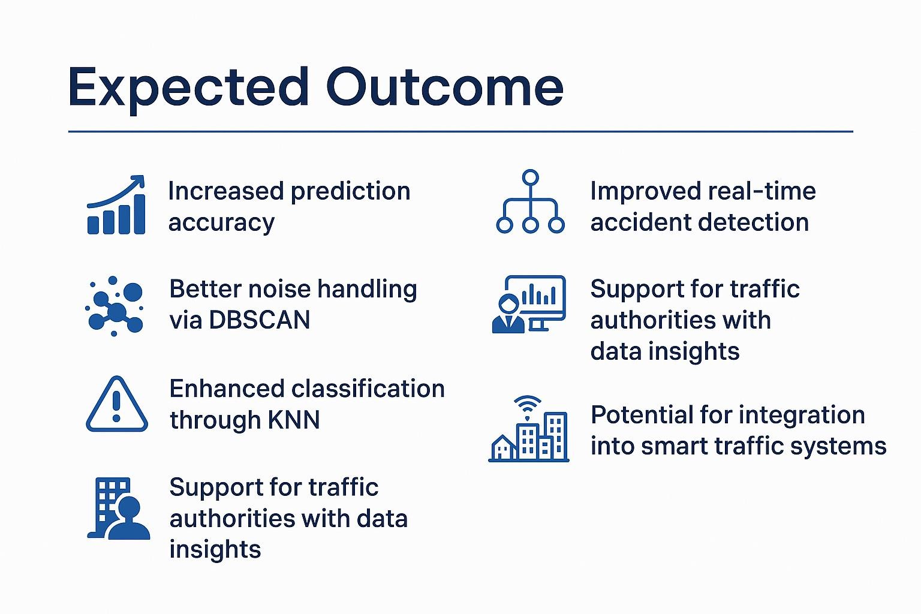
OUTCOMES

Slide 16
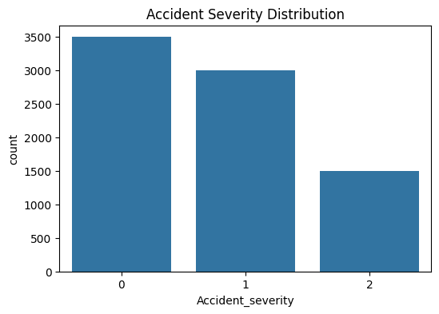
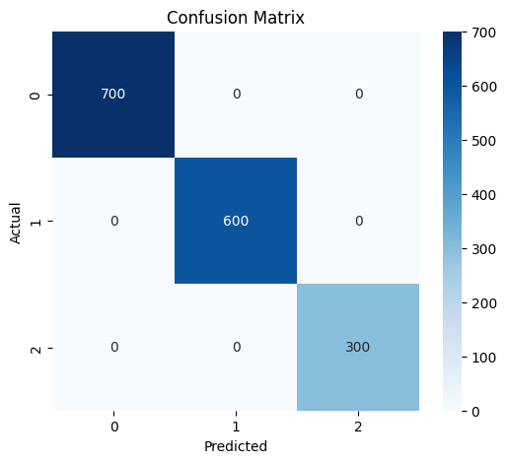
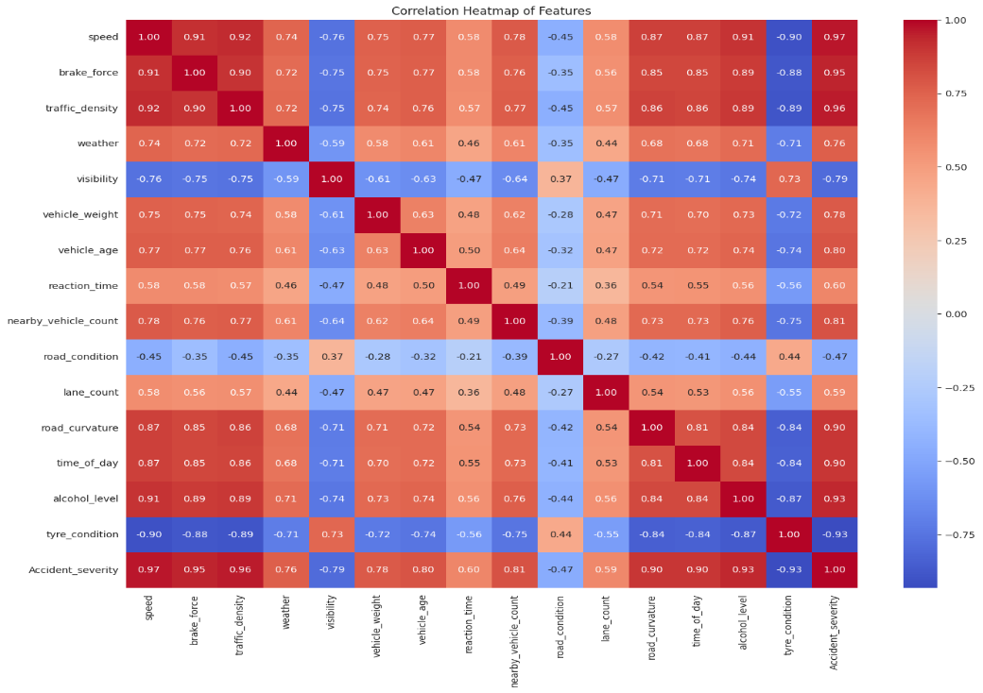
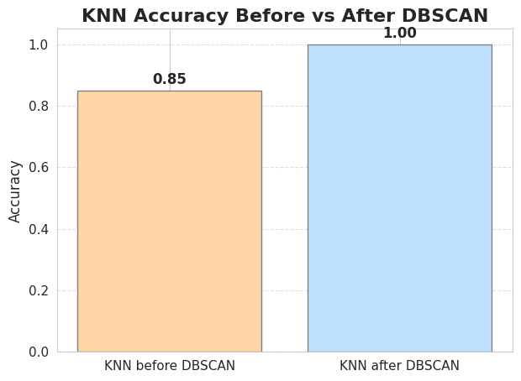
RESULT

Slide 17
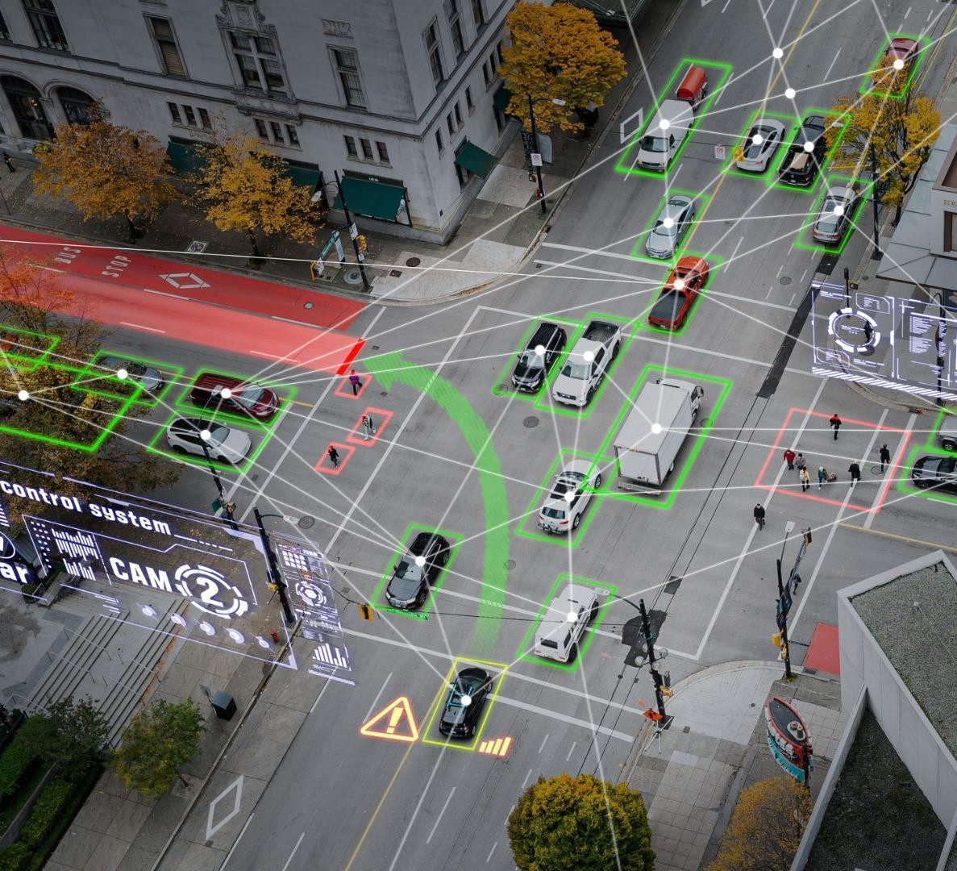
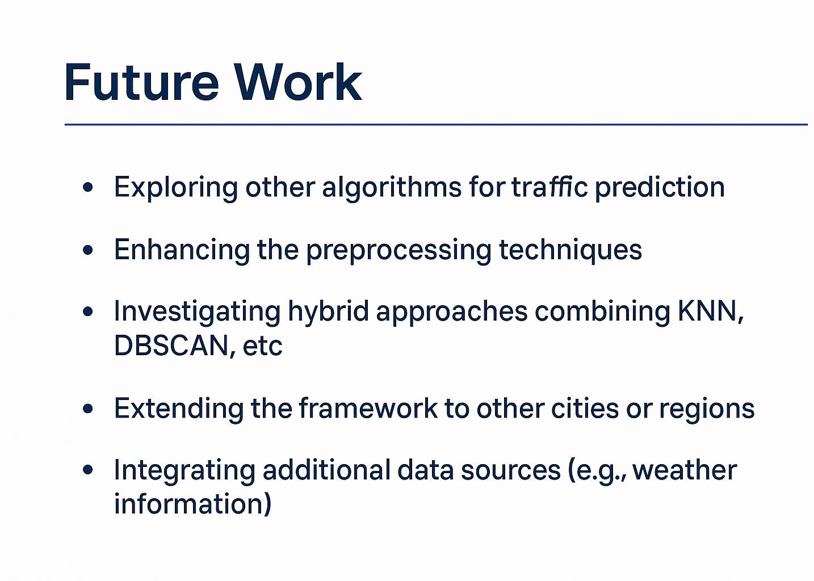

Slide 18
CONCLUSION
The hybrid KNN-DBSCAN model can predict how serious accidents might be by combining classification and clustering methods. Tests show it works better than using KNN or DBSCAN alone, handling noisy data well and giving accurate results on different traffic datasets. This method can help improve emergency response and manage resources more efficiently. Adding data from IoT sensors can make traffic safety even better. In the future, the model will be tested for real-time use, on larger datasets, and in different locations.
In summary, this hybrid model doesn’t stop accidents directly, but it helps us understand when and where accidents are more likely to occur based on past patterns. This can be used to issue travel safety warnings and improve road planning and policies.

Slide 19
References
Z. Wang et al., “Assessing the Impact of Different Population Density Scenarios on Two- Wheeler Accident Characteristics at Intersections,” Sustainability, vol. 16, no. 5, 2024. doi: 10.3390/su16051737
D. Xie et al., “Research on Sequential Decision-Making of Major Accidents with Incomplete
Information,” Entropy, 2024. doi: 10.3390/e26020129
M. Wu et al., “Predictions of Traffic Incident Locations,” Journal of Advanced Transportation, vol. 58, no. 2, 2024.
L. Yang et al., “Comparative Analysis of KNN, SVM, and Ensemble DT Models,” Journal of
Advanced Transportation, 2024.
J. M. Seong et al., “Big Data Analytics with Multivariate Adaptive Regression Splines,” BDCC,
vol. 7, no. 3, 2023.
M. Ghorbani et al., “Crash Prediction Modeling,” ASCE J. of Eng., 2023.
A. Santhosh et al., “Pedestrian Accident Prediction Modelling,” Transportation Research, 2020.

Slide 20


