Slide 1
HTML-CSS-BOOTSTRAP
Presented By - Mrs. Preethi Sagana | Frontend Developer | TipoTapp Inc.

Slide 2
What is HTML?
HTML is a language for describing web pages.
HTML stands for Hyper Text Markup Language
HTML is a markup language
A markup language is a set of markup tags
The tags describe document content
HTML documents contain HTML tags and plain text
HTML documents are also called web pages

Slide 3
HTML Tags
HTML markup tags are usually called HTML tags
HTML tags are keywords (tag names) surrounded by angle brackets like <html>
HTML tags normally come in pairs like <b> and </b>
The first tag in a pair is the start tag, the second tag is the end tag
The end tag is written like the start tag, with a forward slash before the tag name
Start and end tags are also called opening tags and closing tags

Slide 4
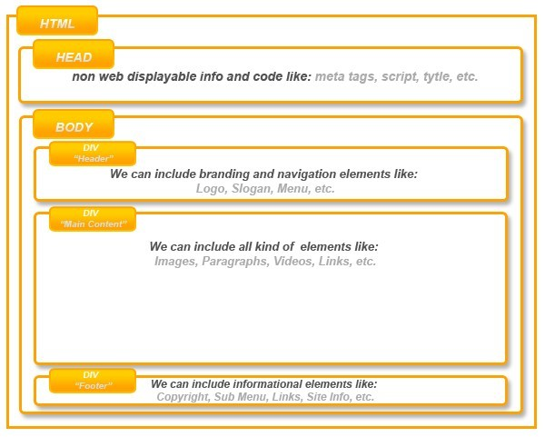
Basic HTML page structure
*

Slide 5

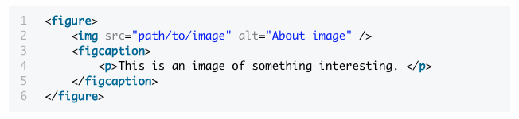

Must know things in html5
New Doctype
The Figure Element

Slide 6


Must know things in html5
3. No More Types for Scripts and Links
4. To Quote or Not to Quote.
5. Make your Content Editable

Slide 7
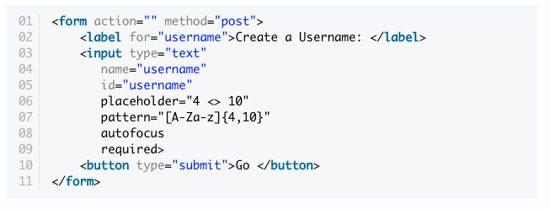
Must know things in html5
6. More HTML5 Form Features
required, autofocus, placeholder, pattern, various input types etc.
7. Video and Audio Support
8. Regular Expressions

Slide 8
What is CSS?
CSS stands for Cascading Style Sheets
Styles define how to display HTML elements
Styles were added to HTML 4.0 to solve a problem
External Style Sheets can save a lot of work
External Style Sheets are stored in CSS files
A CSS (cascading style sheet) file allows to separate web sites HTML content from it’s style.

Slide 9
How to use CSS?
There are three ways of inserting a style sheet:
External Style Sheet:
An external style sheet is ideal when the style is applied to many pages.
<head>
<link rel="stylesheet" type="text/css" href="mystyle.css">
</head>
Internal Style Sheet:
An internal style sheet should be used when a single document has a unique style.
<head>
<style>
p {margin-left:20px;}
body {background-image:url("images/back40.gif");}
</style>
</head>

Slide 10
Inline Styles:
To use inline styles use the style attribute in the relevant tag. The style attribute can contain any CSS property.
<p style="color:#fafafa;margin-left:20px">This is a paragraph.</p>
Multiple Styles Will Cascade into One: Cascading order
Inline style (inside an HTML element)
Internal style sheet (in the head section)
External style sheet
Browser default

Slide 11
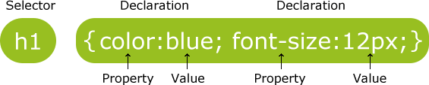
CSS Syntax
A CSS rule has two main parts: a selector, and one or more declarations
Combining Selectors
h1, h2, h3, h4, h5, h6 { color: #009900;
font-family: Georgia, sans-serif;
}

Slide 12
CSS Selector
The id Selector
The id selector is used to specify a style for a single, unique element.
The id selector uses the id attribute of the HTML element, and is defined with a "#".
Syntax
#selector-id { property : value ; }
The class Selector
The class selector is used to specify a style for a group of elements.
The class selector uses the HTML class attribute, and is defined with a "."
Syntax
.selector-class { property : value ; }

Slide 13
CSS Anchors, Links and Pseudo Classes:
Below are the various ways you can use CSS to style links.
a:visited {color: #999999;}
a:hover {color: #333333;}
a:focus {color: #333333;}
a:active {color: #009900;}
a:link {color: #009900;}

Slide 14
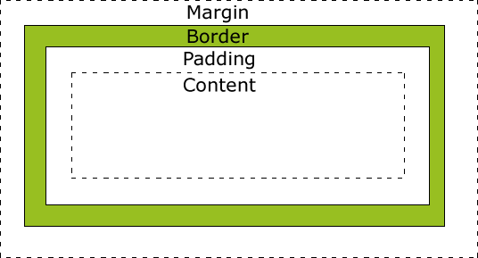
The CSS Box Model
All HTML elements can be considered as boxes. In CSS, the term "box model" is used when talking about design and layout.
The CSS box model is essentially a box that wraps around HTML elements.
The box model allows to place a border around elements and space elements in relation to other elements.

Slide 15
CSS Media Queries
CSS Media Queries are a feature in CSS3 which allows you to specify when certain CSS rules should be applied. This allows you to apply a special CSS for different screen devices with at least one expression:
Large desktop
Portrait tablet to landscape and desktop
Landscape phone to portrait tablet
Landscape phones and down

Slide 16


Slide 17
Advantages
Only valid CSS will be loaded
Web Responsive Design
Adjust print layout
Decrease using JavaScript to load page and detect screen

Slide 18
How to use
/* Large desktop */
@media (min-width: 1200px) { ... }
/* Portrait tablet to landscape and desktop */
@media (min-width: 768px) and (max-width: 979px) { ... }
/* Landscape phone to portrait tablet */
@media (max-width: 767px) { ... }
/* Landscape phones and down */
@media (max-width: 480px) { ... }

Slide 19
Responsive Web Design
Responsive websites repond to their environment
Adaptive (Multiple Fixed Width Layouts) or
Responsive (Multiple Fluid Grid Layouts)
Recommended Approach
Go All In On Responsive
Make pages that look great at any size.

Slide 20
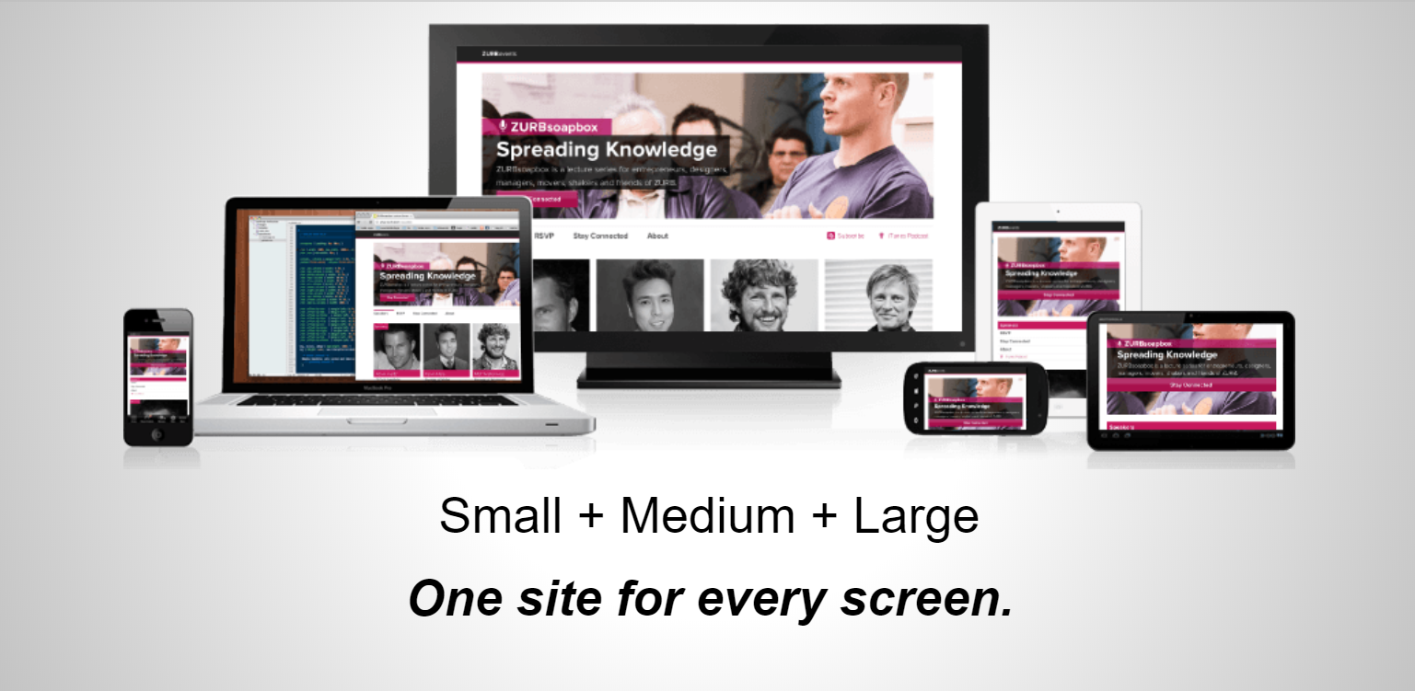

Slide 21
References:
https://www.w3schools.com/html/ https://www.tutorialspoint.com/html5/index.htm https://code.tutsplus.com/tutorials/28-html5-features-tips-and-techniques-you-must-know--net-13520
https://www.w3schools.com/css/default.asp
https://getbootstrap.com/docs/4.5/getting-started/introduction/

Slide 22
Thank You Q&A

