Slide 1

Project on
"Enhancing Search Engine Relevance for Video Subtitles."
by
Team_ID - T211130
Preethi Sundar (IN1241091)
Prudhvinath Thota (IN1240634)

Slide 2
Objective:
To develop an advanced search engine algorithm that effectively retrieves subtitles based on user queries, with specific emphasis on subtitle content. The primary goal is to leverage natural language processing and machine learning techniques to enhance the relevance and accuracy of search results.
Introduction:
Introducing a groundbreaking semantic search engine tailored to revolutionize subtitle retrieval. By focusing on user queries and subtitle content, our innovative algorithm harnesses the power of natural language processing and machine learning. Through advanced techniques, we aim to elevate search accuracy and relevance, delivering unparalleled results for users seeking precise subtitle matches. This engine represents a leap forward in accessing subtitles, promising a seamless experience driven by cutting-edge technology and a deep understanding of language semantics.

Slide 3
Search Engine
A search engine is a software system that enables users to search for information on the internet or within a specific database. It functions by indexing vast amounts of content, such as web pages, documents, images, and other media, and then retrieving relevant results in response to user queries. Search engines employ algorithms to rank search results based on factors like relevance, authority, and user engagement metrics, aiming to provide users with the most accurate and useful information possible. Popular search engines include Google, Bing, Yahoo, and Baidu, which play a crucial role in facilitating access to information across the digital landscape.

Slide 4
Keyword Search Engine:
A keyword search engine operates primarily by matching the keywords or phrases entered by users in the search query with the indexed content. It retrieves results based on exact or related matches to these keywords without necessarily considering the context or meaning behind the words. Keyword search engines rely on algorithms such as TF-IDF (Term Frequency-Inverse Document Frequency) and PageRank to determine the relevance and ranking of search results.
Semantic Search Engine:
A semantic search engine goes beyond keyword matching to understand the meaning and context of user queries and the content being searched. It utilizes natural language processing (NLP) techniques to comprehend the intent behind the query and the semantic relationships between words and phrases. Semantic search engines aim to provide more relevant and accurate results by understanding concepts, entities, and the context of information. They often incorporate machine learning algorithms and knowledge graphs to improve search results based on user intent and context.

Slide 5
Difference:
BERT excels in capturing semantic relationships and understanding the context of language, making it highly effective in semantic search tasks.
TF-IDF, on the other hand, is simpler and computationally efficient, but it may lack the ability to understand the semantics and nuances of language as comprehensively as BERT.
BERT focuses on generating contextual word embeddings, whereas SBERT specializes in generating embeddings for entire sentences or short texts.
BERT is suitable for tasks like text classification and question answering, where word-level context is important.
SBERT is more suitable for tasks like semantic search, information retrieval, and clustering, where understanding the semantic similarity between texts is crucial.

Slide 6
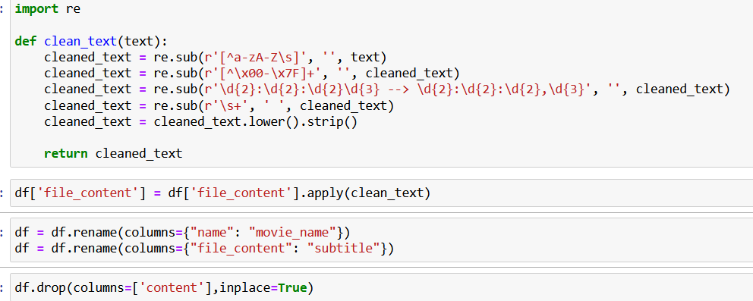
Data processing steps:
Step 1 - Reading the Tables from Database file
Step 2 - Reading the columns of Table
Step 3 - Loading the Database Table inside a Pandas DataFrame
Step 4-Unzipping the content rows and decoding using latin-1
Step 5-Data Cleaning

Slide 7
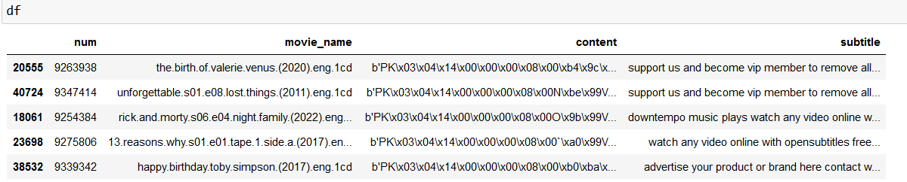
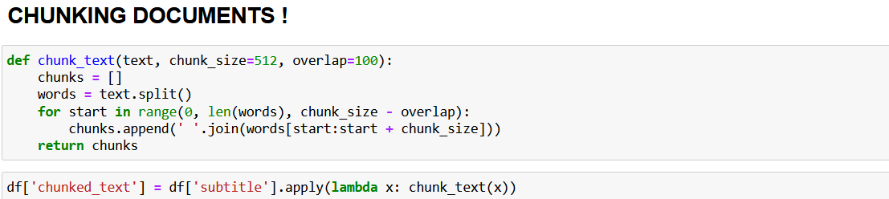
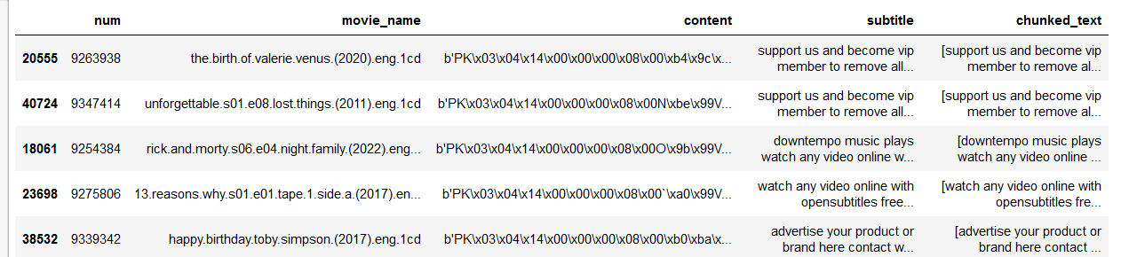

Slide 8
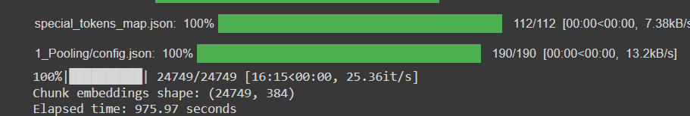
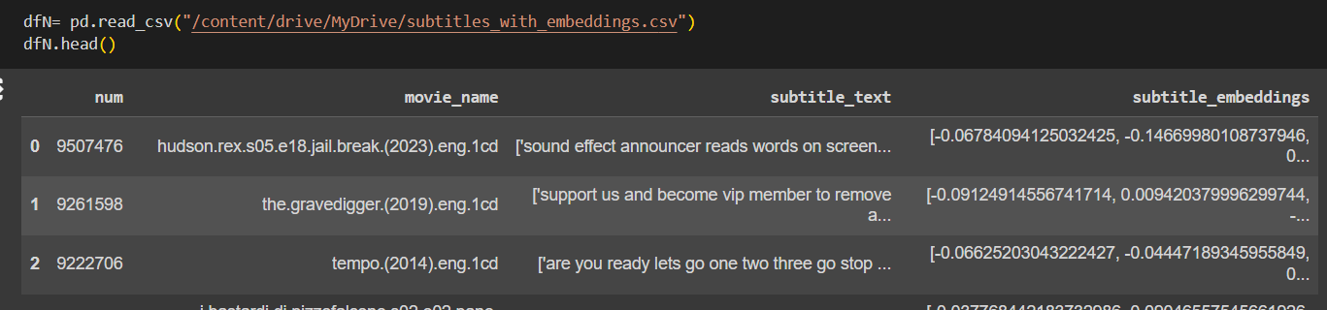
Converting chunked data to embedding with the help of SBERT model = "sentence-transformers/all-MiniLM-L6-v2" and stored in subtitles_with_embeddings.csv

Slide 9
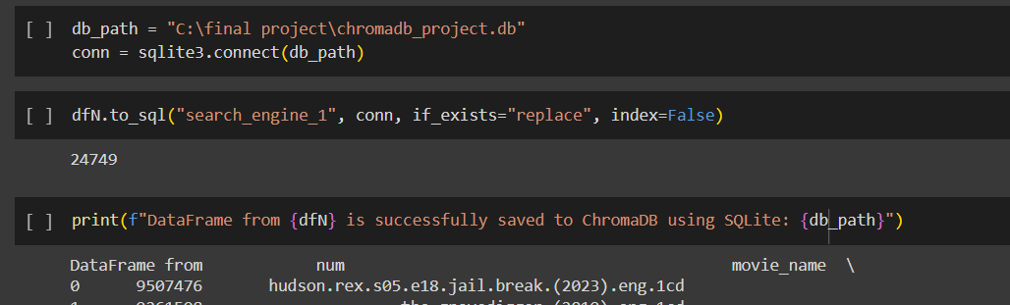
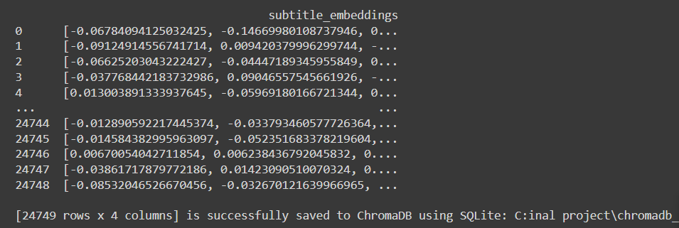

Slide 10
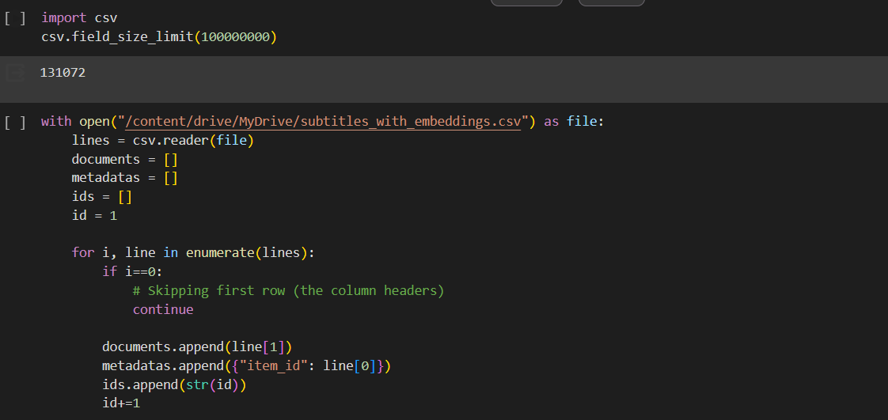
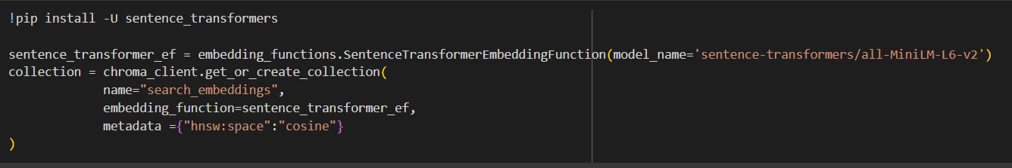

Slide 11
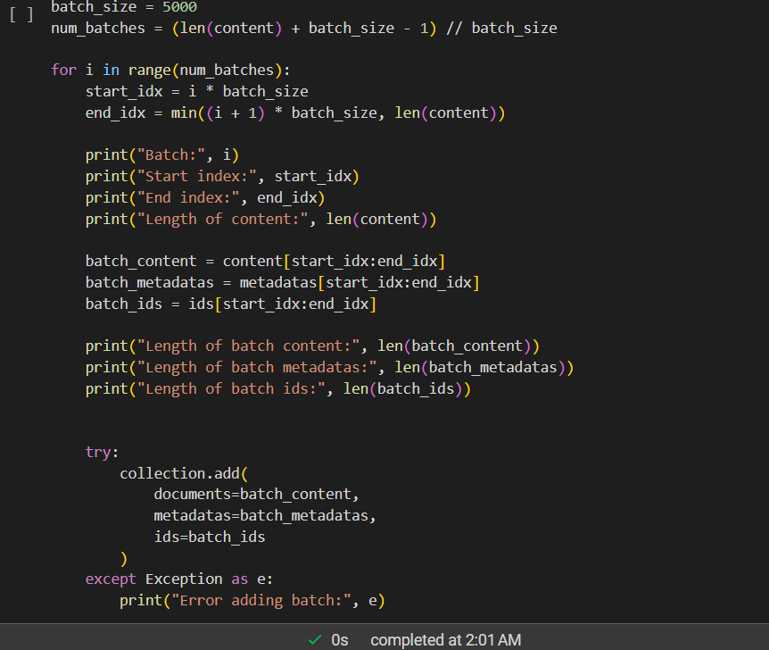

Slide 12
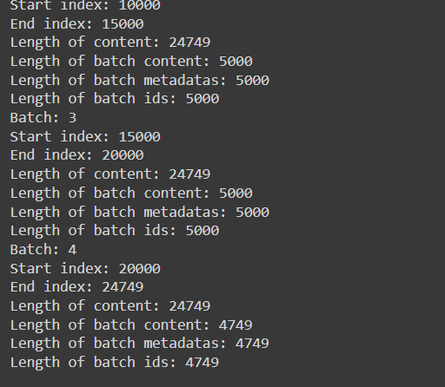
store the embedding in batches

Slide 13
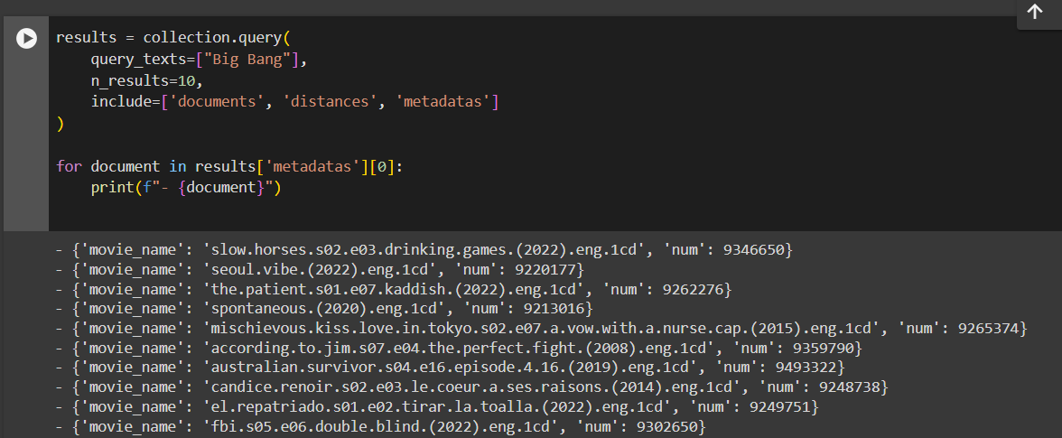

Slide 14
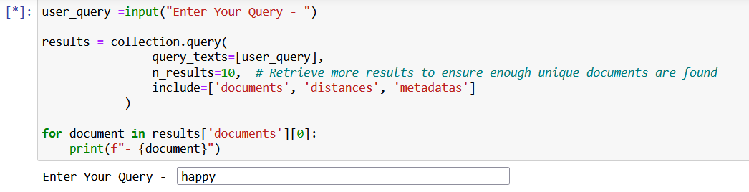
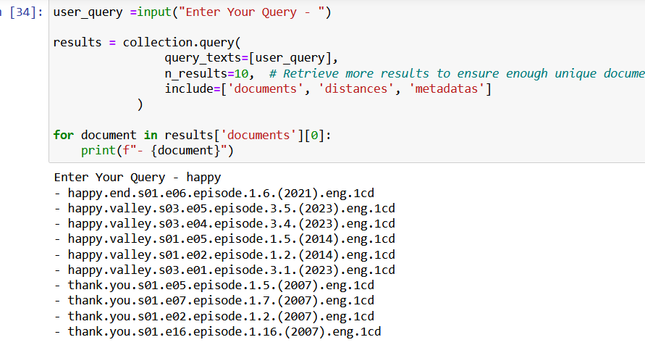

Slide 15

Conclusion:
Our movie subtitle search engine, powered by SBERT, delivers accurate results by capturing semantic similarities. It efficiently matches queries with subtitles, enhancing accessibility and user experience. With scalability and potential for further refinement, it offers a valuable tool for diverse audiences seeking precise subtitle retrieval.

