Slide 1
Consumer Financial Protection Bureau(CFPB)
Project Background:
The Consumer Financial Protection Bureau was established in USA for enabling the USA consumers to report customer support and complaint related information regarding their financial issues with the US government.
As mandated under the Dodd-Frank Act, the CFPB began accepting consumer complaints in July 2011. Starting with credit card complaints, the complaint process has expanded to include mortgages, consumer loans, bank products and services, private student loans, credit reporting problems, and more recently, money transfers and debt collection services.

Slide 2
Why are we analyzing this Data??
The complaint data is freely available for analysis and tracking of how efficiently and effectively the financial institutes handle the complaints lodged against them.
Each complaint consists of attributes that can uniquely describe and identify it.
The Consumer Financial Protection Bureau information can be used in prescriptive analysis to enhance financial consumer services and also improve the response quality of automated consumer support systems.
Complaints are published in the below link https://www.consumerfinance.gov/data-research/consumer-complaints/

Slide 3
Load CFPB data and analyze:
Load the CFPB data:
complains_data = pd.read_csv('Consumer_Complaints.csv')
Total records and columns in CFPB database:
complains_data.shape
(943473, 18)
Data types:
Date received object
Product object
Sub-product object
Issue object
Sub-issue object
Consumer complaint narrative object
Company public response object
Company object
State object
ZIP code object
Tags object
Consumer consent provided? object
Submitted via object
Date sent to company object
Company response to consumer object
Timely response? object
Consumer disputed? object
Complaint ID int64
dtype: object

Slide 4
Cleaning Data CFPB:
Used pandas_profiling to get the insight of the CFPB data.
Used Pivot ui to study the relationship between the attributes
Raw Column names:
Index(['Date received', 'Product', 'Sub-product', 'Issue', 'Sub-issue',
'Consumer complaint narrative', 'Company public response', 'Company',
'State', 'ZIP code', 'Tags', 'Consumer consent provided?',
'Submitted via', 'Date sent to company', 'Company response to consumer',
'Timely response?', 'Consumer disputed?', 'Complaint ID'],
dtype='object')
Cleaning the column names:
Index(['Date_received', 'Product', 'Sub-product', 'Issue', 'Sub-issue',
'Consumer_complaint_narrative', 'Company_public_response', 'Company',
'State', 'ZIP_code', 'Tags', 'Consumer_consent_provided',
'Submitted_via', 'Date_sent_to_company', 'Company_response_to_consumer',
'Timely_response', 'Consumer_disputed', 'Complaint_ID'],
dtype='object')
Selecting one financial institution(i.e BOW) data from the entire dataset:
BOW_complains =complains_data[complains_data.Company == 'BANK OF THE WEST']
Only BOW complaints in CFPB database:
BOW_complains.shape
(894, 18)

Slide 5
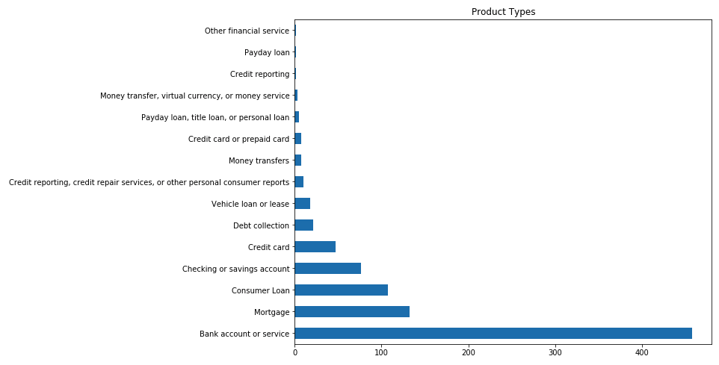
Visualization:
Distribution of complaints across products:
BOW_complains.Product.value_counts().plot(title='Product Types', kind='barh',figsize = (10,8));

Slide 6
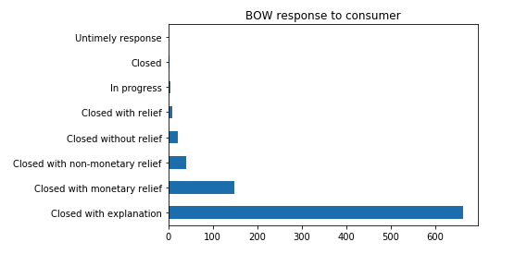
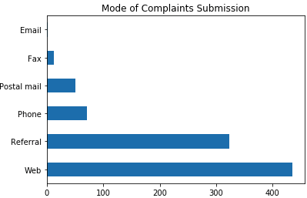
Visualization:
Company(BOW) response to consumer:
BOW_complains['Company_response_to_consumer'].value_counts().plot(title='BOW response to consumer',kind ='barh');
Mode of Complaints Submission:

Slide 7
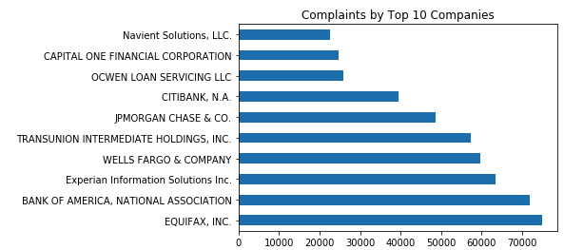
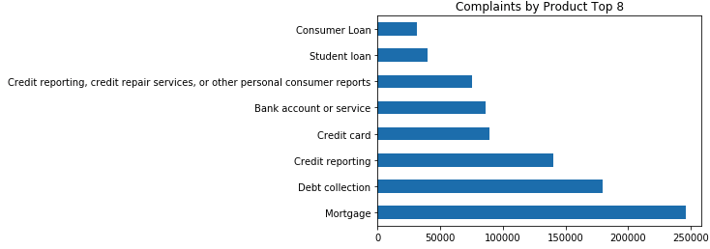
Comparing with other Companies
Complaints by Company - Top 10:
complains_data.Company.value_counts()[:10].plot(title='Complaints by Top 10 Companies', kind='barh');
Complaints by Product - Top 8:
complains_data.Product.value_counts()[:8].plot(title='Complaints by Product Top 8', kind='barh');

Slide 8
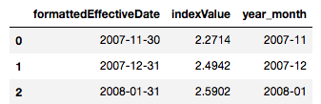
S&P First Mortgage Index Vs Mortgage complaints in CFPB:
Importing S&P First Mortgage Default Index
import json
with open('Source_for_SP_mortgage.json', 'r') as fp:
obj = json.load(fp)
Creating Dataframe for json file:
from pandas import DataFrame
jason_df = DataFrame(obj['indexLevels'])
jason_df_MY = jason_df.ix[:,['formattedEffectiveDate','indexValue']]
jason_df_MY['formattedEffectiveDate'] = pd.to_datetime(jason_df_MY.formattedEffectiveDate)
jason_df_MY['year_month'] = jason_df_MY.formattedEffectiveDate.astype(str).str.slice(0,7)

Slide 9
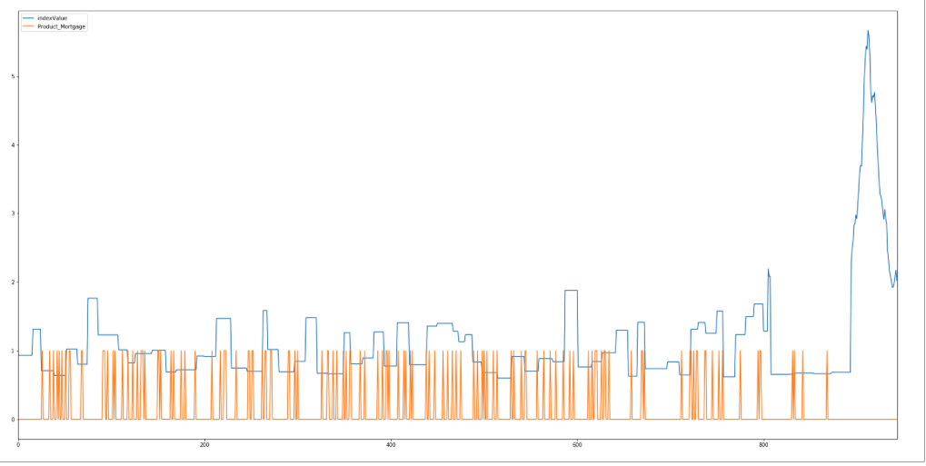
Join S&P First Mortgage Index with Mortgage complaints in CFPB:
Merge Data:
S_P_Mortgage_df = pd.merge(Product_df, jason_df_MY,on='year_month',how ='outer')
Identify how consumer complaints may relate to mortgage defaults:
BOW_complains_Mortgage.ix[:,[4,15]].plot(figsize = (30,15))

Slide 10
Natural Language Processing(NLP):
As CFPB data is unstructured text I am using NLP libraries to convert unstructured text into meaningful numeric data.
Using NLP I want to predict below:
Company_response_to_consumer
Timely_response
Consumer_disputed
Mapping the text to numeric:
BOW_complains['Timely_response_num'] =BOW_complains.Timely_response.map({'No':0, 'Yes':1})
BOW_complains['Consumer_disputed_num'] =BOW_complains.Consumer_disputed.map({'No':0, 'Yes':1})
BOW_complains['Company_response_to_consumer_num'] =BOW_complains.Company_response_to_consumer.map({'Closed with explanation':0, 'Closed with monetary relief':1,'Closed with non-monetary relief':2, 'Closed without relief':3,'In progress':4, 'Closed':5,'Untimely response':6})
# Define X and y
X = BOW_complains.Issue
y = BOW_complains.Timely_response_num
# Split the new DataFrame into training and testing sets
X_train, X_test, y_train, y_test = train_test_split(X, y, random_state=1)

Slide 11
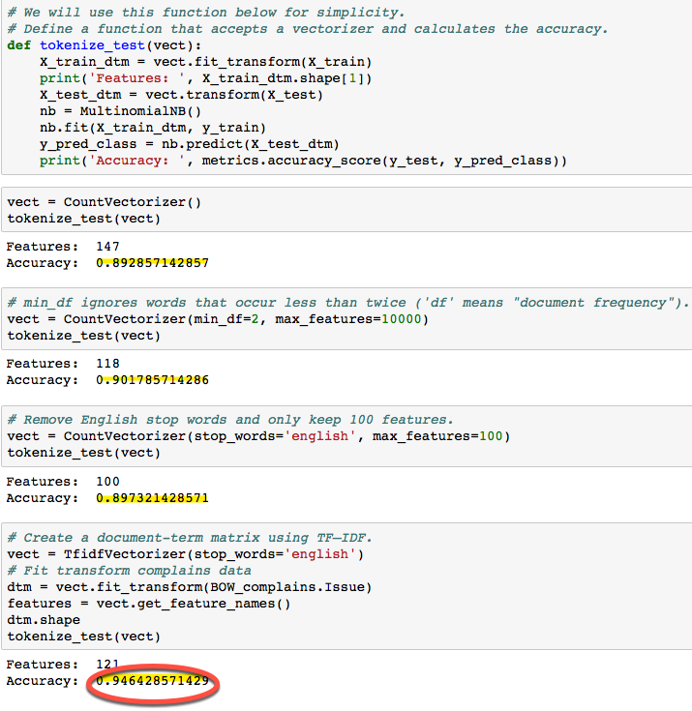
Text processing using Naive Bayes to predict Timely_response

Slide 12
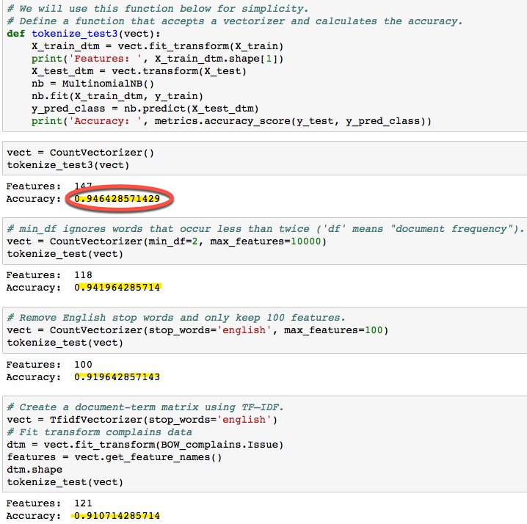
Text processing using Naive Bayes to predict Type of Product

Slide 13
Testing the model by passing random test
Predict the accuracy for Timely response for random Issue:
Predict the accuracy for Type of Product for random Issue:
Next steps:
Same way we can predict Consumer_disputed and Company_response_to_consumer and use this information to enhance financial consumer services and also improve the response quality of automated consumer support systems.

Slide 14

Testing the model by passing random test

