Slide 1
Predicting Interaction Volume
#datr-1128

Slide 2




Customer Service Interactions
Can we predict the total incoming interactions for a company?

Slide 3
Agenda
Introduction
Data and Methodology
Exploratory Data Analysis and Data Cleaning
Feature Engineering
Algorithm Selection
Results
Conclusion

Slide 4
Introduction
I chose data from my company around interaction volume: how many phone calls, livechats, emails, and SMS are handled on a daily basis.
My goal for this project is to train a model to predict interaction volume based on the factors present. I know that there are trends that exist in the data -- day of the week, seasonality, as well as year over year -- so I want to investigate and make sure my chosen model can still predict accurately with those non-linear relationships.

Slide 5
Agenda
Introduction
Data and Methodology
Exploratory Data Analysis and Data Cleaning
Feature Engineering
Algorithm Selection
Results
Conclusion

Slide 6
Data and Methodology
"The quality of your data determines the effectiveness of your models"
I used SQL to query our database and pull out ‘date’, ‘hour’ and ‘count’ for our four dimensions: ‘sms’, ‘calls’, ‘phone’, and ‘email’. I also pulled ‘order volume’ for those date / hour multi-indexes.
Pre-processing was completed in Excel to obfuscate the data so it's not representative of our company data. Here, I multiplied all counts by a formula to arrive at an inflated, but non-representative count. I found some timezone bugs in my data which I fixed at this point.
Once in Jupyter Notebooks, I spent a lot of time getting more familiar with Pandas and exploring the data. Since plotting and visualization was all new, I did a lot of semi-meaningless exploration, chopping up the data multiple ways, trying visualizations, etc.

Slide 7
Agenda
Introduction
Data and Methodology
Exploratory Data Analysis and Data Cleaning
Feature Engineering
Algorithm Selection
Results
Conclusion

Slide 8
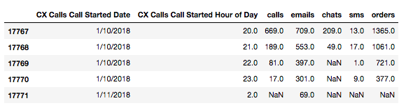
Exploratory Data Analysis and Data Cleaning
“garbage in, garbage out”
Excel date formatting is horrible and I was initially remedying by slicing until I realized Datetime was a thing. Once there, I fell into some traps with groupby and categorical variables as integers (years would be summed, weeks summed, etc).
After getting nowhere trying to visualize ‘day’+’hour’ trends, I decide to drop ‘Hour_of_Day’ and focus more on daily trends
Excel formatting

Slide 9
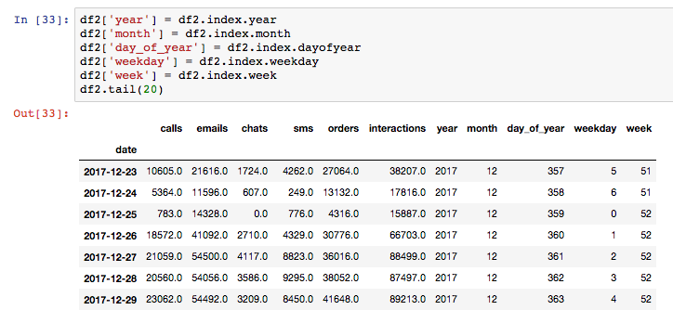
Exploratory Data Analysis and Data Cleaning
Datetime formatting

Slide 10
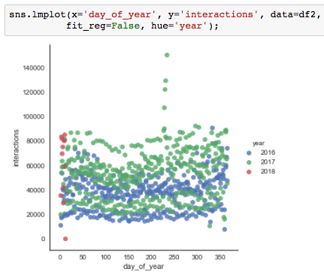
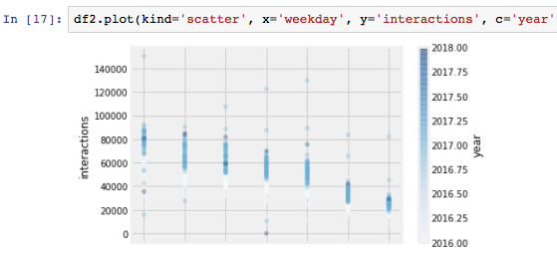
Exploratory Data Analysis and Data Cleaning
#A trend in the data: weekends!
#Outliers: Eclipse week

Slide 11

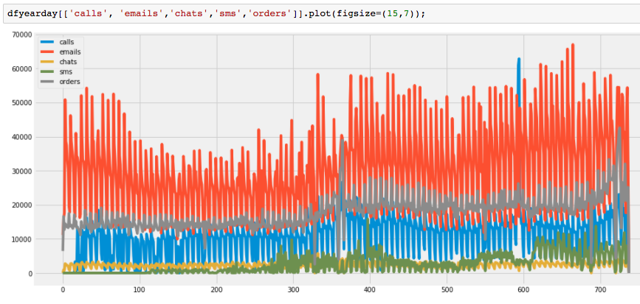
Exploratory Data Analysis and Data Cleaning
#Find a remove those outliers, check to make sure they’re missing
#Plot interactions by day
#Daily became way to hectic, let’s try monthly

Slide 12
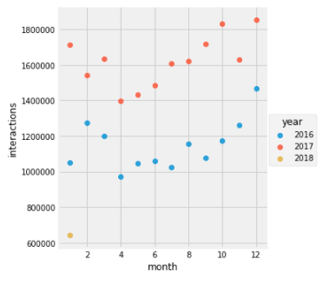
Exploratory Data Analysis and Data Cleaning
#monthly was too sparse, so let's try Weekly!

Slide 13
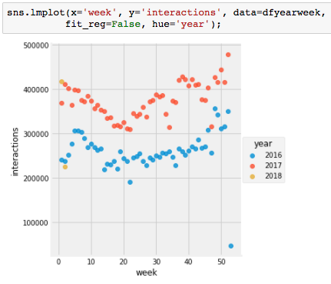
Exploratory Data Analysis and Data Cleaning
#weekly looks just right
#there are some clear trends and the variation by day isn’t an issue anymore

Slide 14
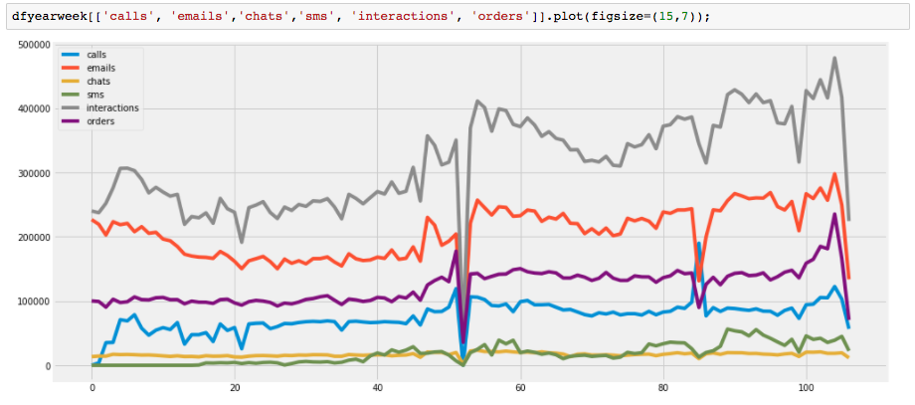
Exploratory Data Analysis and Data Cleaning
#Using week of the year, I noticed some more bad data, which I needed to fix -- week 53, which had a day to itself
#This is going to be the base dataset for my model

Slide 15
Agenda
Introduction
Data and Methodology
Exploratory Data Analysis and Data Cleaning
Feature Engineering
Algorithm Selection
Results
Conclusion

Slide 16
Feature Engineering
“The quality and quantity of the features will have great influence
on whether the model is good or not”
#Created features based of datetime
df2['year'] = df2.index.year
df2['month'] = df2.index.month
df2['day_of_year'] = df2.index.dayofyear
df2['weekday'] = df2.index.weekday
df2['week'] = df2.index.week
# I tried encoding the numerical categorical data, like week or year into different combination of dummy variables for ‘week’ and ‘year’
#Somewhere along the way I decided that it didn’t do much for me to predict the current interactions from orders, so decided to create a new target variable:
#Adding a new column for ‘next_week_interactions’ which pulls the subsequent week's interactions
#The thought process here is that if I can use this week’s data to forecast next week’s interaction volume

Slide 17
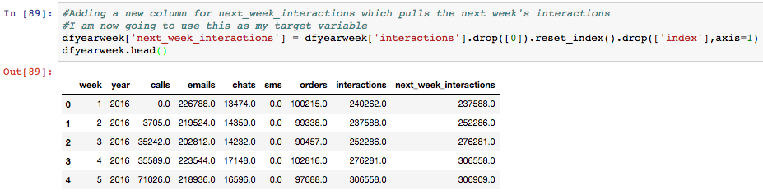
Feature Engineering

Slide 18
Agenda
Introduction
Data and Methodology
Exploratory Data Analysis and Data Cleaning
Feature Engineering
Algorithm Selection
Results
Conclusion

Slide 19
Algorithm Selection
I tried all of the algorithms we learned about and ended up having the best results with Random Forest Regressor.
Random Forest is as a type of ensemble learning method which uses classification trees, bootstrap aggregation (also known as bagging), and random selection of features to to reduce the variance while maintaining the low bias that you get from a Decision Tree model.
results shown in Bühlmann’s article indicate that bagging tends to add bias to the bagged estimator, with the tradeoff of reducing variance.
One attractive feature of random forests is that feature importance can be extracted. Feature importance roughly refers to the contributions of features when building the classification trees in the process of random forests.

Slide 20
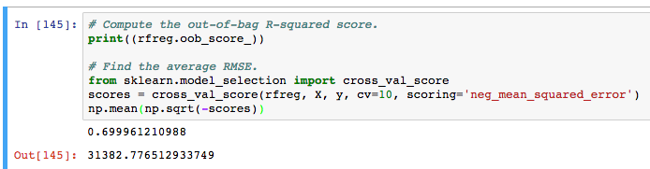
Model Training
First I got the out of bag score and the RMSE to see what score I should try to beat
Splitting the data into train and test sets allows us to test the models that we create on a different subset of the data. This allows us to avoid overfitting the model on the training set.
Specifying a random_state variable allows the outputs that we create to be repeatable. If we don’t do this each time we run the below line of code the train and test datasets will be different.
#split the data into train and test sets

Slide 21
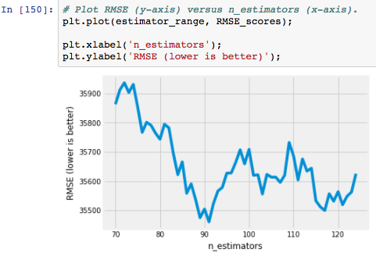

Tuning the Model
#I tuned Individual Parameters, using five-fold cross-validation with each value of n_estimators
n_estimators = The number of trees in the forest
#lowest n_estimators ended up being 91

Slide 22
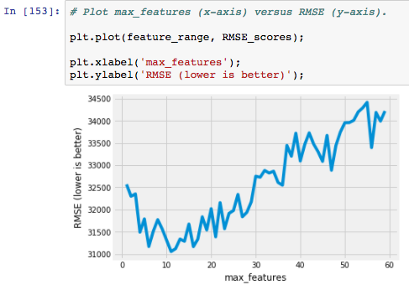

Tuning the Model
#I tuned max_features, using 10-fold cross-validation with each value of max_features
max_features = The number of features to consider when looking for the best split
From here, we can then create the regression using these values

Slide 23
Agenda
Introduction
Data and Methodology
Exploratory Data Analysis and Data Cleaning
Feature Engineering
Algorithm Selection
Results
Conclusion

Slide 24
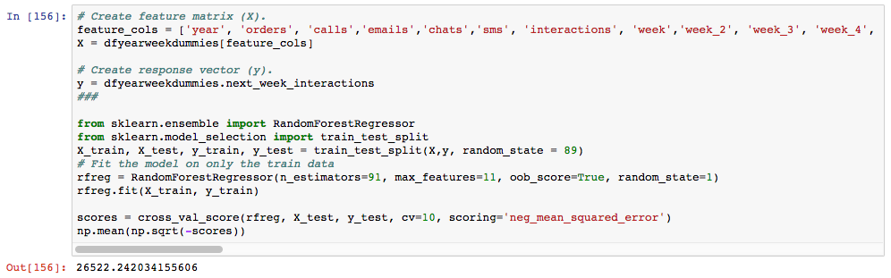
Results
I then used the tested n_estimator and max_features to get the best RMSE

Slide 25
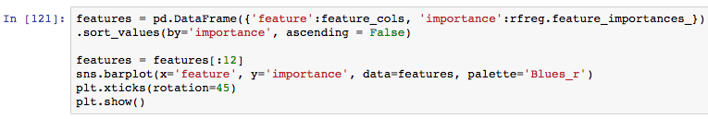
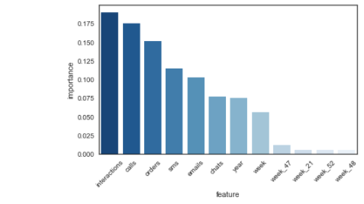
Results
#pull and graph feature_importances_
This breakdown makes sense - interactions are pretty similar week over week. It might be more interesting to run this monthly.
I have a feeling that I might gain more insight when I’m using actual numbers.
It would probably make sense to normalize the numbers as well, so that each feature contributes approximately proportionately to the final RMSE. I’ll do this next time.

Slide 26
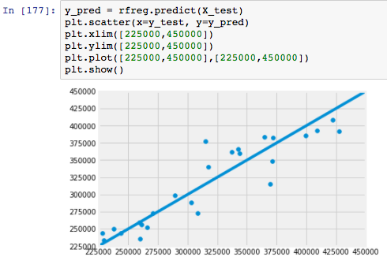
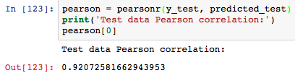

Results
#This model fits the test data reasonably well
Test data Pearson correlation: 0.92072581662943953
The Pearson product-moment correlation coefficient is a measure of the strength of a linear association between two variables
#Test R2 value shows an improvement,
compared to Out-of-bag R-2 score estimate: 0.71860105900039928 (after some feature selection changes):

Slide 27
Agenda
Introduction
Data and Methodology
Exploratory Data Analysis and Data Cleaning
Feature Engineering
Algorithm Selection
Results
Conclusion

Slide 28
Conclusion
#This model worked quite well
#I will go back and re-run these steps with actual data, where I'll be able to identify outliers a bit better (because the data will make sense)
I’d also like to add in some other features which might have an impact on interaction volume, like % of new vs. returning customers, new product launch dates, National Holidays, etc.
#Hopefully we can operationalize this and use it for demand forecasting and staffing utilization, to staff the appropriate headcount to handle interaction volume

Slide 29
Resources
PK_final_project-Final.ipynb
interactions_summary_20180112.csv

Slide 30
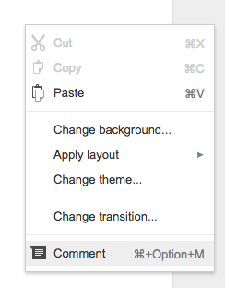
Questions?
Leave comments with feedback and questions on the slides!

