Slide 1

MICROBLOGGING ON TWITTER

Slide 2
ABSTRACT
Microblogging may be a new sort of communication during which users describe their current status briefly posts distributed by instant messages, mobile phones etc..
We present our observations of the microblogging phenomena by studying the topological and geographical properties of the social network in Twitter . We present a taxonomy that categorizes the underlying intentions users have in making microblogging posts.
By aggregating the apparent intentions of users in implicit communities extracted from the info, we show that users with similar intentions connect with one another.
Key words: Microblogging, data analysis, social media, Twitter.

Slide 3
INTRODUCTION
People share knowledge, experiences and thoughts with the world by using Social Media like blogs, forums, wikis, review sites, social networks, tweets and so on.
An opinion “is simply a positive or negative sentiment, view, attitude, emotion, or appraisal about an entity or an aspect of the entity” from an opinion holder at a specific time.
In our Project, we classify the Negative, Neutral, Positive emotions of the user using tweets through Sentimental Analysis with python.

Slide 4
LITERATURE SURVEY
Jumadi. Stated opinion mining with Support Vector Machine (SVM) algorithm to classify tweet opinion The result of this research is 0.838 precision value and 0.76 recall for positive class. Then, 0.78 precision value and 0.853 recall for negative class. Opinion classification with SVM of this research has accuracy 78.75%.
Daniele Cienne.Twitter Vigilance has been designed as a cross-domain, multi-user tool for collecting and analyzing Twitter data, providing aggregated metrics based on the volume of tweets and retweets, users' influence network, Natural Language Processing and Sentiment Analysis of textual content. The proposed architecture has been validated against a dataset of about 270 million tweets showing a high efficiency in recovering Twitter data.

Slide 5
EXISTING SOLUTION
Hoeffding tree algorithm is the most popular tool in mining data streams. For this tree algorithm the Hoeffding’s bound is utilized to find the smallest amount of instances required in a node to choose a splitting attribute.
Replacing the MacDiarmid’s bound in algorithm, we obtain McDiarmid tree algorithm. The accuracy from the McDiarmid tree for sentiment analysis on Twitter is very close to that from the Hoeffding tree,But the process time of the former has decreased.
To achieve that we use Python as it is comfortable and compatible .

Slide 6
PROBLEM STATEMENT
Classifying their tweets using machine learning would eliminate the controversies before opinions are formed on their tweets. It would also sort out abusable issues on social media once if the tweets are classified.
So we are implementing a Machine learning algorithm for sentiment analysis i.e., Natural Language Processing (NLP) on the basis of python by installing different modules.

Slide 7
METHODOLOGY
Getting Authentication credentials & Authenticating
Cleaning
The
tweets
Analyzing
The
tweets
Accessing
User’s
tweets
Subjectivity
&
Polarity
Displaying
Using
Visualization
Techniques

Slide 8
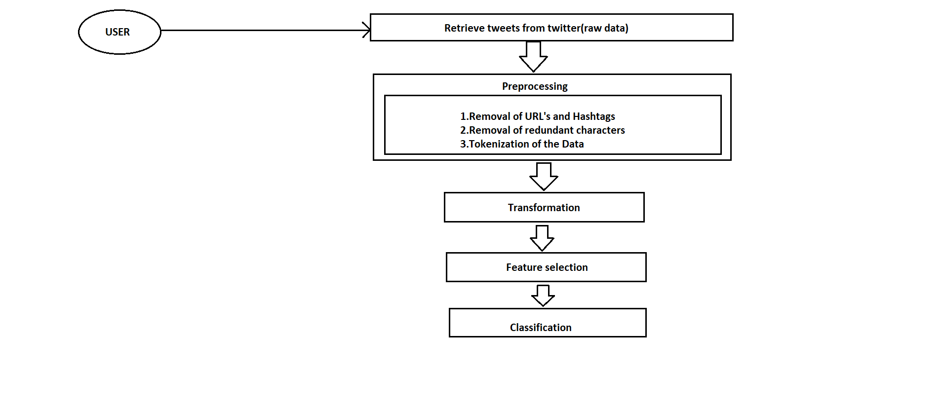
ARCHITECTURE

Slide 9
ARCHITECTURE
1.Retrieve tweets from twitter
Go to authorized account settings by clicking on the more icon in the navigation bar, and selecting the account from the menu. Click on Download an archive of your data. Enter your password under Download an archive of your data, then click confirm. The downloaded data is the raw data for our final output.
2.Preprocessing
Preprocessing undergoes three steps.
1.Removal of URL’S and Hashtags: To set our desired tweet with the limited characters we use this step.
2.Removal of redundant characters: To clean the file for certain extent we use removal of redundant characters.

Slide 10
ARCHITECTURE
Tokenisation of Data:
TweetTokenizer() that helps to tokenize Tweet Corpus into relevant tokens. The advantage of using TweetTokenizer() compared to regular word_tokenize is that, when processing tweets, we often come across emojis, hashtags that need to be handled differently.
3.Transformation:
All the data collected from the previous steps are transformed into our required form so that future processing will be easier.
4.Feature Selection:
Feature selection is an important problem for any pattern classification task .As our aim is to divide the tweets we must use this.
5.Classification:
It is a systematic arrangement in groups according to the respective desired categories.

Slide 11
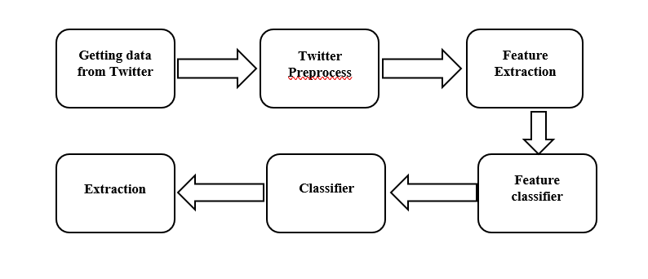
UML DIAGRAM
BLOCK DIAGRAM

Slide 12
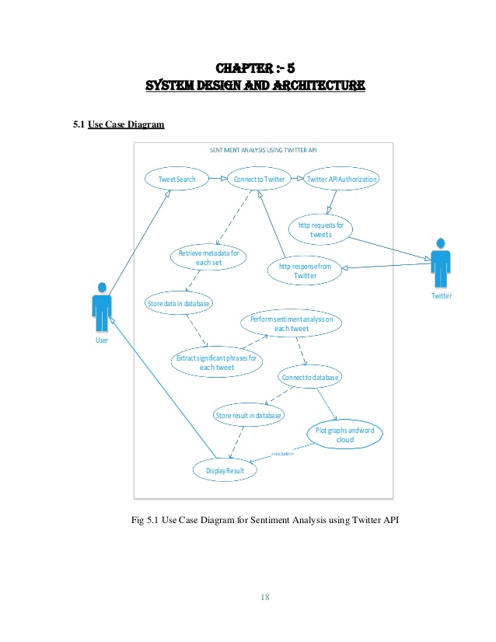
UML DIAGRAM
USE CASE DIAGRAM

Slide 13
MODULE EXPLINATION
The proposed Twitter system for our experiment has the following modules:
The basic Architecture of the Twitter service consists of a User Table, Tweet Table, and Followers Table
Here first we search for the userid with the help of username and get all the ID of the tweets.
Then we go to the tweetid table to get all the actual tweets mapping to that user.
When a user follows another user, it gets stored in the follower table, and also cache it Redis.

Slide 14
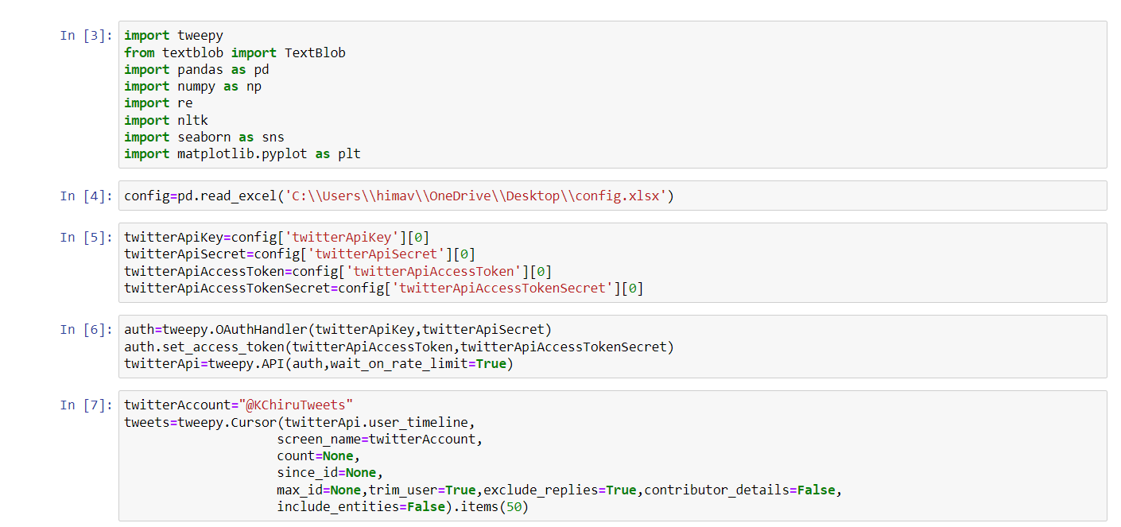
CODING

Slide 15
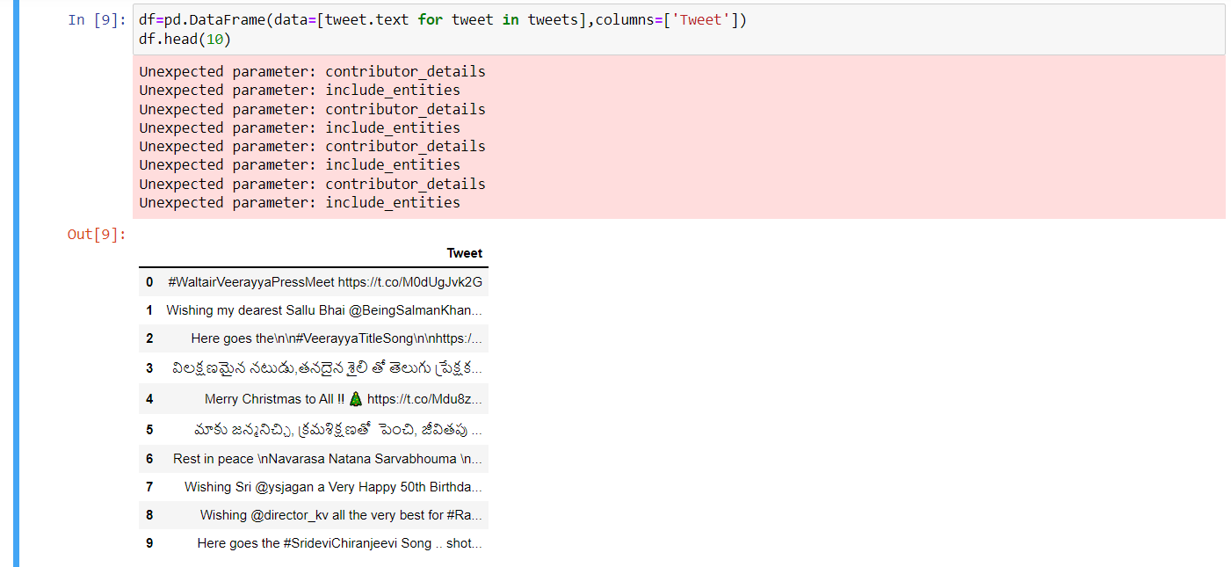

Slide 16
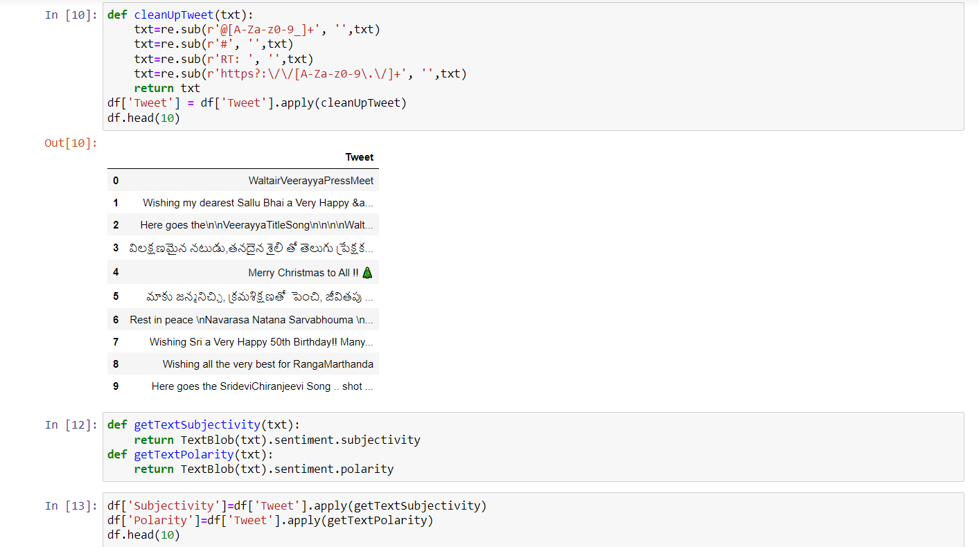

Slide 17
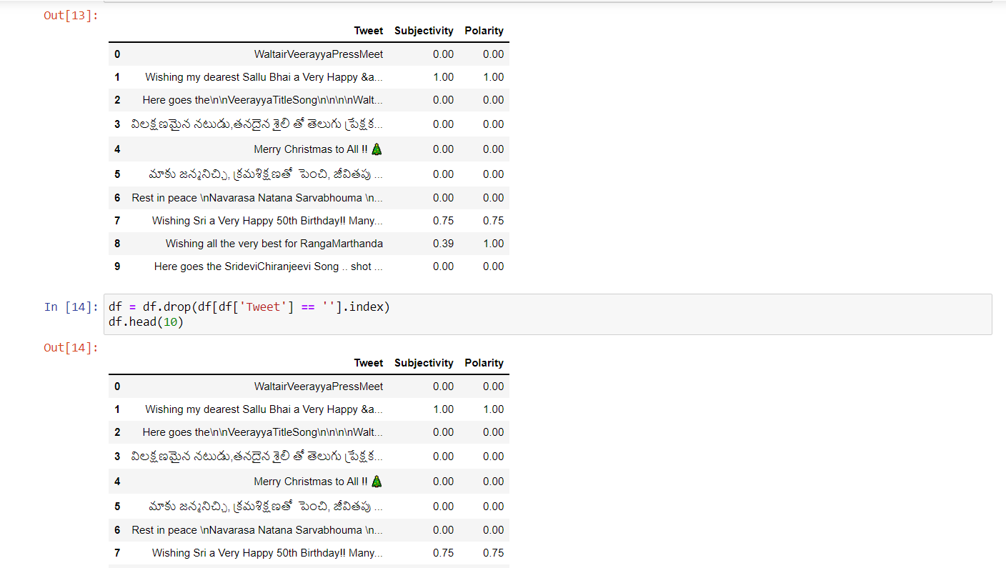

Slide 18
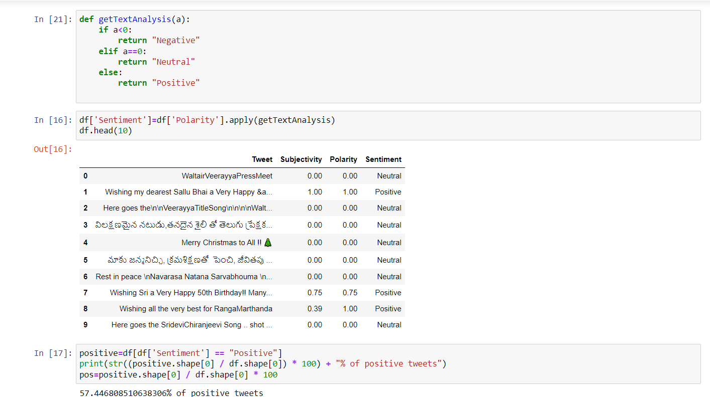

Slide 19
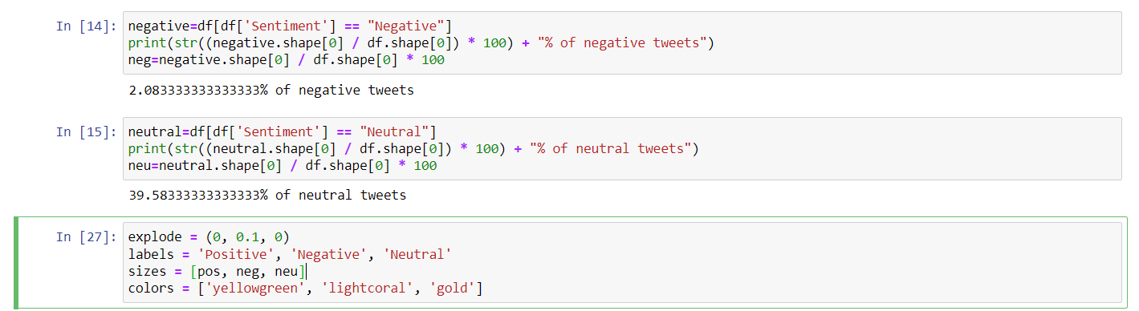

Slide 20
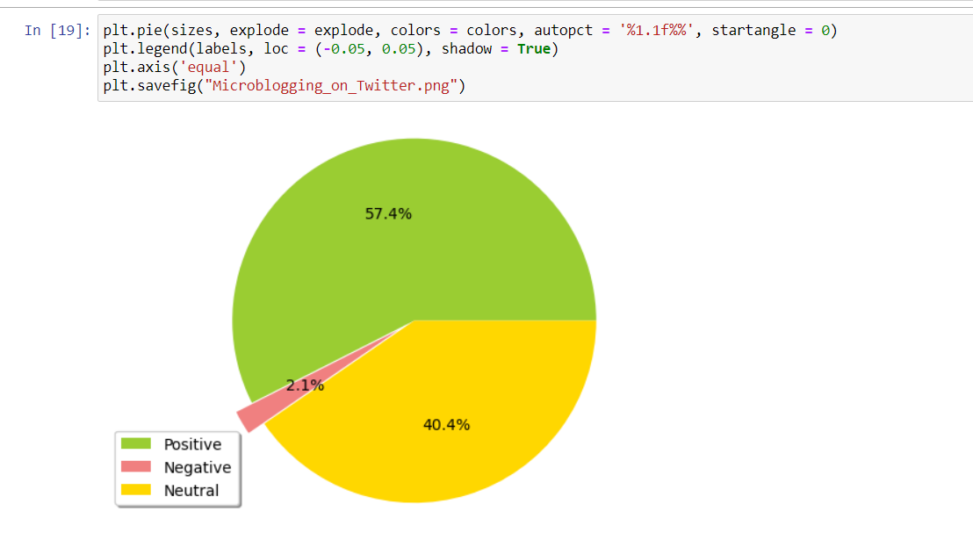

Slide 21
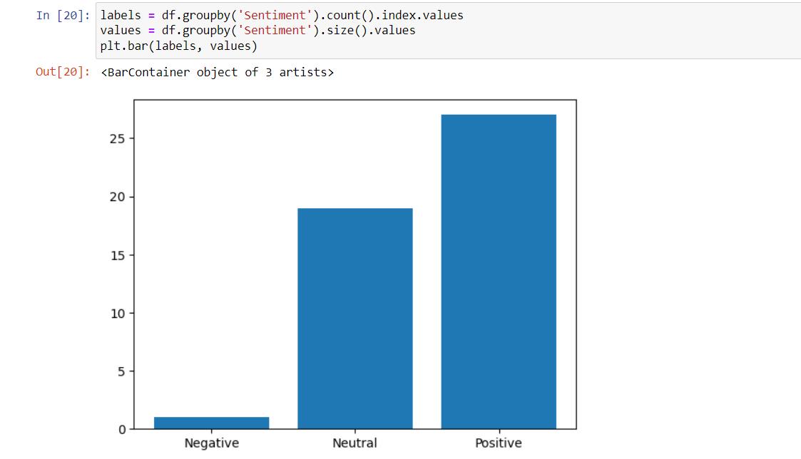

Slide 22
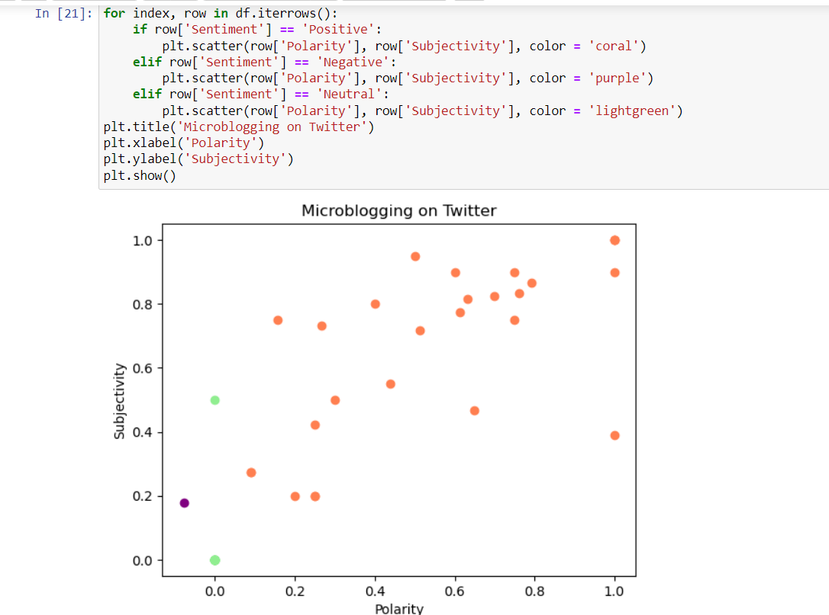

Slide 23
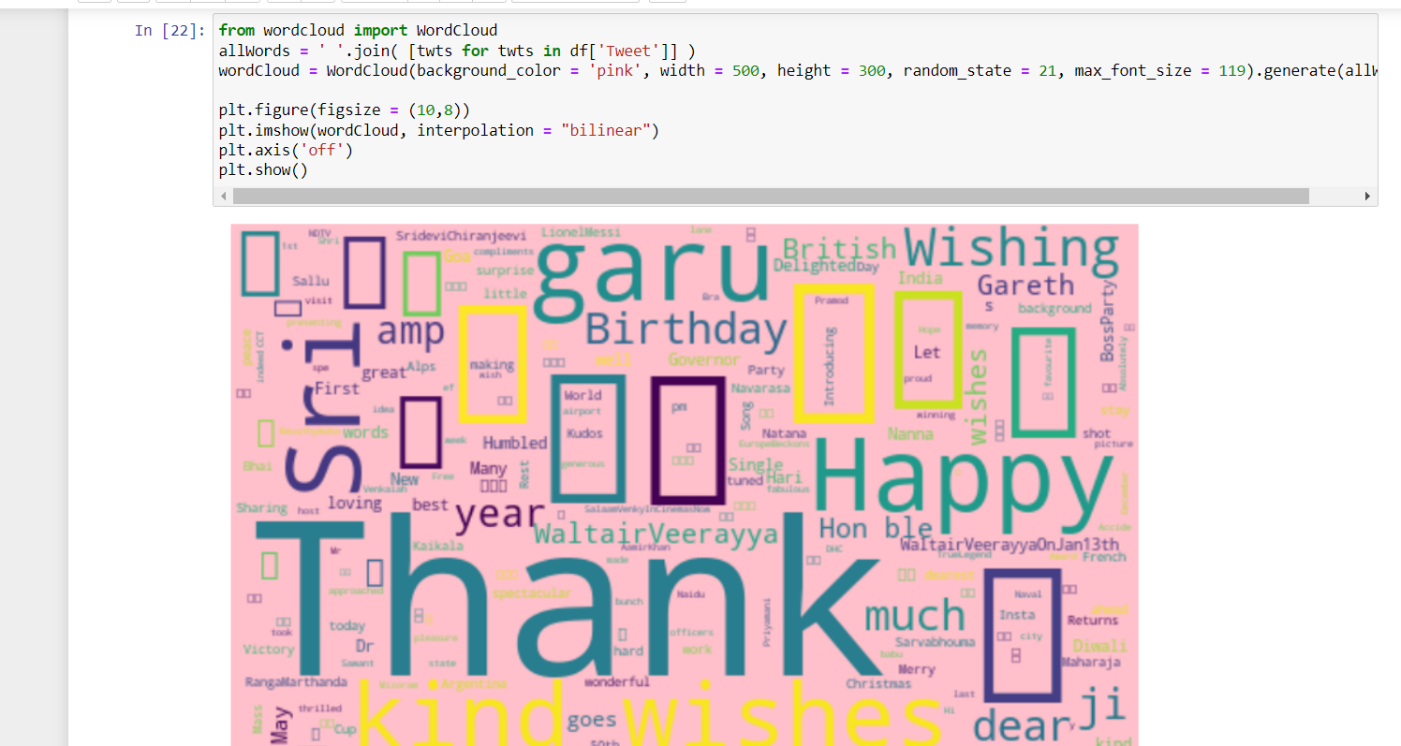

Slide 24
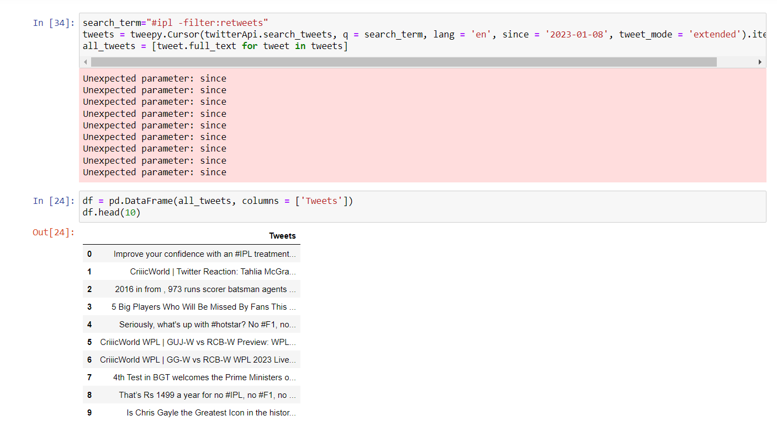

Slide 25
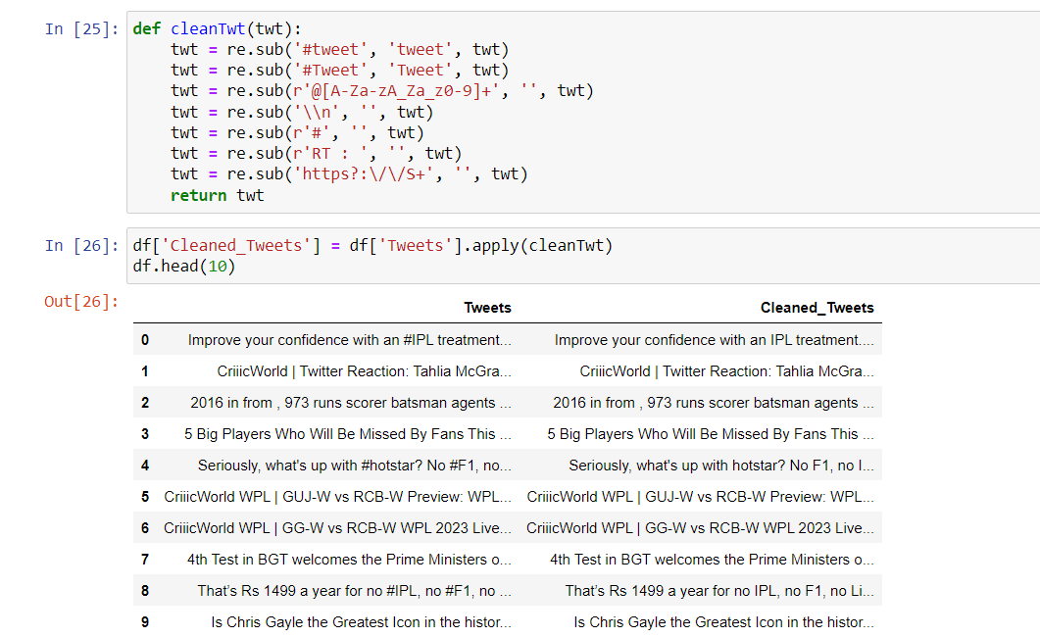

Slide 26
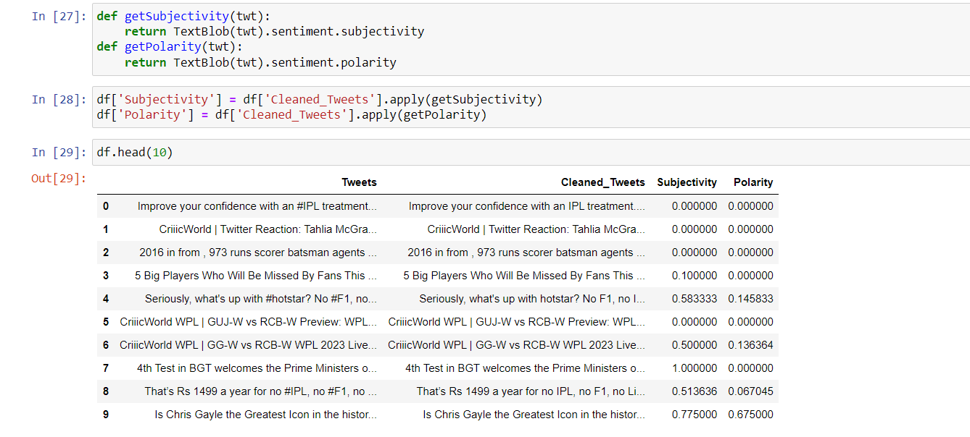

Slide 27
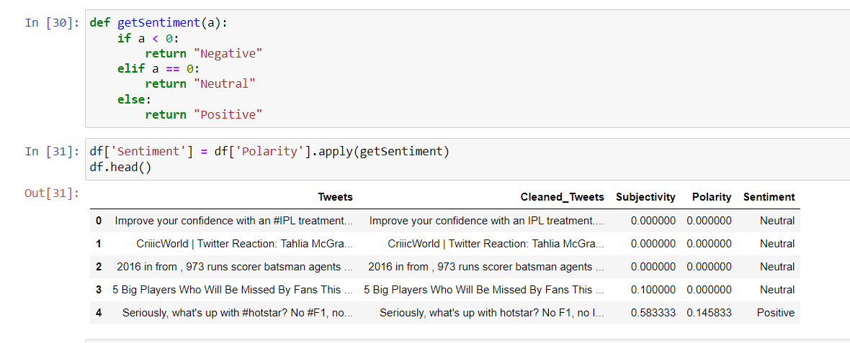

Slide 28
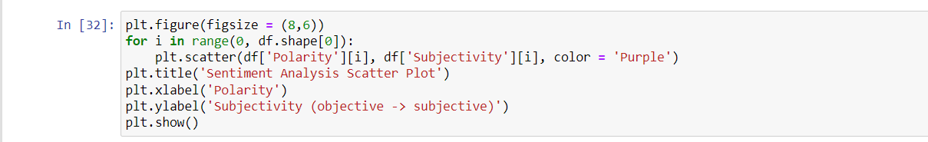
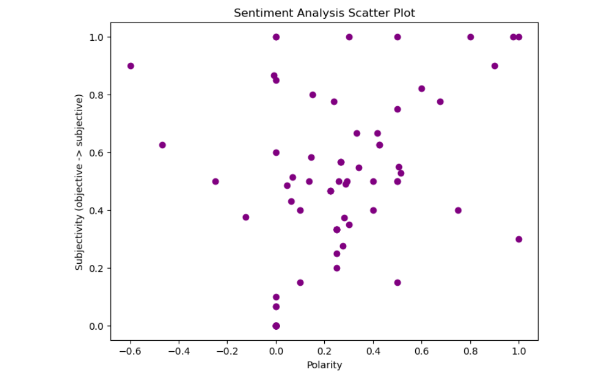

Slide 29
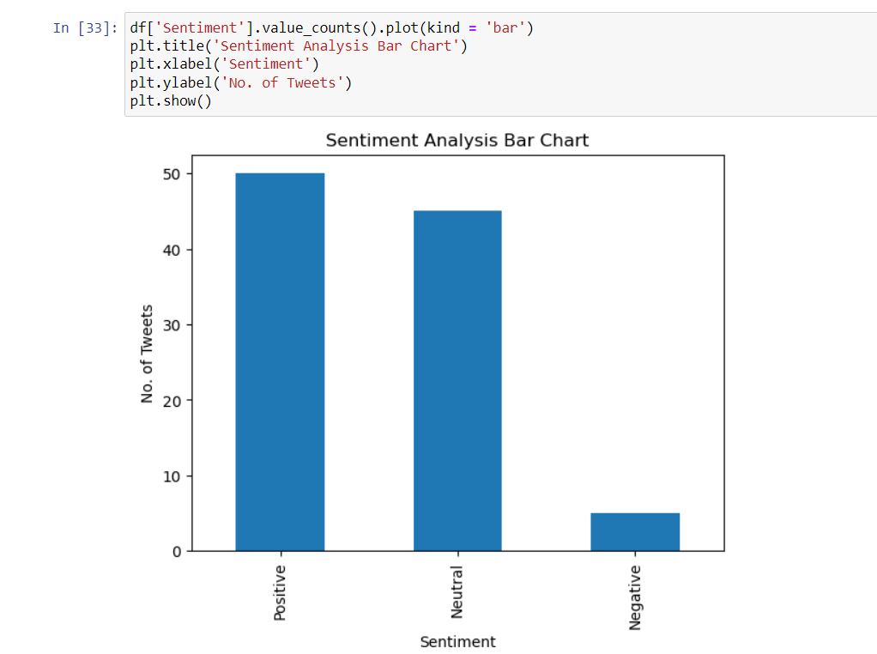

Slide 30
SUMMARY
We have collected different data from the Twitter, our project had analysed the tweets that were retrieved. We have used Tweepy (twitter API) for accessing tweets from twitter.
Our methodology has extracted tweets from Twitter by the 4 keys that were generated after creating an app in the developer account and classified tweets into positive, negative and neutral.
It also stated the subjectivity and polarity of the tweets extracted on giving a username as well as a search term. Then the retrieved data can be visualised using visualization techniques.

