Slide 1
Uber Fare Prediction
Present By – Preeti Sahani(46)

Slide 2
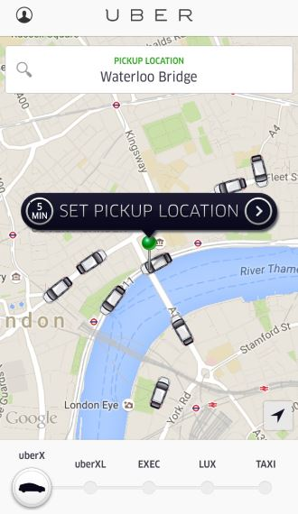
What Is Uber?
A transportation company with an app.
Founded by Travis Kalanick and Garrett Camp, in 2009.
It had 118 million monthly active users worldwide

Slide 3
Overview
This is a basic regression model to predict the fare of the uber ride trained on top of Sklearn RandomForestRegressor model. The model would take the different trip parameters (number of passengers, pick up and drop off geographical coordinates, date and time of the trip) as the input and predict the fare amount as output. The model has been trained with 2 lakh records and acquired an score of 0.968.

Slide 4
About Dataset
2000 Rows & 8 Columns
key
fare_amount
pickup_datetime
pickup_longitude/latitude
dropoff_longitude/latitude
passenger_count

Slide 5
Data Preprocessing
Data preprocessing is a process of preparing the raw data and making it suitable for a machine learning model. It is the first and crucial step while creating a machine learning model.
Step:
- Getting the dataset - Encoding Categorical Data
- Importing libraries - Splitting dataset into training and test set
- Importing datasets - Feature scaling
Finding Missing Data

Slide 6
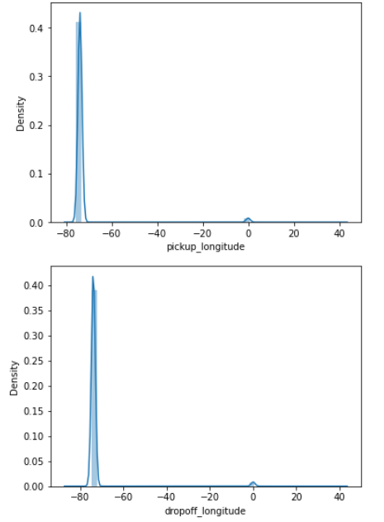
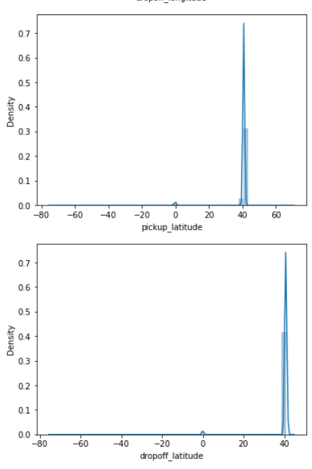
Distribution Plot

Slide 7
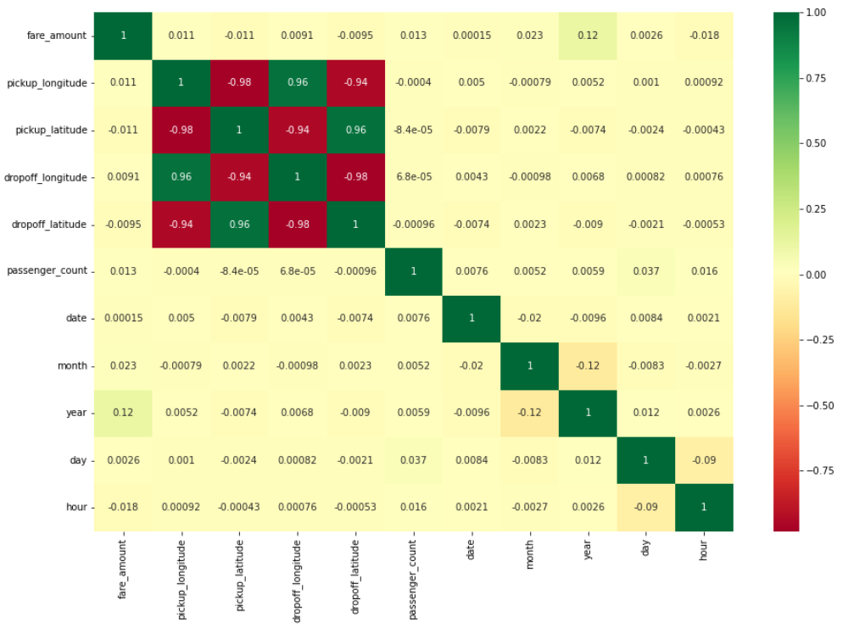
Correlation

Slide 8
Random Forest
A random forest is a meta-estimator.
A supervised learning algorithm.
It is a bagging technique.
It operates by multiple decision trees at training time and give output as a individual tress.

Slide 9
Benefits & Challenges
Reduced risk of overfitting
Easy to determine feature importance
Provides flexibility
Time-consuming process
Requires more resources
More complex

Slide 10
Result
Accuracy score = 96.87%
RMSE = 5.22

Slide 11
CONCLUSION
The Random Forest Regression Model for prediction of dynamic price of trips is providing an efficiency of 96.87%. It is better suited for the prediction of target variable which is trip fare, and it performs very well. Further this work can be carried out using different machine learning algorithms and techniques in order to get higher efficiency and lower errors

Slide 12
Thank You

