Slide 1
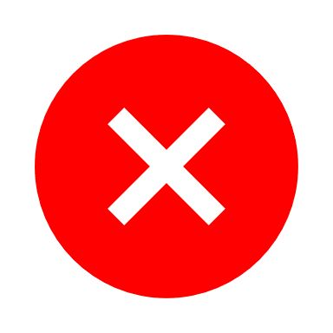



Improved NOK check process related to regulatory or quality blocks, leading to significantly less disruption in IGT-S Supply Chain
From
NOK check (Regulatory / Quality block) executed only at Order release and at Delivery
In case of NOK, system leading to block in factory and/or warehouse if not resolved on time
Process not fully deployed in Pune and Suzhou
To
NOK check executed 3 weeks prior to Order release, at Order Release and at Delivery
In case of NOK, production order not released
Harmonized process within IGT-S across Best / Pune / Suzhou
Improved monitoring and accountability in cross functional team (Supply Chain, Quality and Regulatory), both for Fixed Systems, Mobile systems and Field Extensions/Upgrades
Result
Proactive check allows time to solve issue prior to release
Best: In 2024 93% decrease in stops (418 → 27) and 93% decrease in waiting time (13.1k → 563 hours) compared to 2023
Improved on time shipment towards customers
Ensure compliance: no shipment of systems with a quality or regulatory block
Pre-check
Order release
Delivery
From
Disruption
NOK Check
To
3 weeks
Time to solve issues
No release of orders with block

