Slide 1
BIKE SHARING SERVICE

Slide 2

Business Problem:
Mrs Saini provides the Bike Sharing Service in Ranchi. Mrs Saini wants to know it’s customer behaviour in order to provide better service and attract more customers and in-turn increase the profits.
Mrs Saini

Slide 3
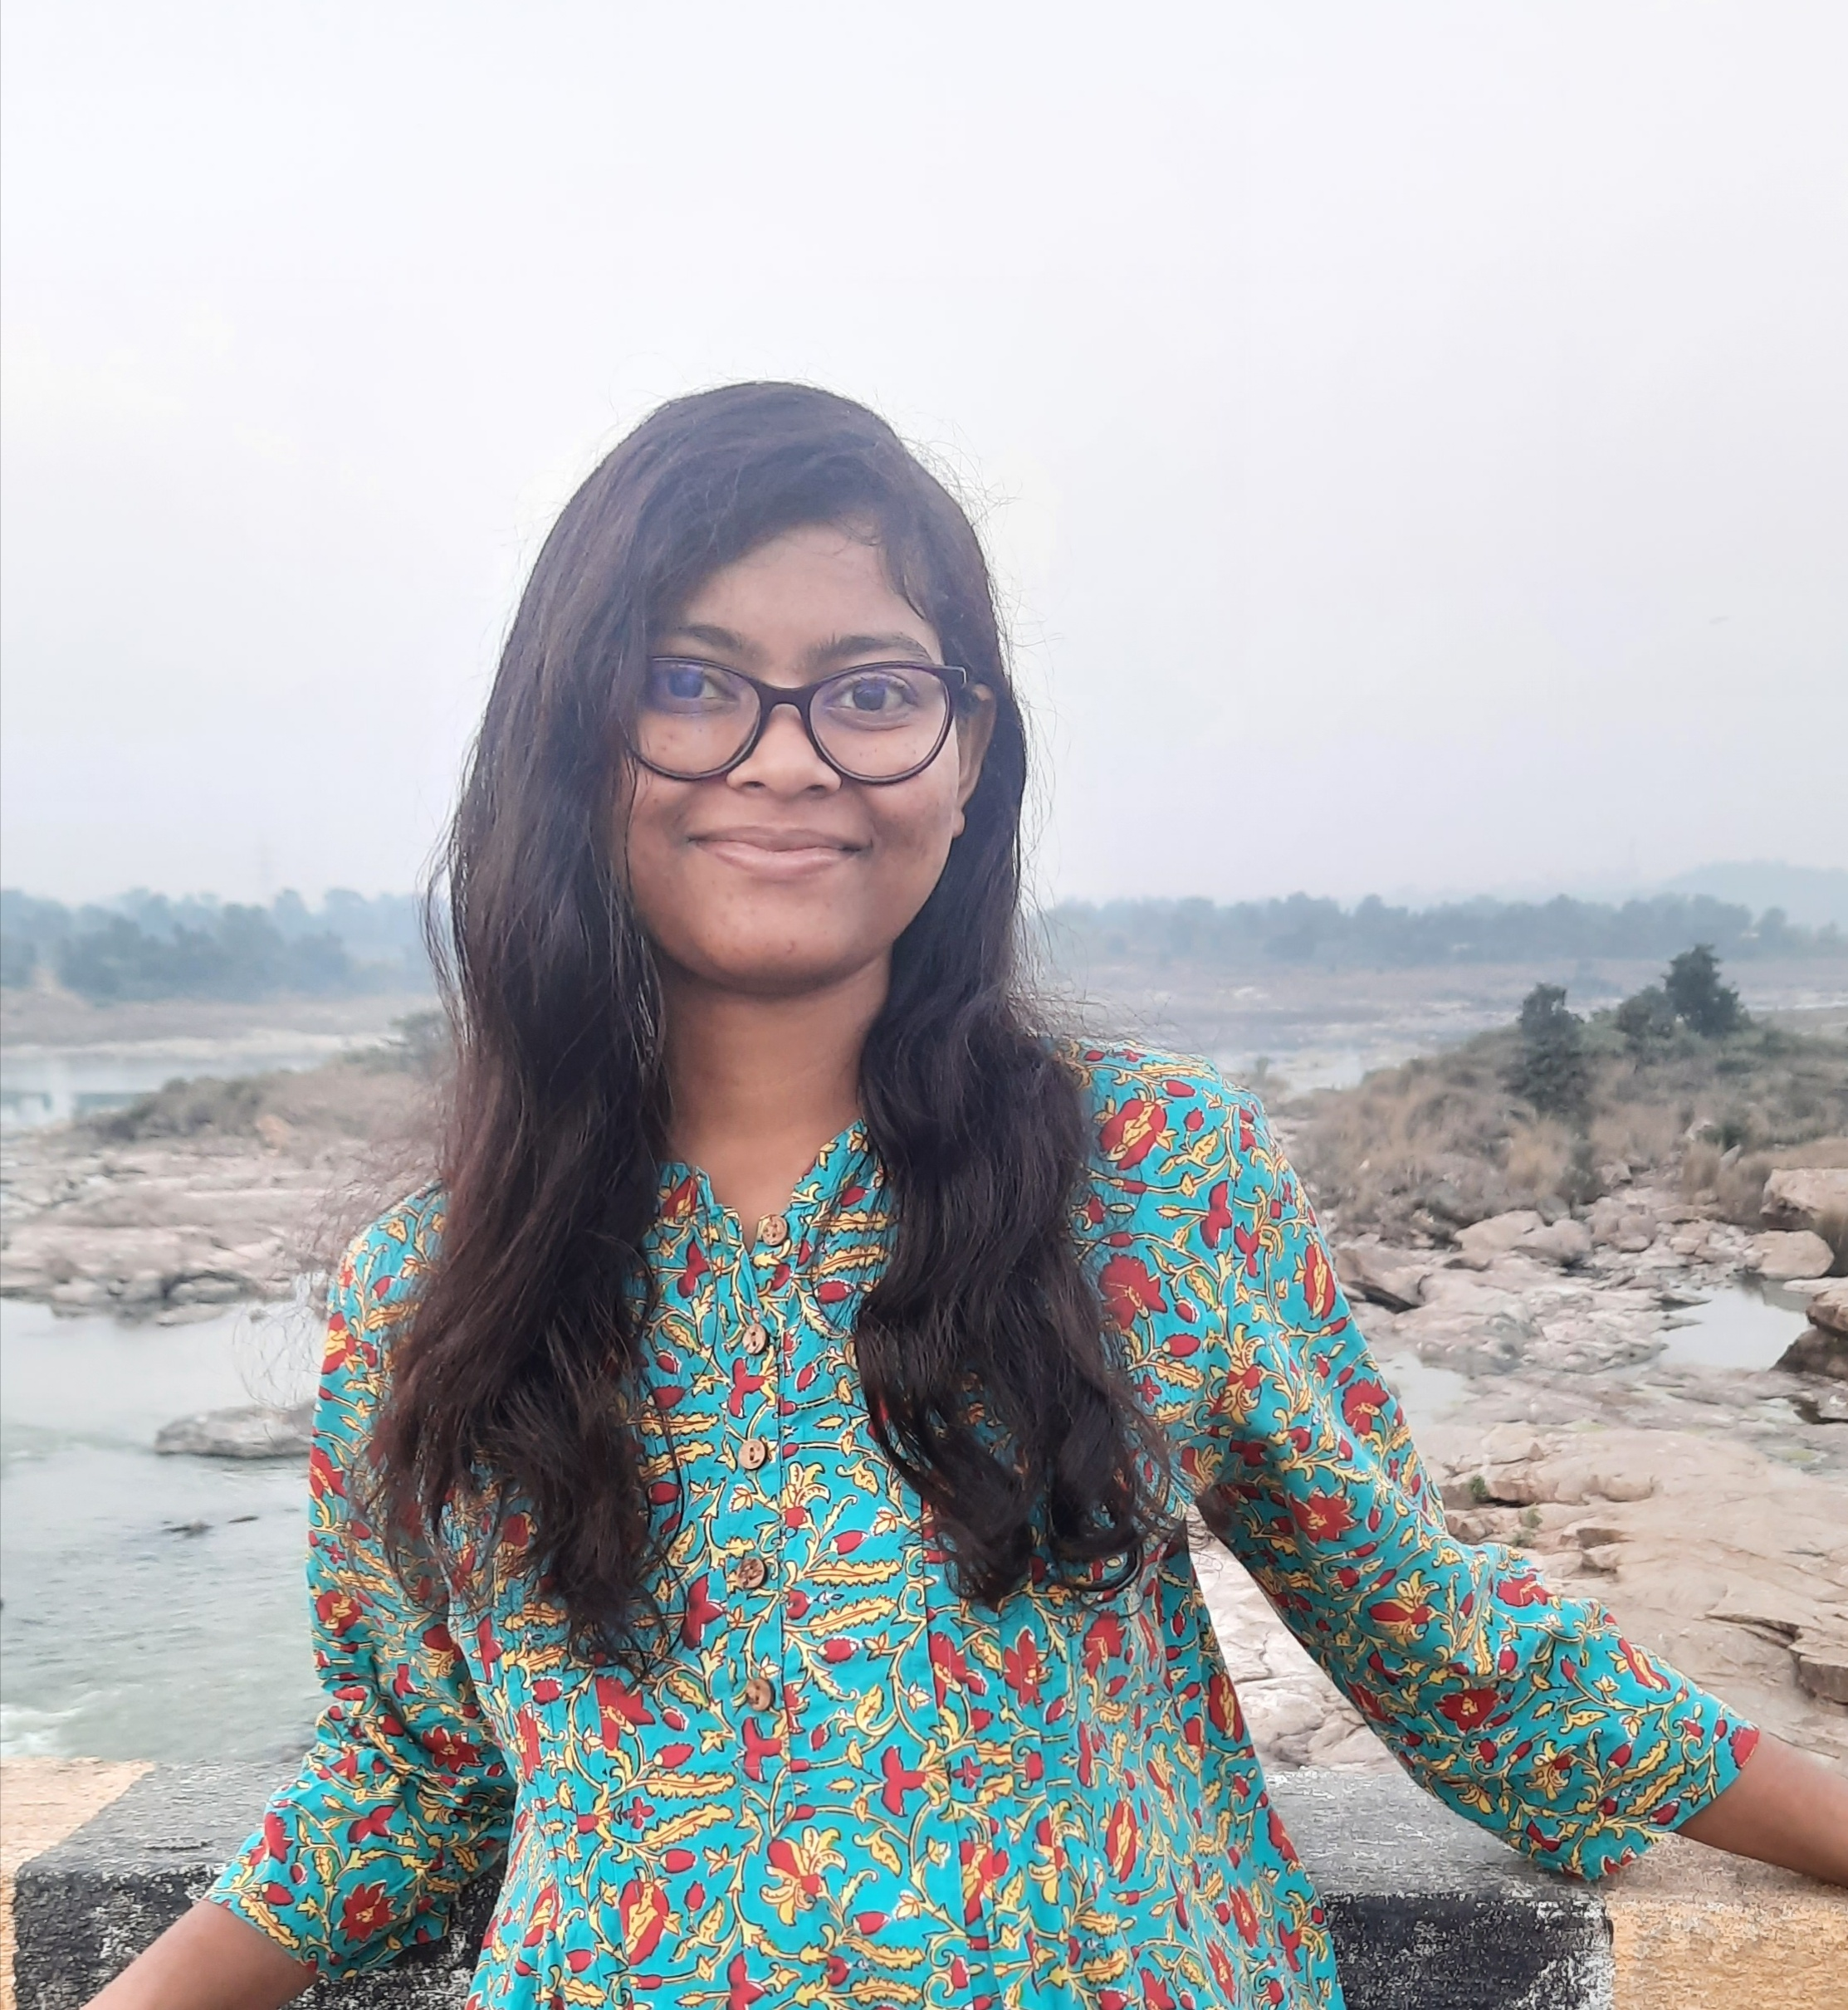
Preeti is currently doing Data Engineering internship in Everlytics. She has keen interest in exploring datasets. She has a skill like sherlock who tries to see what others can’t see and bring in everything in front of her audience. This time she has been given a very tough task which will prove if she has that skill or not…
Preeti Kumari Murmu
Data Analyst

Slide 4


While exploring the data Preeti finds that there are two types of customers that uses Mrs. Saini service:
Registered
Casual

Slide 5
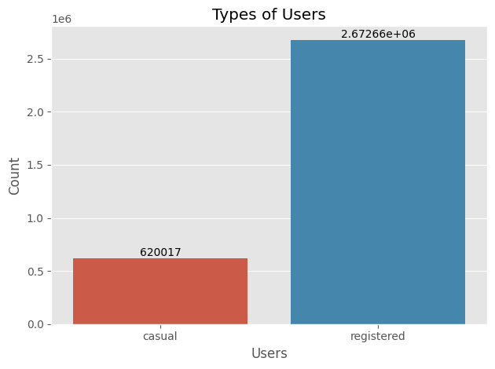
In the span of 2 years from 2011-01-01 to 2012-12-31, there have been total 3292679 ride count. And each type of users contributed as follows:
Registered : 2672662 (81.1%)
Casual : 620017 (18.8%)

Slide 6
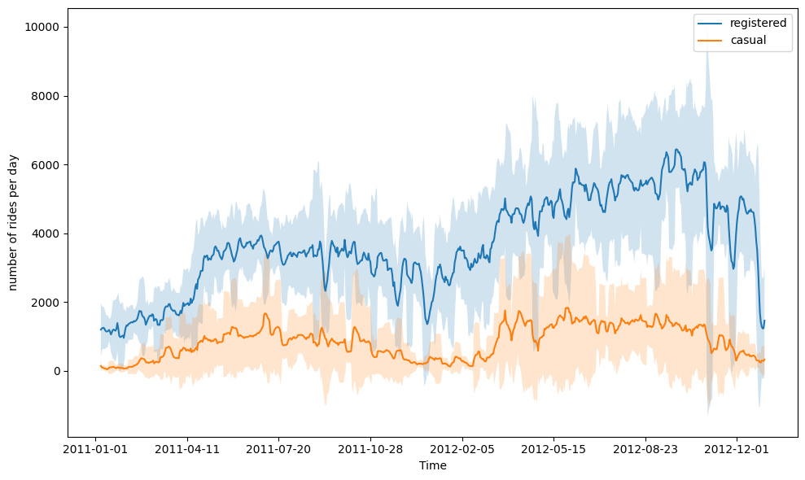
In winter season the ride decreases and in summer the ride increases.

Slide 7
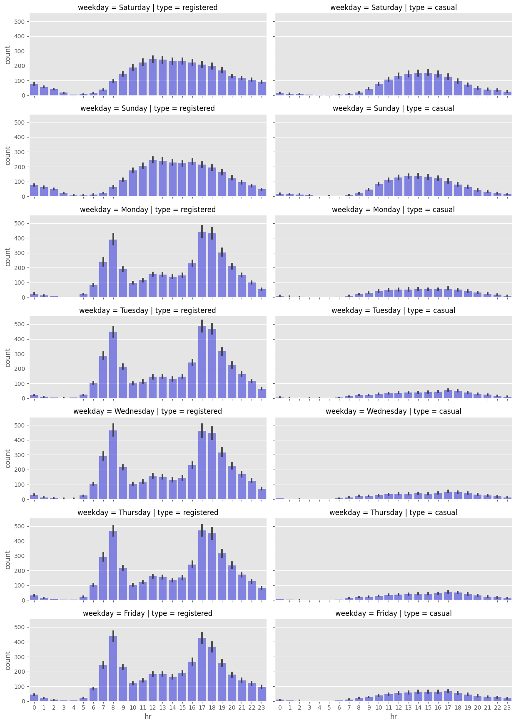
- For registered users there are two peak hours, one at 8 A.M and another at 6 P.M. which is nothing but working hours(9 to 5). So registered users are using the rides for commute.
- On weekends, distribution for both casual and registered users is almost similar(but count is high for registered users).
- Conclusion: most of the rides are happening on working days right before and after the working hours(9 to 5).

Slide 8
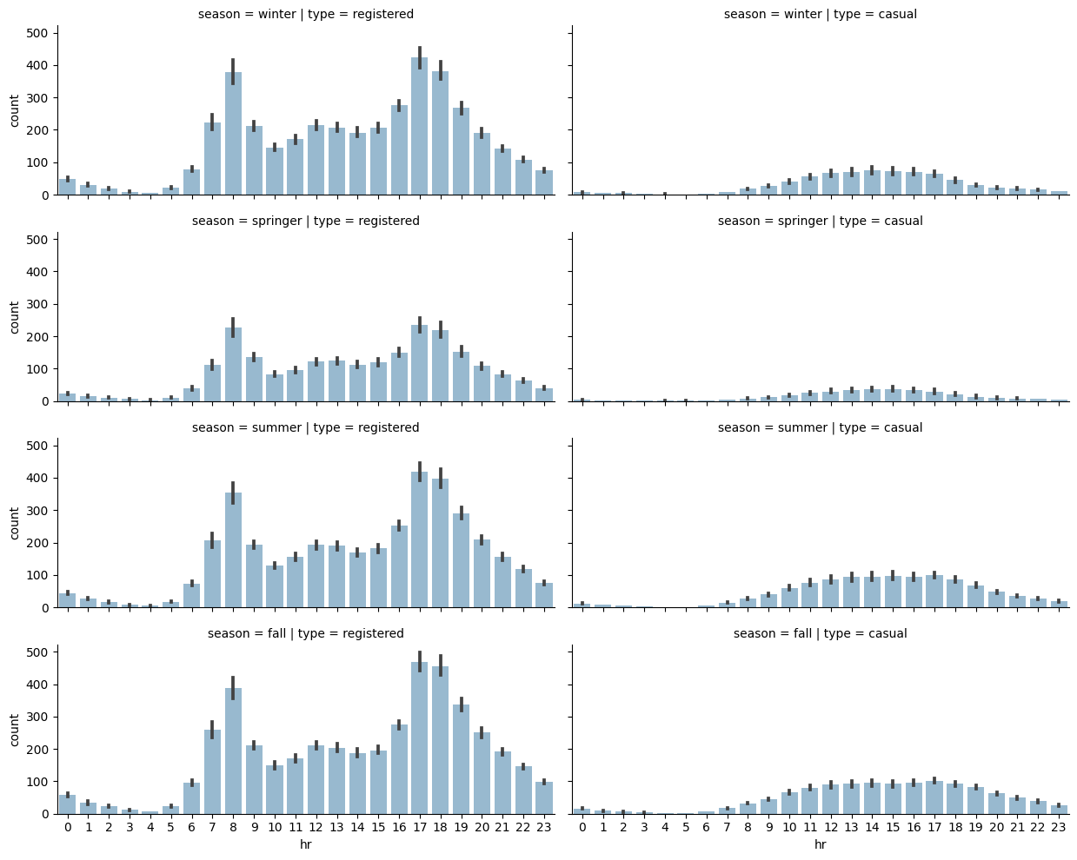
For all season the rides are in same shape except for winter. In winter people take less rides as expected due to poor weather.

Slide 9
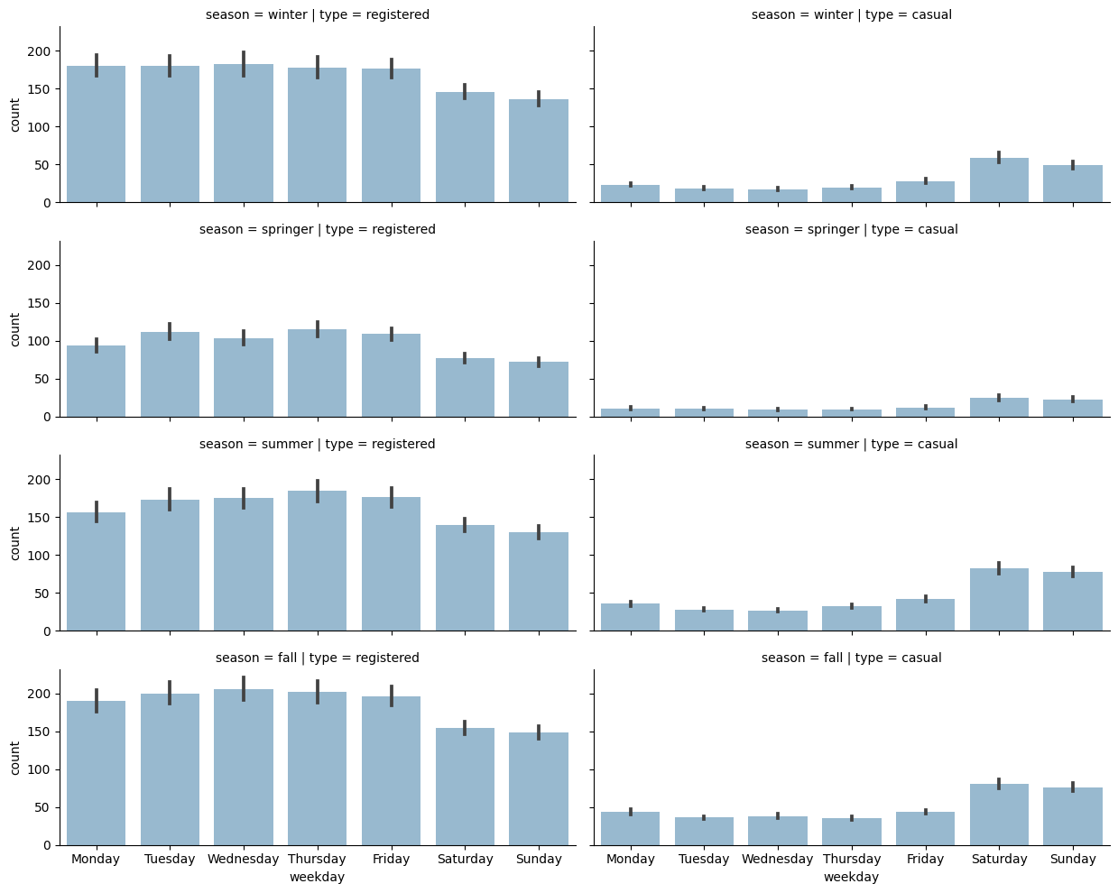
An interesting observation can be seen here is that, rides for registered users goes down on weekends and contrastingly there is a rise on casual rides on weekends which gives us more strong reason to believe that registered users uses the bike sharing service for commute purpose and casual users use ocassionally but we can't be sure with just plot observations. We can do some hypothesis test.

Slide 10
Hypothesis Test
Two-Sample T-Test:
Null Hypothesis: There is no difference in ride count for registered users during weekdays and weekend.
avg_{R}(weekdays) = avg_{R}(weekend)
Alternate Hypothesis: There is difference in ride count for registered users during weekdays and weekend.
avg_{R}(weekdays) ≠ avg_{R}(weekend)

Slide 11
Let’s make a benchmark for our result, if our test value is more than this benchmark then Null Hypothesis is true and should be accepted otherwise Alternate Hypothesis is true and should be accepted. Let’s call this benchmark value as p-value.
Generally for p-value we take 5%, 1% or 10%. Here we can take 5% which means we are setting if there is >=5% chance that Null hypothesis is true and should be accepted then we will accept it otherwise reject it.
Test-result: 3.0911815856939266e-57
Null hypothesis is False and rejected. There is less than 5% chance that Null hypothesis is True, hence rejected the Null hypothesis.
This also satisfies the pattern that we saw in graphs.

Slide 12
Thank You!

