Slide 1
YouTube Comments Classification
Springboard Capstone 2

Slide 2
Introduction
YouTube studio doesn’t show any analytics on content of the comments. With this project I aimed to fill this analytics gap.
In this project, I have tried to come up with an enhanced version of analysis on comments which can be useful to the channel owners to grow their views and revenue.

Slide 3
Audience
YouTube channel owners
This tool can be made available as a stand-alone tool as well and can be used by anyone to perform analysis on a channel/video of their interest.

Slide 4
Data Source
UCI’s YouTube Spam Collection Data Set
Dataset | YouTube ID | Spam | Ham | Total
Psy | 9bZkp7q19f0 | 175 | 175 | 350
Katy Perry | CevxZvSJLk8 | 175 | 175 | 350
LMFAO | KQ6zr6kCPj8 | 236 | 202 | 438
Eminem | uelHwf8o7_U | 245 | 203 | 448
Shakira | pRpeEdMmmQ0 | 174 | 196 | 370
UCI’s YouTube Spam Collection Data Set

Slide 5
Exploratory Data Analysis

Slide 6
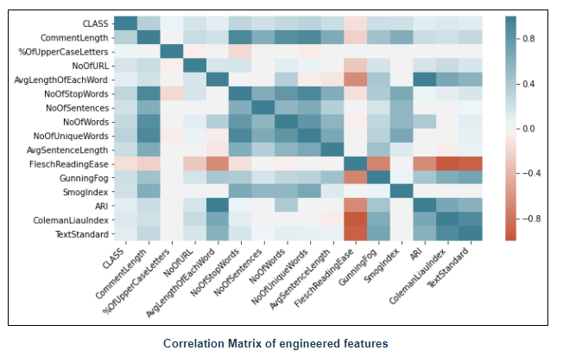
Correlation matrix

Slide 7
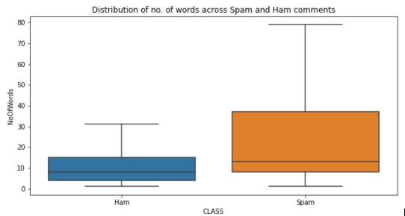
No. of words in each comment:
On average, spam comments are longer than ham comments.
Non-spam comments are consistently shorter but Spam comments vary from short to long.

Slide 8
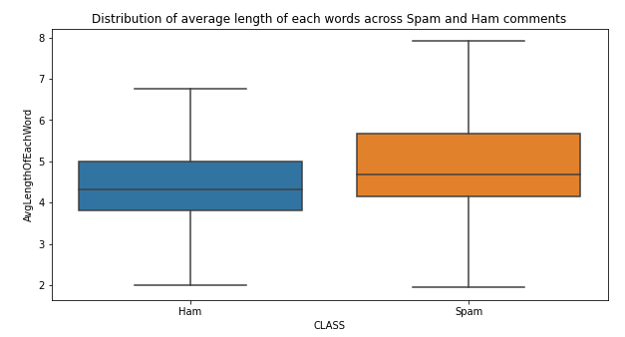
Average length of each word
SPAM comments have lengthier words than non-spam comments.

Slide 9
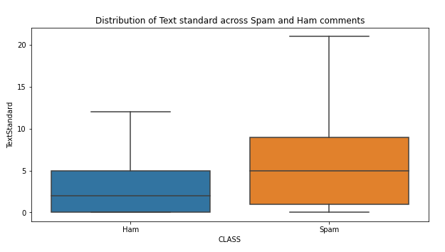
Text standard
There is a stark difference in text standard in the 2 categories. Text standard for spam comments has a median at 5 grade level, while ham comments’ grade level is significantly lower at 2.

Slide 10
Hypothesis Testing
I performed hypothesis testing on below 3 questions.
Are spam comments usually longer than non-spam comments?
Do spam comments have longer words than non-spam comments?
Do spam comments have a different text standard than non-spam comments?
Result: p_value is close to 0 for all the 3 cases and hence we reject the null hypothesis and can say that there is a difference in length , average word length and text standard spam and ham comments.

Slide 11
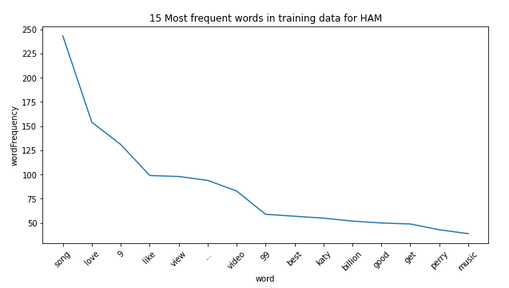
Most predictive words in Ham comments

Slide 12
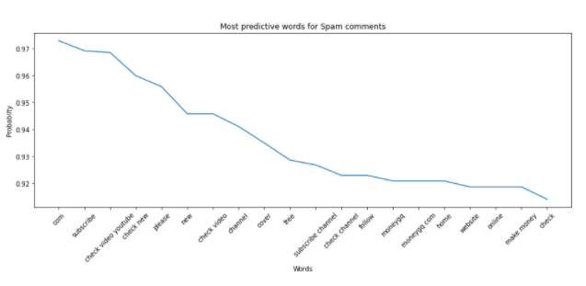
Most predictive words in Spam comments
Most of the spam comments have sentences like “Please like/ check/ subscribe/ follow to my youtube channel” or “please like my video” and are talking about making money.

Slide 13
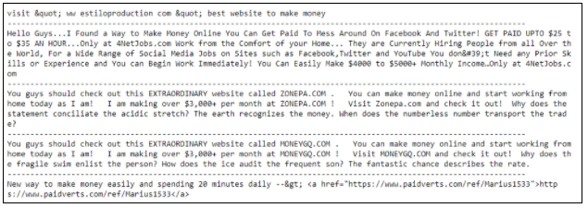
Spam comments with money related words

Slide 14
Data Wrangling
Due to the unstructured nature of text data, it becomes difficult for machine learning models to work directly on raw data. Hence to extract useful signals from data, it becomes more important to remove non-useful noise from the data.

Slide 15
Text Preprocessing
Text data is contains various information that does not help the machine learning model. Stop words, spaces, URLs, etc. are few such piece of information.
During the data preprocessing step, I removed all these texts by creating a function which takes the raw text and returns cleaned text fit for feeding into machine learning model.

Slide 16
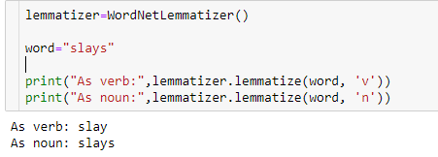
Lemmatization
Lemmatization is the process of grouping together the inflected forms of a word so they can be analyzed as a single term.
Lemmatized as per part of speech of the word so the context of word is not lost.

Slide 17

Handling Emojis
I replaced the emojis with text using emoji library.

Slide 18
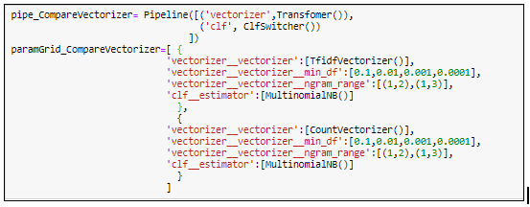
Machine Learning
Transforming text into something that can be consumed by machine learning model is called text-vectorization.
I tried two vectorizers from sklearn library.
Countvectorizer
TFIDFVectorizer.
CountVectorizer outperformed TF-IDF with min_df =0.0001, i.e 0.01% and ngram_range=(1,2).
Countvectorizer got selected as best forming vectorizer with value for min_df is 0.0001 and ngram_range(1,2).

Slide 19
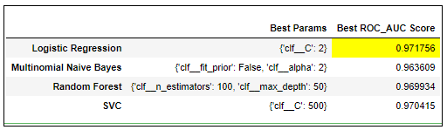
Classifier
Using the vectorizer selected from the previous grid search, I grid searched 4 different models for hyper parameter tuning and compared them with the ROC_AUC score.
Logistic regression got selected as best performing model.

Slide 20
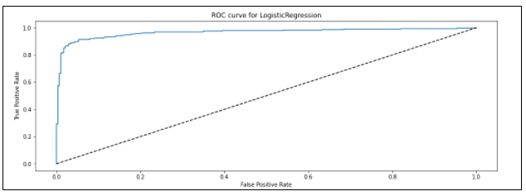
ROC curve
ROC curve represents the ratio of true-positive rate against false-positive rate for a range of threshold. The true-positive rate is the proportion of all spam records correctly classified as spam. Similarly, the false-positive rate is the proportion of ham records incorrectly classified as spam.

Slide 21
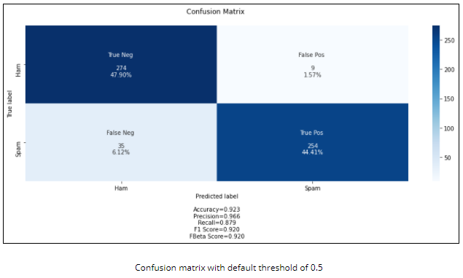
Confusion Matrix

Slide 22
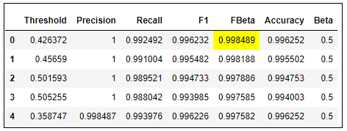
Adjust threshold
I chose 0.5 to set as β as this scenario requires more weight on precision and searched for the optimal threshold that maximizes Fbeta score. I got the highest FBeta score at threshold =0.43.

Slide 23
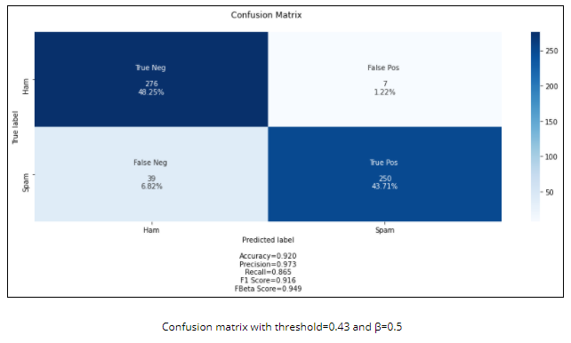
Confusion matric with adjusted threshold

Slide 24
Future Steps
Diversify training data
Topic Analysis
App for user Interface

