Slide 1
Introduction
YouTube studio doesn’t show any analytics on content of the comments. With this project I aimed to fill this analytics gap.
In this project, I have tried to come up with an enhanced version of analysis on comments which can be useful to the channel owner to grow their views and revenue.

Slide 2
Audience
YouTube channel owners
This tool can be made available as a stand-alone tool as well and can be used by anyone to perform analysis on a channel/video of their interest.

Slide 3
Data Source
UCI’s YouTube Spam Collection Data Set
Dataset | YouTube ID | Spam | Ham | Total
Psy | 9bZkp7q19f0 | 175 | 175 | 350
Katy Perry | CevxZvSJLk8 | 175 | 175 | 350
LMFAO | KQ6zr6kCPj8 | 236 | 202 | 438
Eminem | uelHwf8o7_U | 245 | 203 | 448
Shakira | pRpeEdMmmQ0 | 174 | 196 | 370

Slide 4
Exploratory Data Analysis
I found that there are no null and duplicate records in the training dataset.
Added meta-features
Utilized TextStat library to calculate a number of statistics from text to determine readability, complexity and grade level of comments.

Slide 5
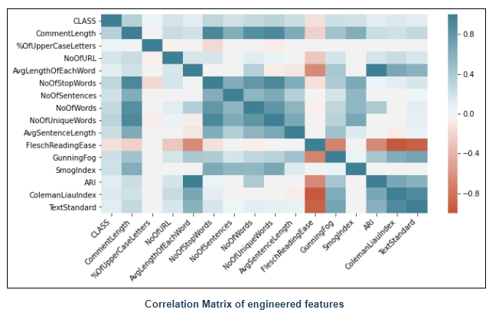
Correlation matrix
Correlation matrix show that there is strong correlation among meta- features .
The indexes about comments’ understandability and readability are also positively or negatively correlated with each other.

Slide 6
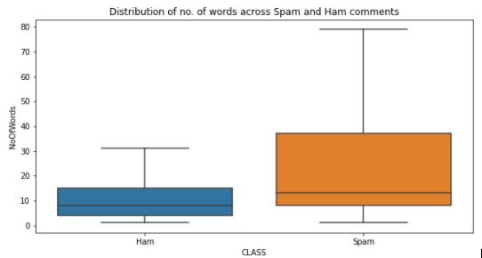
No. of words in each comment
On average, spam comments are longer than ham comments. Non-spam comments are consistently shorter but Spam comments vary from short to long.

Slide 7
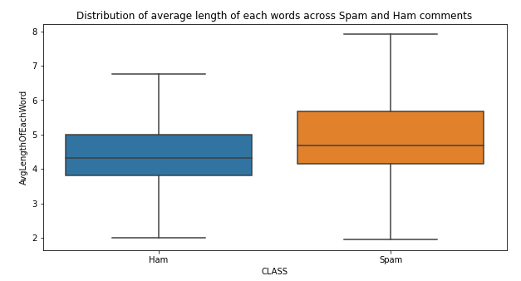
Average length of each word
SPAM comments have lengthier words than non-spam comments.

Slide 8
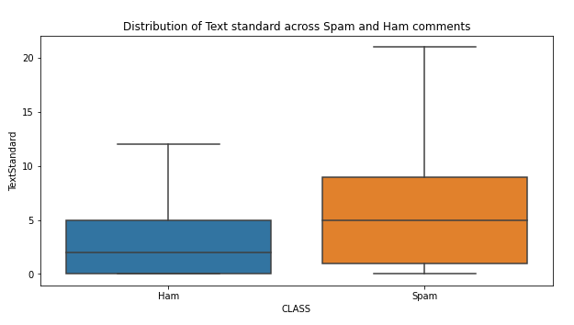
There is a stark difference in text standard in the 2 categories. Text standard for spam comments has a median at 5 grade level, while ham comments’ grade level is significantly lower at 2.

Slide 9
Hypothesis Testing
1. Are spam comments usually longer than non-spam comments?
H0= There is no difference in the length of comments in Spam or Ham category.
H1= Spam and ham comments are different in length.
Result: p_value is close to 0 and hence we reject the null hypothesis and can say that there is a difference in length spam and ham comments.

Slide 10
Hypothesis Testing
2. Do spam comments have longer words than non-spam comments?
H0= There is no difference in the word length in Spam or Ham category.
H1= Spam and ham comments have different word length.
Result: p_value is close to 0 and hence we reject the null hypothesis. Hence, we can say that there is a difference in length of words in spam and ham comments.

Slide 11
Hypothesis Testing
3. Do spam comments have a different text standard than non-spam comments?
H0= There is no difference in text standard in Spam or Ham category.
H1= Spam and ham comments have different text standard.
Result: p_value is close to 0 and hence we reject the null hypothesis. Hence, we can say that there is a difference in text standard in spam and ham comments.

Slide 12
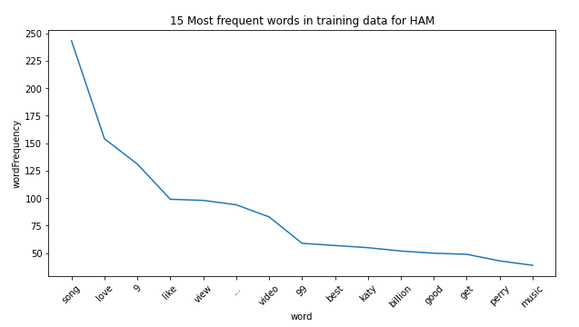
Most predictive words in Ham comments

Slide 13
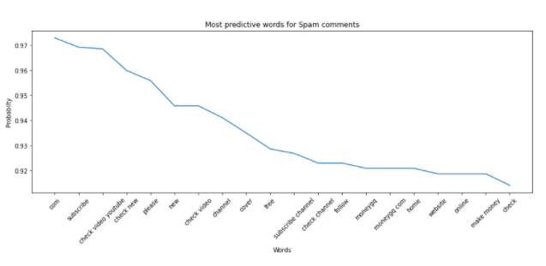
Most predictive words in Spam comments
We can see that most of the spam comments have sentences like “Please like/check/subscribe/follow to my youtube channel” or “please like my video”.
The comments are talking about making money. Most likely luring people on the pretext of making free money from home.

Slide 14
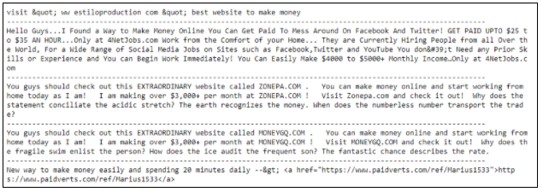
Spam comments mentioning money related words

Slide 15
Data Wrangling
Due to the unstructured nature of text data, it becomes difficult for machine learning models to work directly on raw data. Hence to extract useful signals from data, it becomes more important to remove non-useful noise from the data.

Slide 16
Text Preprocessing
Text data is contains various information that does not help the machine learning model. Stop words, spaces, URLs, etc. are few such piece of information.
During the data preprocessing step, I removed all these texts by creating a function which takes the raw text and returns cleaned text fit for feeding into machine learning model.

Slide 17
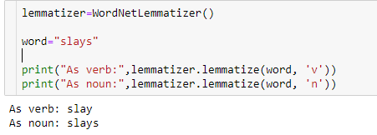
Lemmatization
Lemmatization is the process of grouping together the inflected forms of a word so they can be analyzed as a single term.
Lemmatized as per part of speech of the word so the context of word is not lost.

Slide 18

Handling Emojis
I replaced the emojis with text using emoji library.

Slide 19
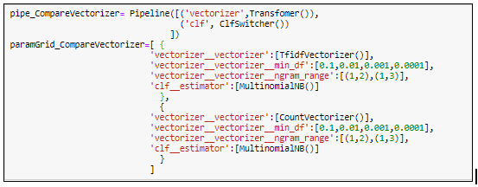
Machine Learning
I tried two vectorizers from sklearn library.
Countvectorizer
TFIDFVectorizer.
Countvectorizer got selected as best forming vectorizer with value for min_df is 0.0001 and ngram_range(1,2).

Slide 20
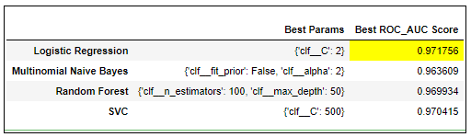
Using the vectorizer selected from the previous grid search, I grid searched 4 different models for hyper parameter tuning and compared them with the ROC_AUC score.
Logistic regression got selected as best performing model.

Slide 21
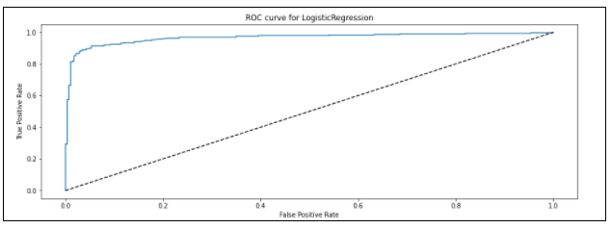
ROC curve for Logistic regression
ROC curve represents the ratio of true-positive rate against false-positive rate for a range of threshold. The true-positive rate is the proportion of all spam records correctly classified as spam. Similarly, the false-positive rate is the proportion of ham records incorrectly classified as spam.

Slide 22
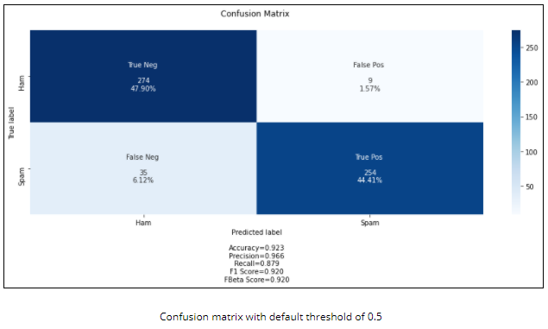
Confusion Matrix

Slide 23
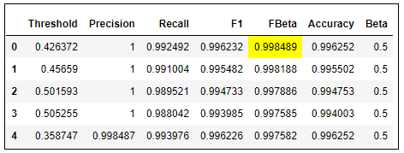
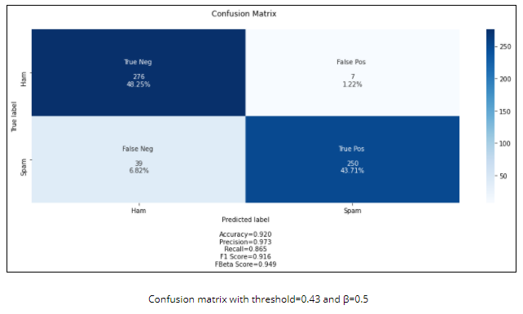
Adjust threshold

Slide 24
Future Steps
Diversify training data
Topic Analysis
App for user Interface

