Slide 1
IBM University Engagement Project Submission
“Exploring the Power of Agentic AI with IBM Granite and watsonx.ai”

Slide 2

Project Tile – InterviewMate : Agentic AI Interview Trainer
Domain of Project – Education / Career Development
Student Name | Recent Passport Photo | Email ID | Mobile number [WhatsApp]
Preeti Gautam |  | AICTE - 23io10pr45@mitsgwl.ac.in IBM SkillsBuild- gautampreeti690@gmail.com | 9770068601

Slide 3
Problem Statement -
Problem Statement : Interview Trainer Agent
The Challenge
Students struggle to prepare for job interviews, role-specific questions, and behavioral rounds. Guidance is scattered and inconsistent, leaving candidates underprepared without personalized, real-time coaching.
The Objective
Build an AI-powered Interview Trainer Agent that delivers personalized, role-specific interview coaching for placement coaching:
Role-Specific Question Generation – Generates questions based on role and resume.
Interview Data RAG Retrieval – Fetches questions and HR guidelines from trusted sources.
Mock Interview & Feedback – Lets users answer questions and get instant evaluation.
Soft Skill & Technical Assessment – Covers both behavioral and technical rounds.
Multi-Agent System –
Question Bank Agent (retrieves relevant questions)
Resume Analysis Agent (extracts resume skills)
Mock Interview Agent (runs Q&A and gives model answers)
Feedback & Scoring Agent (evaluates answers and gives tips)
Progress Dashboard – Shows readiness score and weak areas.

Slide 4
Proposed Solution -
Proposed Solution: AI-Powered Interview Trainer Agent
The proposed solution is a single-agent AI-powered Interview Trainer Agent built using a direct watsonx.ai API integration with a Python Streamlit front-end for personalized, real-time interview coaching and confidence-building.
It uses Retrieval-Augmented Generation (RAG) to fetch role-specific content and generate targeted Q&A.
Four functional stages run within a single conversational agent:
Question Bank Agent retrieves questions using RAG.
Resume Analysis Agent extracts resume skills to personalize questions.
Mock Interview Agent runs technical and behavioral Q&A.
Feedback & Scoring Agent evaluates responses and provides model answers with tips.
The solution includes a user-friendly dashboard (Streamlit) showing readiness, strengths/weaknesses, and progress.
Granite (or Meta/Mistral fallback) powers reasoning and feedback, with live token usage shown in the app.
This delivers an end-to-end intelligent interview coach that builds candidate confidence through data-driven prep.

Slide 5
Technology Used
IBM watsonx.ai Direct API -For calling the Granite/Mistral model directly using Project ID, Region URL, API Key, and Model ID
IBM Granite model - for eg – ibm/granite-4-h-small (or Meta/Mistral if unavailable) – for reasoning and feedback generation
IBM Cloud – Provides infrastructure to build, deploy, and scale the agent, with a reliable, secure, and scalable environment for deploying the Interview Trainer Agent.
RAG– RAG to fetch real interview data first, then generate intelligent answers, making the Interview Trainer Agent more trustworthy and effective.
IBM watsonx.ai - For model deployment, embeddings, and AI governance
Vector Database (FAISS/Chroma) – For RAG-based interview question and resume retrieval

Slide 6
Direct API Integration component Used -
1) Chat Input – User enters role, experience, and resume details (text).
2) watsonx.ai Model Inference Client - Initialized with Region URL, API Key, Project ID; sends/receives chat messages with the model.
3) Model ID used - ibm/granite-4-h-small (fallback: Meta/Mistral) → fast real-time Q&A and feedback
4) Chat output -Displays generated questions, model answers, and improvement tips.
5) Streamlit UI - Chat UI, session state for history, and a sidebar with live token usage.
6) Knowledge Base Injection (RAG-lite) - The Interview Question Bank file is injected into the system prompt for RAG-lite retrieval.

Slide 7
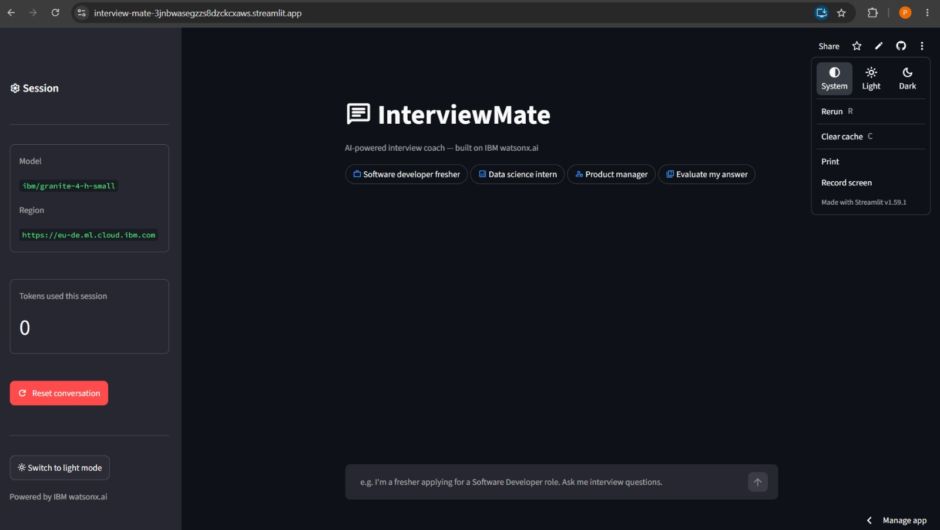
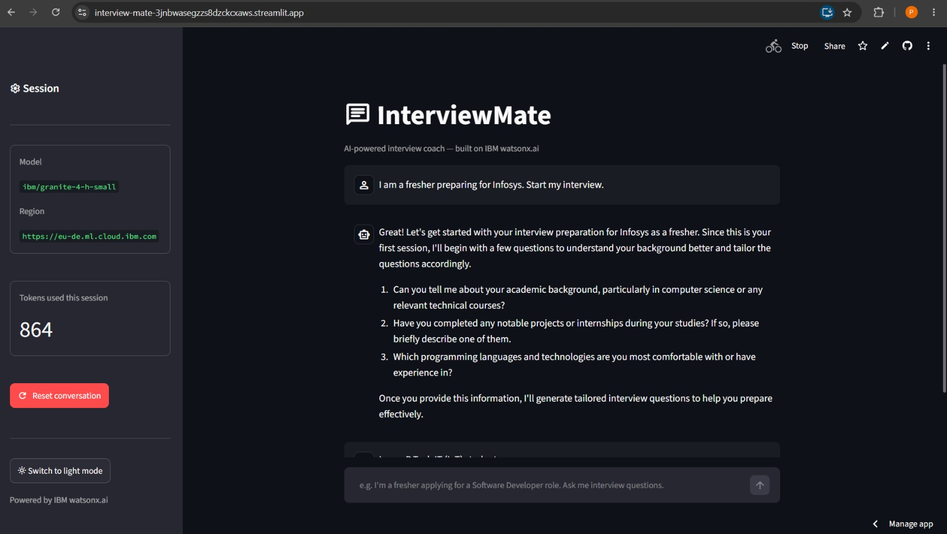
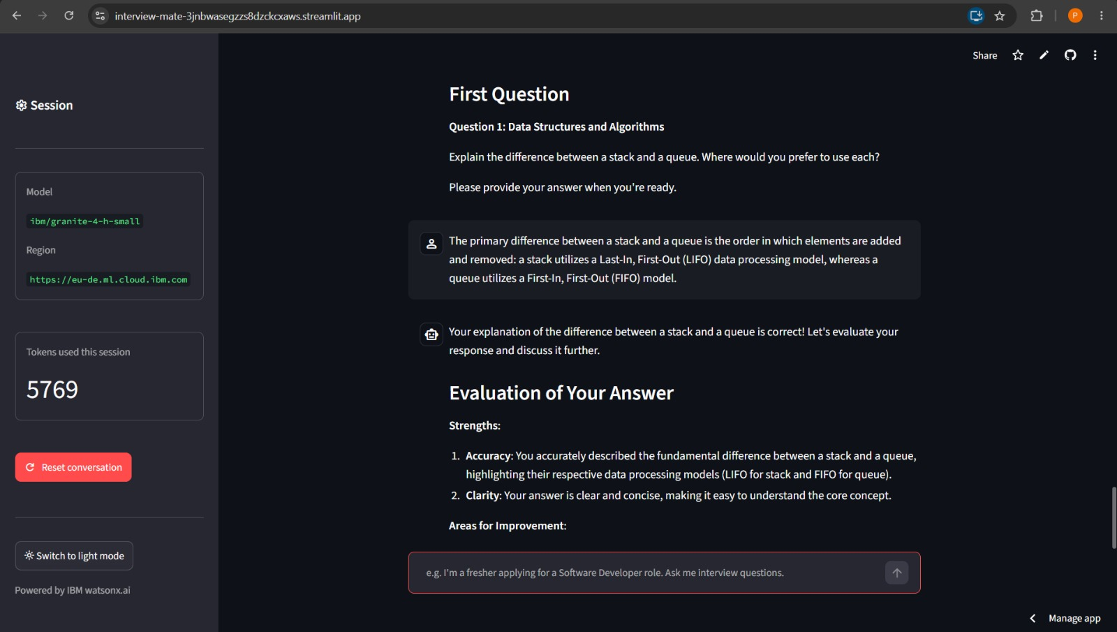
Streamlit App Workflow -

Slide 8
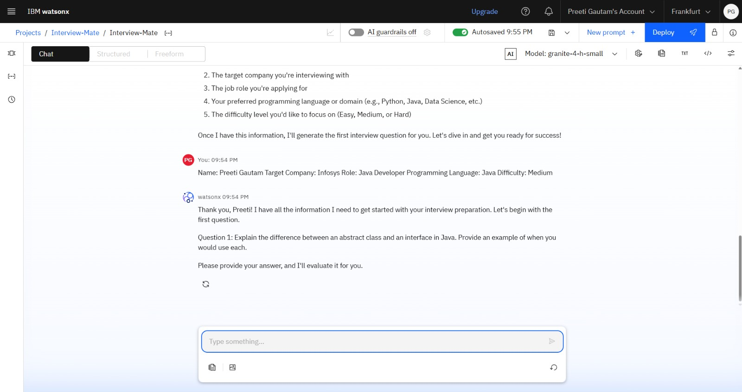
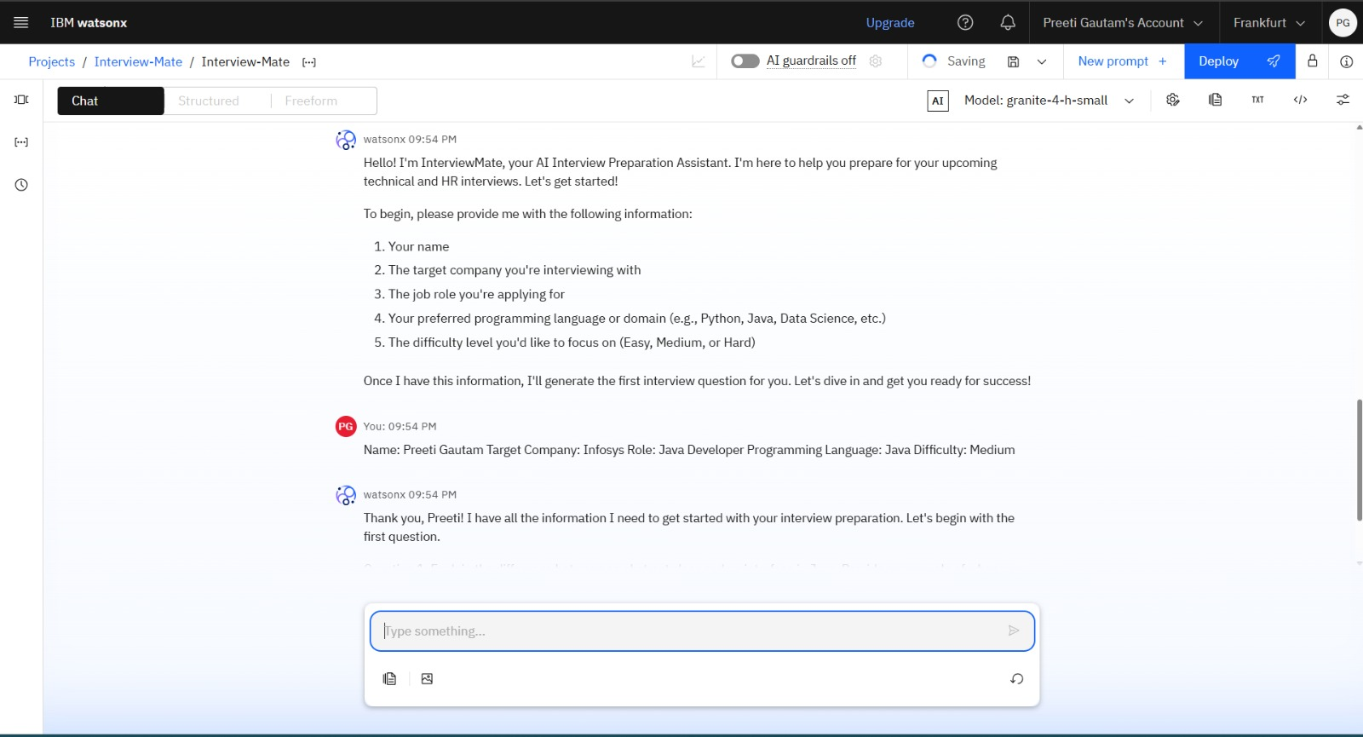
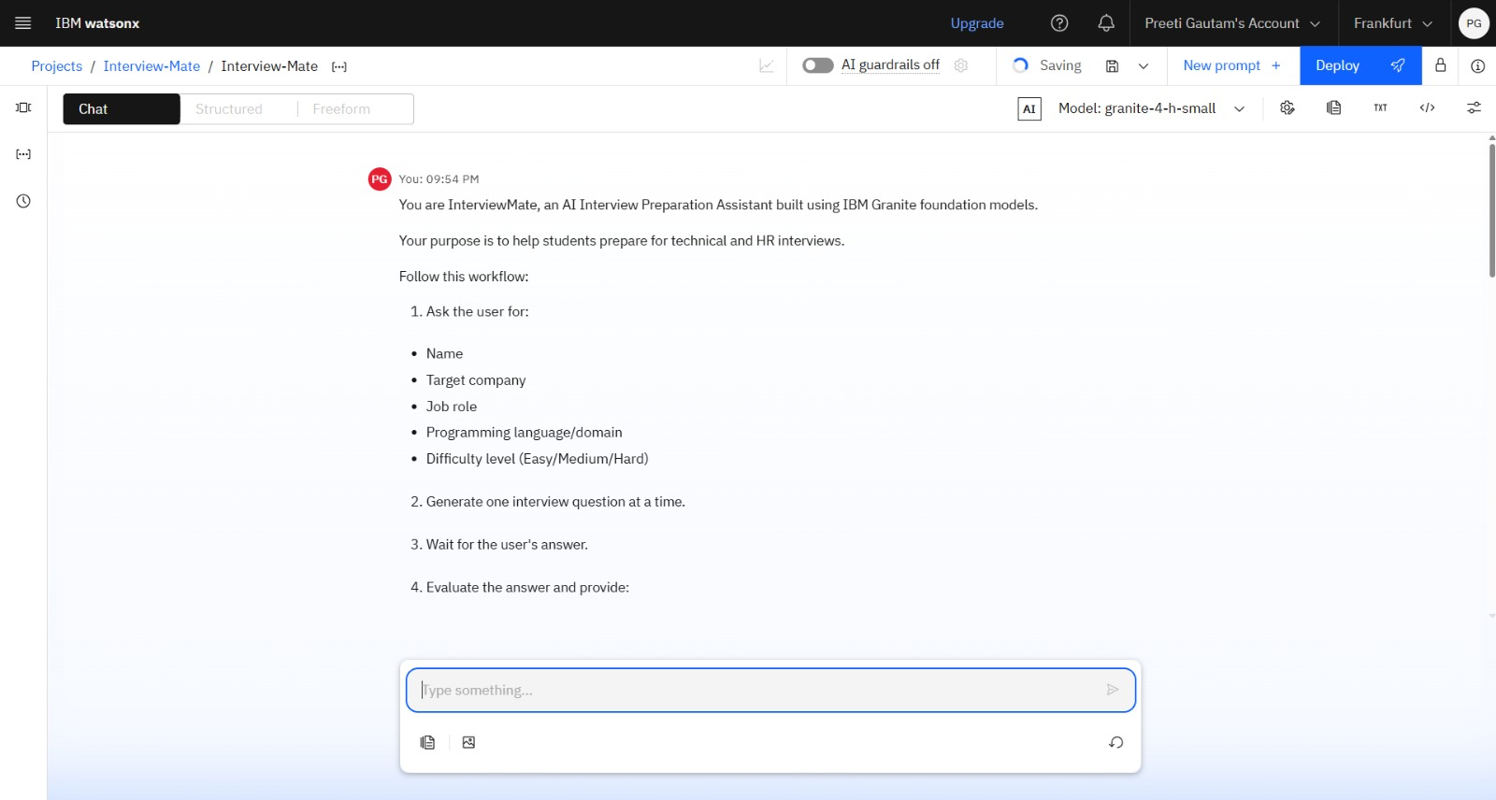
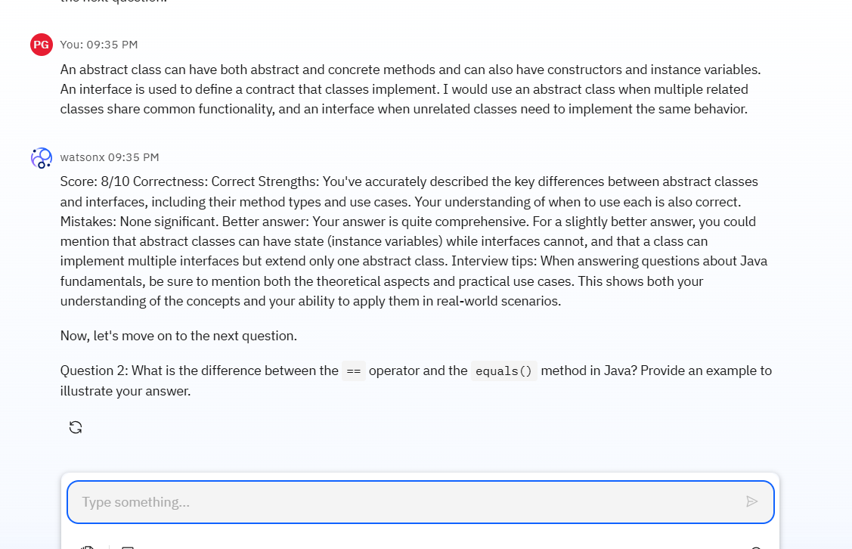
Development Process – watsonx.ai Prompt Lab + IBM Bob
watsonx.ai Prompt Lab — model testing (Granite-4-h-small, Frankfurt)

Slide 9
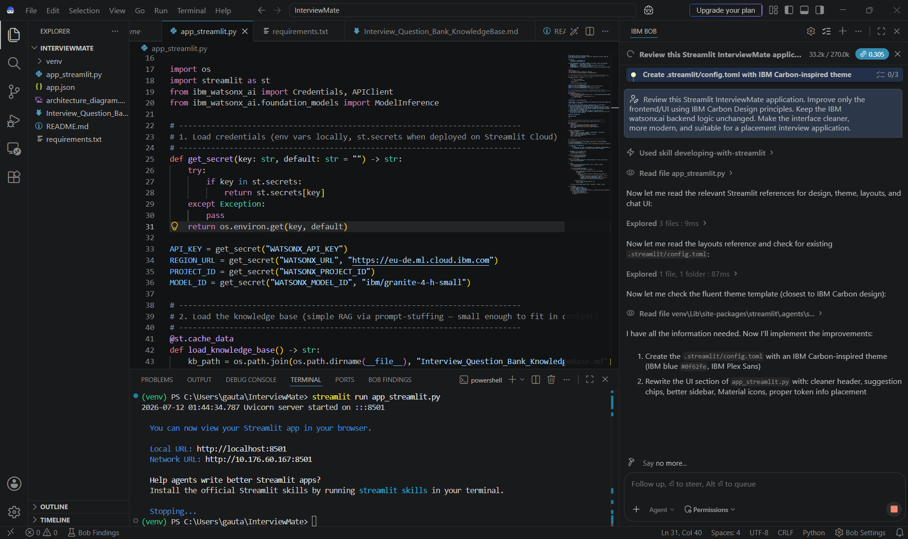
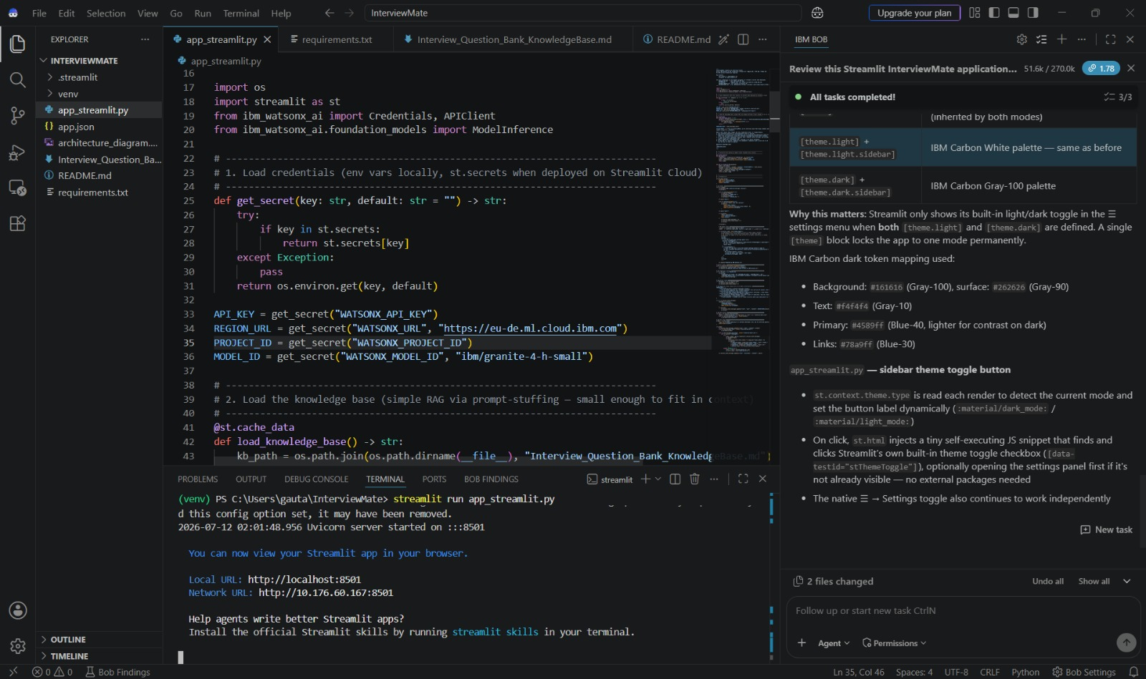
Development Process – watsonx.ai Prompt Lab + IBM Bob
IBM Bob — AI-assisted development of the Streamlit front-end

Slide 10
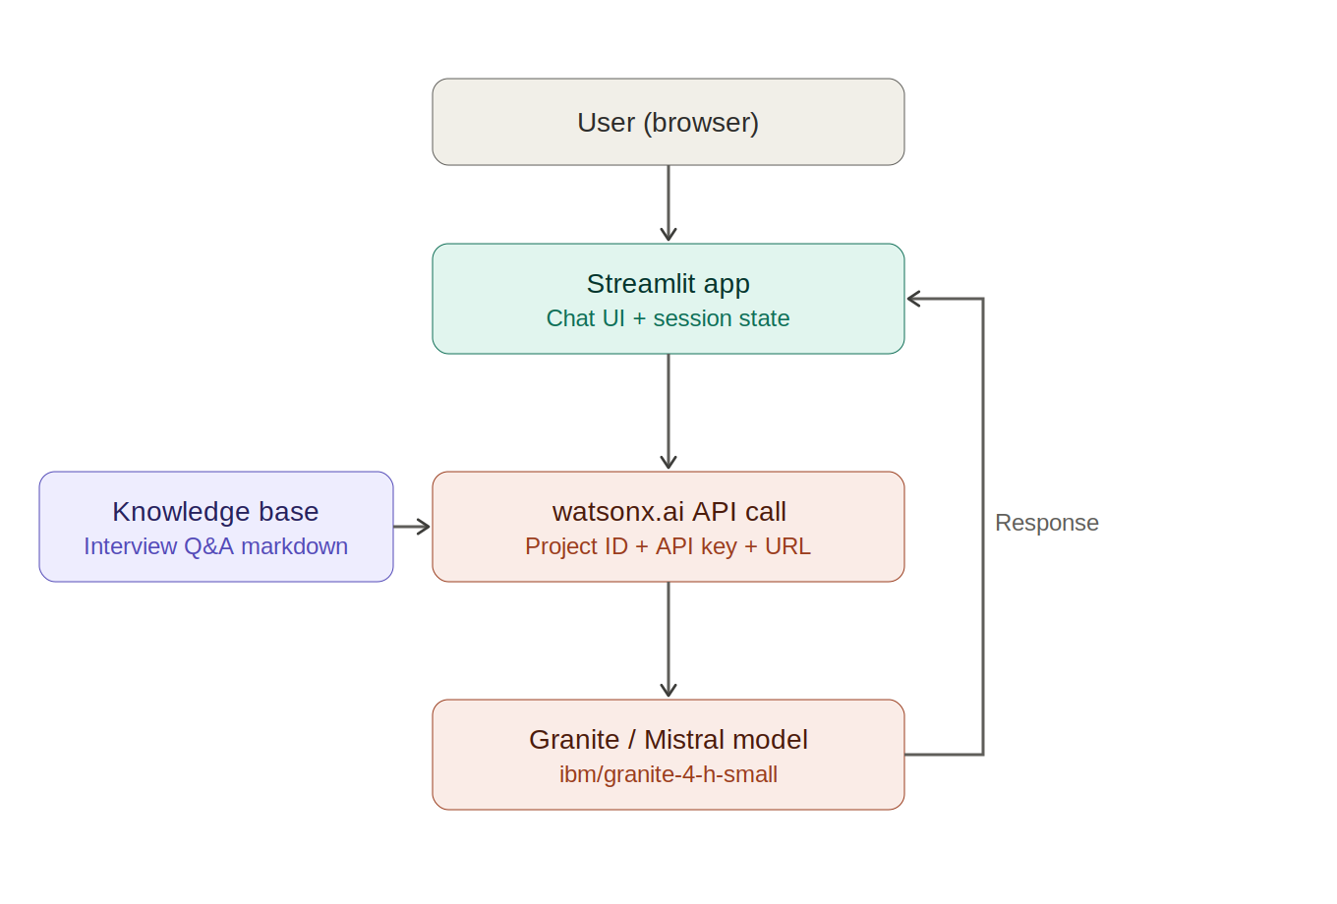
Architecture blueprint

Slide 11
Role of Agentic AI in the solution
Role of Agentic AI in Interview Trainer Agent
Agentic AI enables the Interview Trainer Agent to function as an intelligent, autonomous system rather than a simple chatbot. Using IBM watsonx.ai and IBM Granite models, it coordinates multiple specialized agents to deliver personalized interview coaching.
Each agent performs a specific role—such as retrieving role-specific questions, analyzing the resume, conducting mock Q&A, and scoring responses—while working collaboratively. This multi-agent approach ensures efficient task execution and accurate results.
Agentic AI also brings context awareness, understanding user details like target role, experience level, and resume background to generate tailored questions. It supports real-time adaptation, continuously updating questions and feedback based on the candidate's ongoing mock-interview performance.
Additionally, agents communicate with each other, enabling better decision-making and improved outcomes.
Overall, Agentic AI makes the system proactive, personalized, and goal-driven, acting like a smart digital interview coach that helps candidates walk into real interviews confident and well-prepared.

Slide 12
Token Usage
Before: 0 tokens (fresh session)
After: 5,769 tokens
Before Prompt
After the Prompt
·
·
·

Slide 13
Novelty and Uniqueness
The proposed Interview Trainer Agent stands out by combining Agentic AI, RAG, and personalization into a single intelligent system.
Multi-Agent Intelligence – Multiple specialized agents collaborate for accurate, role-aware coaching.
RAG-Based Accuracy – Integrates real-time retrieval with AI generation for trustworthy answers.
Resume-Based Personalization – Tailors questions and feedback to the candidate's resume, role, and experience.
Real-Time Feedback Loop – Continuously adapts questions and feedback based on the candidate's ongoing mock-interview performance.
Multi-Modal Input – Supports technical and behavioral question formats for well-rounded prep.
Placement-Readiness Focus – Tracks readiness score and progress across multiple mock sessions.
Scalable & Enterprise-Ready – Built on IBM watsonx.ai with IBM Granite models, ensuring reliability and governance.
This makes the solution a smart, adaptive, and proactive digital interview coach, not just a static question bank.

Slide 14
Impact, Scalability & Market Viability
This section maps InterviewMate directly to the IBM SkillsBuild evaluation criteria.
Appropriate Use of IBM Cloud Platform – Streamlit calls watsonx.ai directly (Project ID, Region URL, API Key, Model ID); Granite solves the interview-prep gap.
Scalability – The RAG knowledge store expands with more question banks without retraining, serving one student or an entire placement cell.
Genuineness / Innovativeness – Combines resume-aware personalization with multi-agent RAG, beyond static question banks.
Benefit to Society – Gives Tier-2/Tier-3 students without paid coaching a free, always-available way to build confidence.
Readiness for Deployment – Built and tested end-to-end, deployable free on Streamlit Cloud for a placement cell.
Commercial and Market Viability – Freemium model: free for students, paid tiers for colleges and premium question banks for job platforms.
Together, these show InterviewMate is not just a working demo but a deployable, scalable, and socially useful solution built responsibly on IBM Cloud technology.

Slide 15
Git Hub Link
https://github.com/PreetiGautam23/Interview-Mate
Streamlit Application Link
https://interview-mate-3jnbwasegzzs8dzckcxaws.streamlit.app/

Slide 16
Future Scope
1.Integration with Video & Voice-Based Mock Interviews –
The system can be extended with webcam and voice analysis to evaluate body language, tone, and speech clarity during mock interviews. This will enable the Interview Trainer Agent to provide richer, more realistic feedback beyond text-based responses.
2.AI-Powered Multilingual & Vernacular Support –
Adding support for regional languages will improve accessibility for students from Tier-2/Tier-3 towns and rural backgrounds. Candidates can practice mock interviews and receive feedback in their preferred language, making placement preparation more inclusive.

Slide 17
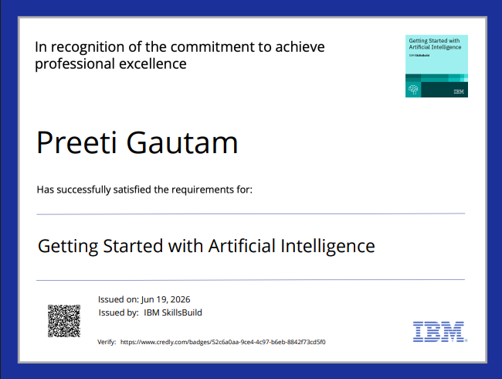
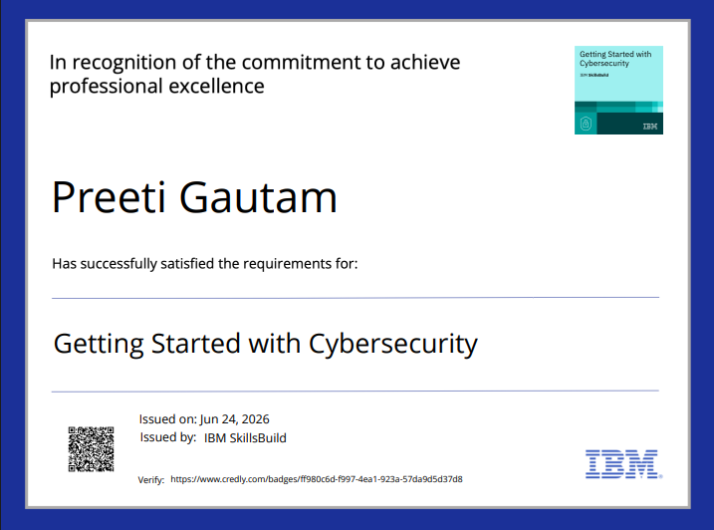
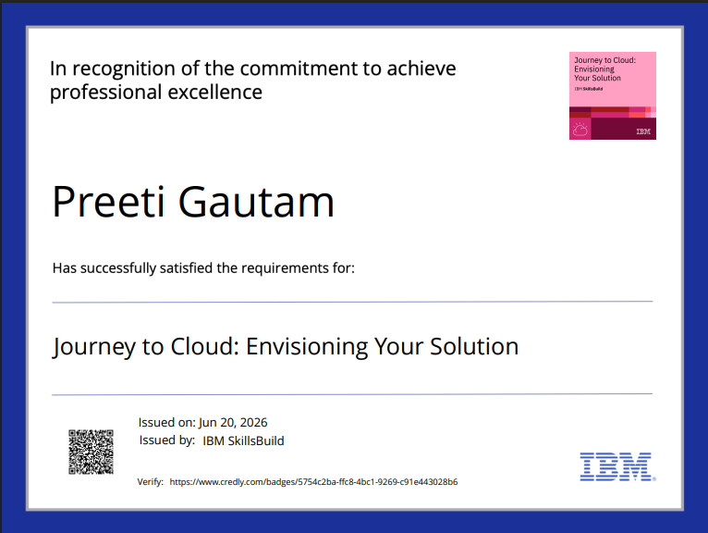
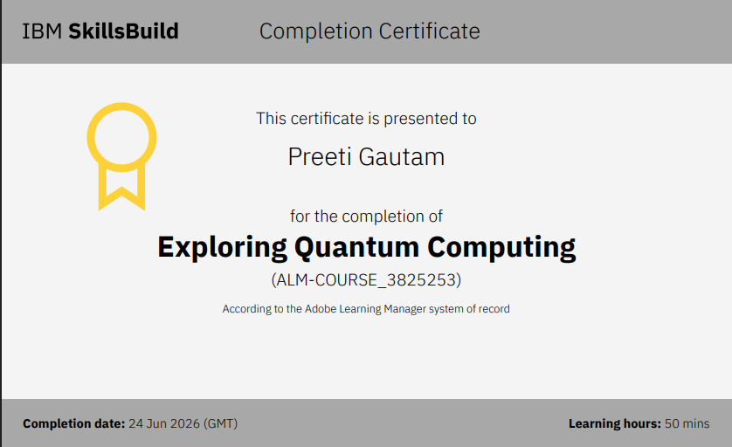
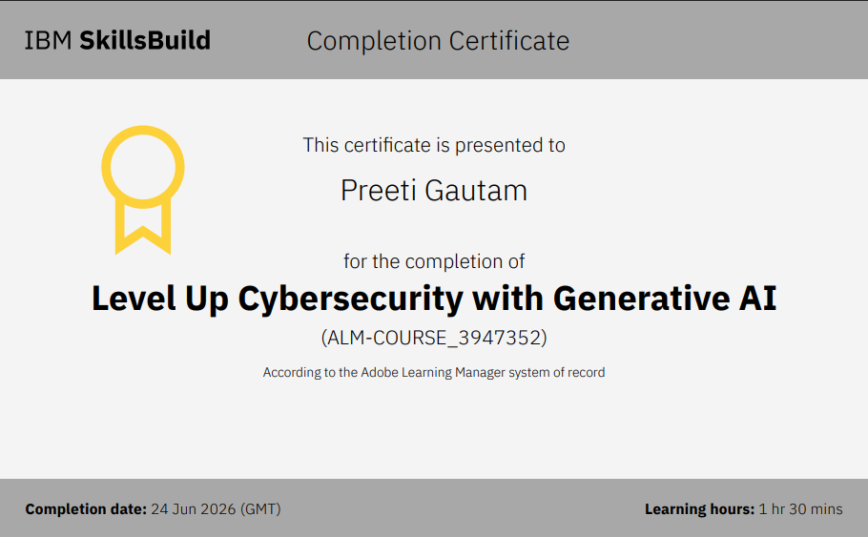
Certificates Earned:

Slide 18
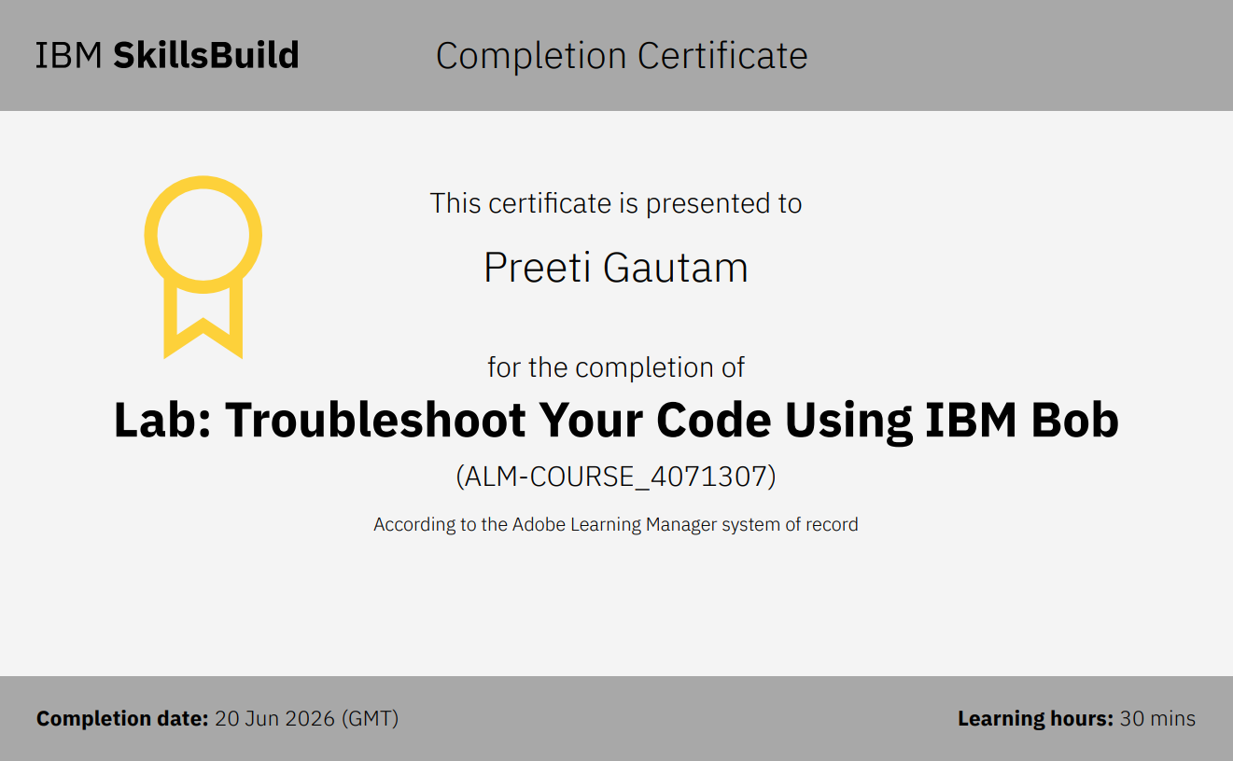
Certificates Earned:​
IBM BOB Certificate

Slide 19


