Slide 1
INVESTMENT ASSIGNMENT SUBMISSION
Name: Preeti Kharb

Slide 2
Project overview
Project Brief: Spark Funds, an asset management company. Spark Funds wants to make investments in a few companies. The CEO of Spark Funds wants to understand the global trends in investments so that she can take the investment decisions effectively.
Business and Data Understanding
Spark Funds wants to invest between 5 to 15 million USD per round of investment
Spark Funds wants to invest only in English-speaking countries because of the ease of communication.
Business strategy: The overall strategy is to invest where other companies are investing, implying that the 'best' sectors and countries are the ones 'where most investors are investing'.
Business Objective: The objective is to identify the best sectors, countries, and a suitable investment type for making investments.
Goals of data analysis:
Investment type analysis: To compare the different funding types to identify the FT suited for Spark Funds strategy.
Country analysis: To identify the countries which have been the most heavily invested in the past.
Sector analysis: To understand the distribution of investments across the eight main sectors.
Base files used:
Companies.csv
Rounds2.csv
Mapping.csv
Links used:
https://en.wikipedia.org/wiki/List_of_countries_and_territories_where_English_is_an_official_language

Slide 3
Problem solving methodology
Data Import
Import data csv files.
Resolve encoding issues.
Create a list of English-speaking countries required to filter the unnecessary data.
Analyse Data
Unique companies in rounds2 and companies dataframe.
Name of column which has unique keys.
Change the casing for permalink and company_permalink columns.
Clean data
Identify missing data
Treat the missing data(Deleted)
Drop unnecessary columns
Merge Data Frames
Create a merged data frame using rounds2 and companies data
Perform Sector Analysis 1
Get the primary sector from the category list columns from the filtered data with selected investment type and countries.
Map the primary sector to the main sector using mapping.csv
Perform Country Analysis
After selecting the investment type, filter the data further using the type chosen and the top 9 countries as per the total raised amount
Identify top 3 English speaking countries using the wiki link.
Perform Investment Type Analysis
Compute average investment, Number of investments, raised amount by each funding type
Select the suitable funding based on the above analysis
Filter Data
As spark funds only wants to invest between 5-15million per investment round, so data outside this range needs to be filtered out.
Filter the data where the countries have English as primary or official language
Perform Sector Analysis 2
Create three data frames D1, D2 and D3 based on the top three countries
Data Visualization
Create Plots using Plotly.Express
Presentation

Slide 4
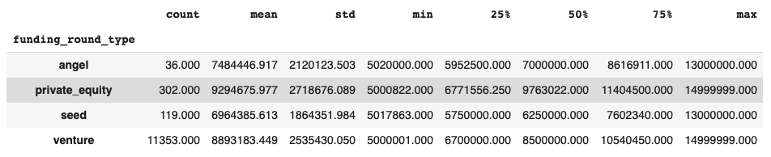
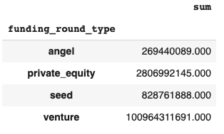
Funding Type Analysis
Considering the range constraint of 5-15 Million per round, data was filtered to include only those investments which fall within this range. Any investment amount which doesn’t satisfy this criteria has not been considered.
Sparks Fund only wants to invest only in English-speaking countries because of the ease of communication with the companies it would invest in hence we have filtered out the data on that basis.
Findings:
Mean and median for Private equity and venture is in closed proximity (+/- 1 Million).
Funding type Venture has maximum number of investments made within this range 5-15 Million for English-speaking countries.
Funding type Venture has raised maximum amount of funding within the given range.
Due to the above findings, Venture would be most suitable for Spark Funds.

Slide 5
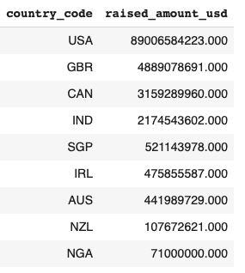
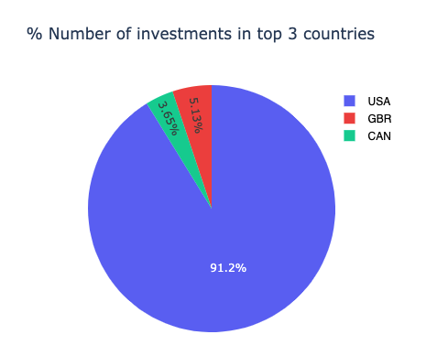
Country Analysis
As per their Strategy, Spark Funds wants to invest in countries which have been the most heavily invested in the past for the chosen investment type. Spark Fund wants to see the top 9 countries which have received the highest total funding across chosen FT i.e. Venture.
Based on the total amount raised, below are the top 9 countries:
The top three countries for funding type Venture are USA, GBR and CAN. Now the dataset will be filtered for these 3 countries.

Slide 6
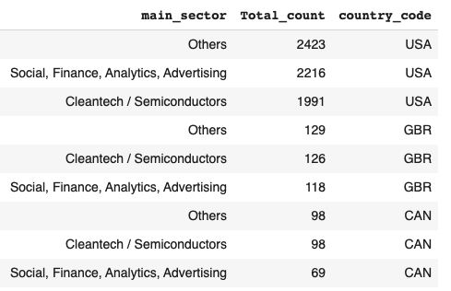
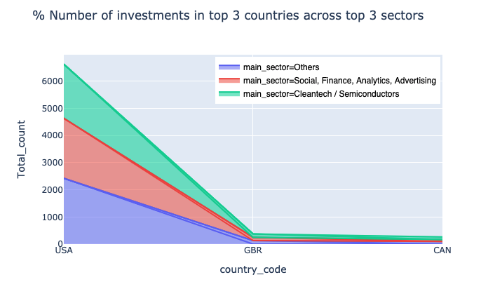
Sector Analysis
Spark Funds further wants to identify main sectors within the top 3 countries where they can invest. This is as per their strategy to invest in sectors where most investments are occurring. Based on the analysis, below sectors are suitable for investment in these 3 countries.

Slide 7
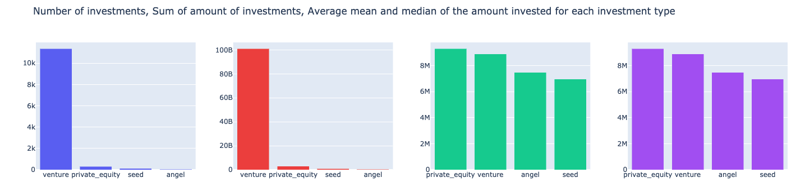
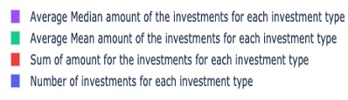
Plot showing the representative amount of investment in each funding type
Plot 1: The representative amount of investment in each funding type
As representative amount didn’t provide complete insight, we used other aggregation functions like total investments (sum) and number of investments (count) to determine Venture as the suitable funding type for Spark Funds.

Slide 8
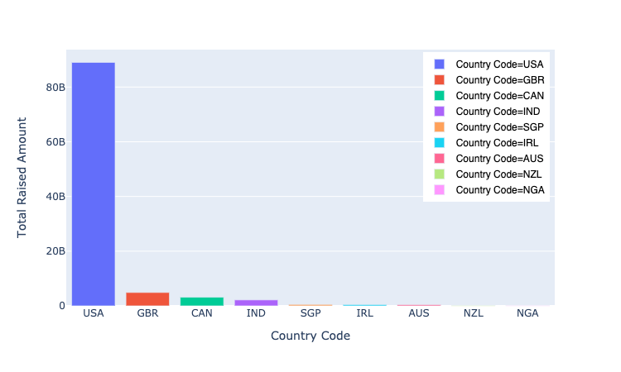
Plot showing the top 9 countries against the total amount of investments
Plot 2: To show total amount of investments made for funding type Venture across top 9 countries.

Slide 9
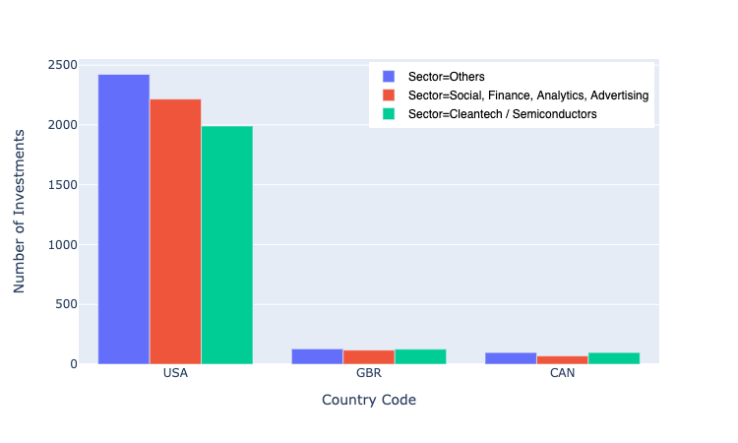
Plot showing the number of investments in the top 3 sectors of the top 3 countries
Plot 3: To show the number of investments in the top 3 sectors of the top 3 countries for funding type venture.

Slide 10
Conclusions
Based on the investment strategy of Spark funds below are the findings:
Considering that Spark Funds wants to invest between 5 to 15 million USD per investment round, Venture funding type would be the best option as the number of investment and amount of investment has been the highest for this funding type.
For funding type venture, the top three English speaking countries with highest investment made in the past are USA, GBR and CAN.
The top sectors to invest across these 3 countries are below:
USA | GBR | CAN
Others | Others | Cleantech / Semiconductors
Social, Finance, Analytics, Advertising | Cleantech / Semiconductors | Others
Cleantech / Semiconductors | Social, Finance, Analytics, Advertising | Social, Finance, Analytics, Advertising

