Slide 1
Total Amount Extractor
An application that extracts the Grand Total Amount from almost every type and template of invoices

Slide 2
Benefits of Using this Application
Incorporating the app will majorly Impact your organization in following manner:
1) Reduction in dependence on Man Power for a repetitive task
2) Improves efficiency and functioning of the organization
3) Automates the process
4) Increases accuracy of the process
5) Reduces time taken for obtaining results
6) Is time independent and can be used to perform the task at anytime
7) Reduces the cost of man labour

Slide 3
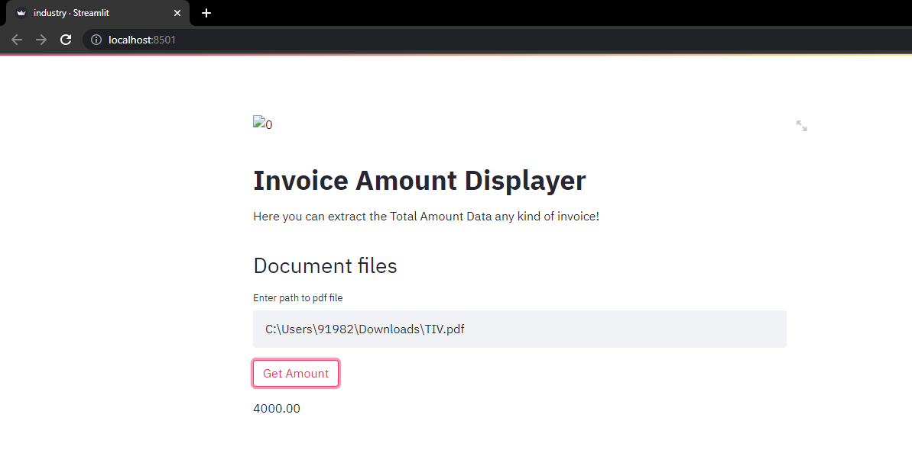
The App Interface
Just enter the path to the invoice pdf file
Click the button
Get the total of invoice

