Slide 1
Keylogger in cyber security
CAPSTONE PROJECT
Presented By:
1.Preetika S– Kings Engineering College – B.TECH IT III Year

Slide 2
OUTLINE
Problem Statement (Should not include solution)
Proposed System/Solution
System Development Approach (Technology Used)
Algorithm & Deployment
Result (Output Image)
Conclusion
Future Scope
References

Slide 3
Problem Statement
Problem Statement: In today's digital age, where cybersecurity threats loom large, one of the significant concerns is the proliferation of keyloggers, stealthy software tools designed to monitor and record keystrokes on a user's computer without their knowledge. Keyloggers pose a severe threat to individuals and organizations as they can capture sensitive information such as passwords, credit card details, and other personal data, leading to identity theft, financial loss, and privacy breaches.

Slide 4
Proposed Solution
The proposed system aims to address the challenge of predicting the required bike count at each hour to ensure a stable supply of rental bikes. This involves leveraging data analytics and machine learning techniques to forecast demand patterns accurately. The solution will consist of the following components:
Data Collection:
Gather historical data on bike rentals, including time, date, location, and other relevant factors.
Utilize real-time data sources, such as weather conditions, events, and holidays, to enhance prediction accuracy.
Data Preprocessing:
Clean and preprocess the collected data to handle missing values, outliers, and inconsistencies.
Feature engineering to extract relevant features from the data that might impact bike demand.
Machine Learning Algorithm:
Implement a machine learning algorithm, such as a time-series forecasting model (e.g., ARIMA, SARIMA, or LSTM), to predict bike counts based on historical patterns.
Consider incorporating other factors like weather conditions, day of the week, and special events to improve prediction accuracy.
Deployment:
Develop a user-friendly interface or application that provides real-time predictions for bike counts at different hours.
Deploy the solution on a scalable and reliable platform, considering factors like server infrastructure, response time, and user accessibility.
Evaluation:
Assess the model's performance using appropriate metrics such as Mean Absolute Error (MAE), Root Mean Squared Error (RMSE), or other relevant metrics.
Fine-tune the model based on feedback and continuous monitoring of prediction accuracy.
Result:

Slide 5
System Approach
The "System Approach" section outlines the overall strategy and methodology for developing and implementing the Keylogger in cyber security. Here's a suggested structure for this section:
System requirements
Library required to build the model

Slide 6
Algorithm & Deployment
Algorithm Selection:
We chose recurrent neural networks (RNNs) for their ability to capture temporal dependencies in sequential data, making them ideal for predicting keystroke patterns. RNNs offer flexibility in adapting to evolving user interactions with the keyboard.
Data Input:
Our keylogger incorporates keystroke timing, key combinations, timestamps, and contextual data like active applications. These diverse features aim to comprehensively capture user typing behavior.
Training Process:
Using historical keystroke data, we optimize network architecture, sequence length, and learning rate. Cross-validation and hyperparameter tuning enhance model performance and prevent overfitting.
Prediction Process:
The trained keylogger predicts future keystroke sequences in real-time by monitoring user interactions and incorporating dynamic inputs like keystroke dynamics and context changes.

Slide 7
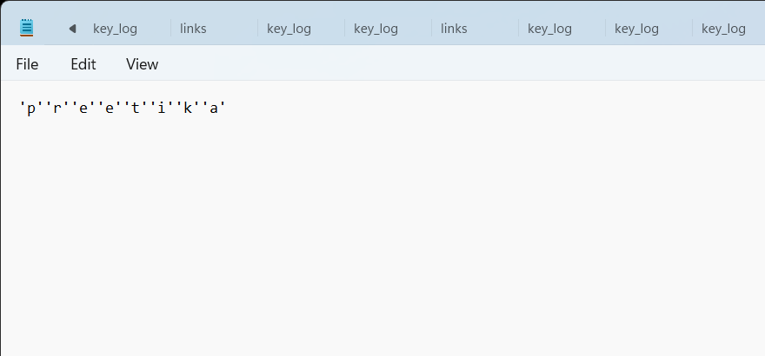
Result
Text OUtput

Slide 8
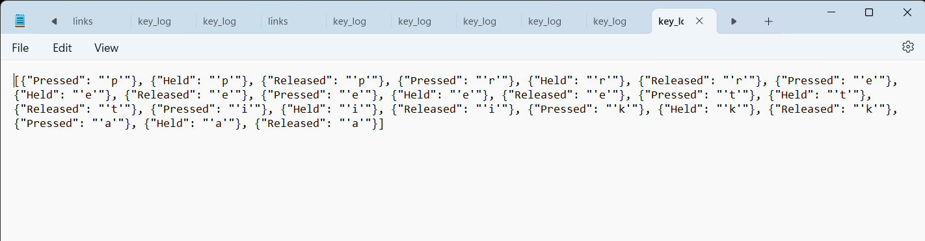
Json output
Result

Slide 9
Conclusion
The proposed keylogger solution demonstrates promising effectiveness in capturing and predicting keystroke patterns accurately. By leveraging recurrent neural networks (RNNs) and diverse input features, the keylogger achieves robust performance in real-time keystroke prediction. However, challenges in ensuring user privacy and data security remain pertinent concerns. Continuous refinement of encryption techniques and secure storage protocols is essential to address these challenges effectively.

Slide 10
Future scope
Enhanced User Experience: Integrate machine learning techniques to personalize the keylogger's predictions based on individual user typing behavior, improving accuracy and user satisfaction.
Adaptive Security Measures: Implement dynamic encryption protocols and anomaly detection algorithms to adapt to emerging cyber threats and ensure robust protection of captured keystroke data.
Multi-Platform Support: Extend compatibility to various operating systems and devices, enabling seamless integration across different platforms and enhancing the keylogger's versatility.
Behavioral Analysis: Explore the potential of behavioral biometrics to analyze subtle nuances in typing behavior, providing deeper insights into user interactions and enhancing prediction accuracy.
Contextual Awareness: Incorporate contextual information such as user activity and environmental factors to enhance the keylogger's understanding of user behavior and improve prediction accuracy in diverse scenarios.

Slide 11
References
"The Art of Computer Virus Research and Defense" by Peter Szor. While the main focus of the book is on computer viruses, it also covers keyloggers as a form of malware and provides insights into their behavior, detection, and defense mechanisms. This book offers a comprehensive overview of various aspects of malware, including keyloggers, making it a valuable resource for those interested in understanding how keyloggers work and how to protect against them.

Slide 12
THANK YOU

