Slide 1
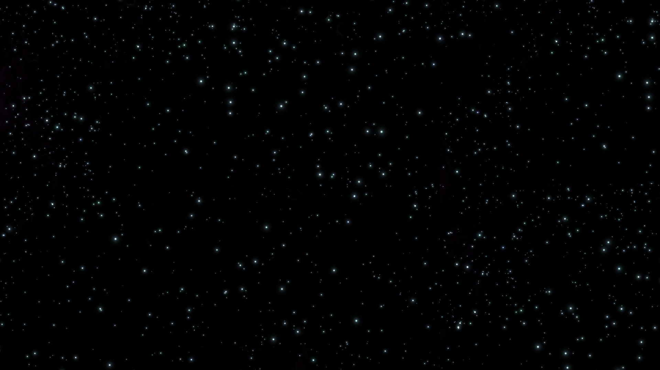

UFO Data August 13, 2018
Joey Chen
Anuraag Mohile
Catherine McNabb
Preetika Srivastav

Slide 2

Data Exploration

