Slide 1
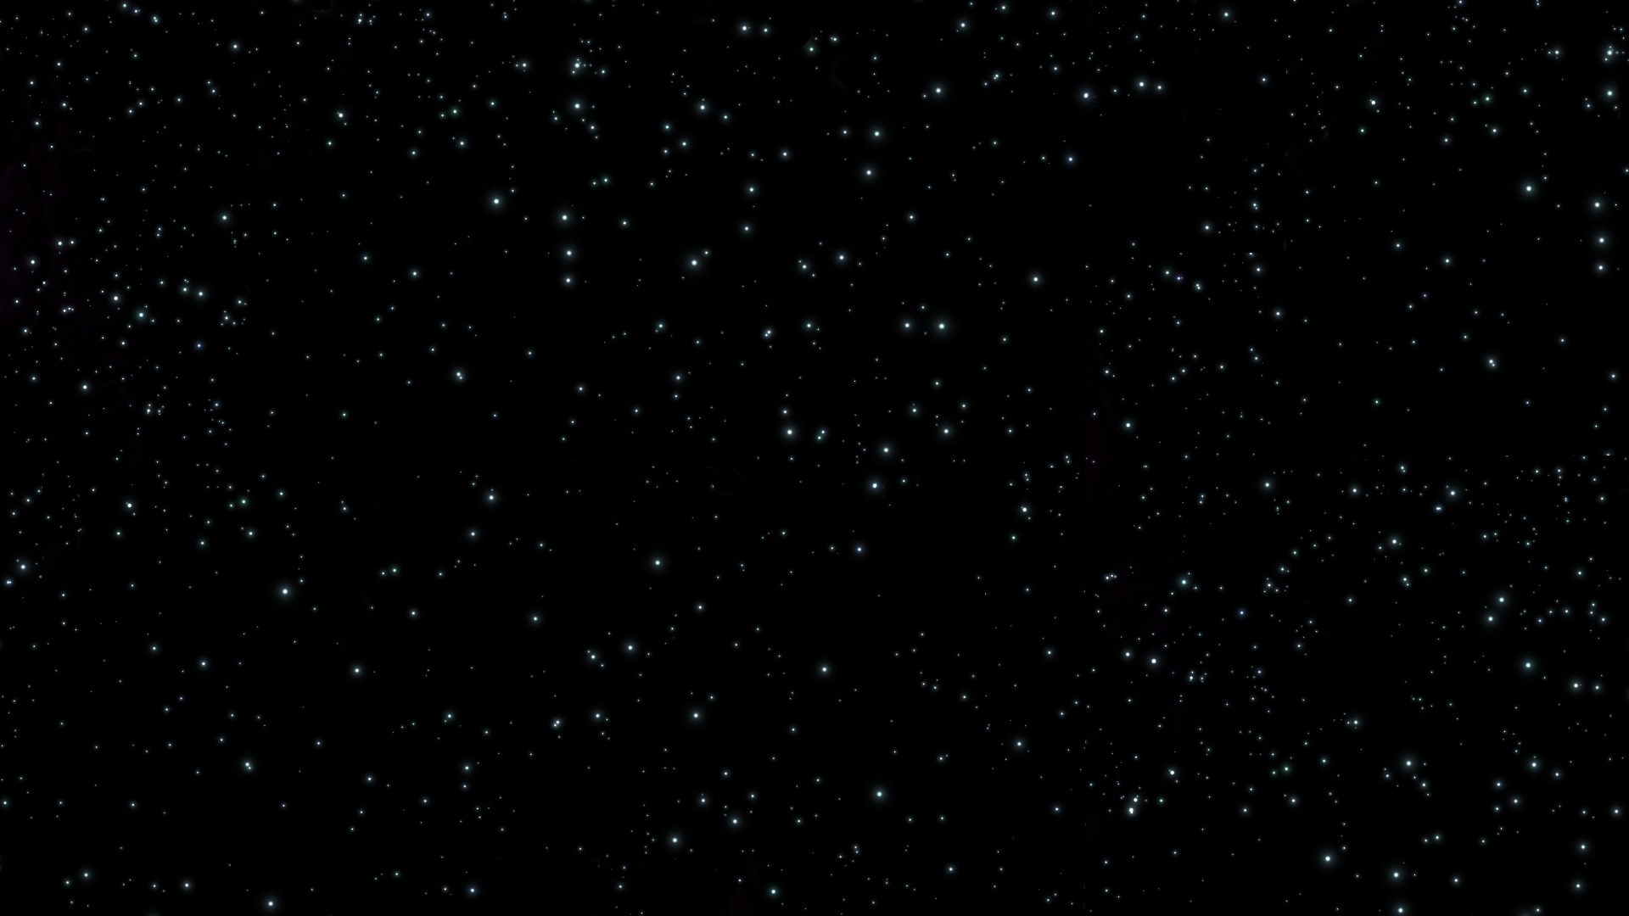

UFO Data August 13, 2018
Joey Chen
Anuraag Mohile
Catherine McNabb
Preetika Srivastava

Slide 2

Agenda
Description of Data
Exploratory Analysis
Insights
Conclusion

Slide 3
Description of data

Slide 4
Why UFO Data?
UFOlogy – the study of UFO’s
Pop culture – Men in Black, ET, Star Wars, Independence Day
Conspiracy Theories – Area 51, Stonehenge, Egyptian Pyramids
“1996 Gallup Poll reported that 71 percent of the United States population believed that the U.S. government was covering up information regarding UFOs” (Wikipedia)

Slide 5
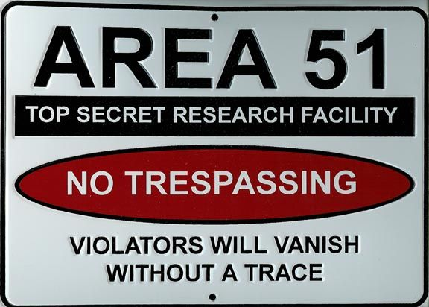
Data Background
In the data set:
Date and time
Latitude and Longitude
City, State, and Country
Shape
Duration
Unexplainable v Explainable
Added:
Weather
Day of the Week
Moon Phase
Proximity to US Airforce Base

Slide 6
Exploratory Analysis

Slide 7
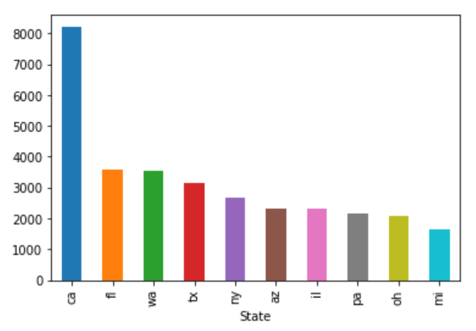
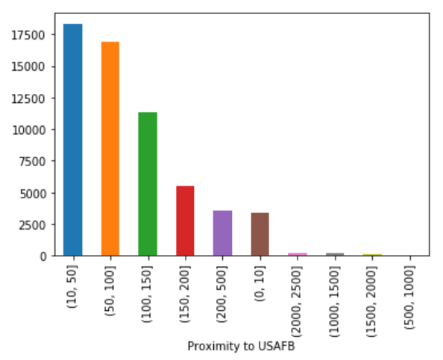
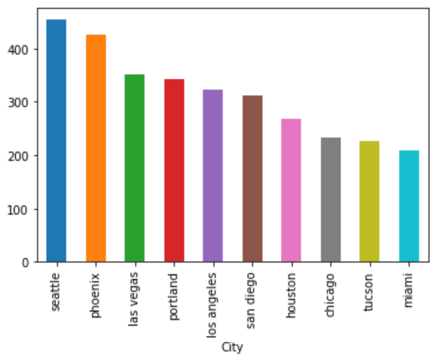
Where Will I See a UFO?
State
Proximity to Airforce Base
# of Sightings
# of Sightings
City
# of Sightings
Notes:
CA, FL, TX, NY, and IL the most populous

Slide 8
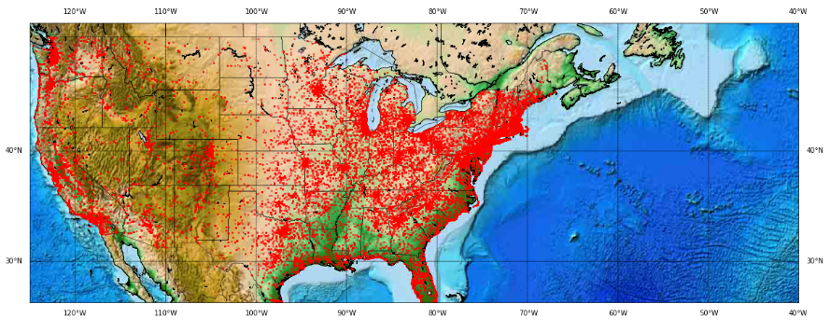
Created using mpl_toolkits:: basemap

Slide 9
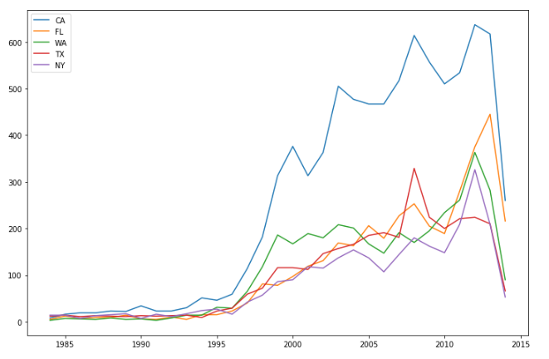
Created using timeseries

Slide 10
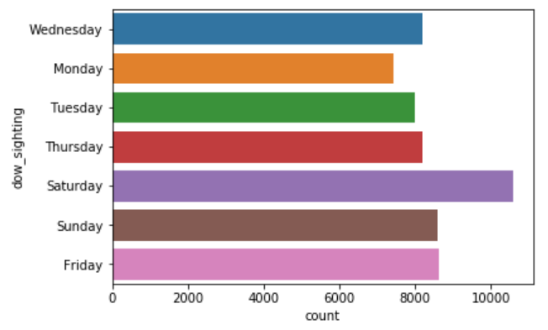
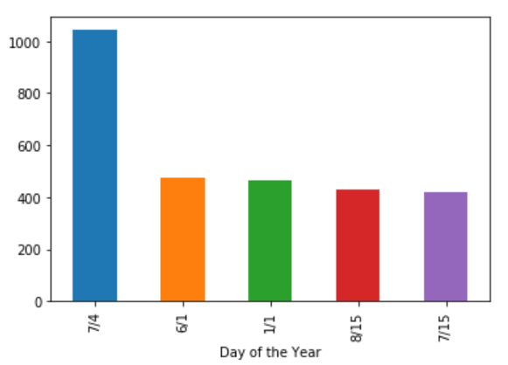
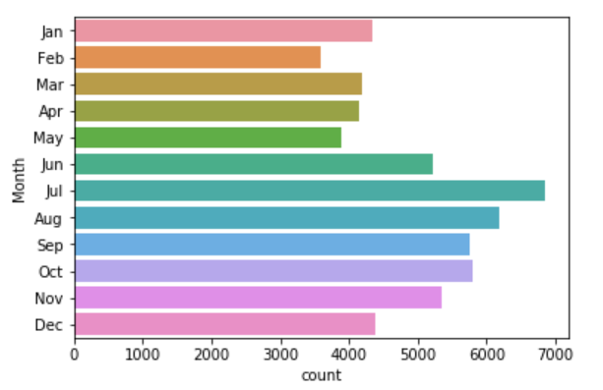
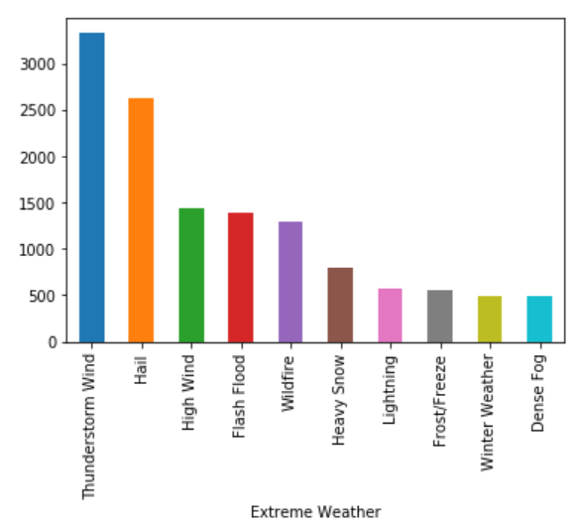
When Will I See a UFO?
Day of the Week
Day of the Year
# of Sightings
Month
Severe Weather Day of Sighting
# of Sightings
Notes:
Change month to month name

Slide 11
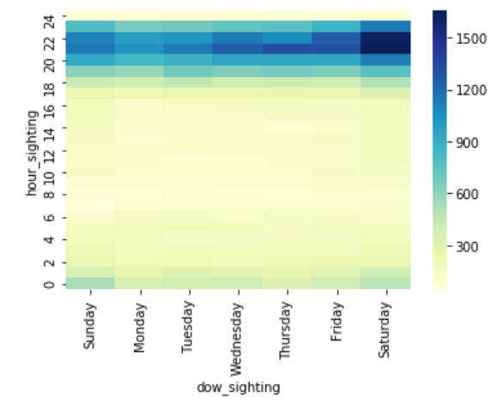
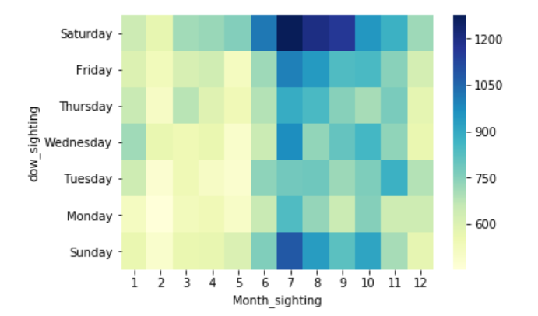
When Will I See a UFO (cont.) ?
Hour vs. Day of the Week
Day of the Week vs. Month

Slide 12
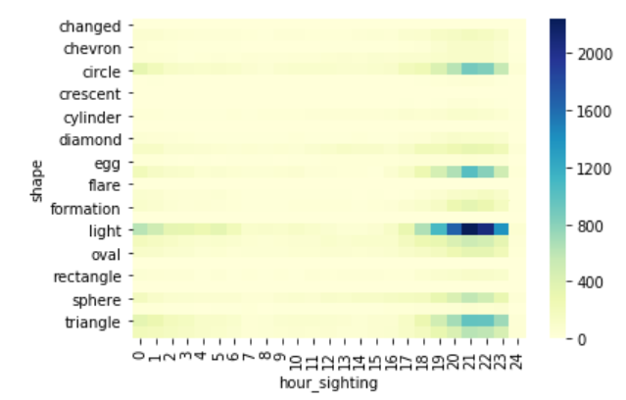
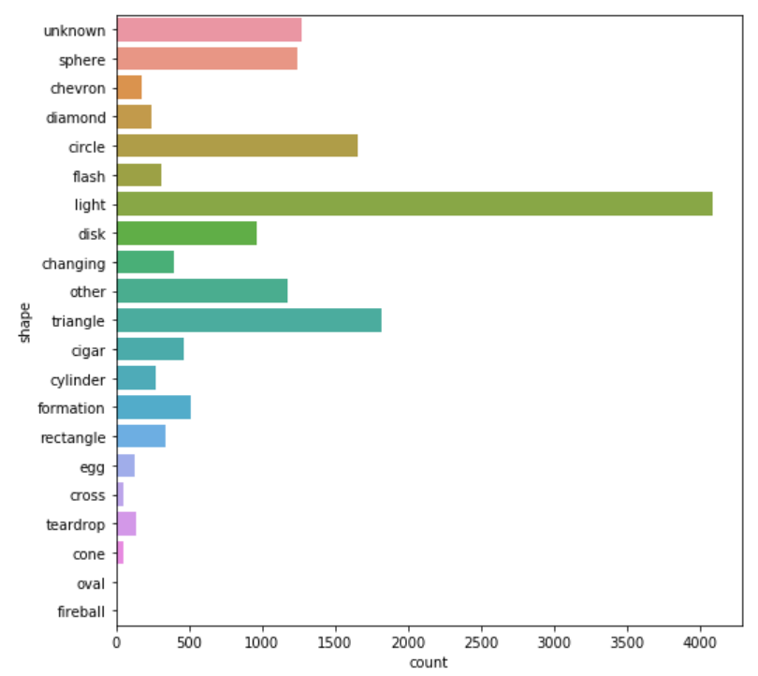
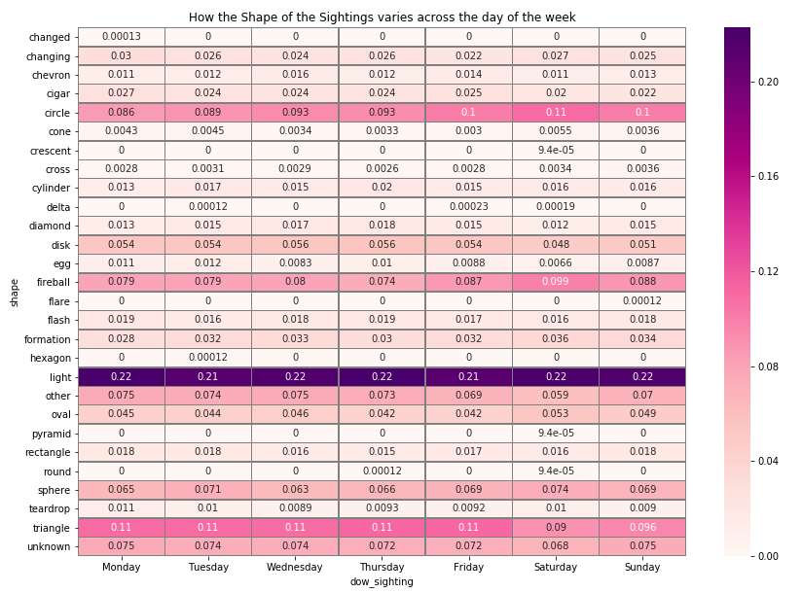
What Will I See?
Shape vs. Hour
Type of Shape

Slide 13
Insights

Slide 14
Logistic Regression
Y = Explainable Events
Most Unexplainable Shapes:
Cigar
Chevron
Triangle
Egg
 |  | Prediction
 |  | 0 | 1 | Total
Actual | 0.0 | 28,742 | 44 | 28,786
 | 1.0 | 941 | 114 | 1,055
 | Total | 29,683 | 158 | 29,841
Test Data Confusion Matrix
Most Unexplainable States:
Arkansas
Idaho
Wisconsin
Precision-Recall Table
 | Precision | Recall | Support
0.0 (Unexplained) | 0.97 | 1.00 | 28,786
1.0 (Explained) | 0.72 | 0.11 | 1,055
Avg/Total | 0.96 | 0.97 | 29,841
Notes:
Prediction rate not great, but gave us some way to see where to find a “true” UFO

Slide 15
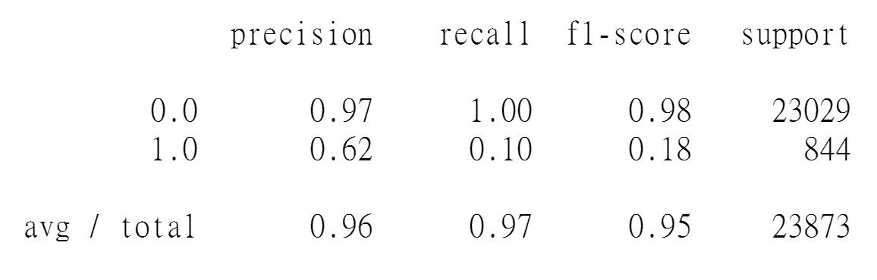
Random Forest
Training Data Confusion Matrix
Test Data Confusion Matrix
Prediction Actual | 0 | 1
0 | 34541 | 2
1 | 276 | 989
Prediction Actual | 0 | 1
0 | 22974 | 55
1 | 756 | 88
Accuracy : 0.9922
Accuracy : 0.9660

Slide 16
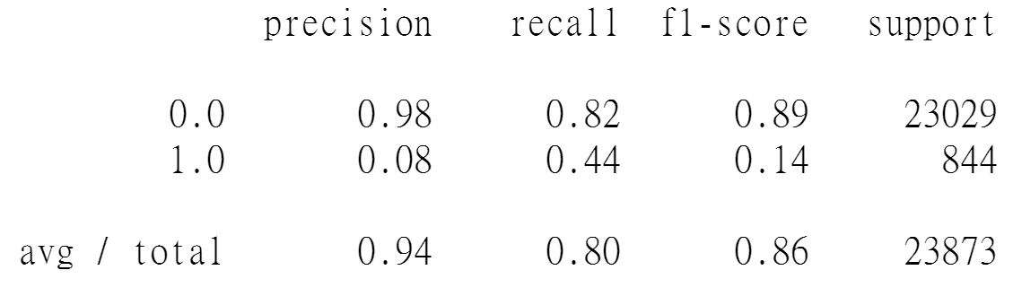
Random Forest: Threshold = 0.95
Training Data Confusion Matrix
Test Data Confusion Matrix
Prediction Actual | 0 | 1
0 | 31675 | 2868
1 | 0 | 1265
Prediction Actual | 0 | 1
0 | 18819 | 4210
1 | 472 | 372
Accuracy : 0.9199
Accuracy : 0.8039

Slide 17
Random Forest: Feature Importance
Features | Importance
Time | 0.010399
Proximity to USAFB | 0.004348
Date | 0.002605
Days Lapsed after Sighting | 0.001957
Duration (seconds) | 0.001336
Day of the Week | 0.001215
Shape | 0.001099
State | 0.000900
Extreme Weather | 0.000421
Moon Phase | 0.000001

Slide 18
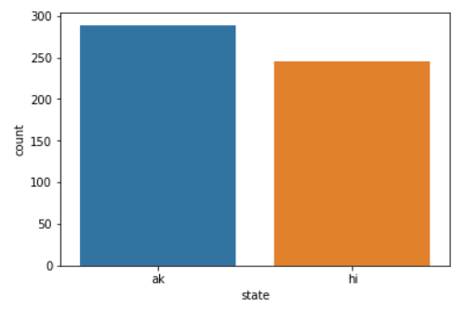
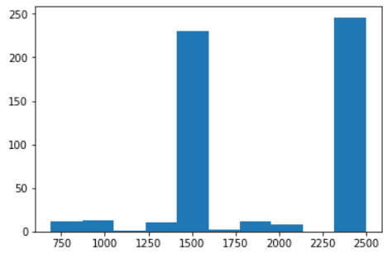
K Means Clustering: Cluster 3
# of Sightings by State
Proximity to Airforce Base
Cluster 3:
Alaska and Hawaii
>=1500 miles from an airforce base
Notes:
How many total clusters? 8 cluster total
Explainable or unexplainable?

Slide 19
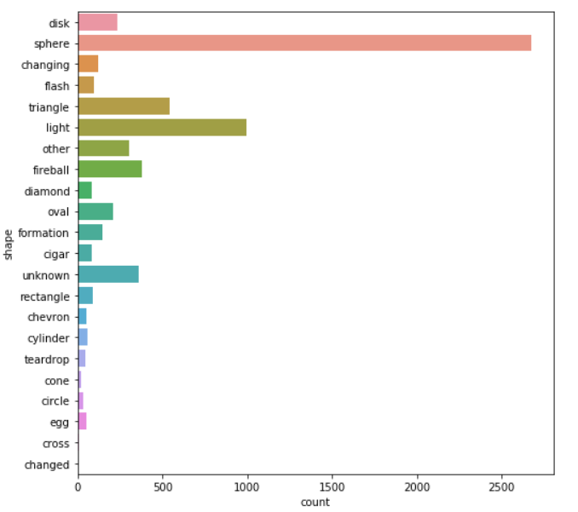
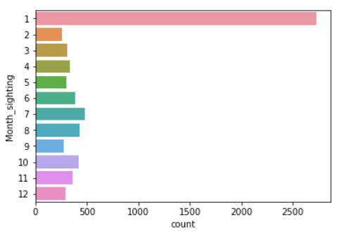
K Means Clustering: Cluster 7
Shape of UFO
Month of Sighting
Cluster 7:
Spherical UFOs
January
Notes:
How many total clusters? Explainable or unexplainable?

Slide 20
Conclusion

Slide 21
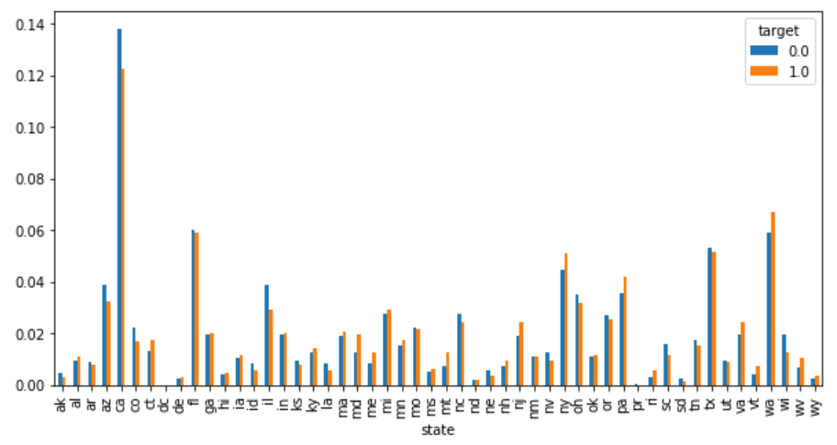
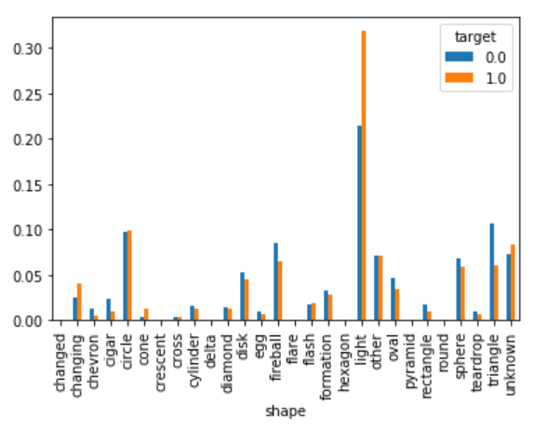
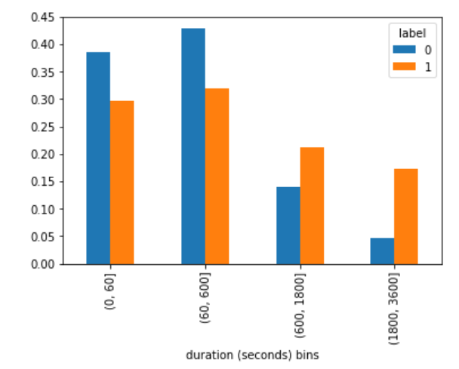
“Explainable” v “Unexplainable”
UFO States
UFO Shapes
UFO Duration
Notes:
Triangle – like logistic regression, also fireball and sphere
Shorter duration
CA, IL, AZ

Slide 22
Where Will I See a UFO?
State
Proximity to Airforce Base
# of Sightings
# of Sightings
City
# of Sightings
Notes:
CA, FL, TX, NY, and IL the most populous

Slide 23
When Will I See a UFO?
Day of the Week
Day of the Year
# of Sightings
Month
Severe Weather Day of Sighting
# of Sightings
Notes:
Change month to month name

Slide 24
What Will I See?
Shape vs. Hour
Type of Shape
Notes:
Preetika to add other shape v. time graphs

Slide 25
How to See a “Real” UFO:
Phoenix, AZ
Look for a triangle or cigar
Go at night time
On the weekend
July through September
Notes:
Filter out “explainable” observances?
Triangle insight came from logistic regression

