Slide 1
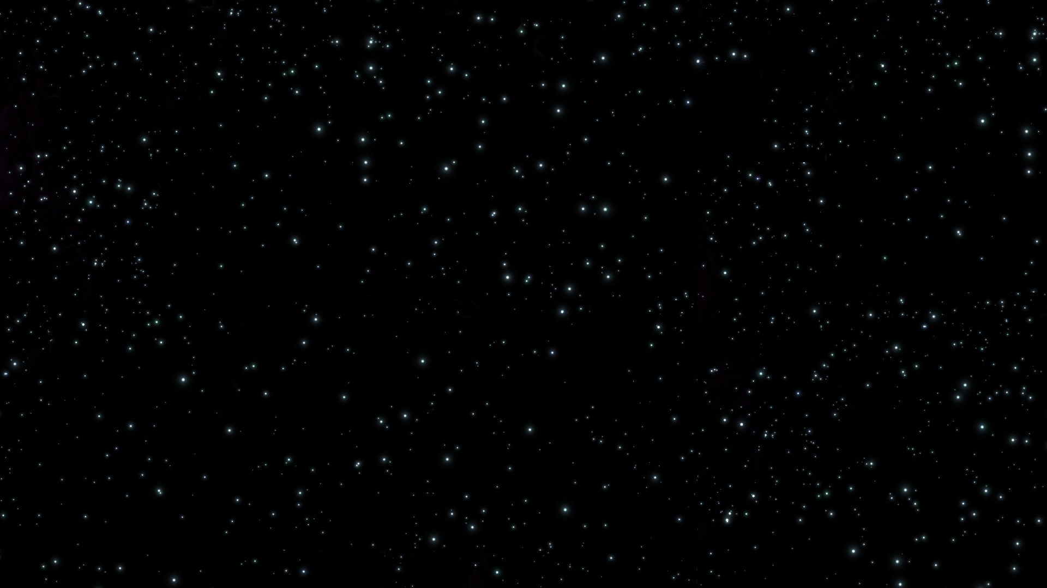

UFO Data August 13, 2018
Joey Chen
Anuraag Mohile
Catherine McNabb
Preetika Srivastav

Slide 2

Agenda
Description of Data
Exploratory Analysis
Insights
Conclusion

Slide 3
Description of data

Slide 4
Why UFO Data?
UFOlogy – the study of UFO’s
Pop culture – Men in Black, ET, Star Wars, Independence Day
Conspiracy Theories – Area 51, Stonehenge, Egyptian Pyramids
“1996 Gallup Poll reported that 71 percent of the United States population believed that the U.S. government was covering up information regarding UFOs” (Wikipedia)

Slide 5
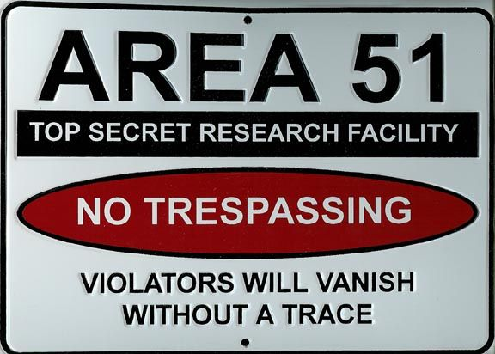
Data Background
In the data set:
Date and time
Latitude and Longitude
City, State, and Country
Shape
Duration
Unexplainable v Explainable
Added:
Weather
Day of the Week
Moon Phase
Proximity to US Airforce Base

Slide 6
Exploratory Analysis

Slide 7
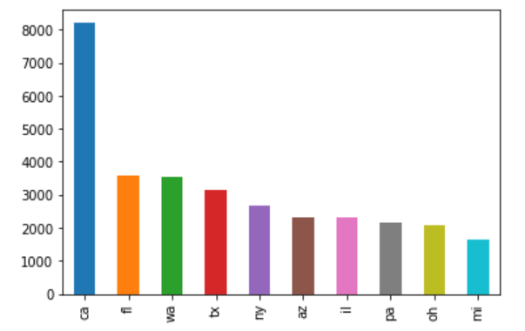
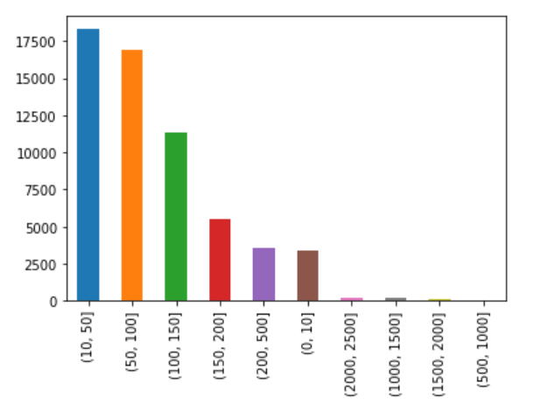
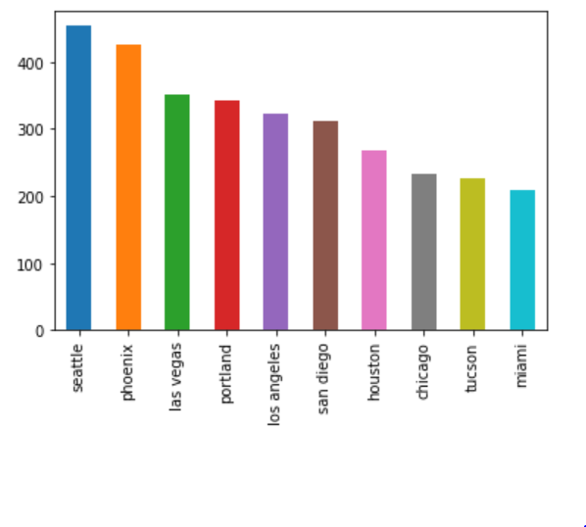
Where Will I see a UFO?
Proximity to Airforce Base
State
# of Sightings
# of Sightings
Top Ten States
City
Distance from Airforce Base (Miles)
# of Sightings
Top Ten Cities

Slide 8
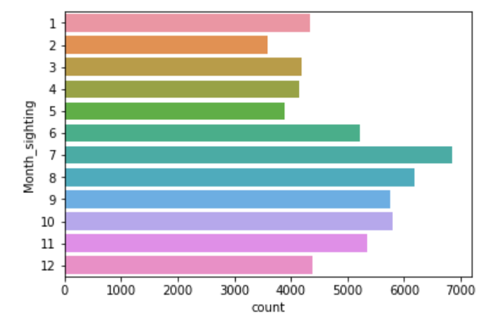
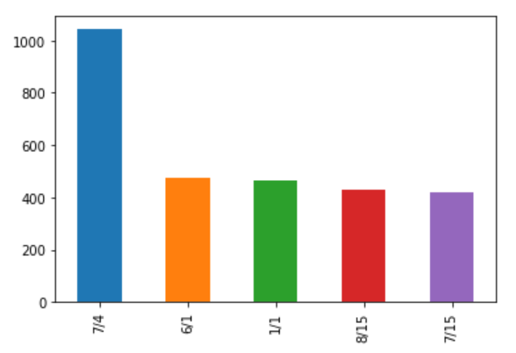
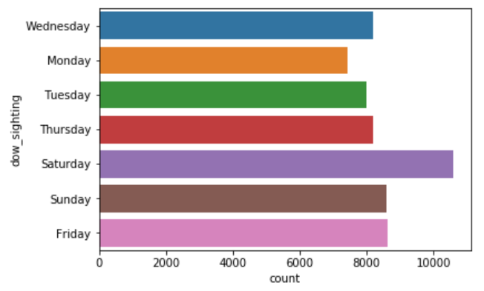
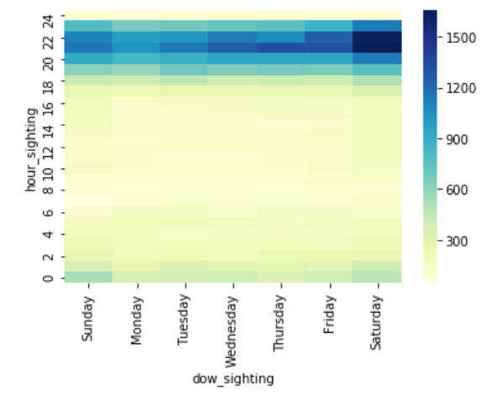
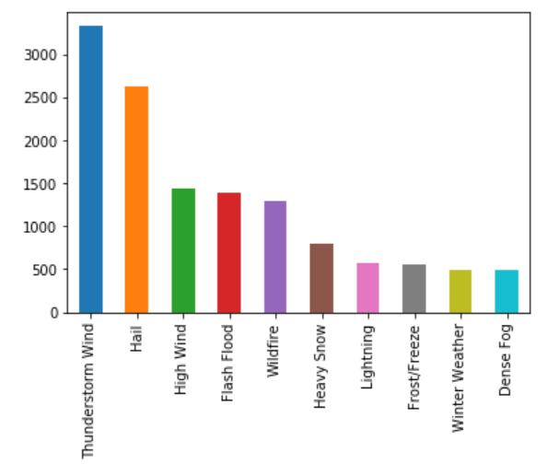
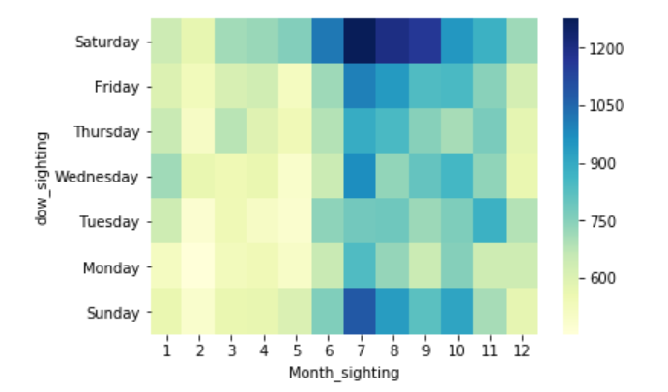
When Will I See a UFO?
Day of the Week
Month
Day of the Year
Top Five Days of the Year
Hour vs. Day of the Week
Severe Weather Day of Sighting
Day of the Week vs. Month
Top Ten Extreme Weather Events

Slide 9
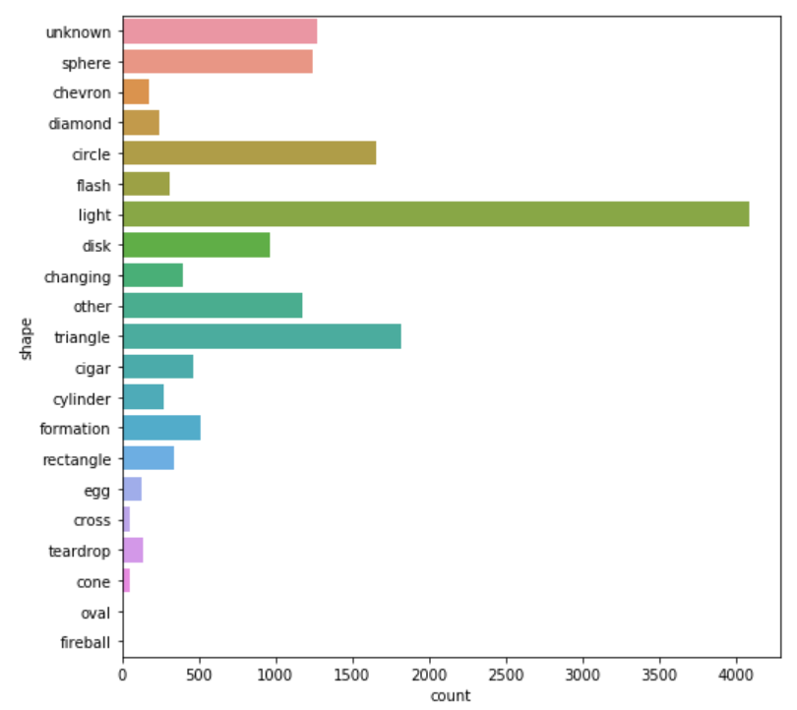
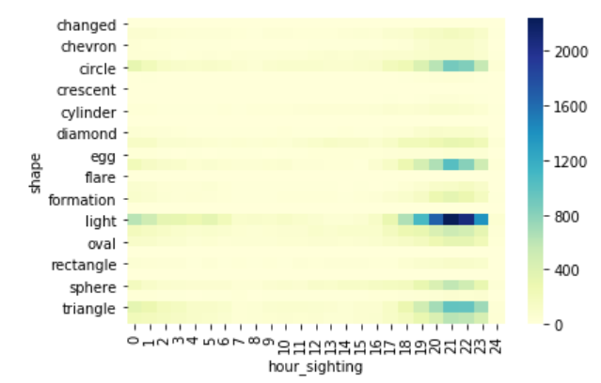
What Will I See?
“Shape”
Shape vs. Hour

Slide 10
Insights

Slide 11
Logistic Regression
Y = Explainable Events
Test Data Confusion Matrix
 |  | Prediction
 |  | 0 | 1 | Total
Actual | 0.0 | 28,742 | 44 | 28,786
 | 1.0 | 941 | 114 | 1,055
 | Total | 29,683 | 158 | 29,841
Most Unexplainable Shapes:
Cigar
Chevron
Triangle
Egg
Most Unexplainable States:
Arkansas
Idaho
Wisconsin
Precision-Recall Table
 | Precision | Recall | Support
0.0 (Unexplained) | 0.97 | 1.00 | 28,786
1.0 (Explained) | 0.72 | 0.11 | 1,055
Avg/Total | 0.96 | 0.97 | 29,841

Slide 12
Random Forest : Threshold = 0.5
Training Data Confusion Matrix
Test Data Confusion Matrix
Training Data Confusion Matrix
 |  | Prediction
 |  | 0 | 1 | Total
Actual | 0.0 | 22,974 | 55 | 23,029
 | 1.0 | 756 | 88 | 844
 | Total | 23,730 | 143 | 23,873
 |  | Prediction
 |  | 0 | 1 | Total
Actual | 0.0 | 34,541 | 2 | 34,543
 | 1.0 | 276 | 989 | 1,265
 | Total | 34,817 | 991 | 35,808
Test Data Confusion Matrix
Accuracy : 0.9922
Accuracy : 0.9660
Precision-Recall Table
 | Precision | Recall | Support
0.0 (Unexplained) | 0.97 | 1.00 | 23,029
1.0 (Explained) | 0.62 | 0.10 | 844
Avg/Total | 0.96 | 0.97 | 23,873

Slide 13
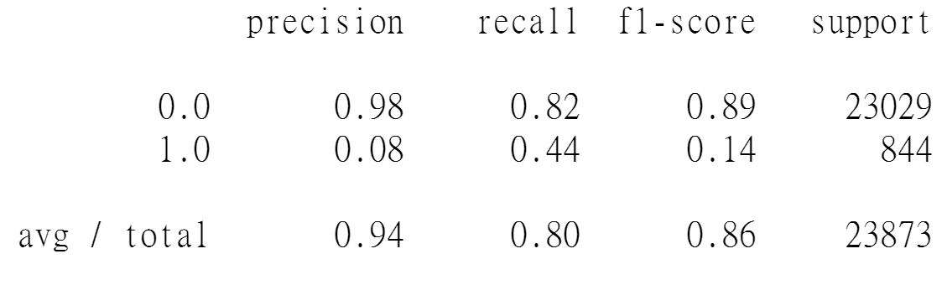
Random Forest: Threshold = 0.05
Training Data Confusion Matrix
Test Data Confusion Matrix
Prediction Actual | 0 | 1
0 | 31675 | 2868
1 | 0 | 1265
Prediction Actual | 0 | 1
0 | 18819 | 4210
1 | 472 | 372
Accuracy : 0.9199
Accuracy : 0.8039
 |  | Prediction
 |  | 0 | 1 | Total
Actual | 0.0 | 34,541 | 2 | 34,543
 | 1.0 | 276 | 989 | 1,265
 | Total | 34,817 | 991 | 35,808

Slide 14
Random Forest: Feature Importance
Features | Importance
Time | 0.010399
Proximity to USAFB | 0.004348
Date | 0.002605
Days Lapsed after Sighting | 0.001957
Duration (seconds) | 0.001336
Day of the Week | 0.001215
Shape | 0.001099
State | 0.000900
Extreme Weather | 0.000421
Moon Phase | 0.000001

Slide 15
K-Means Clustering

Slide 16
Conclusion

