Slide 1


UFO Data August 13, 2018
Joey Chen
Anuraag Mohile
Catherine McNabb
Preetika Srivastav

Slide 2

Agenda
Description of Data
Exploratory Analysis
Insights

Slide 3
Description of data

Slide 4
Why UFO Data?
UFOlogy – the study of UFO’s
Pop culture – Men in Black, ET, Star Wars, Independence Day
Conspiracy Theories – Area 51, Stonehenge, Egyptian Pyramids
“1996 Gallup Poll reported that 71 percent of the United States population believed that the U.S. government was covering up information regarding UFOs”

Slide 5
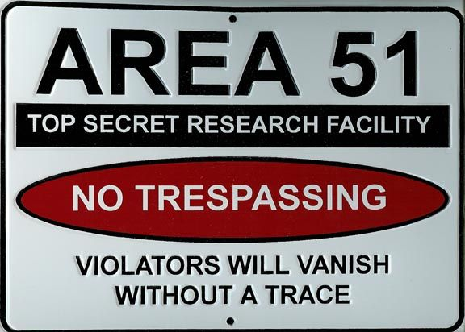
Data Background
In the data set:
Date and time
Latitude and Longitude
City, State, and Country
Shape
Duration
Unexplainable v Explainable
Added:
Weather
Day of the Week
Moon Phase
Proximity to US Airforce Base

Slide 6
Exploratory Analysis

Slide 7
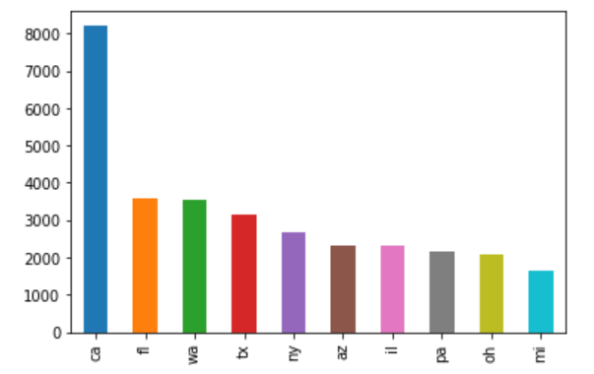
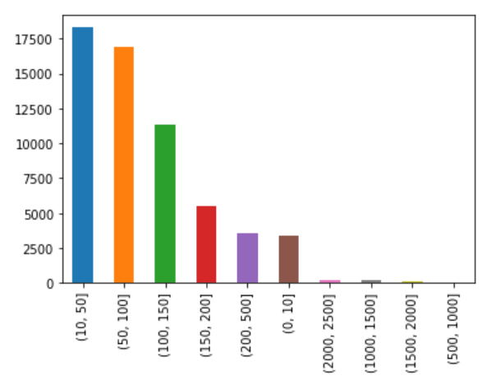
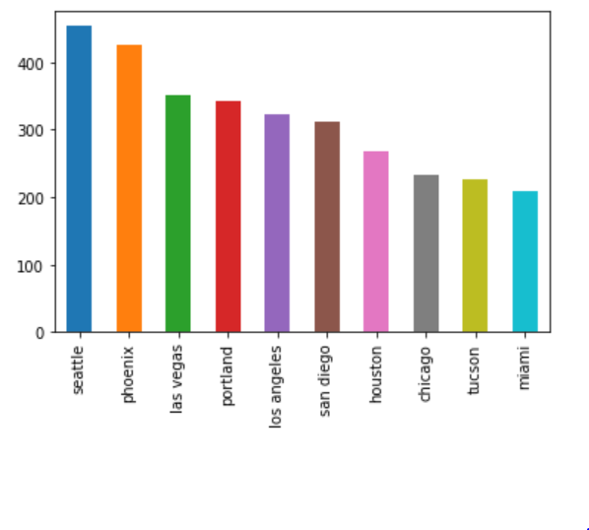
Where Will I see a UFO?
State
Proximity to Airforce Base
City

Slide 8
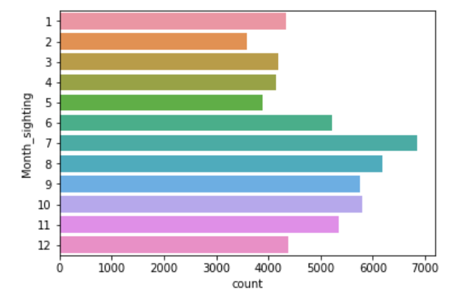
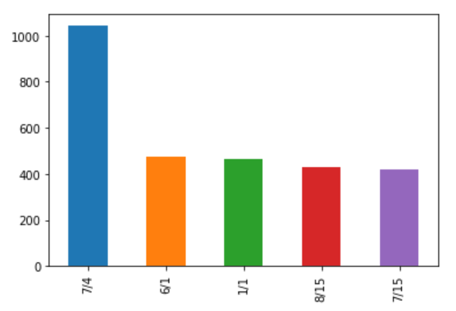
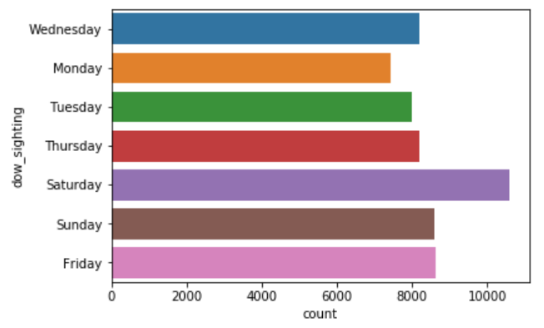
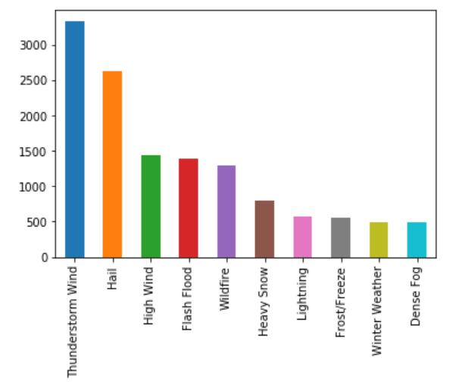
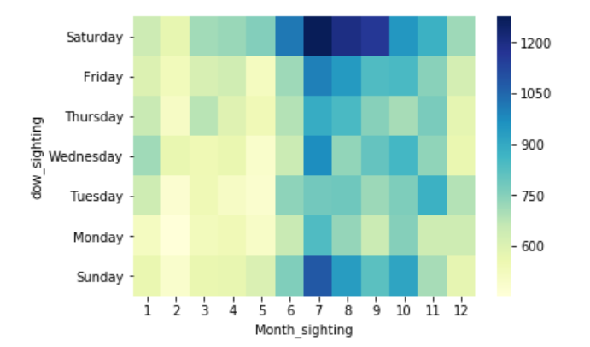
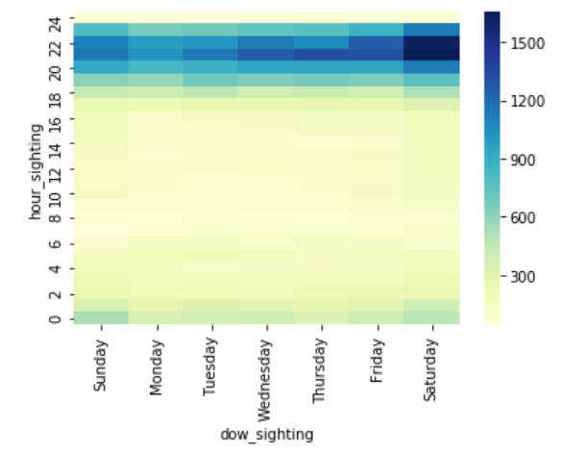
When Will I See a UFO?
Day of the Week
Month
Day of the Year
Hour vs. Day of the Week
Severe Weather Day of Sighting
Day of the Week vs. Month

Slide 9
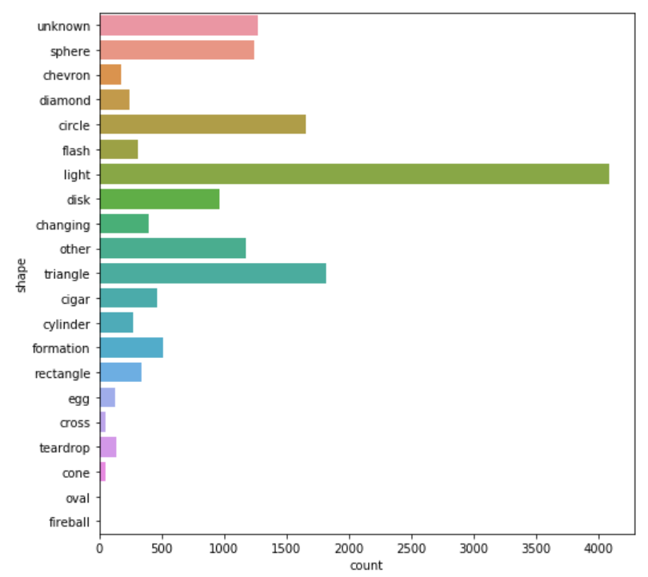
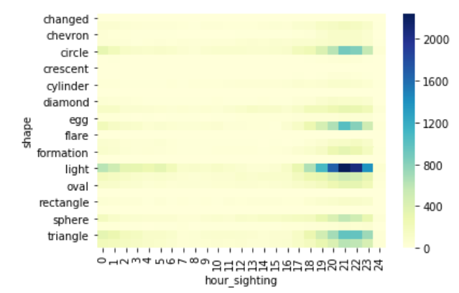
Shape vs. Hour

Slide 10
Insights

Slide 11
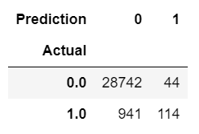
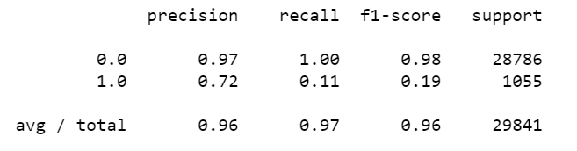
Logistic Regression
Y = Explainable Events
Most Unexplainable Shapes:
Cigar
Chevron
Triangle
Egg
Most Unexplainable States:
Arkansas
Idaho
Wisconsin

Slide 12
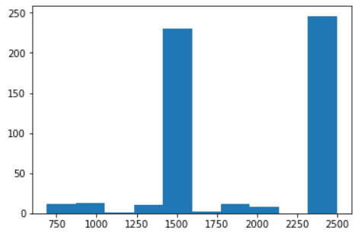
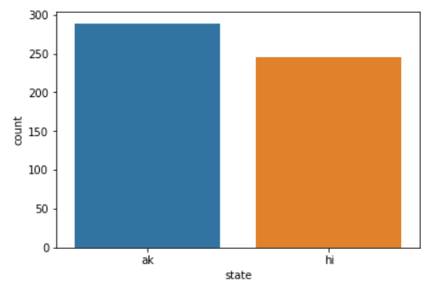
Clustering K-means Clustering

Slide 13
