Slide 1


Corona Virus Analysis
SQL Queries for Data Analysis

Slide 2
TABLE OF CONTENTS
01
02
03
OverView
Dataset Description
Queries
04
05
Analysis Summary
Conclusion
Impact of COVID-19 and role of data analysis
Details of each column in the dataset.
Some key Queries to get insights
Summary of key insights from the data analysis
Importance of data-driven decision-making

Slide 3
Overview
This project analyzes a coronavirus dataset using SQL queries to derive meaningful insights. It covers confirmed cases, deaths, and recoveries, and calculates mortality and recovery rates. By querying the dataset, the project aims to identify patterns and trends in the spread and impact of the virus. The findings will be presented comprehensively, offering valuable information on the pandemic's progression and effects. This analysis will help understand the virus's behavior, aiding in better response strategies.

Slide 4

Dataset Description
The dataset contains the following columns: 1. Province: Geographic subdivision within a country/region. 2. Country/Region: Geographic entity where data is recorded. 3. Latitude: North-south position on Earth's surface. 4. Longitude: East-west position on Earth's surface. 5. Date: Recorded date of CORONA VIRUS data. 6. Confirmed: Number of diagnosed CORONA VIRUS cases. 7. Deaths: Number of CORONA VIRUS-related deaths. 8. Recovered: Number of recovered CORONA VIRUS cases.

Slide 5
Queries
Key queries include analyzing confirmed cases, deaths, recoveries, and calculating mortality and recovery rates to uncover patterns and trends in the coronavirus dataset.

Slide 6
01
Check for NULL values
SELECT SUM(CASE WHEN Province IS NULL THEN 1 ELSE 0 END) AS Province_nulls, SUM(CASE WHEN `Country/Region` IS NULL THEN 1 ELSE 0 END) AS Country_Region_nulls, SUM(CASE WHEN Latitude IS NULL THEN 1 ELSE 0 END) AS Latitude_nulls, SUM(CASE WHEN Longitude IS NULL THEN 1 ELSE 0 END) AS Longitude_nulls, SUM(CASE WHEN Date IS NULL THEN 1 ELSE 0 END) AS Date_nulls, SUM(CASE WHEN Confirmed IS NULL THEN 1 ELSE 0 END) AS Confirmed_nulls, SUM(CASE WHEN Deaths IS NULL THEN 1 ELSE 0 END) AS Deaths_nulls, SUM(CASE WHEN Recovered IS NULL THEN 1 ELSE 0 END) AS Recovered_nullsFROM df;

Slide 7
If NULL values are present, update them with zeros for all columns.
02
We know that there are no NULL values in any of the columns in the dataset. Therefore, there is no need to execute query number 2, which would replace NULL values with zeroes.

Slide 8

Check total number of rows
03
SELECT COUNT(*) AS total_rows FROM df;

Slide 9

04
Check start date and end date
SELECT MIN(Date) AS start_date, MAX(Date) AS end_date FROM df;

Slide 10

Number of months present in the dataset
05
SELECT COUNT(DISTINCT strftime('%Y-%m', Date)) AS num_months FROM df;

Slide 11
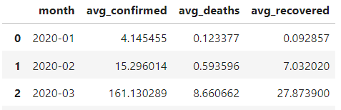
06
Monthly average for confirmed, deaths, recovered
SELECT strftime('%Y-%m', Date) AS month, AVG(Confirmed) AS avg_confirmed,AVG(Deaths) AS avg_deaths, AVG(Recovered) AS avg_recoveredFROM dfGROUP BY month;

Slide 12
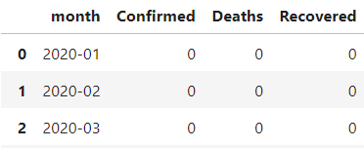
Most frequent value for confirmed, deaths, recovered each month.
07
SELECT month,Confirmed,Deaths,Recovered FROM (SELECT strftime('%Y-%m', Date) AS month,Confirmed,Deaths,Recovered, ROW_NUMBER() OVER (PARTITION BY strftime('%Y-%m', Date) ORDER BY COUNT(*) DESC) AS r FROM df GROUP BY month, Confirmed, Deaths, Recovered) t WHERE r = 1;
.

Slide 13
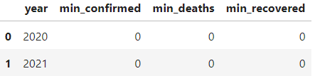
Minimum values for confirmed, deaths, recovered per year
08
SELECT strftime('%Y', Date) AS year,MIN(Confirmed) AS min_confirmed,MIN(Deaths) AS min_deaths,MIN(Recovered) AS min_recovered FROM df GROUP BY year;

Slide 14
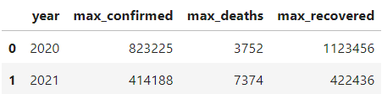
09
Maximum values for confirmed, deaths, recovered per year
SELECT strftime('%Y', Date) AS year,MAX(Confirmed) AS max_confirmed,MAX(Deaths) AS max_deaths,MAX(Recovered) AS max_recovered FROM df GROUP BY year;

Slide 15
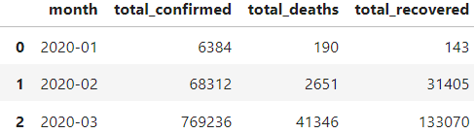
Total number of cases of confirmed, deaths, recovered each month
10
SELECT strftime('%Y-%m', Date) AS month,SUM(Confirmed) AS total_confirmed,SUM(Deaths) AS total_deaths,SUM(Recovered) AS total_recovered FROM df GROUP BY month;

Slide 16

11
Spread of virus with respect to confirmed cases
SELECT SUM(Confirmed) AS total_confirmed,AVG(Confirmed) AS avg_confirmed,SUM((Confirmed - (SELECT AVG(Confirmed) FROM df)) * (Confirmed - (SELECT AVG(Confirmed) FROM df))) / COUNT(*) AS variance_confirmed FROM df;

Slide 17
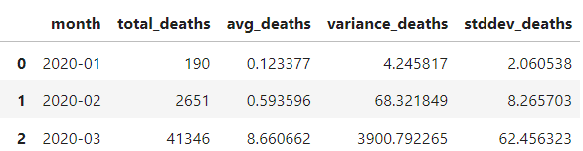
12
Spread of virus with respect to death cases per month
SELECT strftime('%Y-%m', Date) AS month,SUM(Deaths) AS total_deaths,AVG(Deaths) AS avg_deaths,AVG(Deaths * Deaths) - AVG(Deaths) * AVG(Deaths) AS variance_deaths FROM df GROUP BY strftime('%Y-%m', Date);

Slide 18

Spread of virus with respect to recovered cases
13
SELECT SUM(Recovered) AS total_recovered,AVG(Recovered) AS avg_recovered,SUM((Recovered - (SELECT AVG(Recovered) FROM df)) * (Recovered - (SELECT AVG(Recovered) FROM df))) / COUNT(*) AS variance_recovered FROM df;

Slide 19

Country with highest number of confirmed cases
14
SELECT `Country/Region` FROM df GROUP BY `Country/Region` ORDER BY SUM(Confirmed) DESC LIMIT 1;

Slide 20

15
Country with the lowest number of death cases
SELECT `Country/Region` FROM df GROUP BY `Country/Region` ORDER BY SUM(Deaths) LIMIT 1;

Slide 21
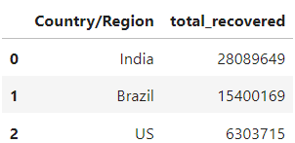
Top 3 countries with highest recovered cases
16
SELECT `Country/Region`, SUM(Recovered) AS total_recovered FROM df GROUP BY `Country/Region` ORDER BY total_recovered DESC LIMIT 3;

Slide 22
Conclusion
The analysis provides a comprehensive overview of the impact of the coronavirus across different countries and regions. Utilizing SQL queries, we have gained critical insights into confirmed cases, deaths, recoveries, and trends over time. By examining this data, we can identify patterns and anomalies that reveal how the virus has spread and affected various populations. The insights derived from the data can inform public health decisions and strategies, helping authorities to allocate resources more effectively, implement timely interventions, and evaluate the efficacy of measures taken to curb the virus's spread. This analysis also highlights differences in how regions have managed the pandemic, offering valuable lessons for future outbreaks. Overall, our use of SQL for this in-depth analysis of the coronavirus dataset enables a data-driven approach to understanding and combating the virus, ultimately contributing to better public health outcomes and preparedness.

Slide 23
THANKS!
Do you have any questions?
Feel free to ask me on LinkedIn if you have any questions or
need further information.

