Slide 1
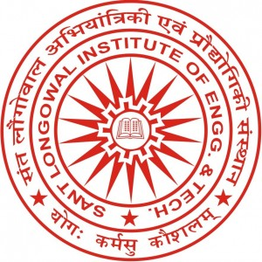
Anshumat Oct-Dec 2022 (Vol V, Issue IV)
A quarterly newsletter of
Sant Longowal Institute of Engineering and Technology, Longowal – 148106
(Deemed-to-be-University under Ministry of Education (MoE), Govt. of India)

