Slide 1
NorthWind Sales Analysis
By Preety Paramanick

Slide 2
Objective
The objective of this Power BI report is to create a visually appealing and user-friendly dashboard that effectively communicates key performance metrics for Northwind Traders. The report aims to provide insights into customer behavior, sales patterns, and employee performance, thereby aiding in the decision-making processes. It will cover areas such as sales analysis, customer segmentation, inventory trends, and employee performance, consolidating data from multiple tables for a comprehensive view of the company’s operations. The report is designed to empower stakeholders to make data-driven decisions by offering valuable insights and facilitating data exploration through interactive visualizations and dynamic filters. The expected impact is to revolutionize how Northwind Traders interacts with its data, enabling the company to remain competitive and drive its business forward in the wholesale market landscape.

Slide 3
Data Dictionary
Customers Table
Customer ID: Unique identifier for each customer
Company Name: Name of the customer’s company
Contact Name: Name of the contact person at the customer’s company
Contact Title: Job title of the contact person
Address: Address of the customer’s company
City: City where the customer’s company is located
Region: Region where the customer’s company is located
Postal Code: Postal code of the customer’s company
Country: Country where the customer’s company is located
Phone: Phone number of the customer’s company
Fax: Fax number of the customer’s company

Slide 4
Employees Table
Employee ID: Unique identifier for each employee
Last Name: Last name of the employee
First Name: First name of the employee
Title: Job title of the employee
Title of Courtesy: Courtesy title for the employee (e.g., Mr., Ms., Dr.)
Birth Date: Birth date of the employee
Hire Date: Date when the employee was hired
Address: Address of the employee
City: City where the employee lives
Region: Region where the employee lives
Postal Code: Postal code of the employee’s address
Country: Country where the employee lives
Home Phone: Home phone number of the employee
Extension: Extension number at the office for the employee
Photo: Photo of the employee
Notes: Additional notes about the employee
Reports To: The superior/manager to whom the employee reports
Photo Path: File path of the employee’s photo
NumOrder: Sum of NumOrder of Employee
Tenure: Number of Working days of Employees
Total OrderValue: Total Order Value of Employees

Slide 5
Orders Table
Order ID: Unique identifier for each order
Customer ID: Unique identifier for the customer who placed the order
Employee ID: Unique identifier for the employee who handled the order
Order Date: Date when the order was placed
Required Date: Date when the order needs to be delivered
Shipped Date: Date when the order was shipped
Ship Via: Method of shipping
Freight: Freight charges for the order
Ship Name: Name of the ship/vehicle used for shipping
Ship Address: Address where the order needs to be shipped
Ship City: City where the order needs to be shipped
Ship Region: Region where the order needs to be shipped
Ship Postal Code: Postal code of the shipping address
Ship Country: Country where the order needs to be shipped
Processing Time: Processing time of orders
NumOrders: NumOrder of orders

Slide 6
Order Details Table
Order ID: Unique identifier for the order
Product ID: Unique identifier for the product ordered
Unit Price: Price per unit of the product
Quantity: Quantity of the product ordered
Discount: Discount applied to the product
OrderValue: Ordervalue of order details
TotalValue: Totalvalue of order details
Shippers Table
Shipper ID: Unique identifier for each shipping company
Company Name: Name of the shipping company
Phone: Phone number of the shipping company
Order Count: Total order count of company
Categories Table
Category ID: Unique identifier for each product category
Category Name: Name of the product category
Description: Description of the product category

Slide 7
Products Table
Product ID: Unique identifier for each product
Product Name: Name of the product
Supplier ID: Unique identifier for the supplier of the product
Category ID: Unique identifier for the category of the product
Quantity Per Unit: Quantity of the product per unit
Unit Price: Price per unit of the product
Units In Stock: Number of units of the product in stock
Units On Order: Number of units of the product on order
Reorder Level: Level of stock at which the product should be reordered
Discontinued: Whether the product is discontinued
Average_Unit_Price: Average value of unit price of the product
Revenue: Total sales of product
Total Quantity Sold: Number of total quantity sold
Total Sales Volume: Total Number od sales

Slide 8
Suppliers Table
Supplier ID: Unique identifier for each supplier
Company Name: Name of the supplier company
Contact Name: Name of the contact person at the supplier company
Contact Title: Job title of the contact person
Address: Address of the supplier company
City: City where the supplier company is located
Region: Region where the supplier company is located
Postal Code: Postal code of the supplier company
Country: Country where the supplier company is located
Phone: Phone number of the supplier company
Fax: Fax number of the supplier company
Home Page: Website of the supplier company

Slide 9
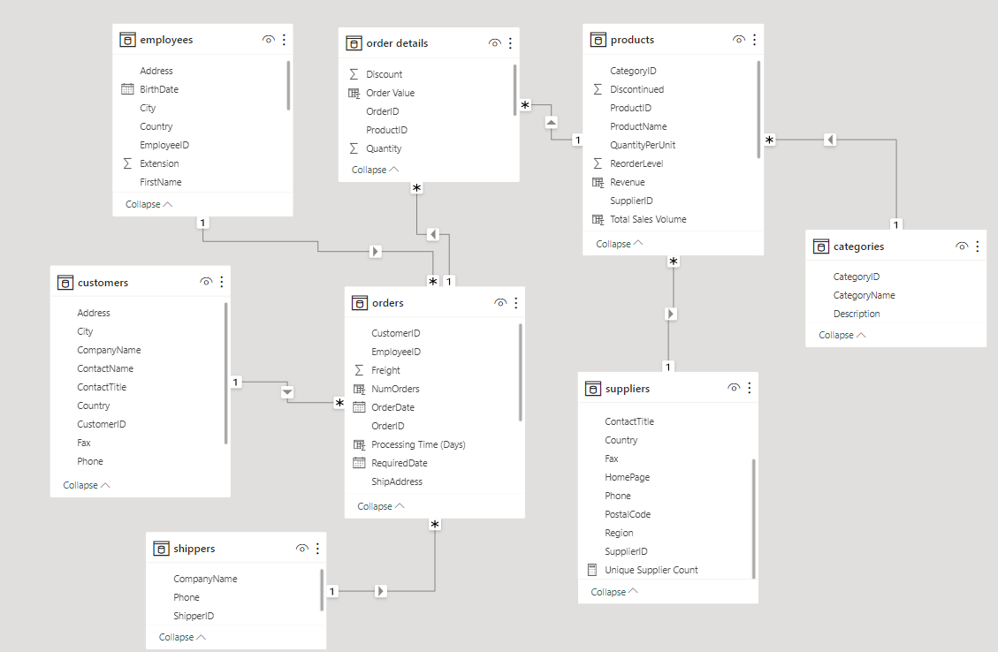
E-R Diagram

Slide 10
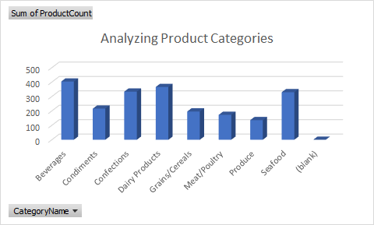
Problem Statement with Solution and Insights EDA Questions
1.What are the key factors influencing customer retention or loyalty based on the dataset?
=To identify key factors influencing customer retention or loyalty based on the Northwind database, we use SQL queries to extract relevant insights from the dataset.

Slide 11
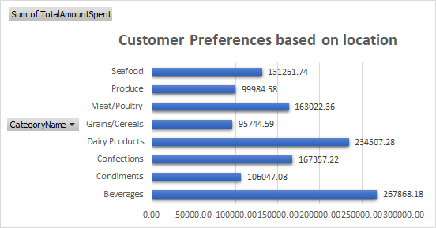
Problem Statement with Solution and Insights EDA Questions
2.How do customer preferences vary based on their location or demographics? Can we explore this through interactive visualizations?
=To explore how customer preferences vary based on their location or demographics and create interactive visualizations, you can use SQL to extract relevant data.

Slide 12
Problem Statement with Solution and Insights EDA Questions
3.Are there any interesting patterns or clusters in customer behavior that can be visualized to identify potential market segments?
=To identify interesting patterns or clusters in customer behavior and visualize potential market segments using the Northwind dataset, we use SQL to analyze the data and Excel for visualization.

Slide 13
Problem Statement with Solution and Insights EDA Questions
4.Are there any specific product categories or SKUs that contribute significantly to order revenue? Can we identify them through visualizations?
=To identify specific product categories or SKUs that contribute significantly to order revenue and visualize them using SQL and Excel, we can follow these steps:

Slide 14
Problem Statement with Solution and Insights EDA Questions
5.Are there any correlations between order size and customer demographics or product categories? Can we explore this visually using scatter plots or heatmaps?
=To identify specific product categories or SKUs that contribute significantly to order revenue and visualize them using SQL and Excel, we can follow these steps:

Slide 15
Problem Statement with Solution and Insights EDA Questions
6.How does order frequency vary across different customer segments? Can we visualize this using bar charts or treemaps?
=To analyze how order frequency varies across different customer segments and visualize this using bar charts or treemaps, you can use SQL to extract and summarize the data and Excel for visualization.

Slide 16
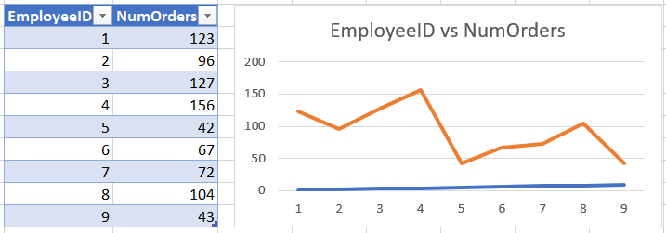
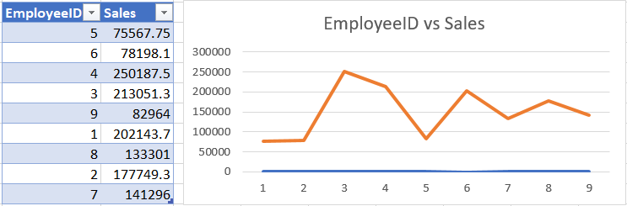
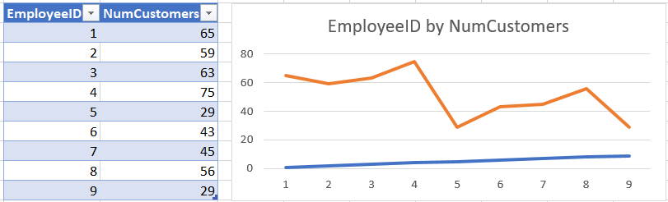
Problem Statement with Solution and Insights EDA Questions
7.Are there any correlations between employee satisfaction levels and key performance indicators?
=Analyzing the correlation between employee satisfaction levels and key performance indicators (KPIs) in the Northwind dataset can provide valuable insights. To explore this visually using scatter plots or line charts, we can use SQL to extract and summarize the data and Excel for visualization.

Slide 17
Problem Statement with Solution and Insights EDA Questions
8.How does employee turnover vary across different departments or job roles? Can we visualize this using bar charts or heatmaps?
=To analyze how employee turnover varies across different departments or job roles in the Northwind dataset and visualize this using bar charts, you can use SQL to extract and summarize the data, and then use Excel for visualization.

Slide 18
Problem Statement with Solution and Insights EDA Questions
9.Can we identify any patterns or clusters in employee skill sets or qualifications through visualizations? How can this information be used for talent management?
=To identify patterns or clusters in employee skill sets or qualifications through visualizations and use this information for talent management, we can follow these steps using SQL and Excel

Slide 19
Problem Statement with Solution and Insights EDA Questions
10. Are there any correlations between product attributes (e.g., size, color, features) and sales performance? Can we explore this visually using scatter plots or heatmaps?
=To Identify this we need to check data, Due to the limitation of data we don't have specific attributes like size, color, or features for the products.We can still analyze the correlation between available attributes and sales performance.

Slide 20
Problem Statement with Solution and Insights EDA Questions
11.How does product demand fluctuate over different seasons or months? Can we visualize this through line charts or area charts?
=Definitely we can visulize a drastic downfall from the month of may to july in the demand of products through the line chart

Slide 21
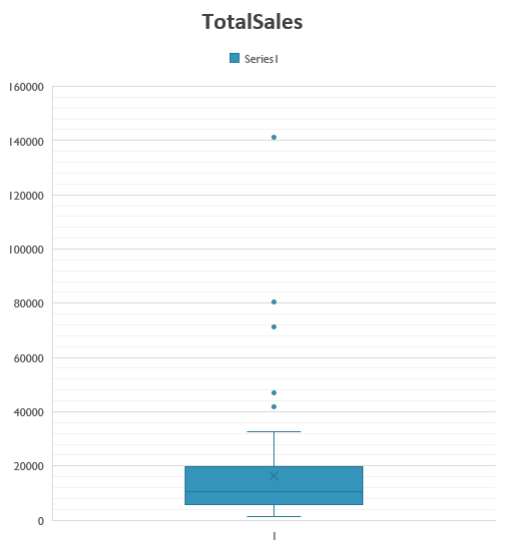
Problem Statement with Solution and Insights EDA Questions
12.Can we identify any outliers or anomalies in product performance or sales using visualizations? How can this information be used for product optimization?
=We can identify the outliers by visualize the box plot and wishker chart. we can discontinue the products that are outliers.

Slide 22
Problem Statement with Solution and Insights EDA Questions
13.Are there any correlations between supplier attributes (e.g., location, size, industry) and performance metrics (e.g., on-time delivery, product quality)?
= This can provide insights into the inventory levels maintained by each supplier, which can be useful for managing stock and ensuring a steady supply of products.

Slide 23
Problem Statement with Solution and Insights EDA Questions
15.Can we identify any trends or patterns in supplier costs or pricing structures through visualizations? How can this information be used for procurement optimization?
= We can conclude from the visualization that suppliers with lower average prices and lower variability might be more reliable in terms of cost management.

Slide 24
Problem Statement with Solution and Insights PowerBI Questions
1.How does customer distribution vary across different regions or customer segments? Can we visualize it on a map or bar chart?
By using either a bar chart or a map visualization, you can effectively display how customer distribution varies across different regions or customer segments in Power BI. The choice between a bar chart and a map depends on your data and the visual representation that best conveys the information to your audience.
2.What is the trend in customer acquisition over time? Can we create a line chart or area chart to display it?
The line chart shows the number of new customers acquired each year. We can see that the number of new customers has been fluctuating over the years.
3.Can we visualize the distribution of customer demographics such as age, gender, or income using histograms or pie charts?
The provided datasets do not contain demographic information such as age, gender, or income for the customers. The available customer-related information is limited to company name, contact name, contact title, address, city, region, postal code, country, and phone. While we don't have specific demographic data like age, gender, or income, we can still explore and visualize other aspects of the customer data that we do have. For example, we can look at the distribution of customers by country or city.

Slide 25
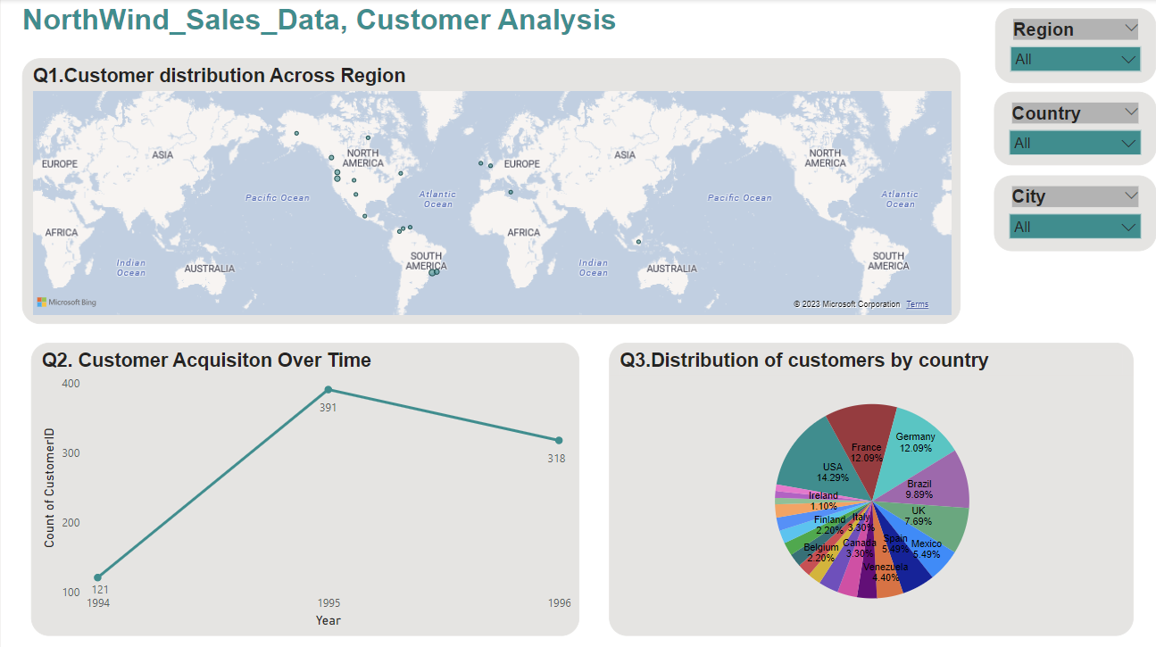
Customer Anasysis

Slide 26
Problem Statement with Solution and Insights PowerBI Questions
4.How does order volume change over time? Can we create a time series chart or stacked bar chart to visualize it?
It appears there was an error due to the 'Period' data type of the 'YearMonth' column. To resolve this, we can convert the 'Period' data type to 'datetime' before plotting.
5.What is the distribution of order values? Can we create a histogram or box plot to display it?
The histogram shows the frequency of different order values. We can see that most of the order values are concentrated on the lower end, indicating that smaller orders are more common.
6.Can we visualize the average order processing time or shipping duration using a bar chart or box plot?
To visualize the average order processing time or shipping duration, we first need to calculate these metrics. The order processing time can be calculated as the difference between the order date and the shipped date.

Slide 27
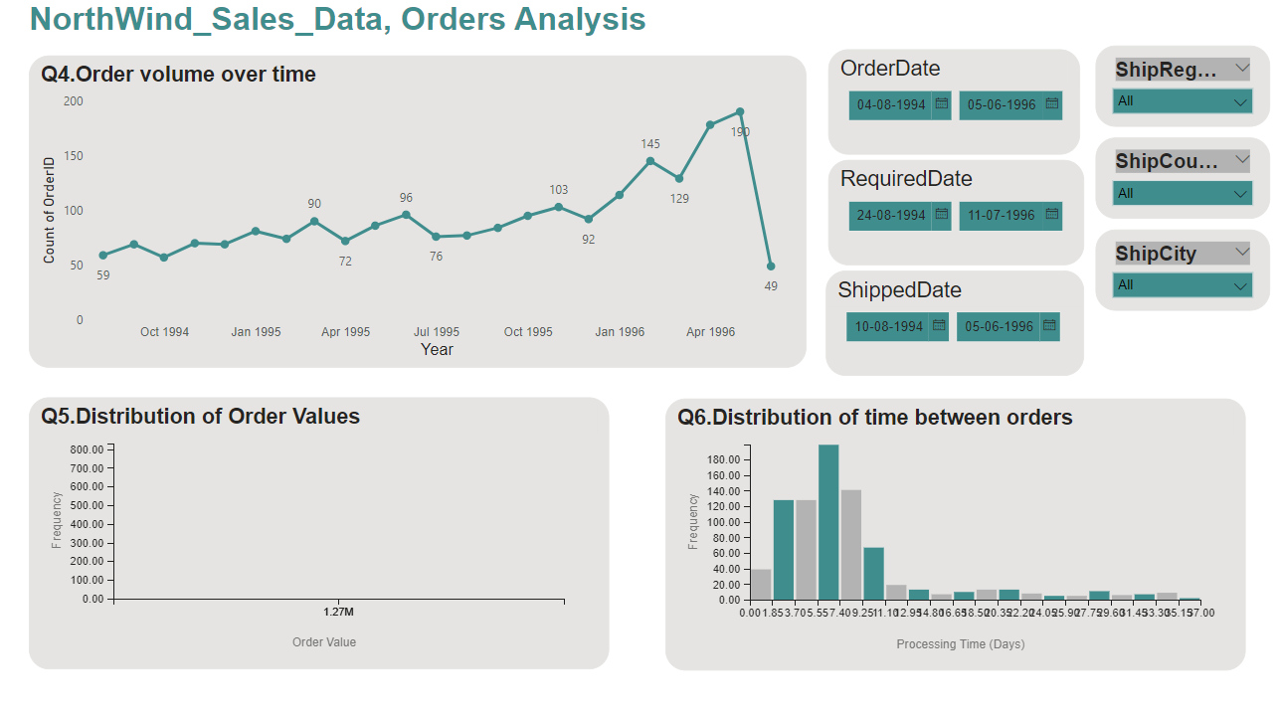
Order analysis

Slide 28
Problem Statement with Solution and Insights PowerBI Questions
7.How does employee productivity vary across different departments or job roles? Can we create a stacked bar chart or grouped column chart to visualize it?
To analyze employee productivity across different departments or job roles, we need data that includes information about employees' departments or job roles and their productivity measures. However, the provided datasets do not contain this information.
8.What is the distribution of employee tenure? Can we create a histogram or box plot to display it?
The tenure of each employee in years, calculated as the difference between the current date (2023-11-08) and the hire date of each employee.
9.Can we visualize employee performance ratings or KPIs using a radar chart or bullet graph?
we can visualize employee performance ratings or KPIs using a radar chart or bullet graph in PowerBI. However, PowerBI does not natively support radar charts or bullet graphs. Instead, we can use a combination of bar charts, line charts, and card visuals to create a similar effect.

Slide 29
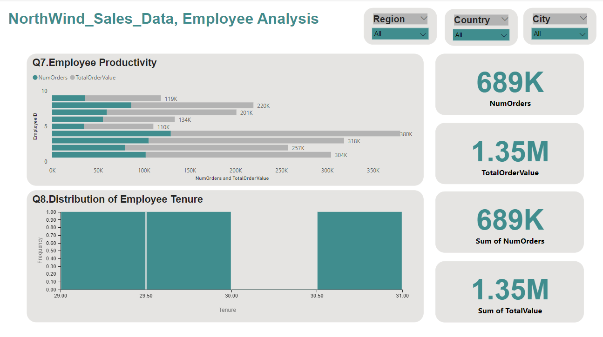
Employee analysis

Slide 30
Problem Statement with Solution and Insights PowerBI Questions
10.What is the distribution of product ratings or reviews? Can we create a histogram or stacked bar chart to visualize it?
we can create a distribution of other product-related metrics with the available data. For instance, we can use the 'Quantity' column in the 'order_details' dataframe to create a distribution of product quantities sold. This can give us an idea of which products are most popular.
11.How does the sales volume vary across different product categories? Can we create a bar chart or treemap to display it?
Merge the 'products' dataframe with the 'categories' dataframe to get the category for each product.Merge the resulting dataframe with the 'order_details' dataframe to get the sales volume for each product.Group the resulting dataframe by 'CategoryID' and sum the 'Quantity' for each category.
12.Can we visualize the pricing distribution of products using a box plot or violin plot?
we can use a histogram to visualize the distribution of prices. the histogram shows the frequency of different price ranges.

Slide 31
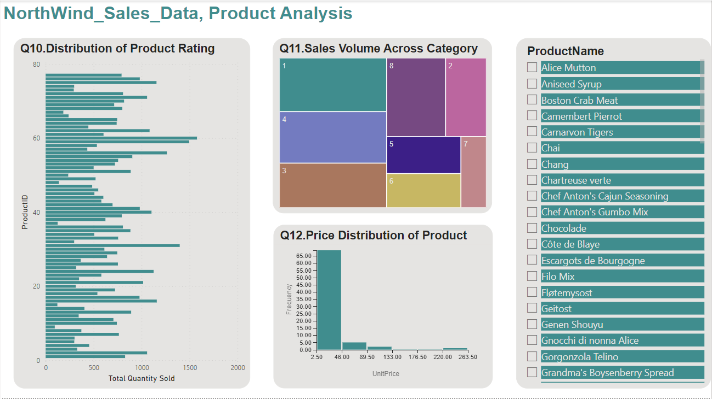
Product analysis

Slide 32
Problem Statement with Solution and Insights PowerBI Questions
13.What is the distribution of supplier ratings or performance metrics? Can we create a bar chart or radar chart to visualize it?
we calculate the total quantity of products sold for each supplier. For this, we'll need to join the 'products' and 'order details' dataframes on 'ProductID', and then group by 'SupplierID'.We have calculated the number of products supplied by each supplier, the total quantity of products sold for each supplier, and the total revenue generated from each supplier's products.
14.How does the cost or pricing structure vary across different suppliers? Can we create a box plot or stacked bar chart to display it?
To analyze the cost or pricing structure across different suppliers, we can use the 'UnitPrice' column in the 'products' table. To analyze the cost structure, we can calculate the average unit price for each supplier.
15.Can we visualize the geographical distribution of suppliers using a map or bubble chart?
To visualize the geographical distribution of suppliers using a map or bubble chart in Power BI, you would need to have geographical data such as the latitude and longitude, or the city and country of the suppliers.

Slide 33
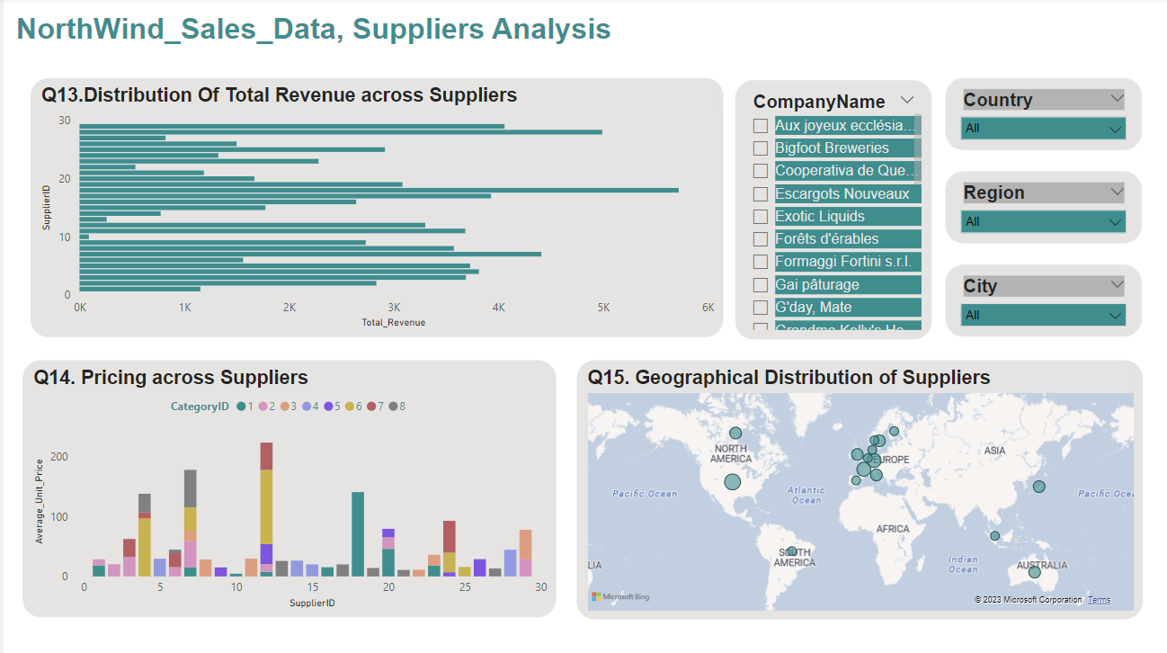
Supplier analysis

Slide 34
Conclusion
The Northwind Sales data provides a wealth of information for analysis and visualization. Effective data visualization in Power BI enables stakeholders to gain valuable insights and make data-driven decisions in various aspects of their business, including customer behavior, sales trends, employee performance, and product optimization. The insights derived from this analysis can help Northwind Traders stay competitive and excel in the wholesale market landscape.

Slide 35


